Slide 1
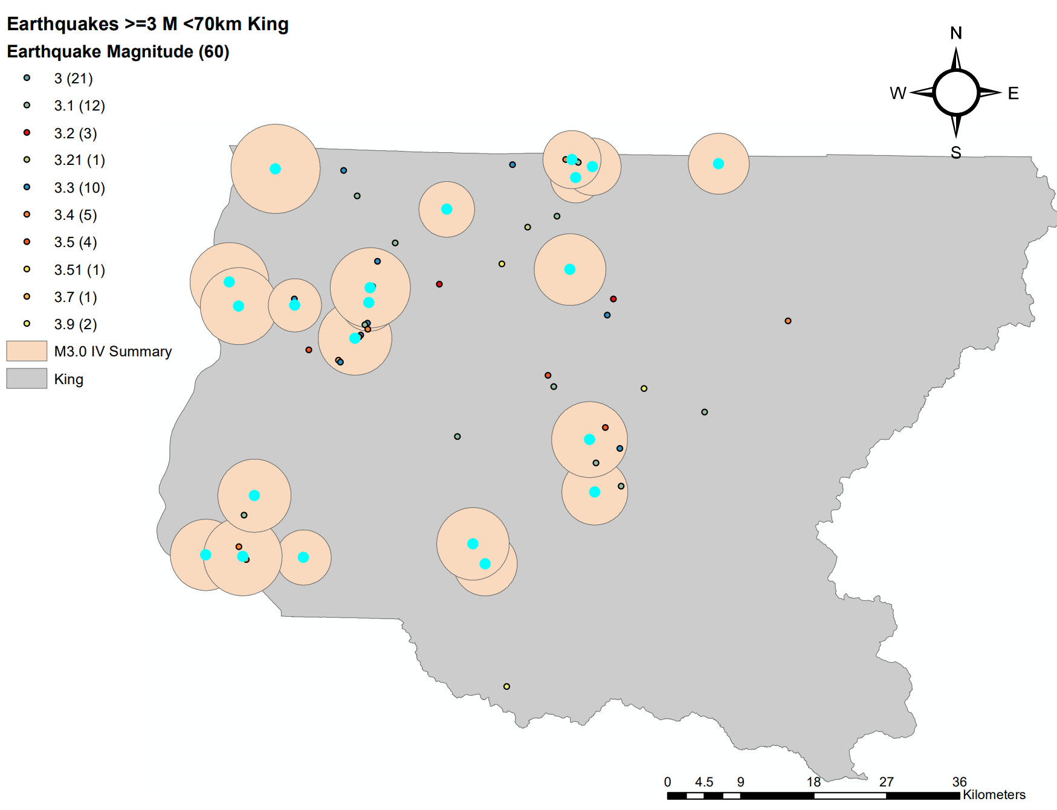
Earthquakes influence on population and land use in King County with GIS as a visual aid
Xiaohan Yao
Earth and Space Science
Undergraduate Senior

Slide 2
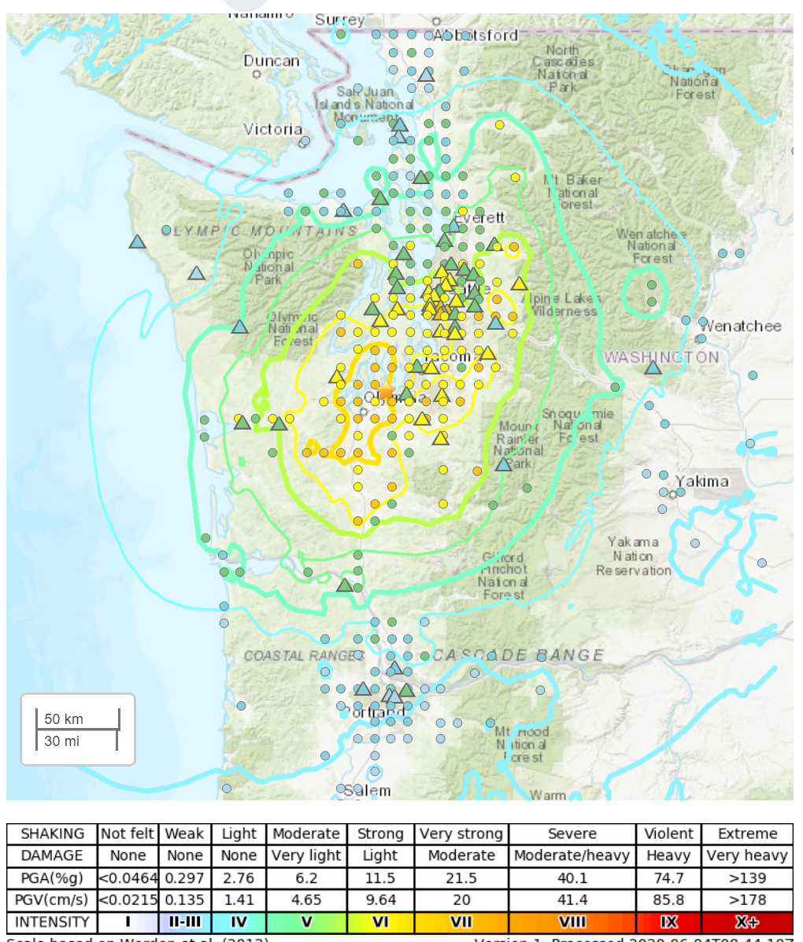
Data Collection
Depth shallower than 70 km
Magnitude greater than 3
Intensity map to various earthquakes
Population data within theoretically impacted area
Land use data within theoretically impacted area

Slide 3
Used Data Set
WA_seismogenic_features
  Earthquake > 1 with depth and magnitude
    The main layer to analyse
Census
  Block10e
    POP100
      Population information
Land use
  Landuse.shp
    DESCRP
      Land use information

Slide 4
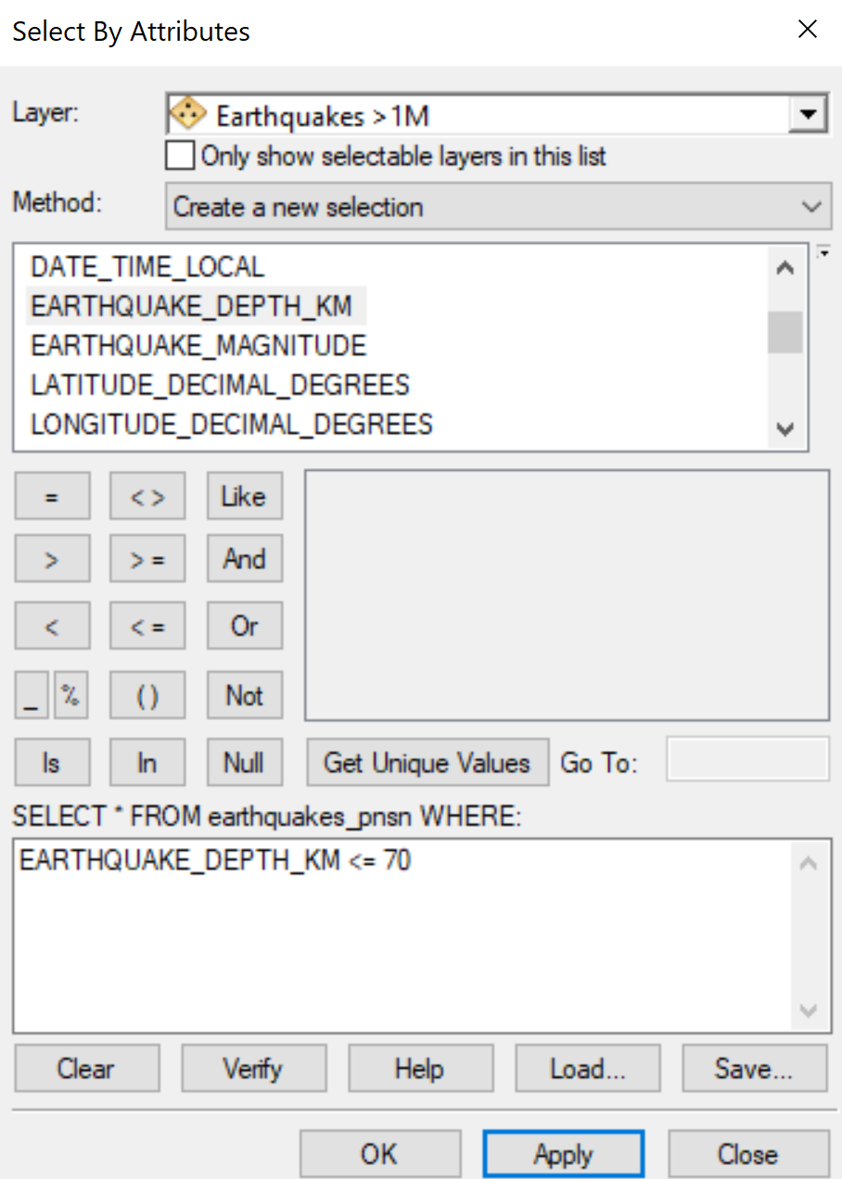
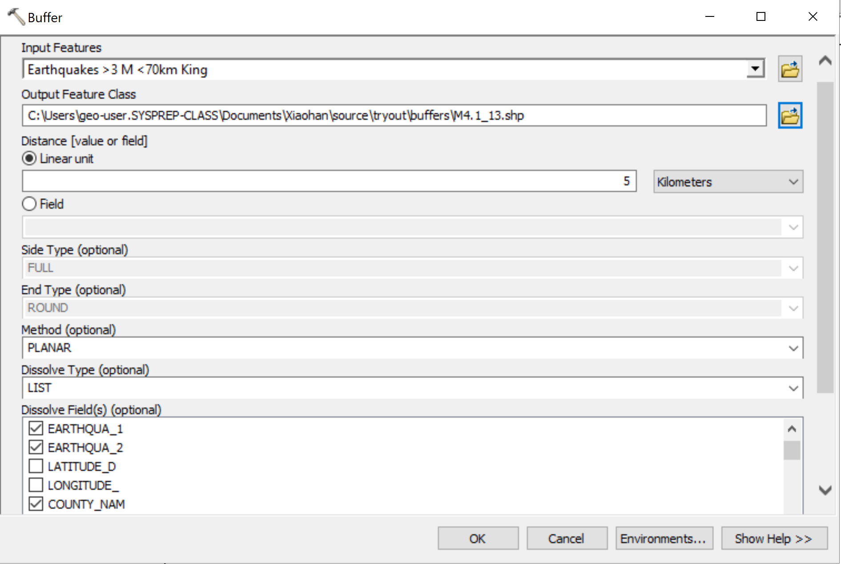
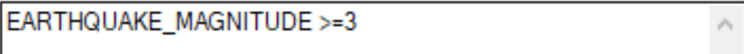
Processing
Step 1
Step 2

Slide 5
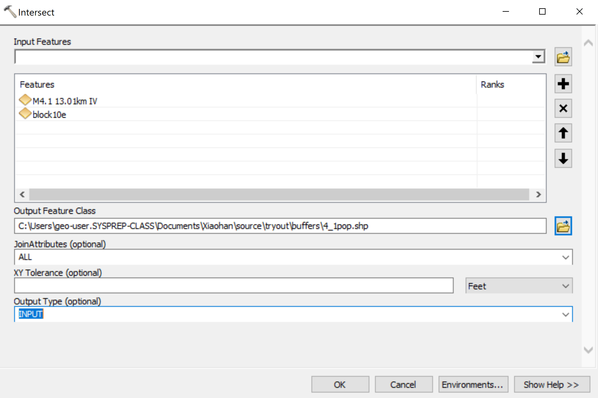
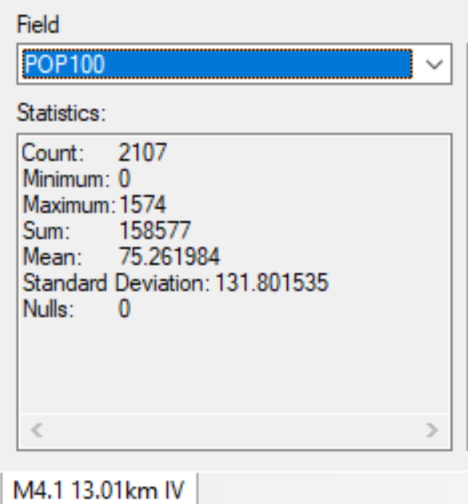
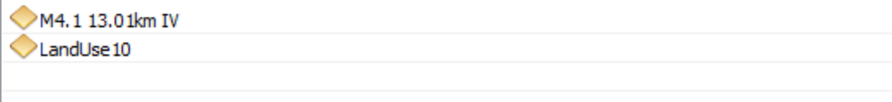
Processing
Step 3
Step 4

Slide 6
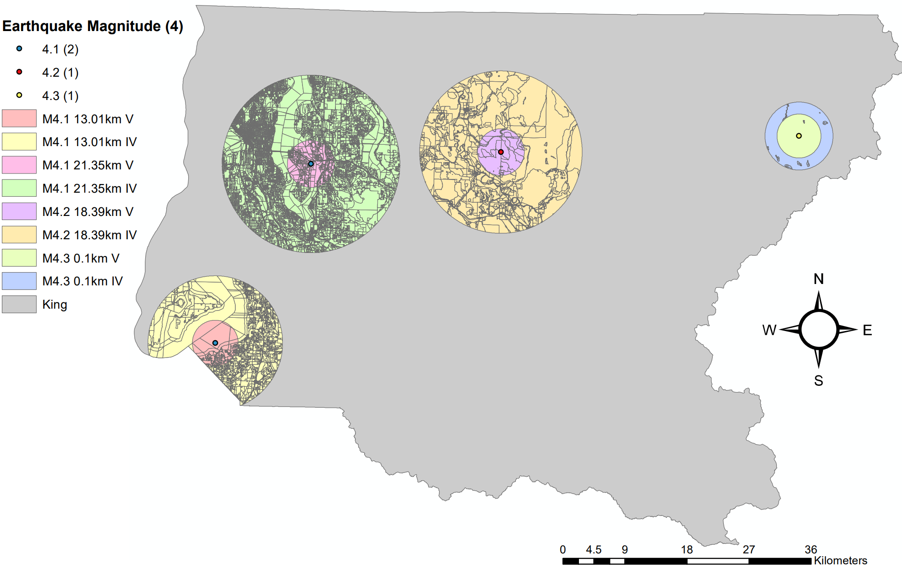
Results
Population
Magnitude | Depth (km) | Impacted Population (V intensity) | Impacted Population (IV intensity)
4.1 | 13.01 | 16616 | 158577
4.1 | 21.35 | 37052 | 701340
4.2 | 18.39 | 599 | 40344
4.3 | 0.1 | 26 | 26

Slide 7
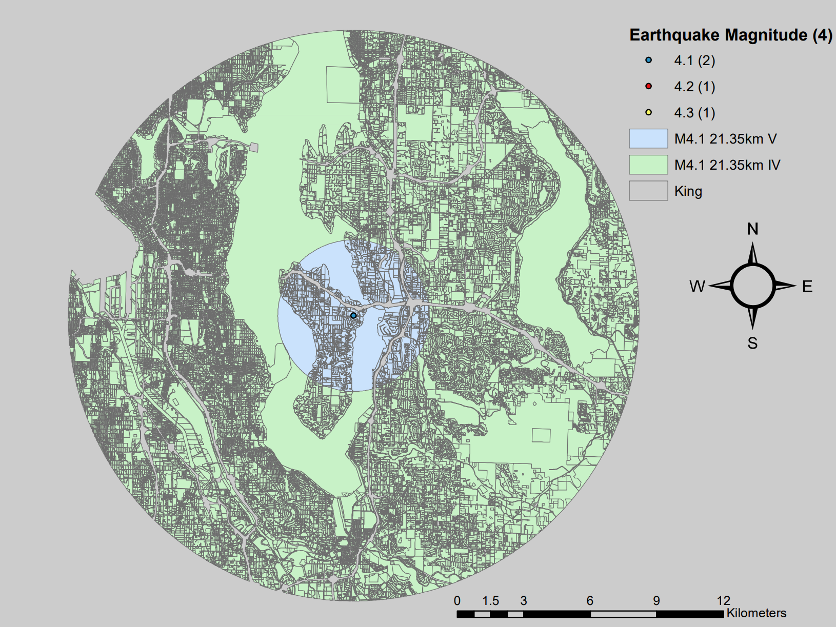
Results
Land use

Slide 8
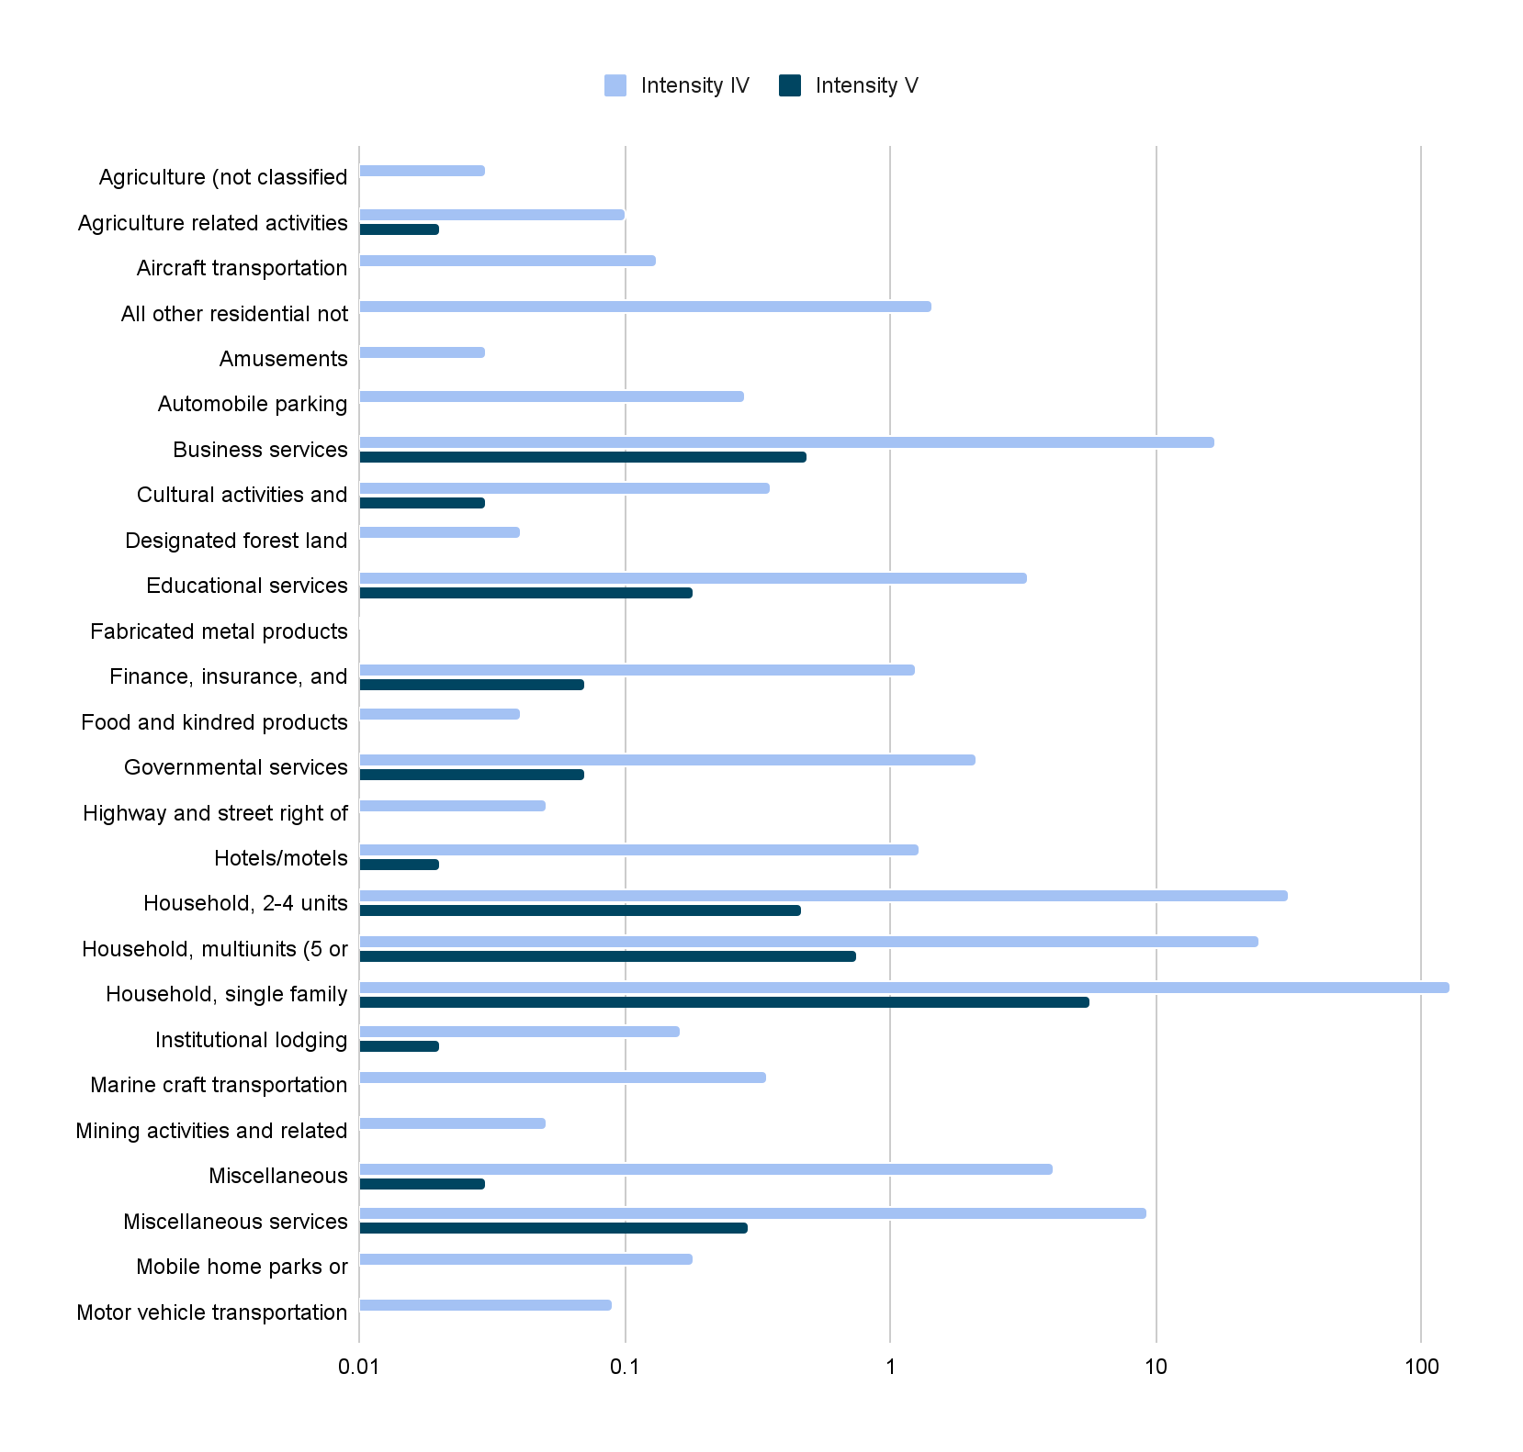
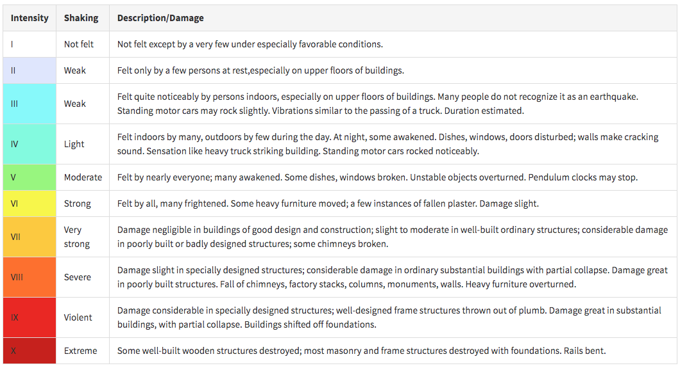

Slide 9
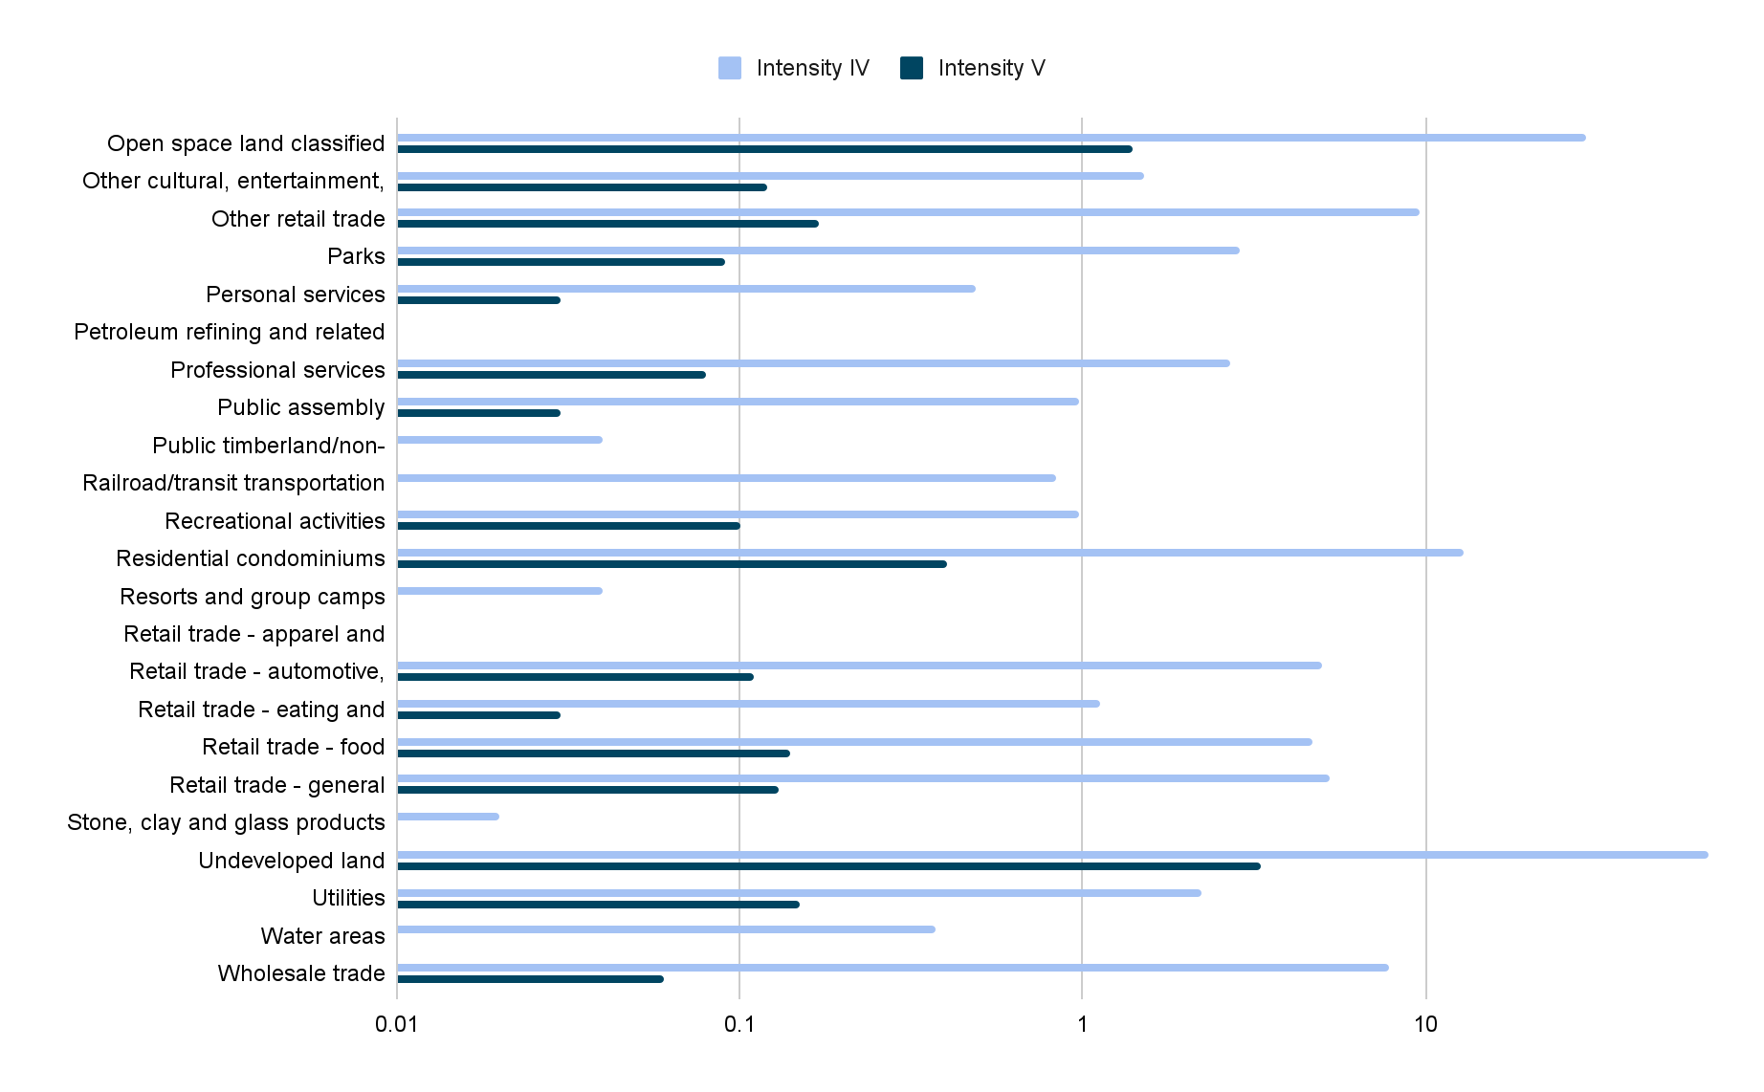

Slide 10
Limitation
This analysis only included a small type of earthquake
  shallow earthquakes 0-70km and magnitude that greater than 3 (intensity could be IV or greater), and ignored deeper earthquakes that could happen
The study area is only within King County
  Further studies could be more specific within a place such as Seattle or review broader for more general trend and rules in Washington State
Relationship between magnitude, depth, and affecting area should be more precise
  The buffer zone (affecting area) for earthquakes with each magnitude are based on a simply conduct by myself that lack reasonable support from resources
Data requires update
  The total population in 2010 and land us is in 2007

Slide 11



Special thanks to
Professor Steven Walters

