Slide 1
The Conservation Value of Place-Based Subsistence Mapping in Northwest Alaska
Victoria Buschman

Slide 2
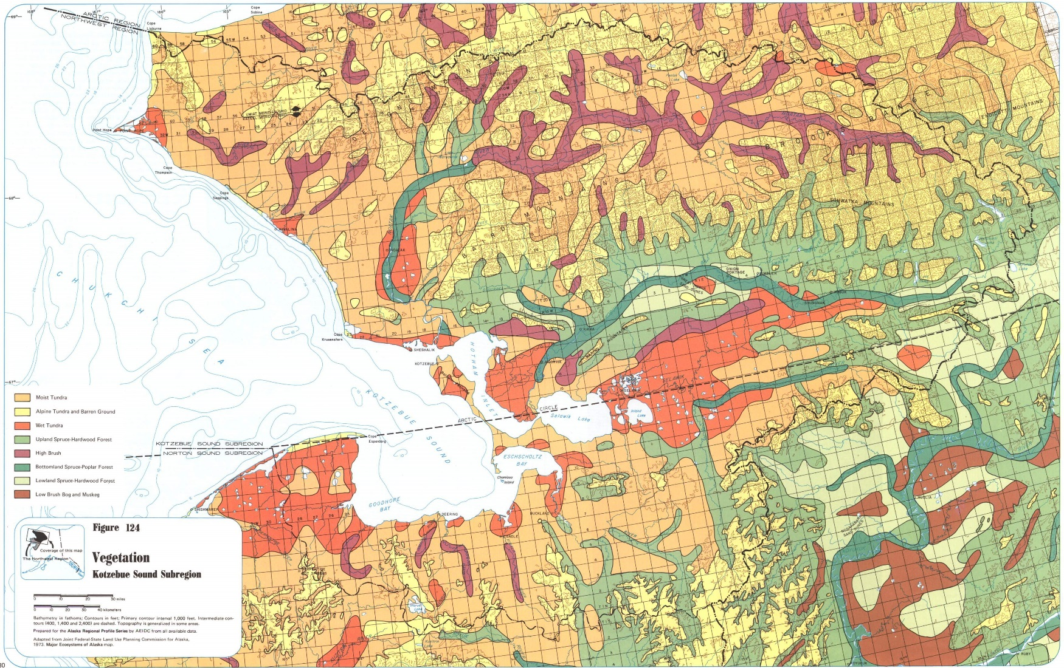
Notes:
Geophysically unique and interesting, geophysical and environmental properties including sea ice that support the diverse fish, birds and mammals that occupy the landscape. It’s what’s kept people here for thousands of years. (Let this continue through to the next image as we talk about animals

Slide 3
Area of Interest
Notes:
Geophysically unique and interesting, geophysical and environmental properties including sea ice that support the diverse fish, birds and mammals that occupy the landscape. It’s what’s kept people here for thousands of years. (Let this continue through to the next image as we talk about animals

Slide 4
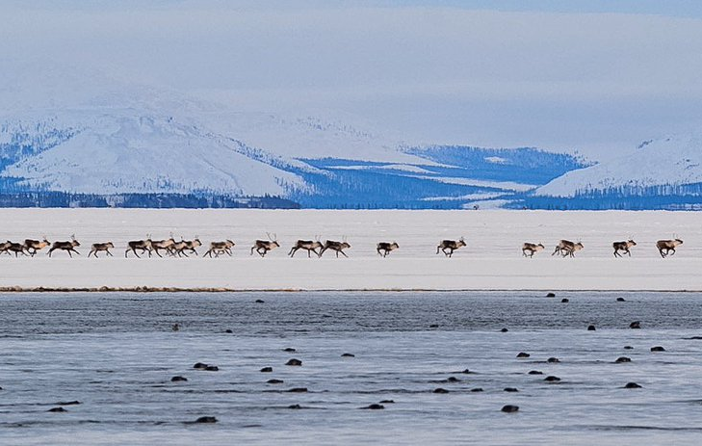
Margie Ubben, KTUU.com

Slide 5
Margie Ubben, KTUU.com

Slide 6
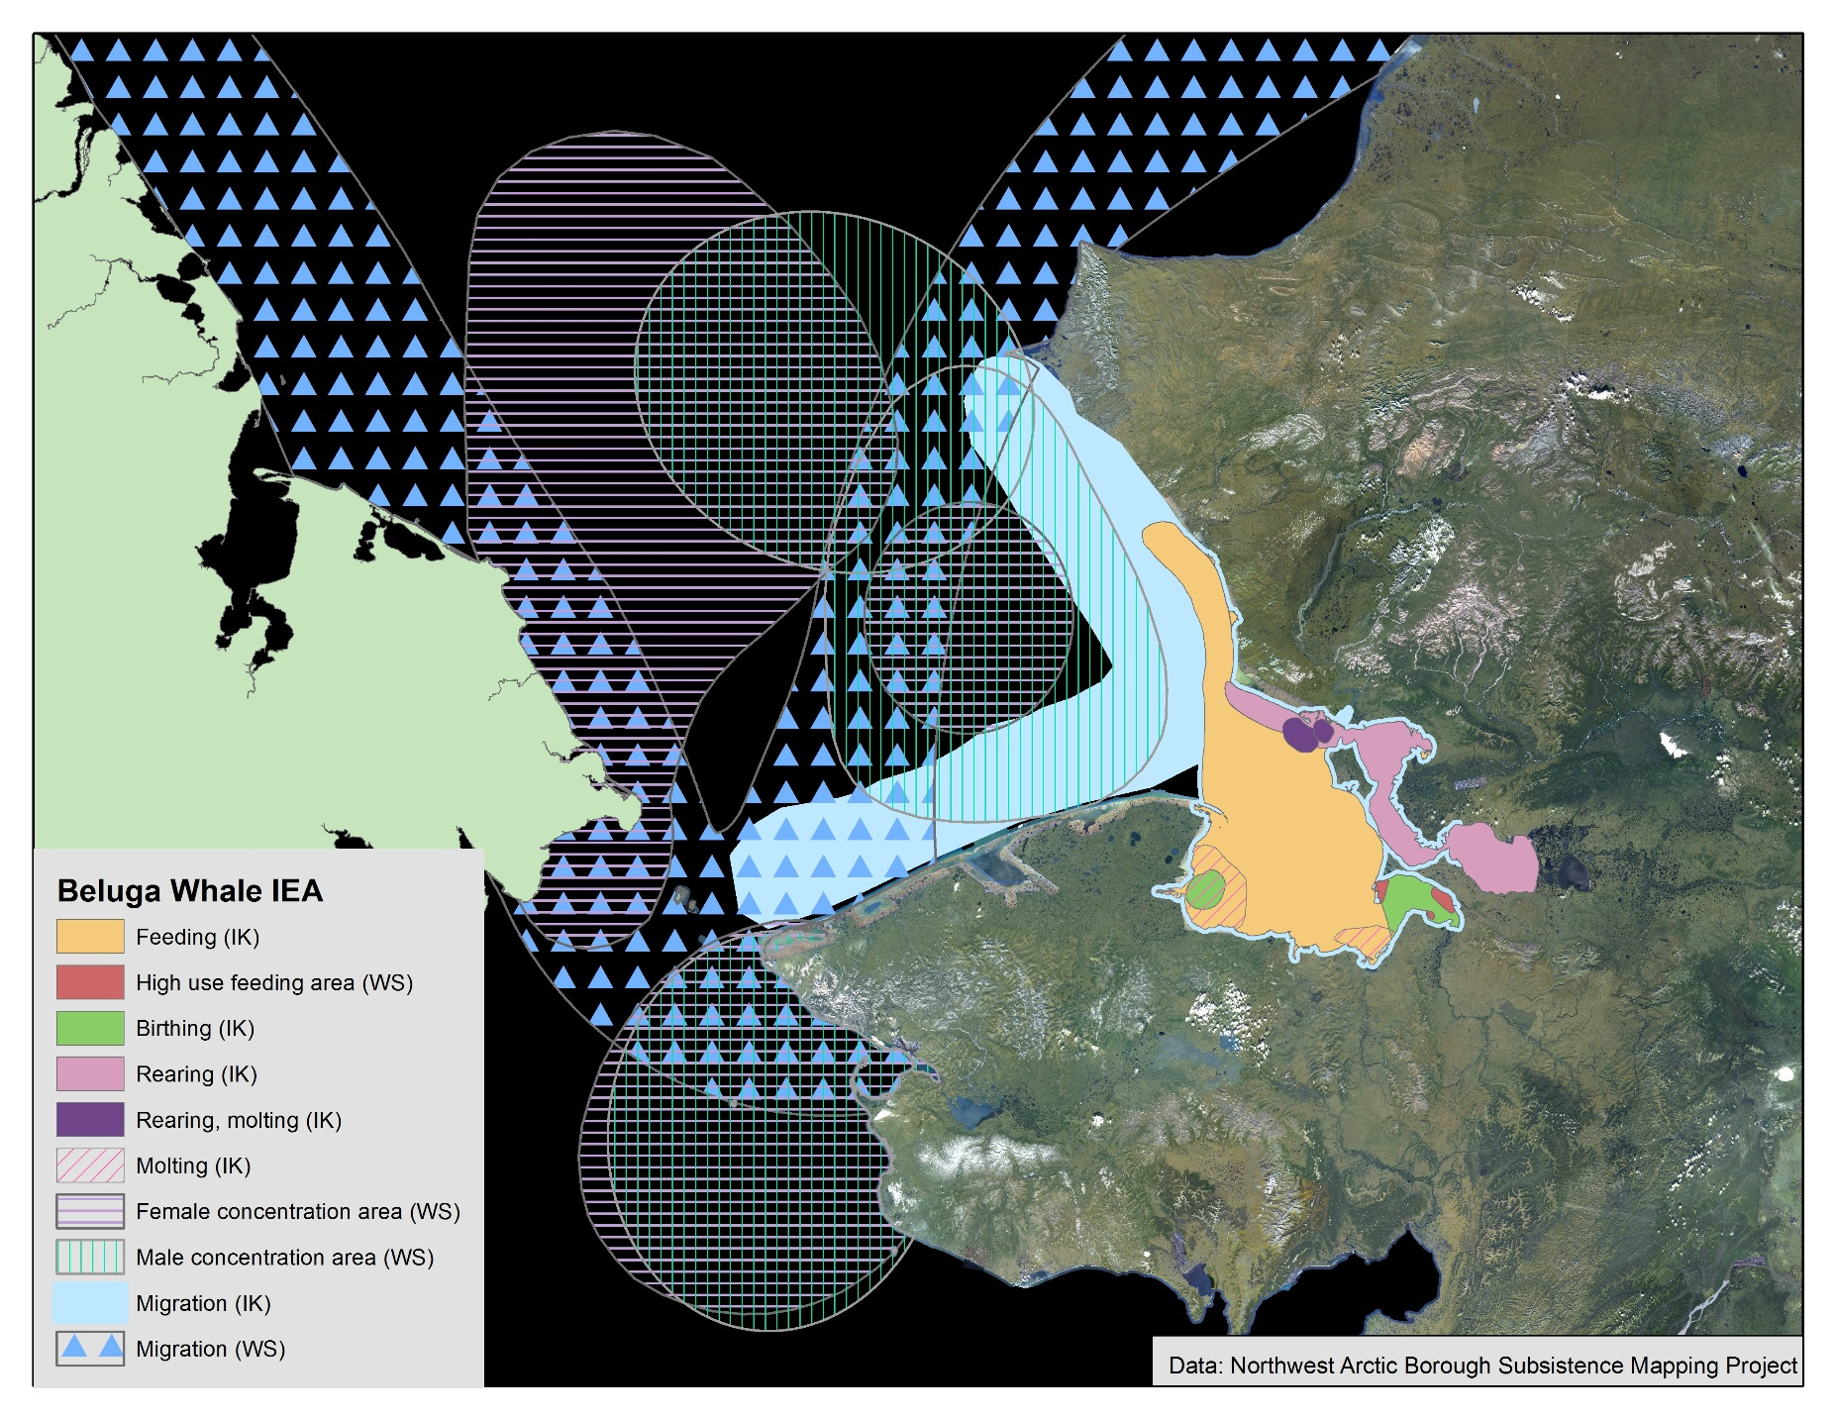

Slide 10
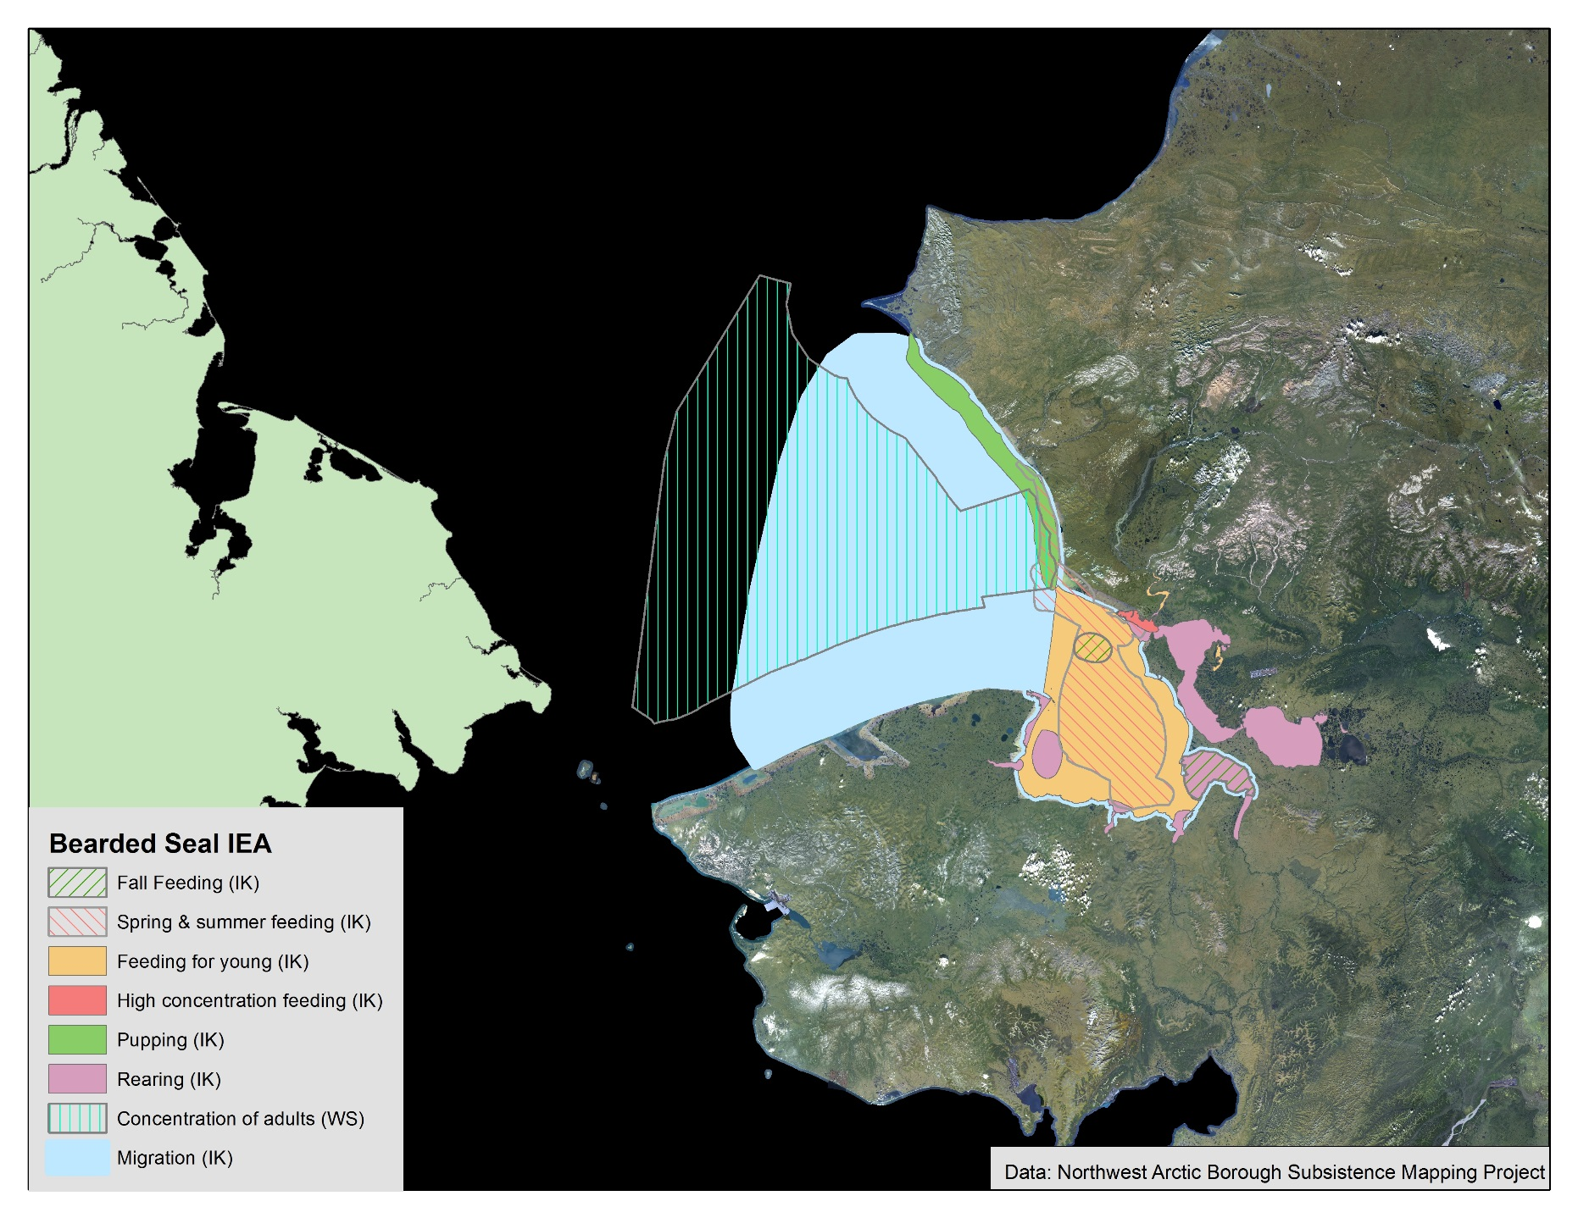

Slide 11
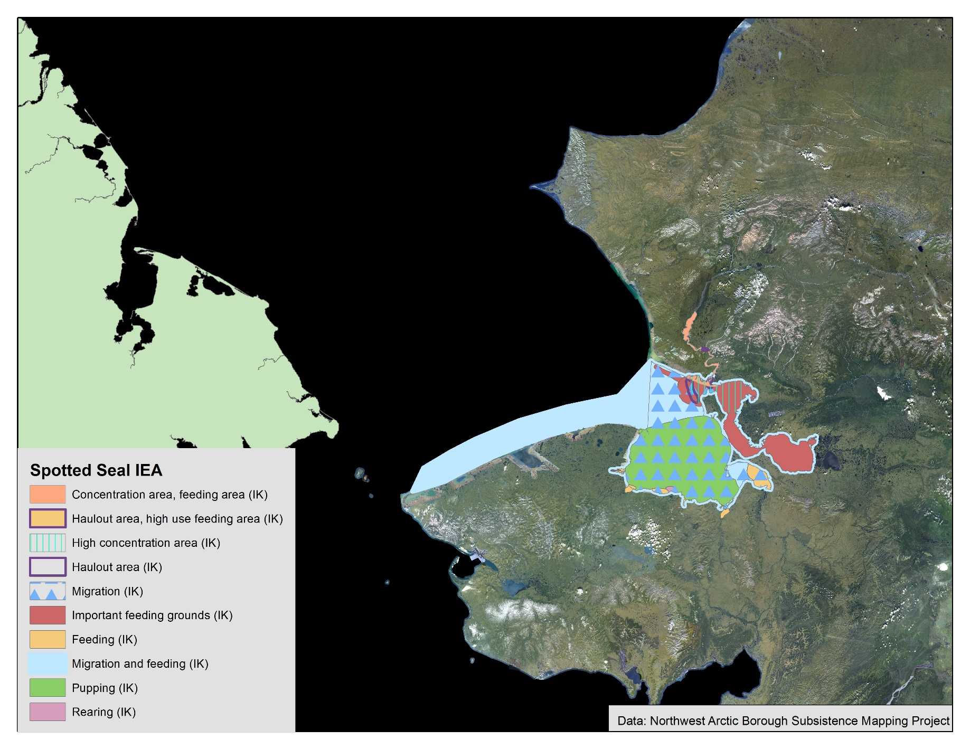

Slide 12
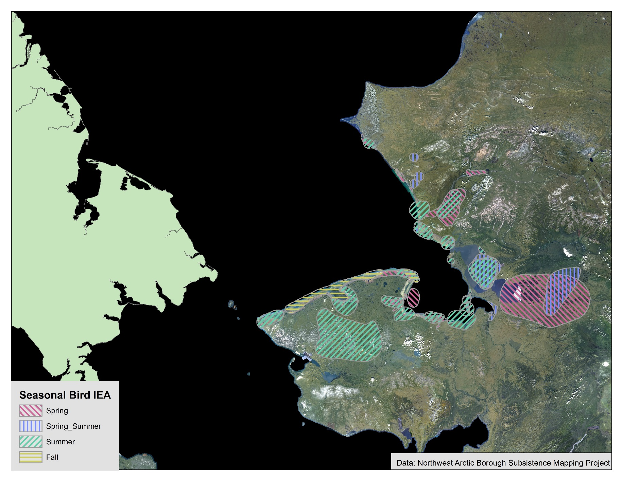

Slide 14
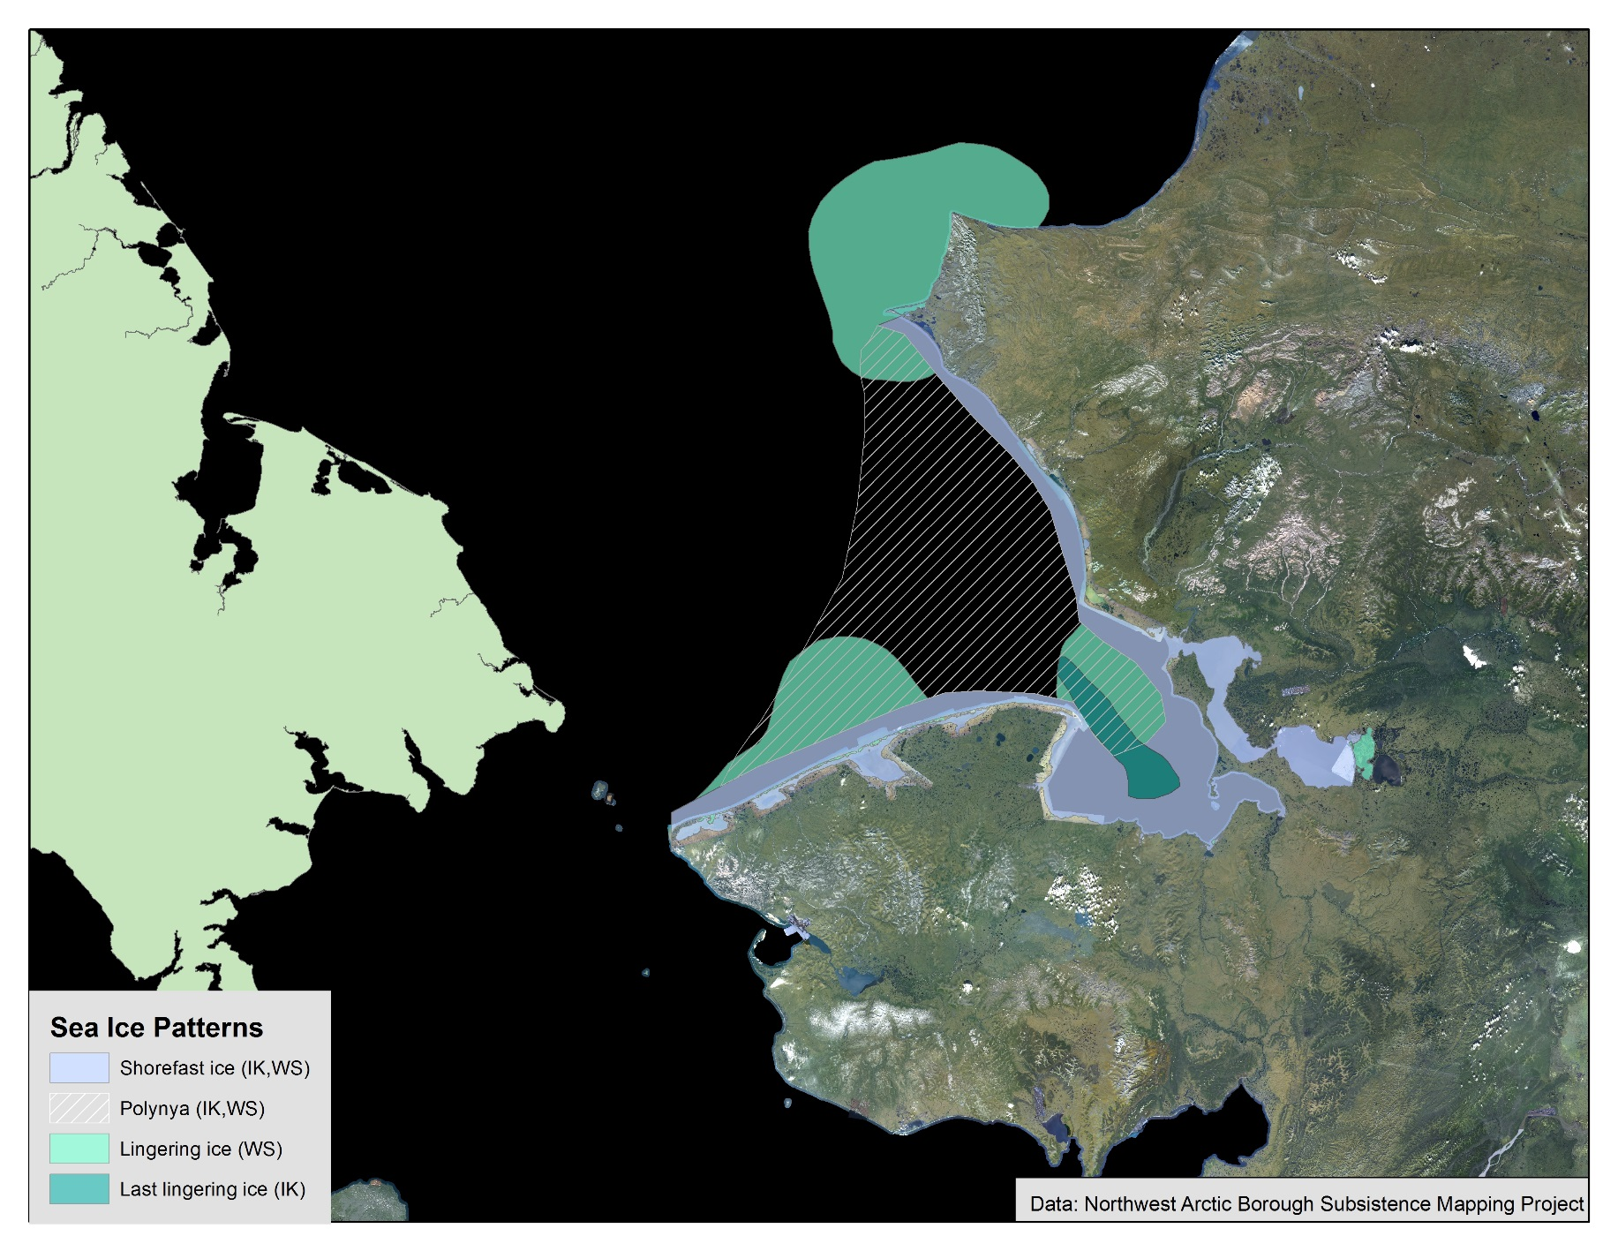

Slide 15
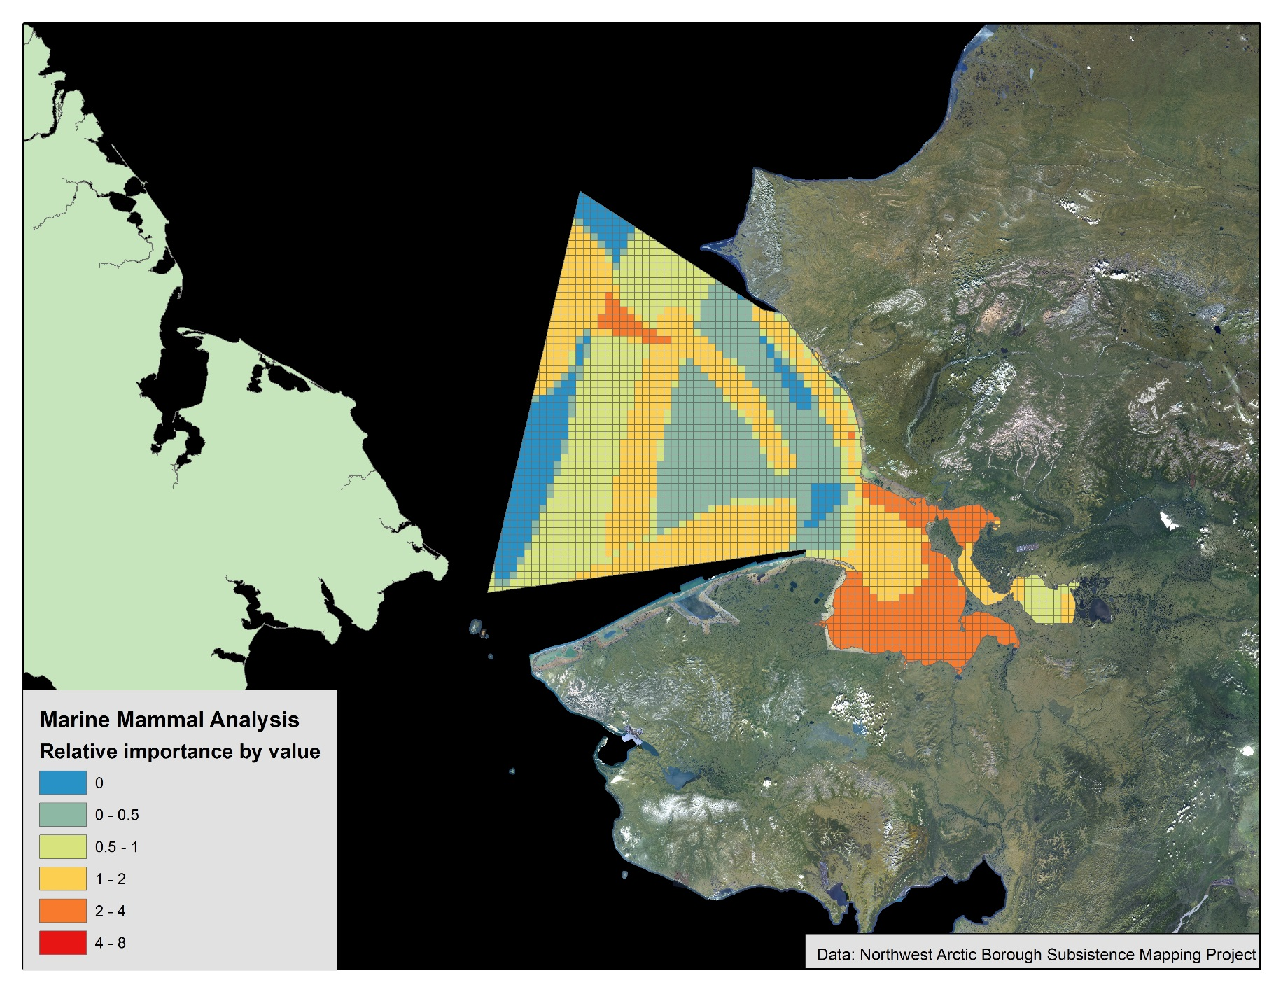

Slide 16
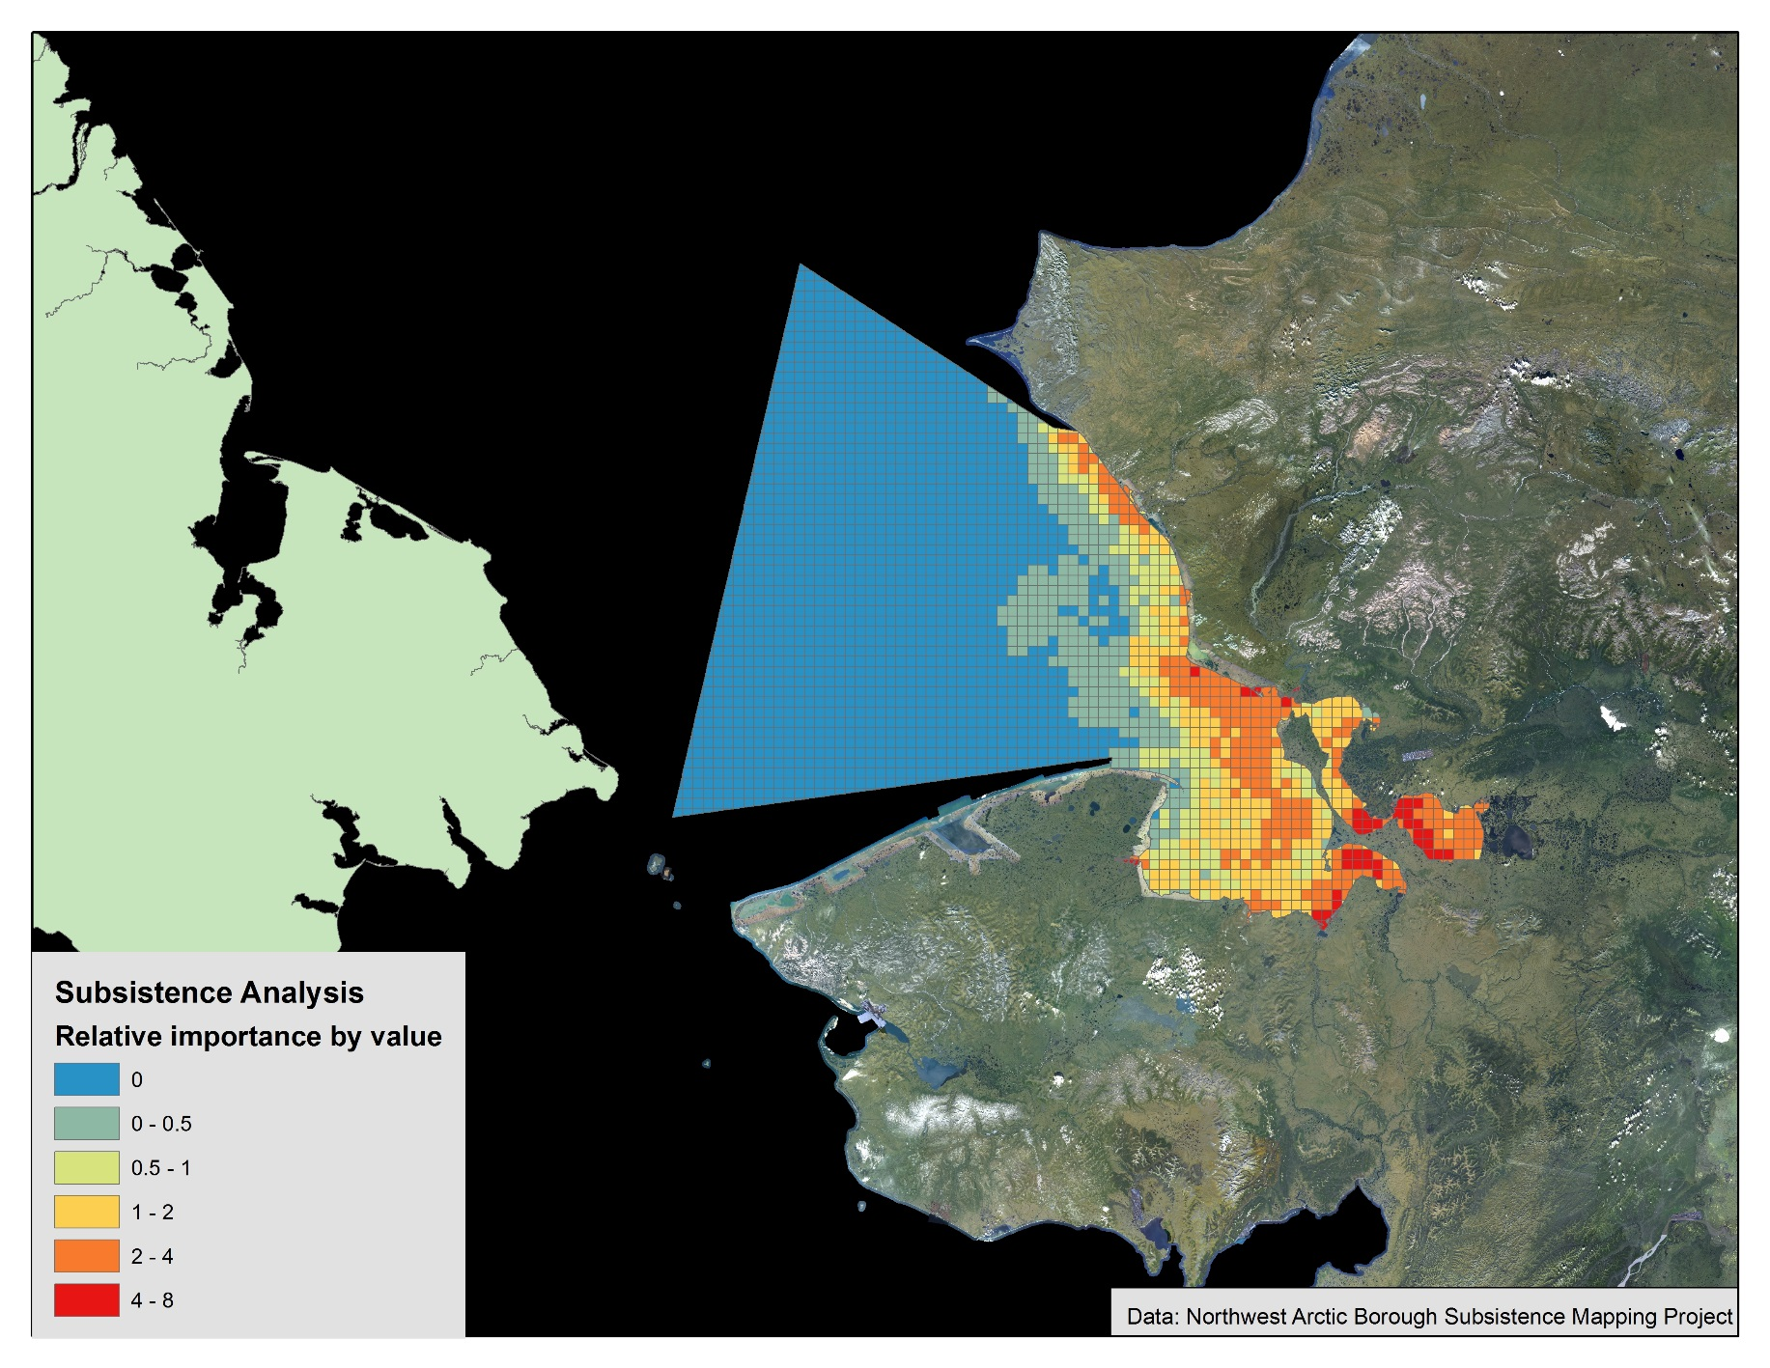

Slide 17
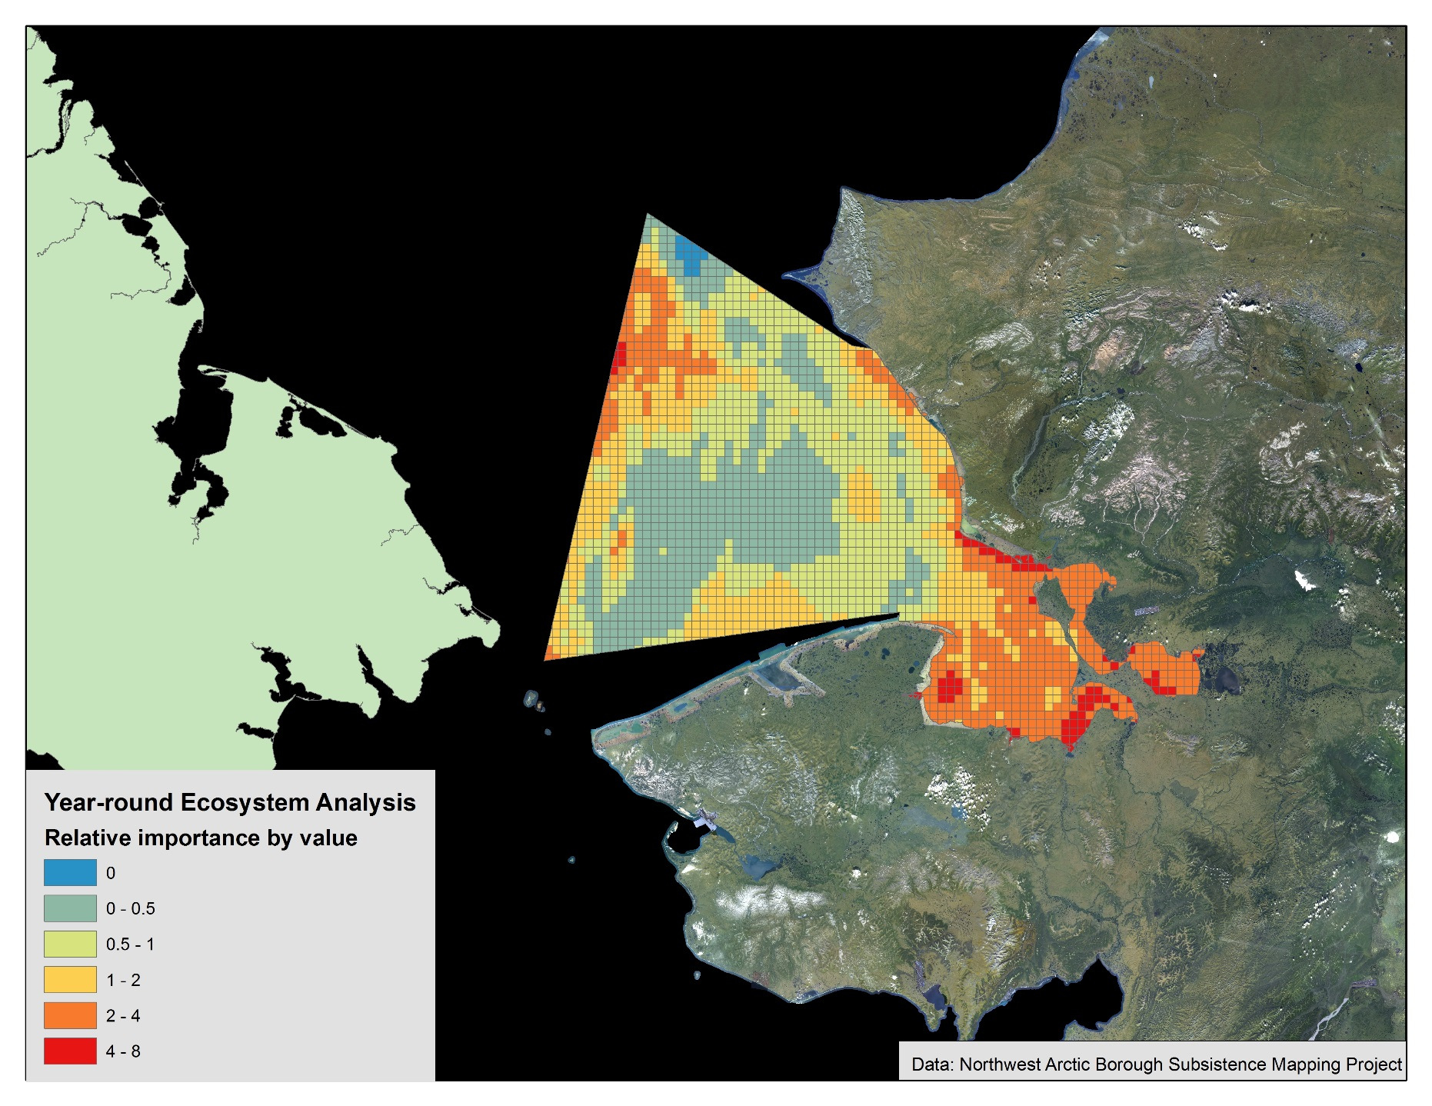

Slide 21
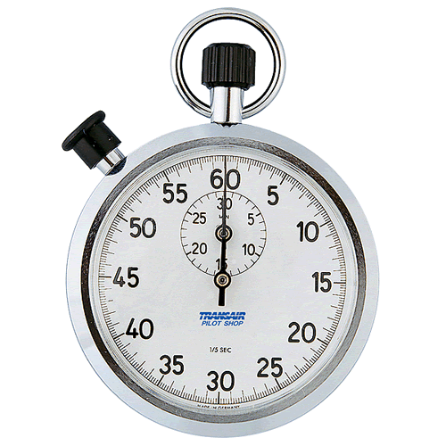
Time’s Up!
About your speaker:
  Name: Victoria Buschman
  Department: SEFS, Evans School of Public Policy and Governance
  Email: vbuschmn@uw.edu
  Quick bio: Victoria is Alaska Native and studies the relationship between wildlife conservation and Indigenous food security in the Arctic.

