Slide 1
Caring for the Mind, Body, and Spirit: Cura Personalis in
Student Employment Practices
Abby Vande Walle, avandewa@nd.edu
Hesburgh Libraries, University of Notre Dame

Slide 2

Hesburgh Libraries
Large, academic library system serving nearly 13,000 undergraduate and graduate students at the University of Notre Dame
Our library workforce includes
  136 faculty and staff
  120 student employees
Circulation Services
  2 full time staff
  15 students
Image: library.nd.edu

Slide 3
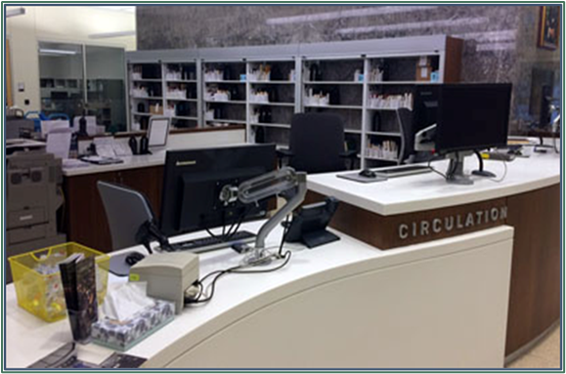
Motivation & Purpose
Post-pandemic, we observed that student employees often:
Had difficulty balancing commitments
Lacked a sense of belonging
Suffered from increased anxiety
Arrived for work overwhelmed
Were not taking time for food/meals
Recognizing the stresses and challenges our students were facing, our department developed initiatives to promote
student employee wellness
Image: library.nd.edu

Slide 4
So what is
Cura Personalis?

Slide 5

MIND
BODY
SPIRIT
Meaning “care for the whole person” in Latin, Cura Personalis is the mindset of caring for and nurturing the entirety of an individual: their mind, body, and spirit. [1]
Cura Personalis, as a holistic approach, shapes the student employee training, initiatives, and team building practices we have adopted

Slide 6
Our Goals
01
02
03
Lessen student employees’ overall stress when they are at work
Demonstrate support and care for their wellbeing both in and out of the library workspace
Foster a sense of belonging

Slide 7
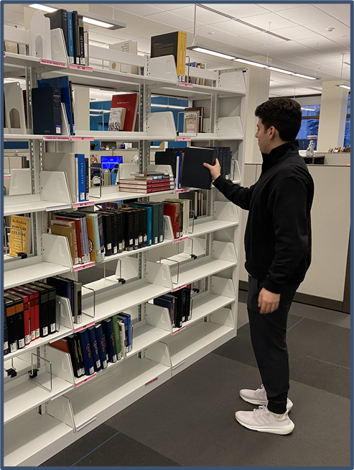
Initiatives to support Mind
Crossword & Games Subscription
Mental Wellness Training
Professional Development Sessions
Gamified Desk Training
Flex Shifts
Flex Shift: Scheduled or spontaneous time working off desk (when the calendar allows). Some students have regular, weekly Flex shifts where they work on off desk projects (inventories, media management, digital projects, etc.) while others ask for time off desk when they are having a particularly difficult day

Slide 8
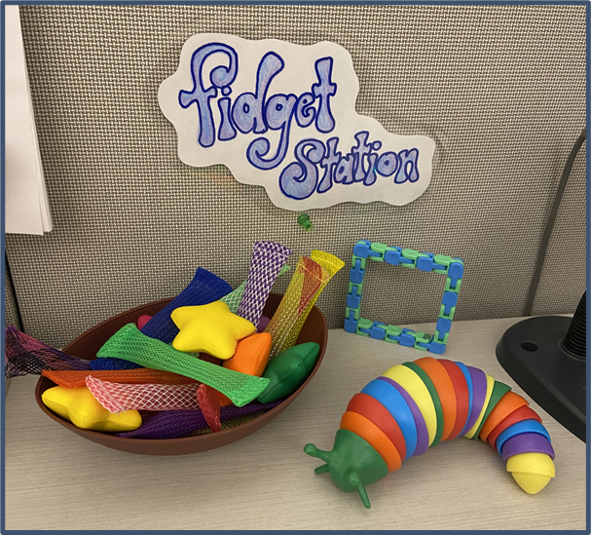
Initiatives to support Body
Safety Training Session
On-Hand Snacks
Yoga Mats and “Floor Time”
Intermural Sports Team
Student Employee Bookable Study Space
Extra Eating Breaks
Fidget Station
Yoga Mats: We have two departmental yoga mats that student employees can use during their break or any time they might need one. The mats are primarily for students to have “floor time” or grounding, which helps to calm thoughts and soothe anxiety. [2]

Slide 9
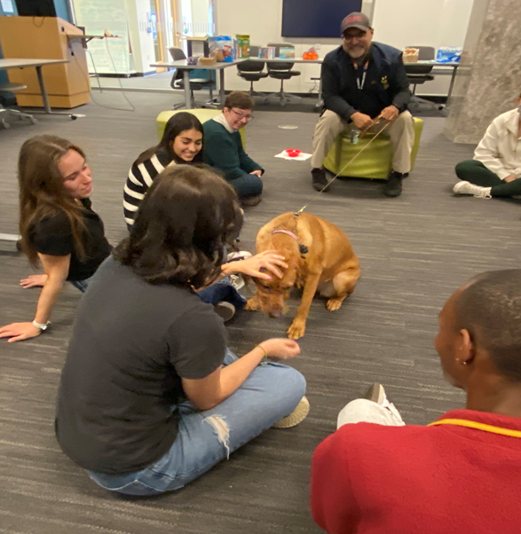
Initiatives to support Spirit
Comfort K9 Visits
Relaxation Events (succulent planting, free coffee)
Fantasy Football League
March Madness Bracket Challenge
Holiday Parties
End of Year Celebration
Coloring Pages
Comfort K9: We schedule time for one of our campus therapy and outreach dogs to visit student employees at the library. The students can pet/interact with the dog, play games with her, and ask questions of her handler

Slide 10
Results
Student employee retention rates have increased dramatically in our unit
Sense of community and belonging in the department is high, which we feel has led to fewer “call offs” and more covered shifts
Attendance at events is steady
Student employees are more willing to approach staff if they are having issues or need support

Slide 11
Student Employee Feedback
“I know many students who would not eat at all in a day but are able to because of the snacks in the snack drawer. I think it genuinely helps every student's mental health to have these amenities on-campus for them.”
“I love the events we have because it builds camaraderie and allows me to see the coworkers that I no longer have shifts with.”
“The engagement events are extremely crucial in making the library a safe and welcoming space to work. It provides students with opportunities to get to know each other outside of work and fosters a sense of community.”
“This is an incredible community. All of the extra things that you do for us are so appreciated and valued.”

Slide 12
References & Resources
References
[1] Sucher, A., Leeds, M., Clemens, E., Tuck, K., Malarkey, C., Behrmann, L., Lalama, J. T., & Smith, K.
(2023). Cura personalis: Care of the whole person through student wellness initiatives. American
Journal of Pharmaceutical Education, 87(8), 100433. https://doi.org/10.1016/j.ajpe.2023.100433
[2] Maharaj, N. (2024, June 10). Lying on the floor can help you feel less overwhelmed. Here's how to do it and why it works. Business Insider. https://www.businessinsider.com/floor-time-why-it-works-how-to-do-it-2024-6
Helpful Resources
Baldwin, D. A., Wilkinson, F. C., & Barkley, D. (2000). Effective management of student
employment: Organizing for student employment in academic libraries. Libraries Unlimited.
Crowe, S., & Sclippa, E. (2020). Games and gamification in academic libraries. Association of College and Research Libraries.
McClellan, G. S., Creager, K., Savoca, M., & Kuh, G. D. (2018). A good job: Campus employment as a high-impact practice (First edition.). Stylus Publishing, LLC.

Slide 13
Thank you!
Abby Vande Walle
avandewa@nd.edu

