Slide 1
Utilizing Data-Planet Datasets in ArcMap:
The Geography & Politics of the Social Services Gap
Kian Flynn, UW Libraries

Slide 2

Data-Planet
Sample Sources
Census Bureau
Departments of Agriculture, Defense, Labor
EPA
FBI
NOAA
United Nations
IMF
Zillow
35 billion data points
4.9 billion datasets
450+ source databases
70+ data providers
Growing 20% per year

Slide 3

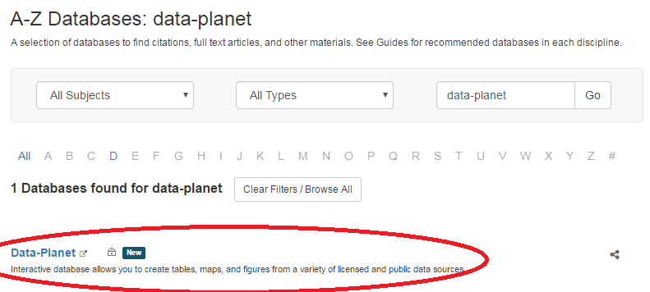
How to Access

Slide 4
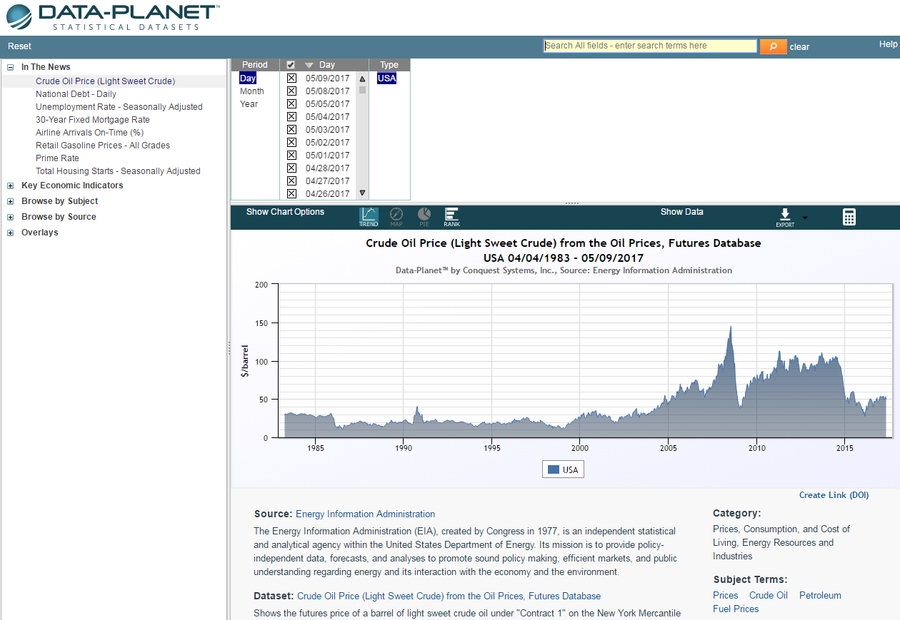
Interface

Slide 5
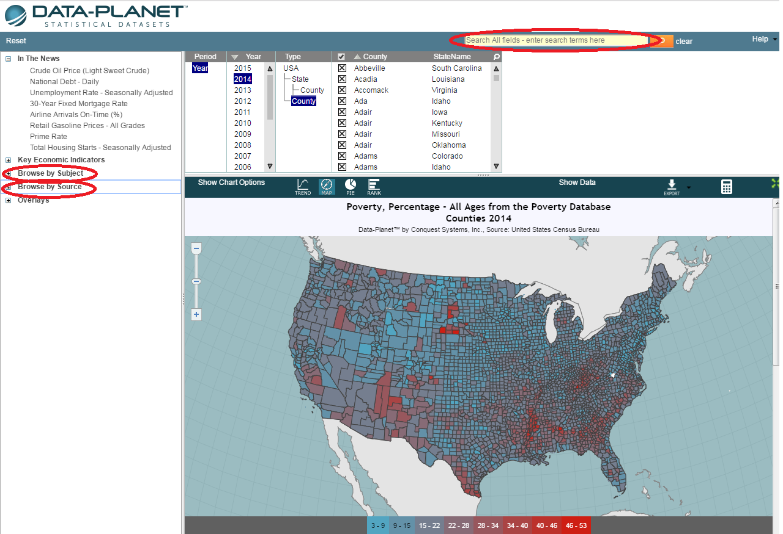
Search for Datasets

Slide 6
Select Data, Geography, & Chart Type

Slide 7
Export Shapefile

Slide 8
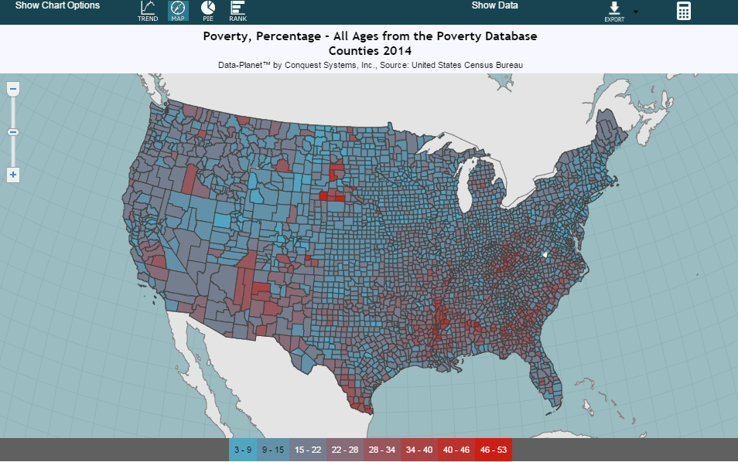
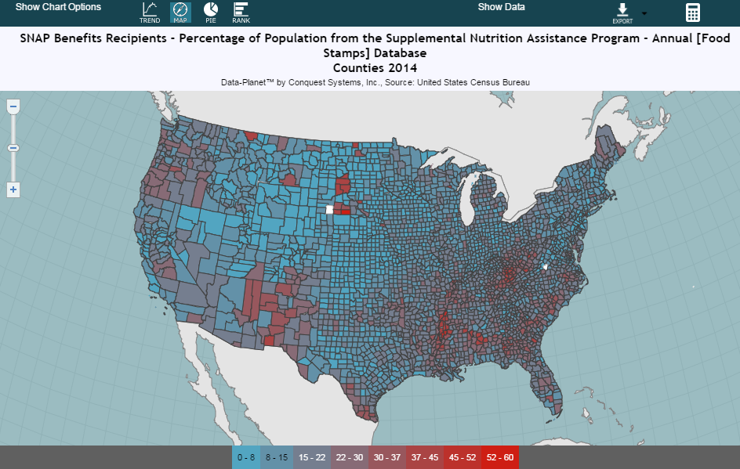
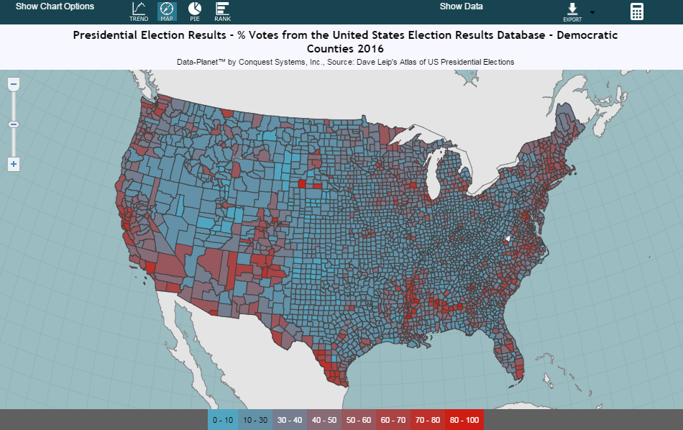
Data from Different Sources
Poverty Rate, U.S. Census Bureau
SNAP Benefits, U.S. Census Bureau
2016 Election Results, Dave Leip’s Atlas

Slide 9
Data from Different Sources
Poverty Rate, U.S. Census Bureau
SNAP Benefits, U.S. Census Bureau
2016 Election Results, Dave Leip’s Atlas

Slide 10
Research Topic: Social Services Gap
15.5%
14.4%
Below Poverty Level
(U.S. Population)
Receiving SNAP Benefits
(U.S. Population)

Slide 11
Research Topic: Social Services Gap
SNAP eligibility is mostly set at the federal level (though states have some flexibility) and is determined by a household’s assets and gross and net monthly income.

Slide 12
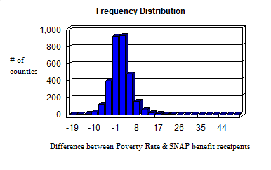
Correlation between Poverty Rate and SNAP participation rate
80% of counties have Poverty & SNAP rates within 5%.
615 counties have differences greater than 5%

Slide 13
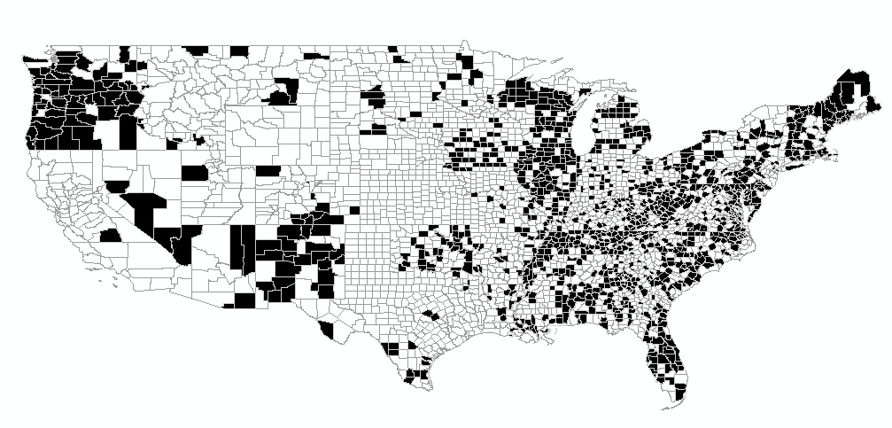
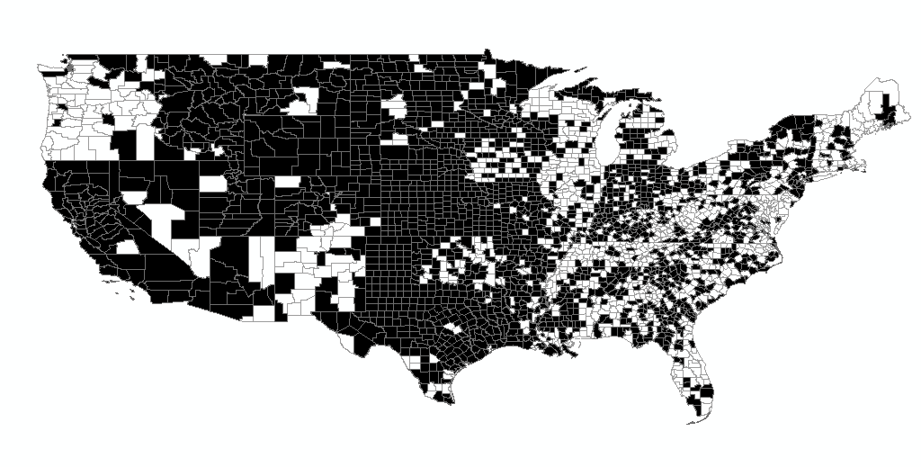
The Geography of the Social Services Gap
U.S. Counties
SNAP > Poverty Rate
U.S. Counties
Poverty Rate > SNAP

Slide 14
Possible Explanations
Awareness of services
Difficult to navigate
Stigma of SNAP
Local politics

Slide 15
Rural/Urban Divide
Median Population Size
36,523
20,871
Counties without Social Services Gap
Counties with Social Services Gap

Slide 16
The Politics of the Social Services Gap
Counties where SNAP participation rate is more than 5 percent greater than the Poverty Rate (161 counties)
All other counties:
56.2%
43.8%
Democratic Nominee
Hillary Clinton
Republican Nominee
Donald Trump
50.9%
49.1%
Democratic Nominee
Hillary Clinton
Republican Nominee
Donald Trump

Slide 17
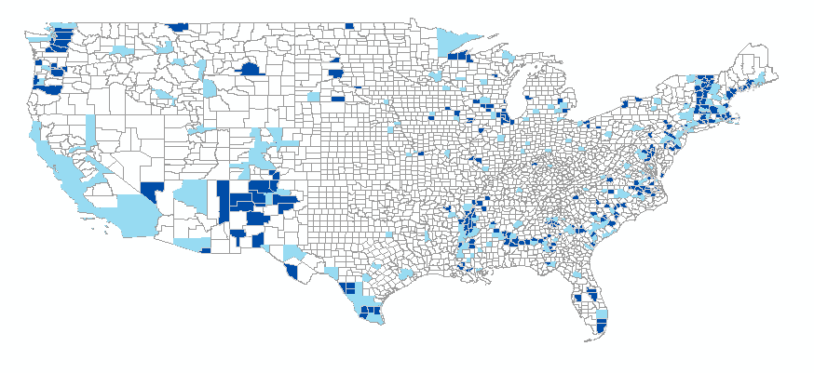
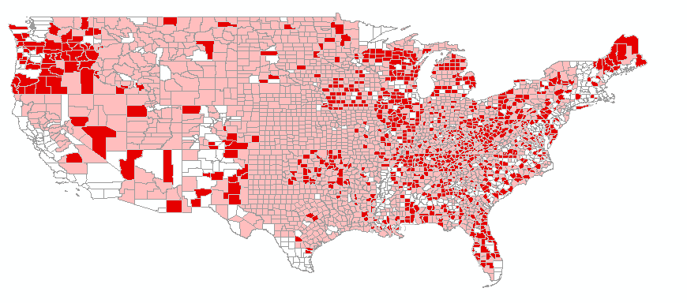
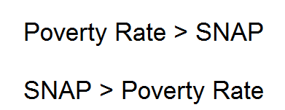
Mapping the 2016 election and the Social Services Gap
2016 Election, Democratic Counties
2016 Election, Republican Counties
50.9% of counties had a positive
“social welfare gap”
65.7% of counties had a positive
“social welfare gap”

Slide 18
Mapping the 2016 election and the Social Services Gap
2016 Election, Democratic Counties
2016 Election, Republican Counties
50.9% of counties had a positive
“social welfare gap”
65.7% of counties had a positive
“social welfare gap”

Slide 19
Mapping the 2016 election and the Social Services Gap
+4% Social Services Gap
-3% Democratic vote in 2016

Slide 20
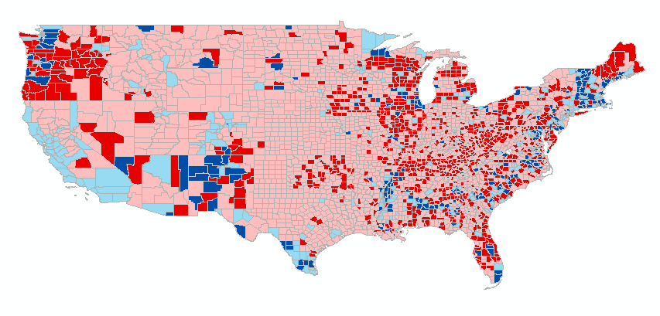
Data-Planet
Available on the Libraries’ Articles & Research Databases page (“A-to-Z list”)
Datasets used:
SNAP Benefits Recipients - Percentage of Population from the Supplemental Nutrition Assistance Program - Annual [Food Stamps] Database
Poverty, Percentage - All Ages from the Poverty Database (Small Area Income and Poverty Estimates (SAIPE))
Total Population from the American Community Survey Summary File: 5-Year Estimates Database
Presidential Election Results - % Votes from the United States Election Results Database

Slide 21

Time’s Up!
About your speaker:
  Kian Flynn
  University of Washington Libraries
  flynnk7@uw.edu
  Geography & Global Studies Librarian

