Slide 1
Mapping the University of Washington’s Sephardic Studies Collection
Benjamin Charles Germain Lee
Ph.D. Student
Paul G. Allen School for Computer Science & Engineering
University of Washington
Notes:
Say a word about the Sephardic Jewish people (oftentimes, Jewish history is reduced to that of the Ashkenazi Jewish people)

Slide 2
In collaboration with:
Devin Naar, Isaac Alhadeff Professor of Sephardic Studies and Associate Professor of History and Jewish Studies at the University of Washington
Ty Alhadeff, the Sephardic Studies Research Coordinator of the Stroum Center for Jewish Studies at the University of Washington
Makena Mezistrano, Research Assistant, Stroum Center for Jewish Studies at the University of Washington

Slide 3
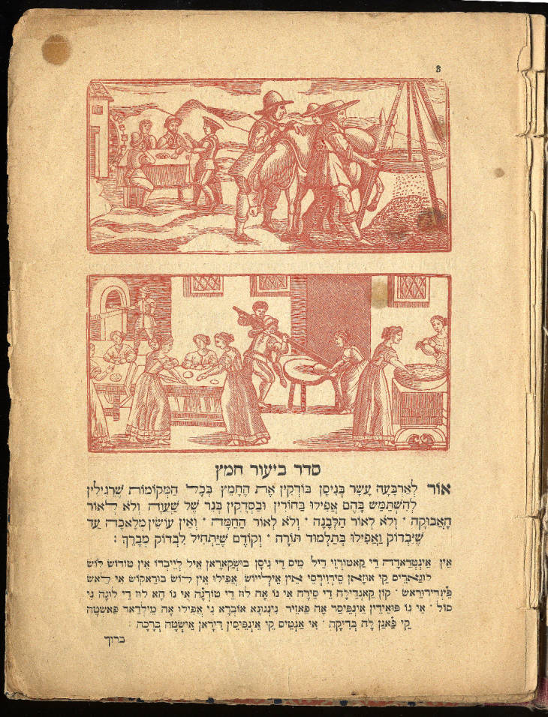
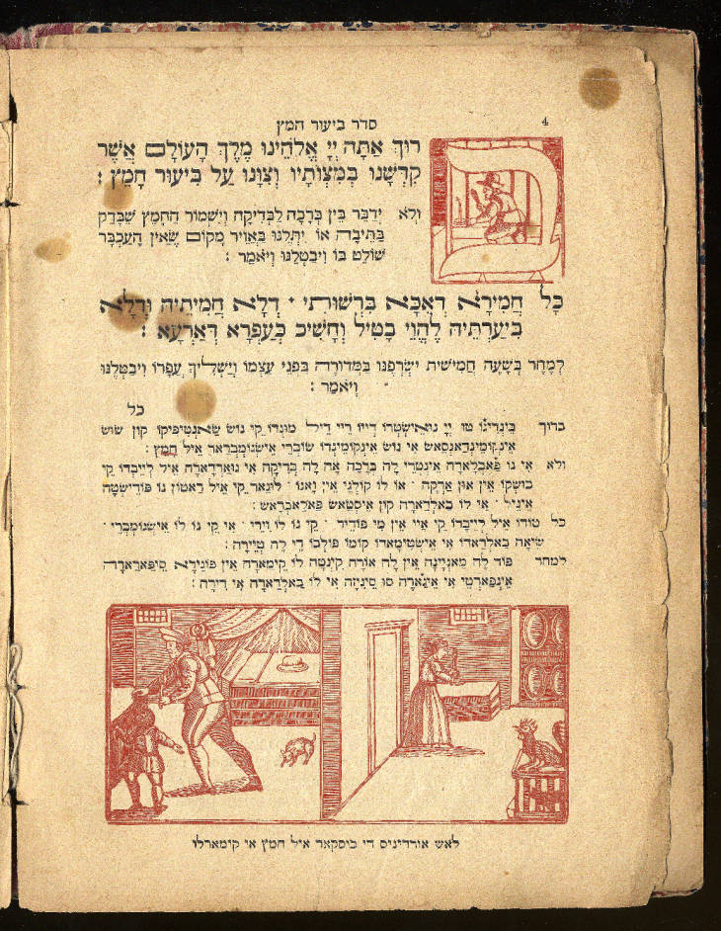
The Sephardic Studies Collection
Source: https://digitalcollections.lib.washington.edu/digital/collection/p16786coll3/id/192
Notes:
One of the richest and most diverse Sephardic Studies collections in the world
Primary language: Ladino (Judezmo, Judeo-Spanish)
Over 1500 Ladino books
More Ladino volumes than the Library of Congress!
Say a word about the Sephardic Jewish people (oftentimes, Jewish history is reduced to that of the Ashkenazi Jewish people)
Here: Seder Haggadah

Slide 4
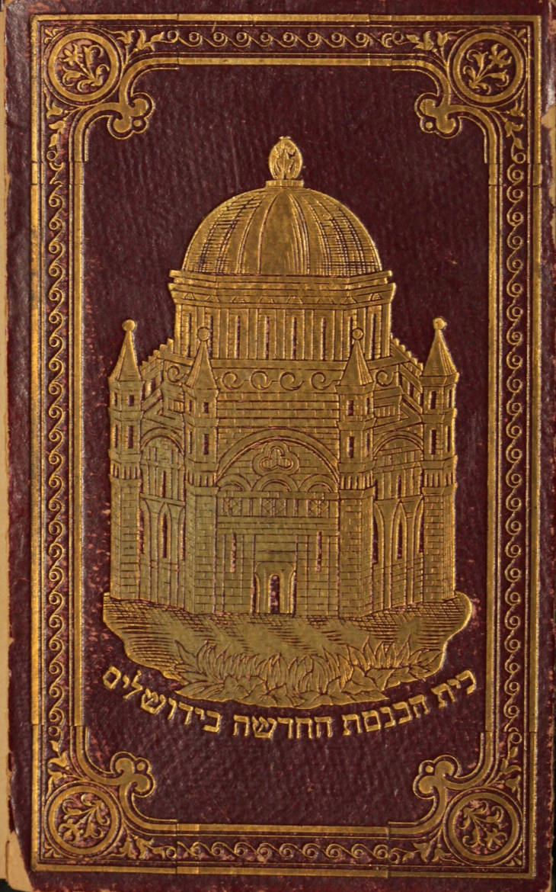
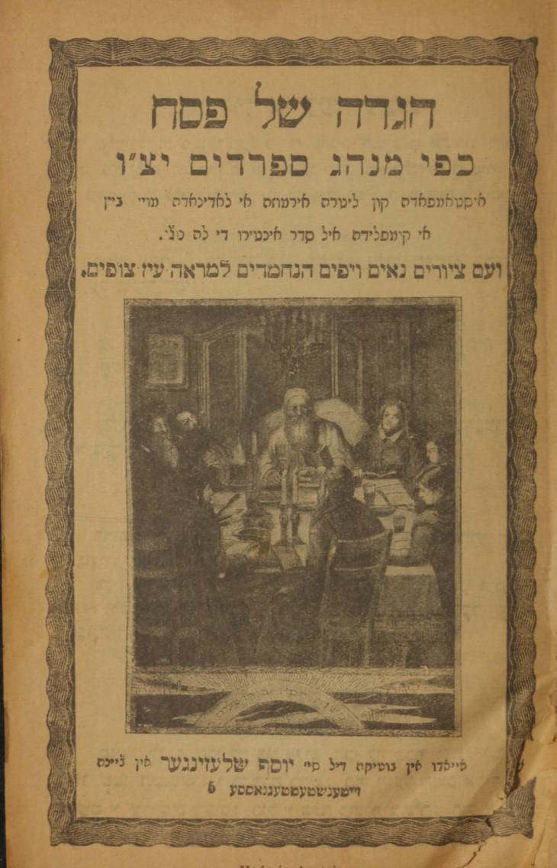
The Sephardic Studies Collection
Source: https://digitalcollections.lib.washington.edu/digital/collection/p16786coll3/id/3664
Notes:
One of the richest and most diverse Sephardic Studies collections in the world
Primary language: Ladino (Judezmo, Judeo-Spanish)
Over 1500 Ladino books
More Ladino volumes than the Library of Congress!
Say a word about the Sephardic Jewish people (oftentimes, Jewish history is reduced to that of the Ashkenazi Jewish people)

Slide 5
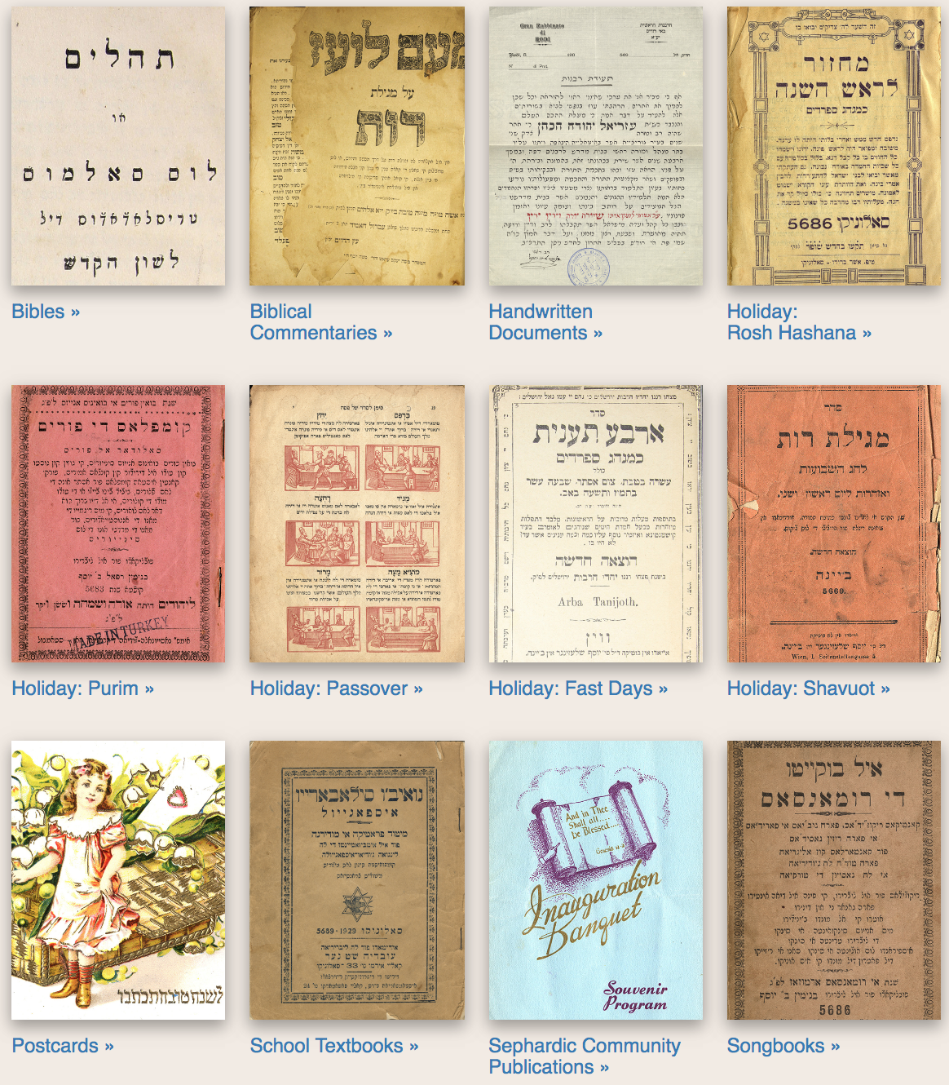
Source: https://content.lib.washington.edu/sephardicweb/index.html

Slide 6
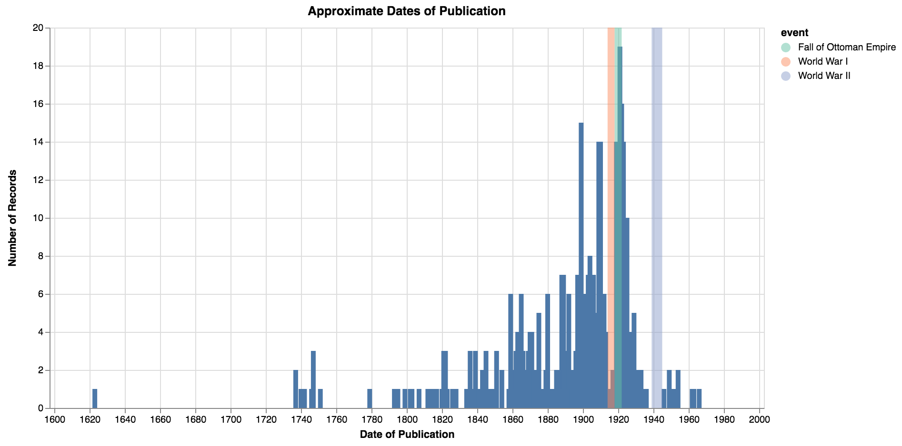

Slide 7
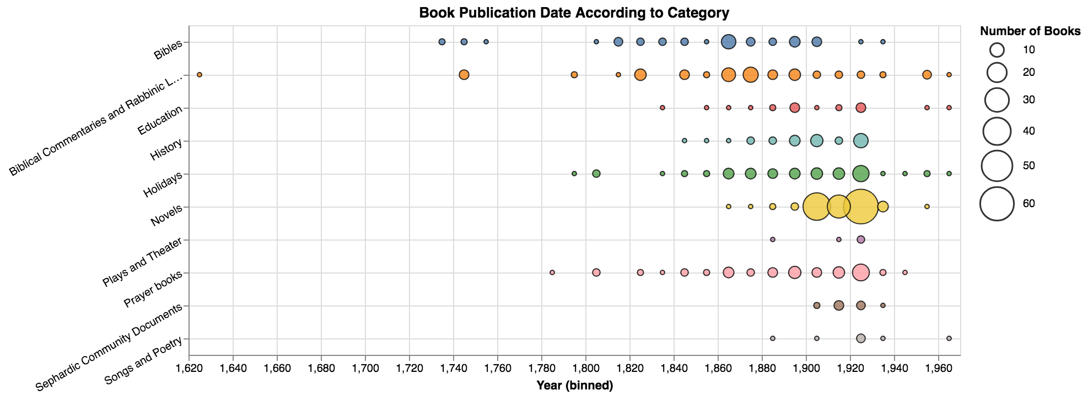

Slide 8
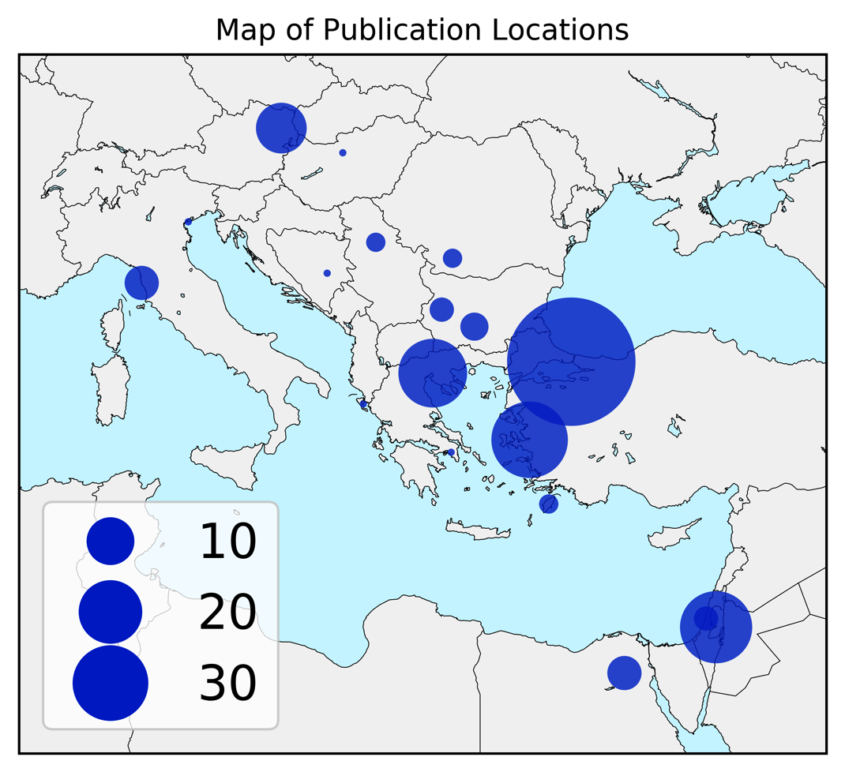

Slide 10
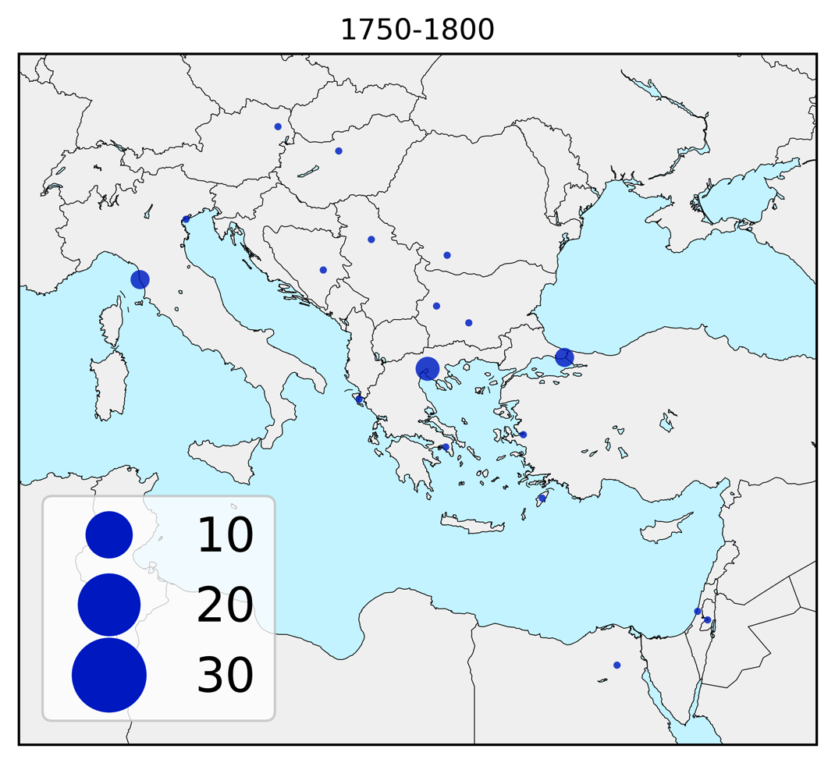

Slide 11
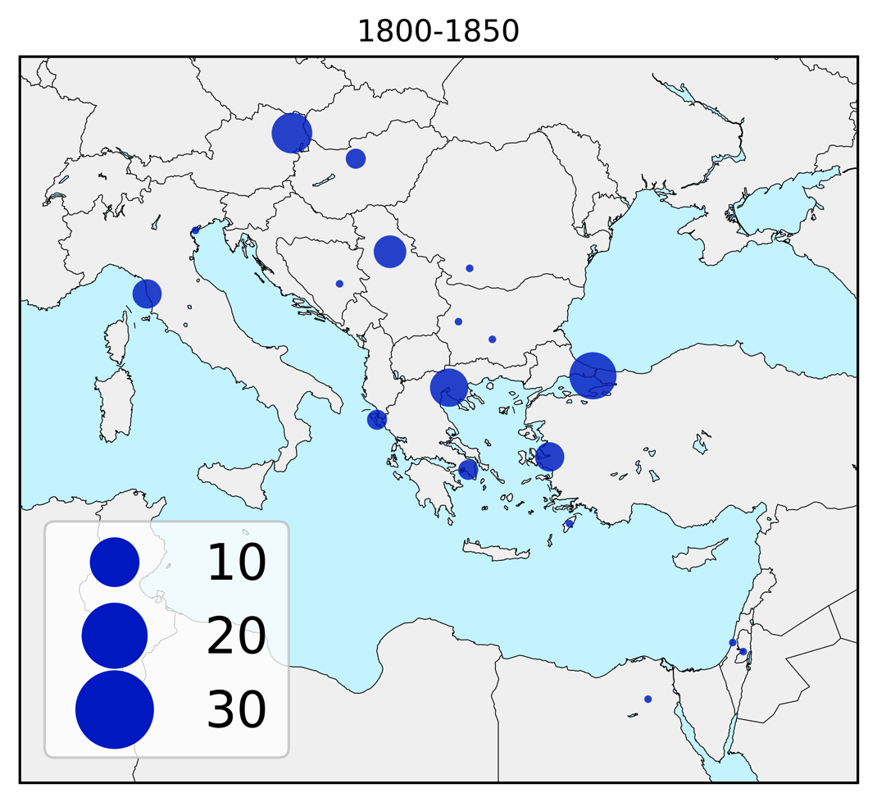

Slide 12
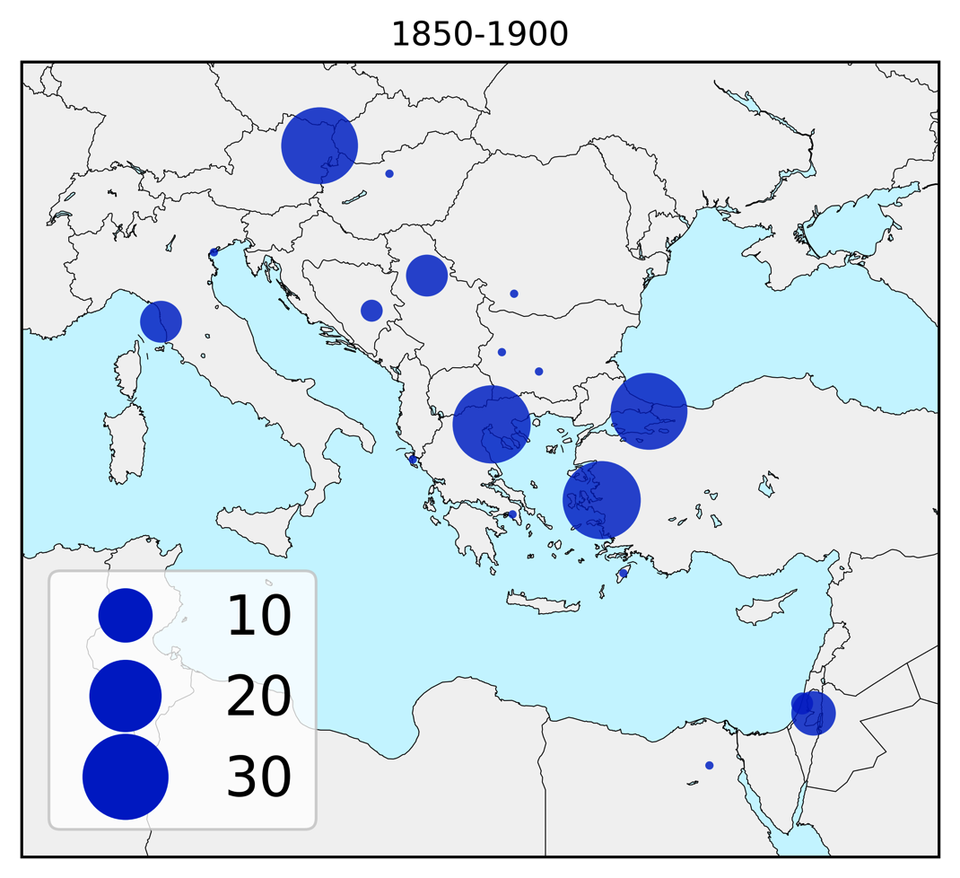

Slide 14
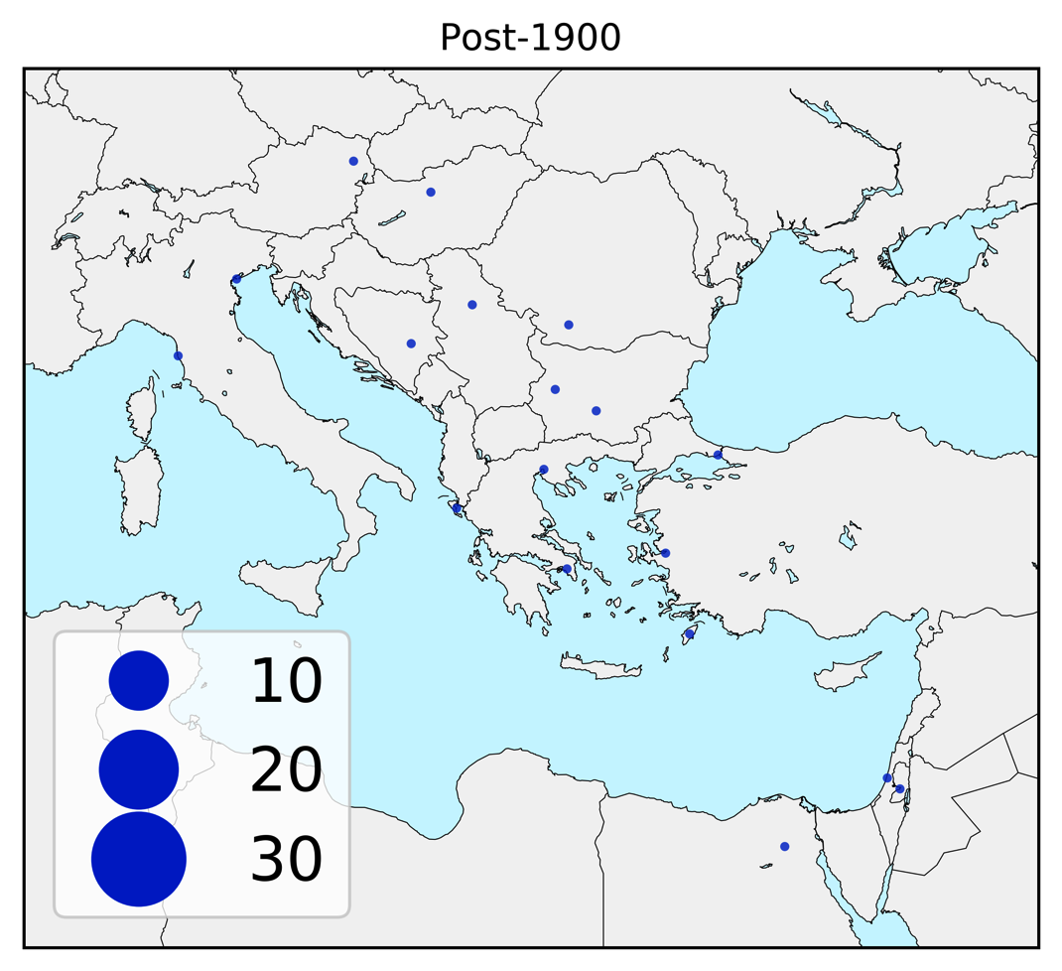

Slide 15
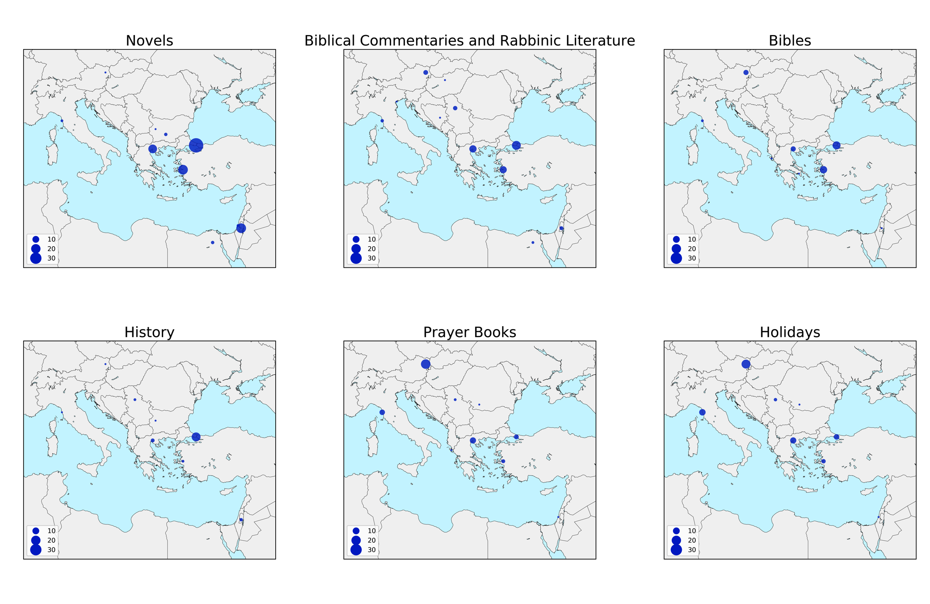

Slide 18
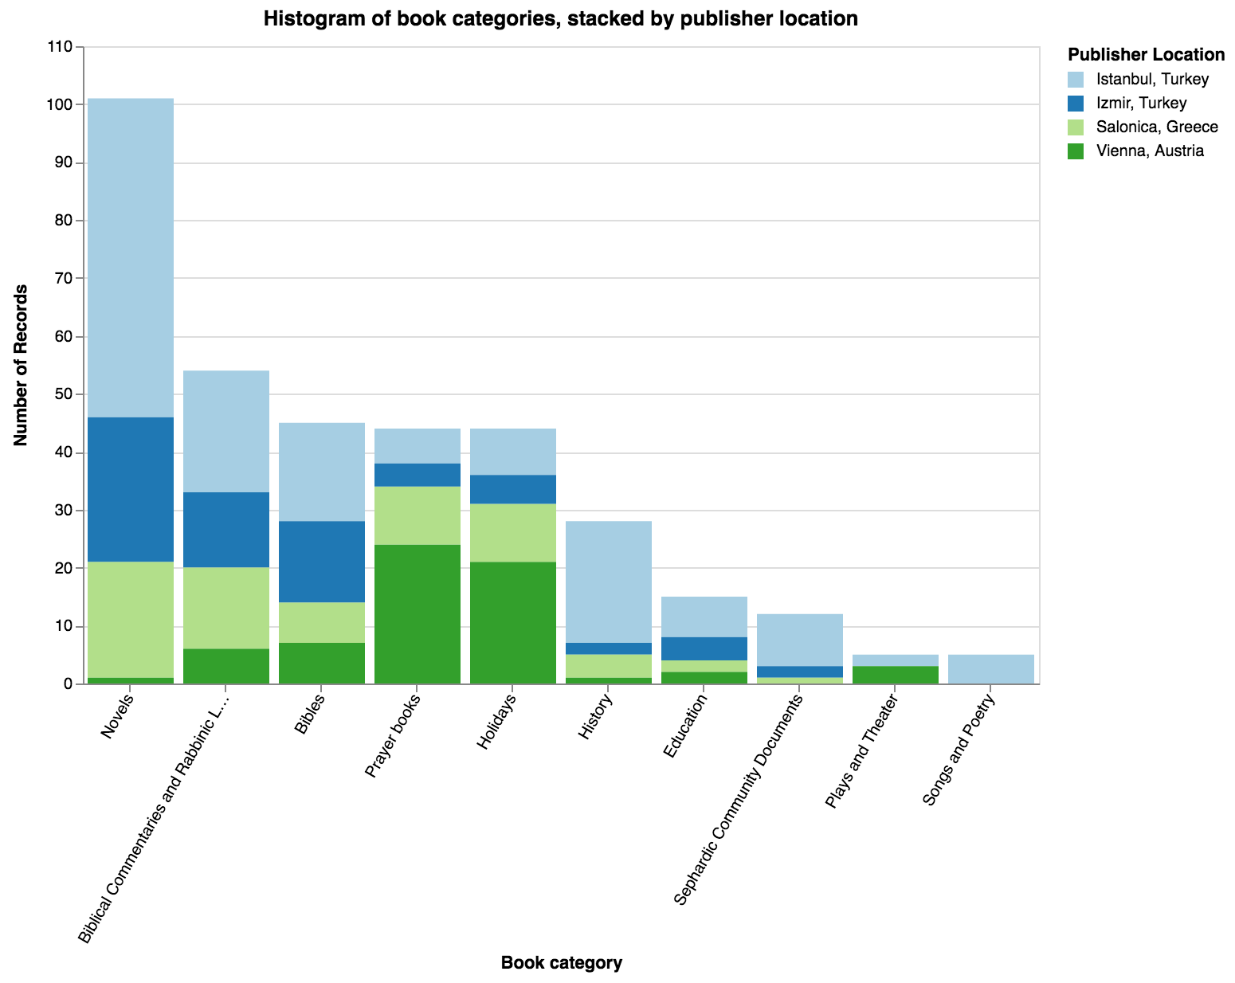

Slide 19

If you would like to see more…
Visit the Sephardic Studies Digital Collection online
https://content.lib.washington.edu/sephardicweb/index.html
You can flip through digital copies of the books!
Attend the Seattle Sephardic Legacies
event on June 2nd!
  Sponsored by the Stroum Center for Jewish Studies and the National Endowment for the Humanities
  UW HUB Lyceum, Sunday, June 2nd at 2 PM

Slide 20

Time’s Up!
About your speaker:
  Name: Ben Lee
  Email: bcgl@uw.edu
  Social Media: @lee_bcg, www.bcglee.com
  Quick bio: I am a first-year Ph.D. student in the Paul G. Allen School for Computer Science and Engineering at Udub. I graduated from Harvard College in 2017 and have served as the Digital Humanities Associate Fellow at the United States Holocaust Memorial Museum, as well as a Visiting Fellow in Harvard’s History Department.
  I love all things digital humanities and would love to chat more!

