Slide 1
Two Geospatial Data Resources @ Your Library that You Need to Know
With
Matt and Kian

Slide 2



Notes:
Demographic data is core to a lot of GIS research projects. But working with the US Census Bureau often leads one to experience levels of frustration and despair. Trying to understand what variables are included in which Census tool (Decennial OR American Community Survey) can make you to wish that you had a direct line to a Census master like Gov Docs Librarian, Cass Hartnett. On top of that you still have to get the TIGER/Line files and join the two pieces together.
There’s got to be a better way?!?

Slide 3



Notes:
You’re in luck!
“SimplyAnalytics is a web-based mapping, analytics, and data visualization application that makes it easy for anyone to create interactive maps, charts, and reports using 100,000+ data variables. …related to demographics, employment, housing, market segments, businesses, consumer spending, brand preferences, public health, and more from industry-leading data vendors.”--http://simplyanalytics.com/
Primarily comes from 2 vendors: EASI and Simmons
EASI (Easy Analytic Software Inc.) Data:
Using input data from the Census Bureau, Bureau of Labor Statistics, and Mediamark, EASI develops model-based indicators of the demographic characteristics, consumer spending, and behavior patterns
range of geographic areas—State, counties, census tracts, and block groups.

Slide 4
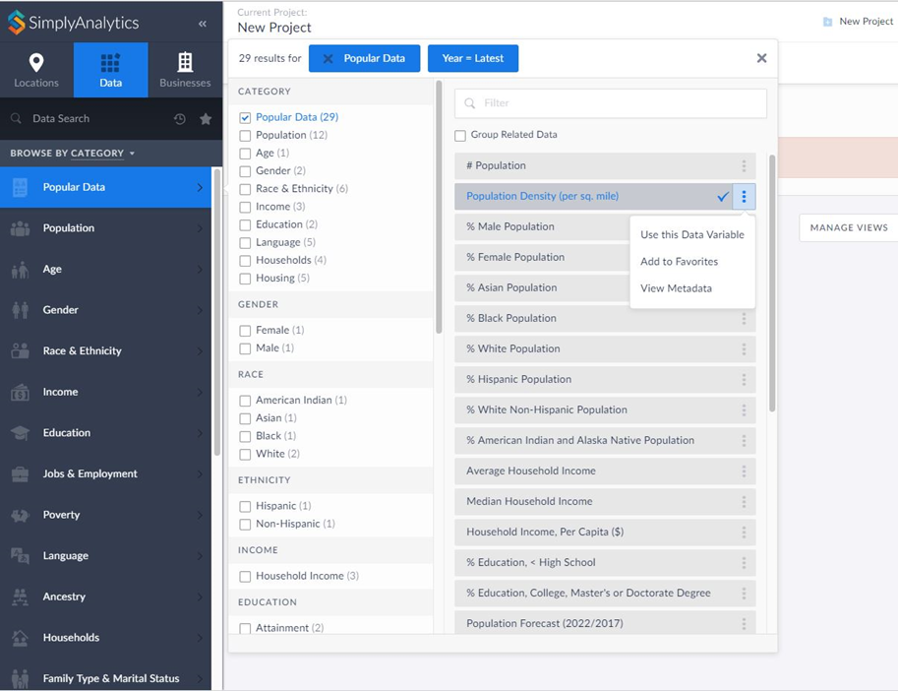
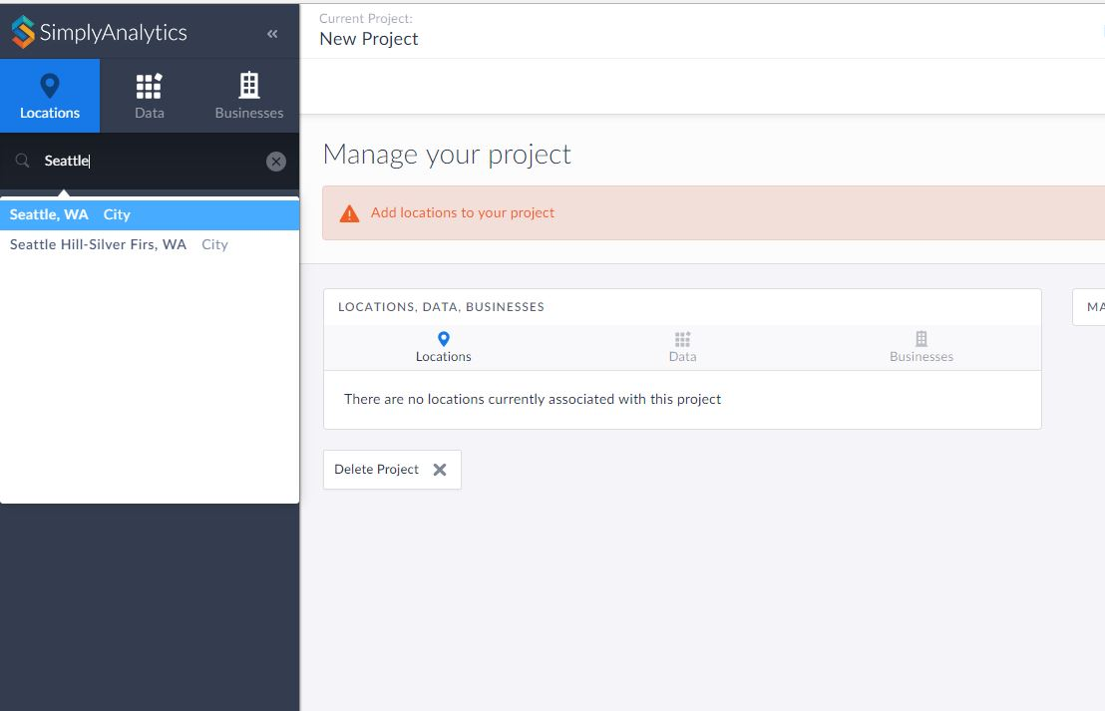
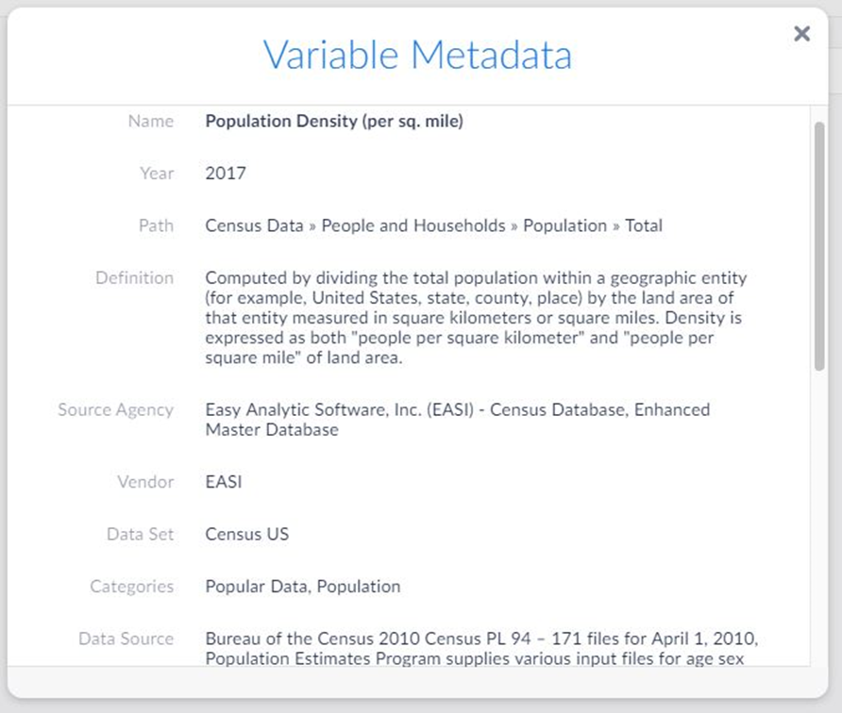
Notes:
Once inside, the first thing you want to do is choose your data variable. You don’t need to know if it is part of the Decennial Census or ACS. They’ve categorized everything into topics that make it easy to browse. Here we’re selecting Population Density per sq mile.
Once you’ve selected your variable, the next thing you need to do is select your location of interest. You can choose from National down to City level geographies. As you type, an auto-generated list of options will appear. Here we are choosing to map the City of Seattle.
Of course, SimplyAnalytics does include metadata, so if you wanted to know if this is a Census or ACS variable, you can find out. It also contains info on what the variable is, so that you can be confident you are mapping the right thing in order to tell your story.

Slide 5
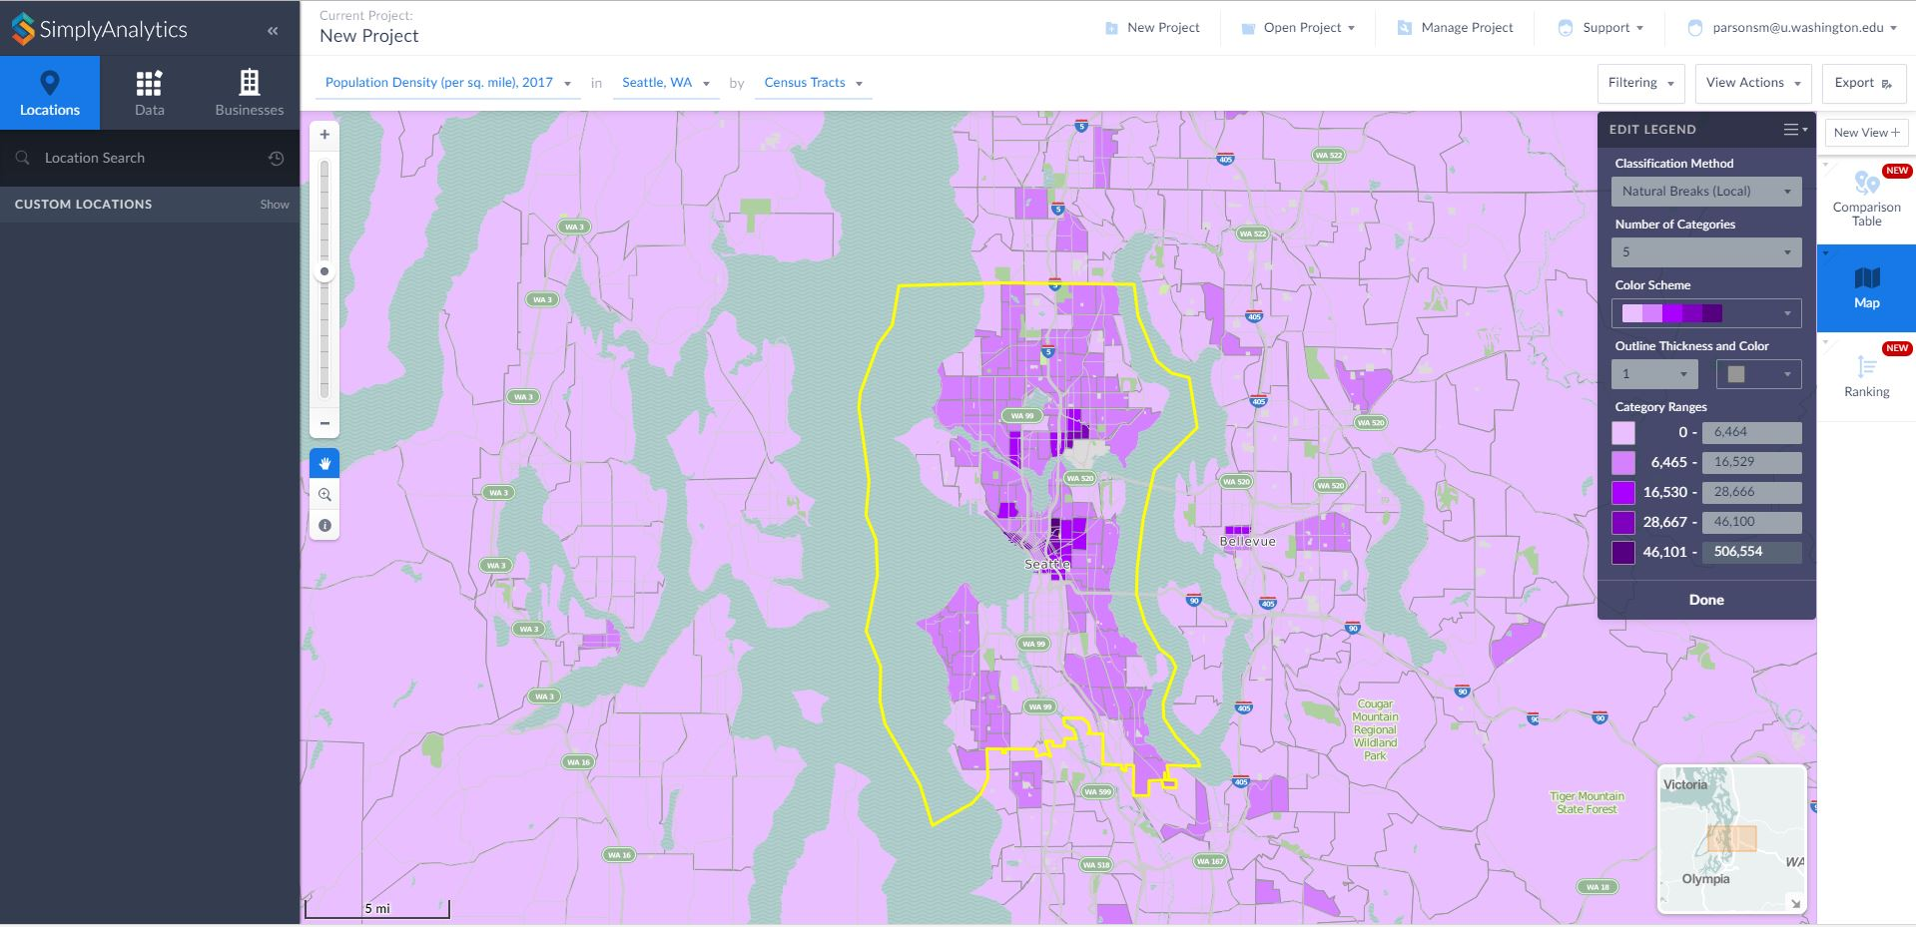
Notes:
Once your variable and location are selected, SimplyAnalytics creates an interactive map like this one. Here you can edit the legend, color scheme, classification method, etc. You can also change the level of Census geography depicted from State down to Block Group.

Slide 6
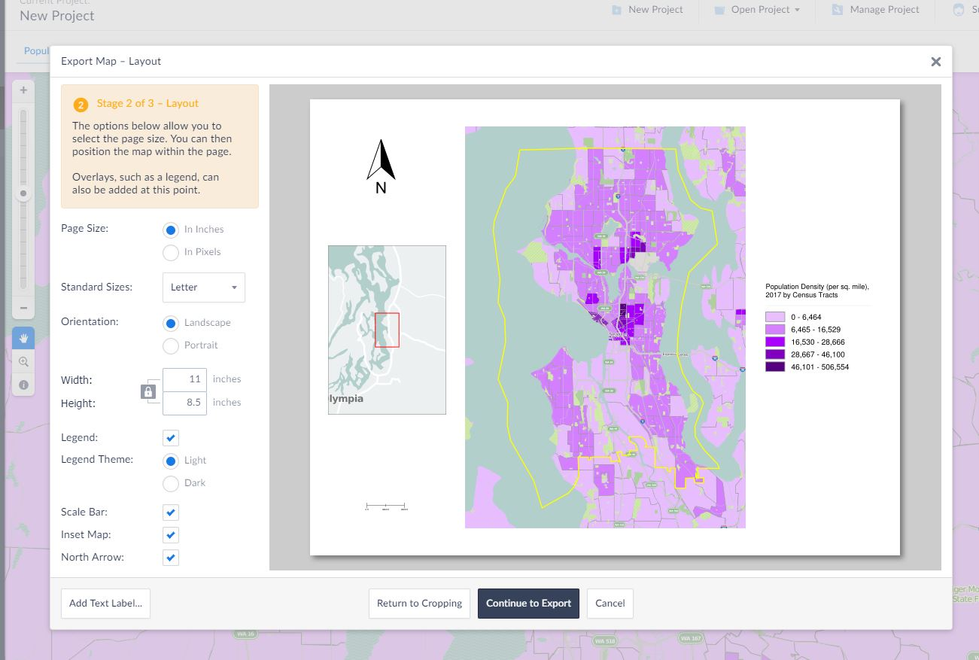
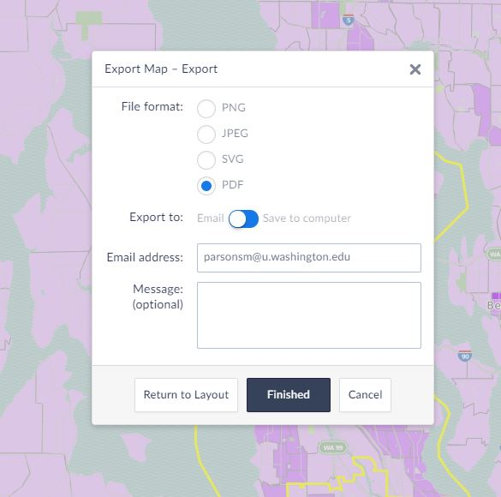
Notes:
You can also create a custom layout of your map after you are done with your editing. Options for exporting the layout include jpg, pdf, and other formats.

Slide 7
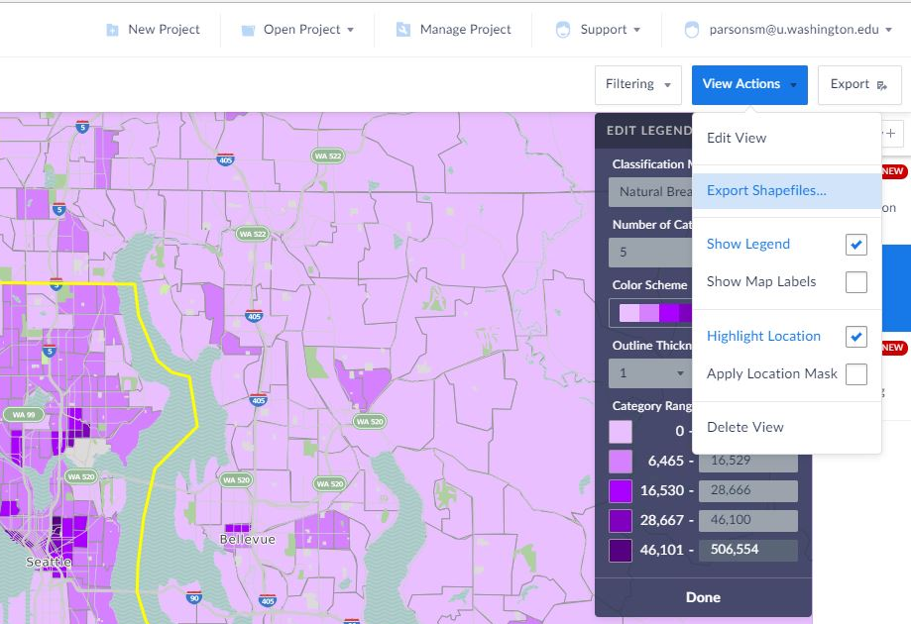
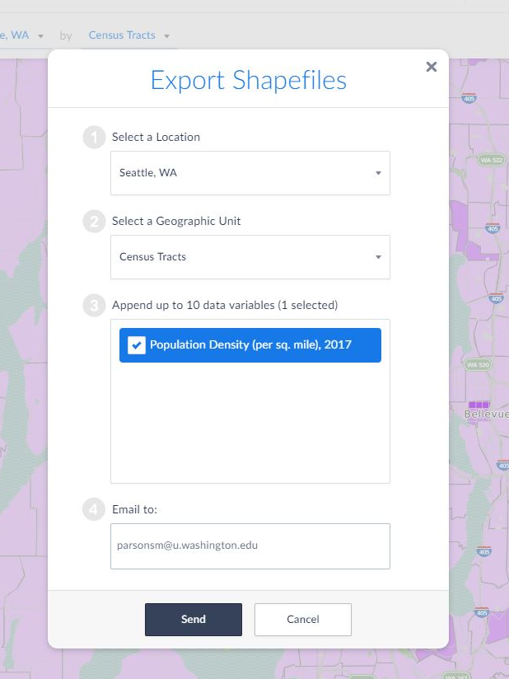
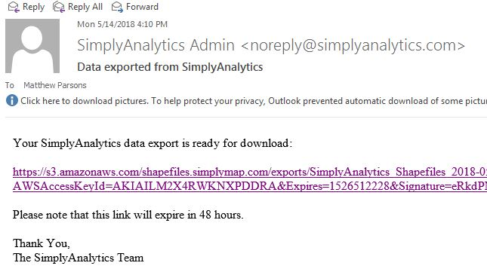
Notes:
But the neat thing about SimplyAnalytics is that you also have to option of exporting the map data out as a shapefile. With a few clicks of the mouse, you can tell SimplyAnalytics to package up the Census attribute data with the Census geography. Once the backend processing is complete, you get an email with a link to download the zipped shapefile.

Slide 8
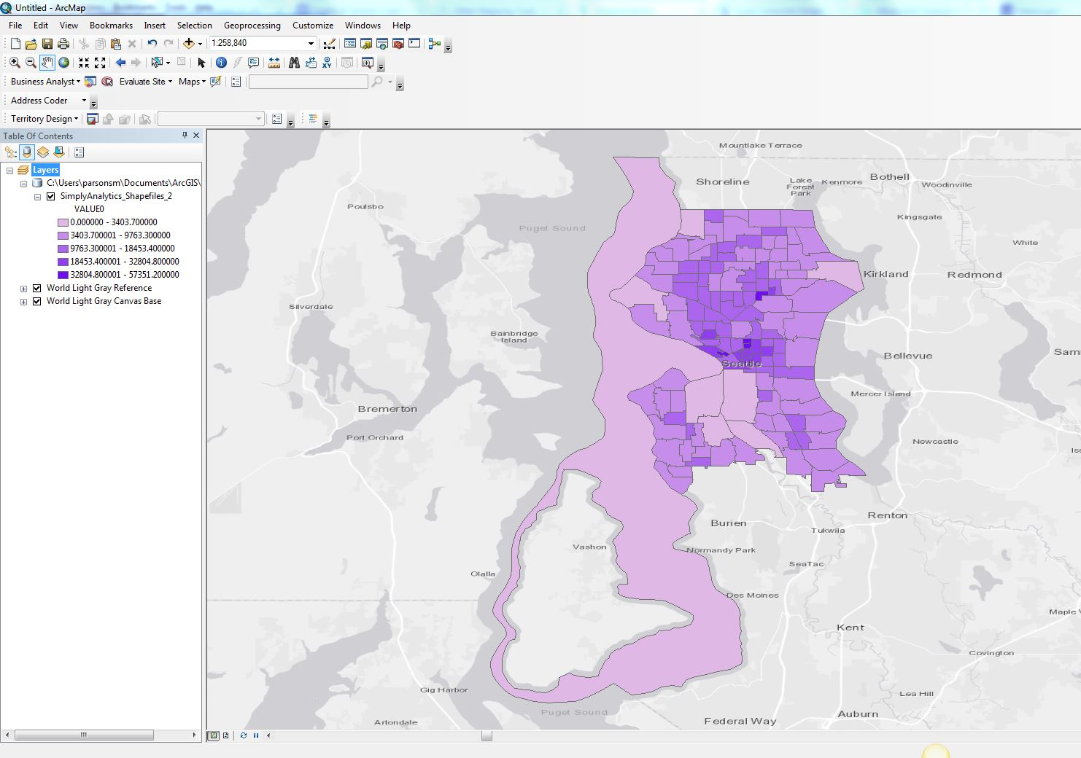
Notes:
After you download and extract the zipped file, you can add it to your ArcMap project just like any other shapefile.

Slide 9
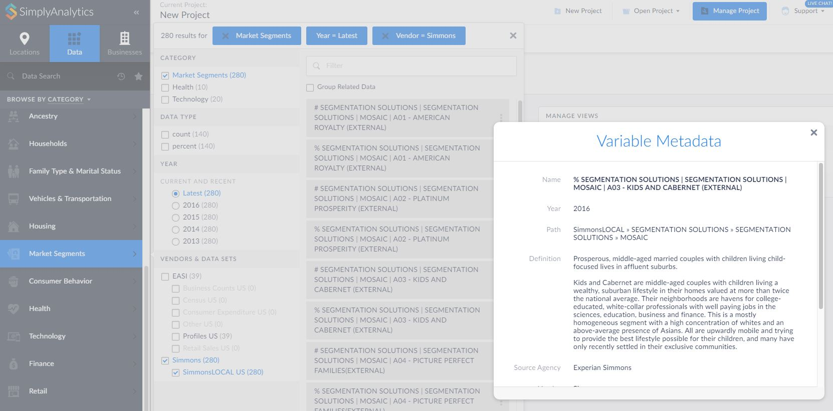

Notes:
But wait, there’s more. Remember the other vendor supplying data to SimplyAnalytics, Simmons?
Simmons Local Consumer Insight (SimmonsLOCAL) Data includes:
information on lifestyles, attitudes, purchase behaviors, and media usage
analysis down to the zip code level
For all of America’s 210 media markets.
So if you want to map the percent of the population classified as “Kids and Cabernet” in your zip code, you can!

Slide 10
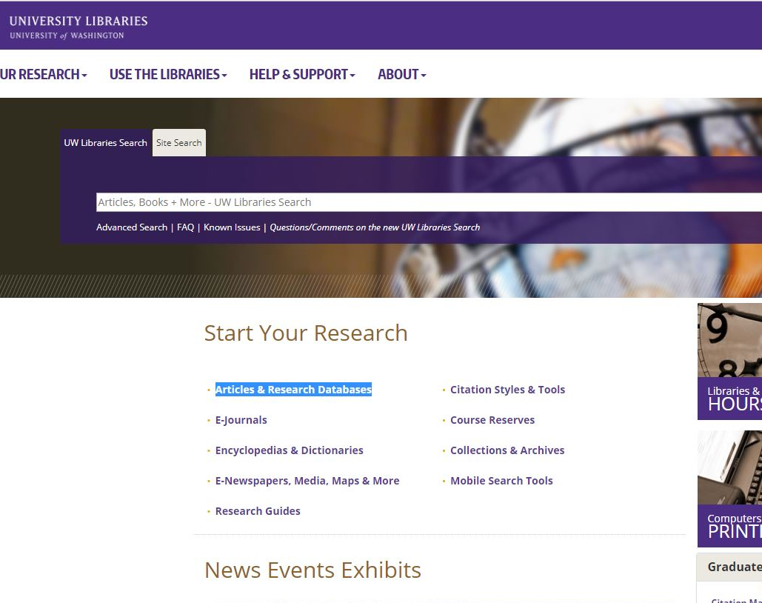
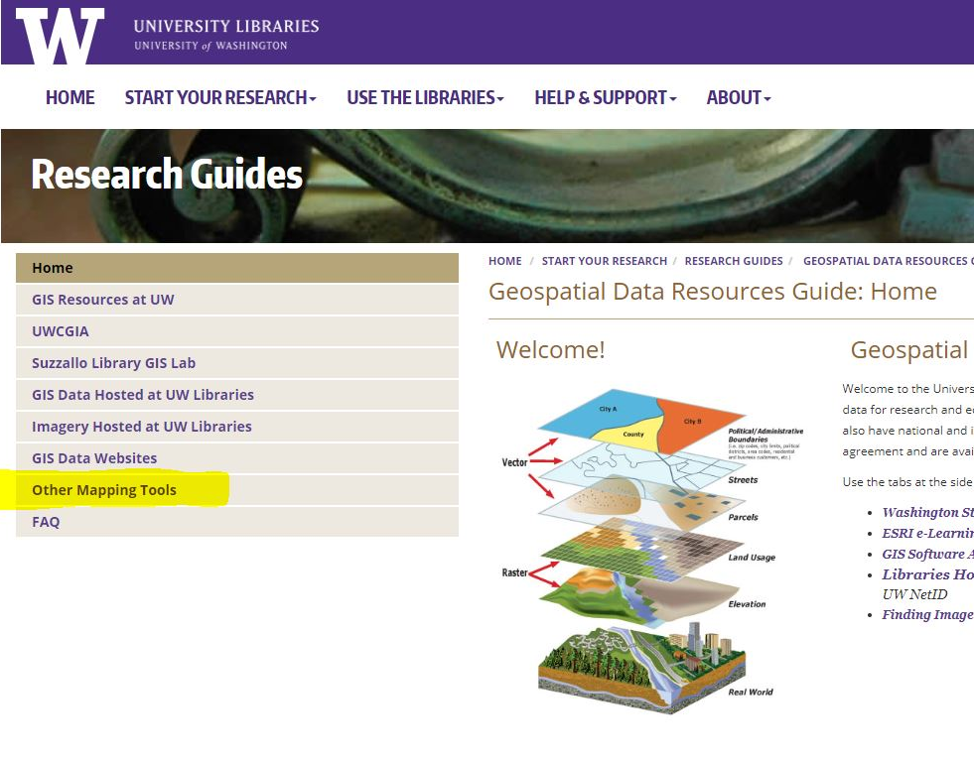
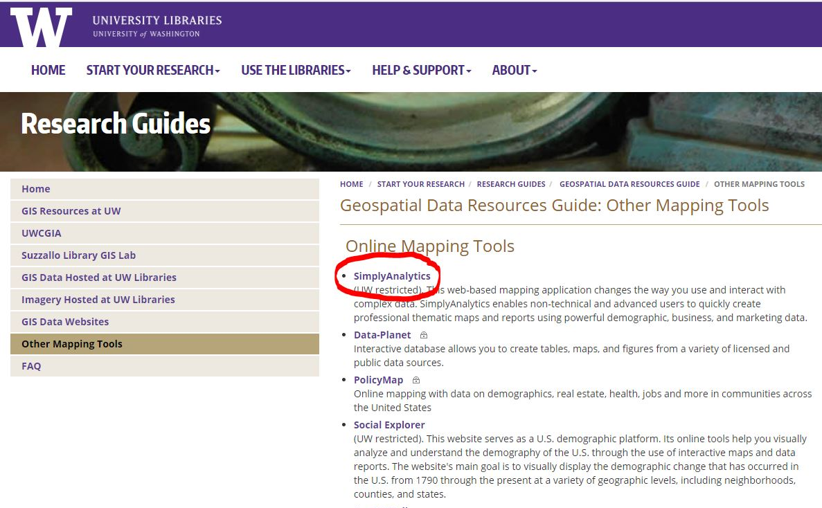
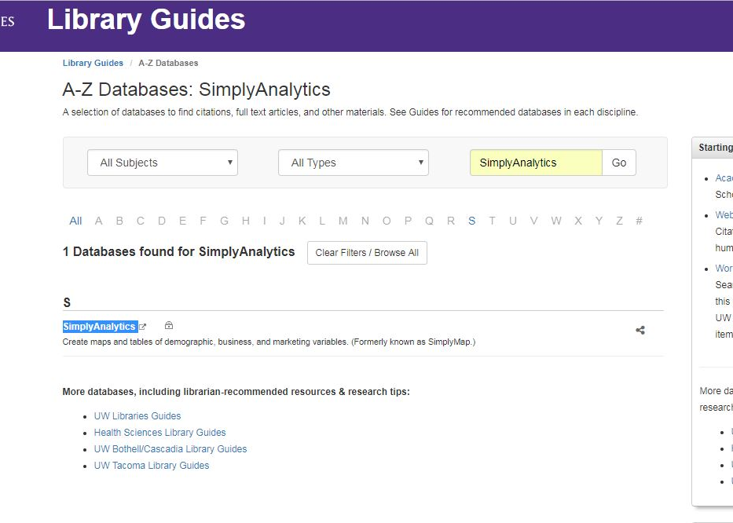
Notes:
So, how do you get to SimplyAnalytics? It’s simple: either via the UW Libraries’ Articles & Research Databases link and search for “SimplyAnalytics.”
Or by linking to it from the Libraries Geospatial Data Resources Guide’s page on “Other Mapping Tools.”

Slide 11

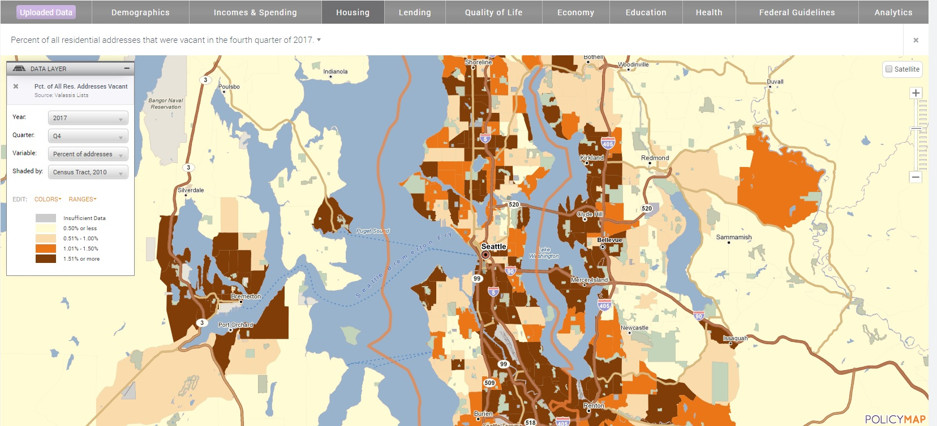
washington.policymap.com

Slide 12
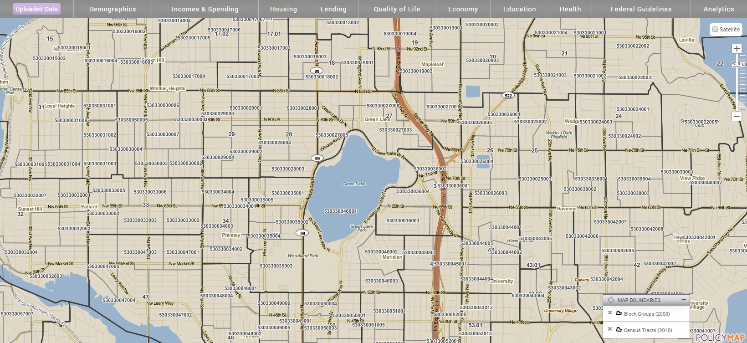
Census Geography Boundaries
washington.policymap.com

Slide 13
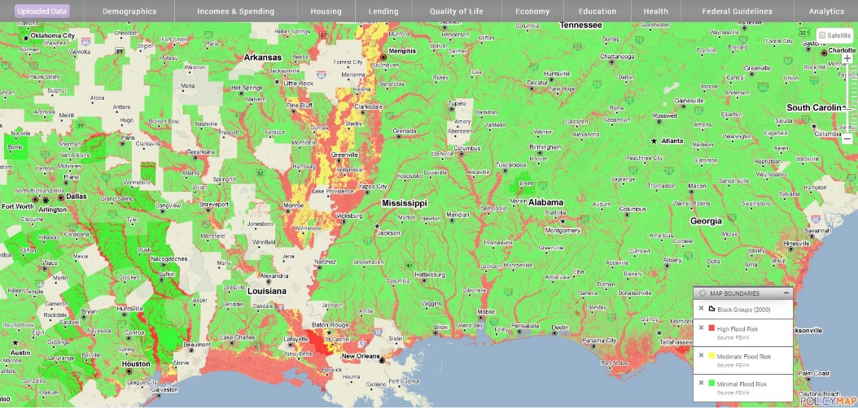
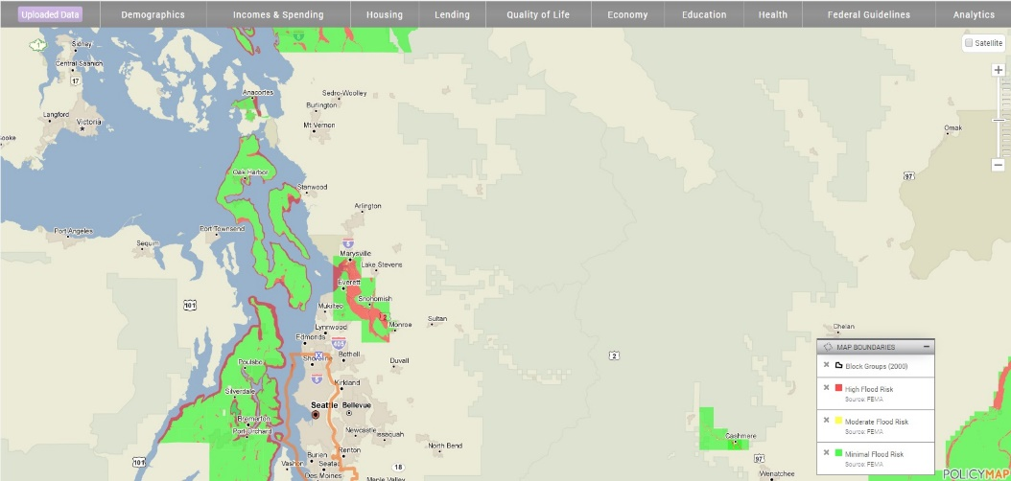
Map Features
Flood Risk Areas, US Gulf Coast
Flood Risk Areas, King County
washington.policymap.com

Slide 14
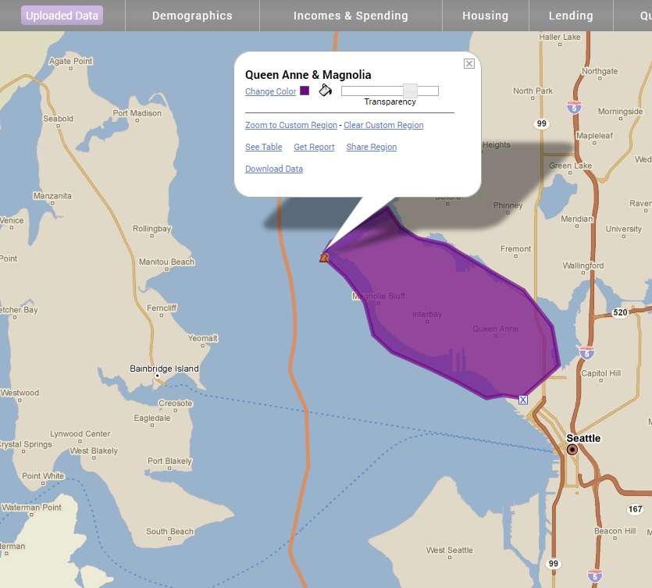
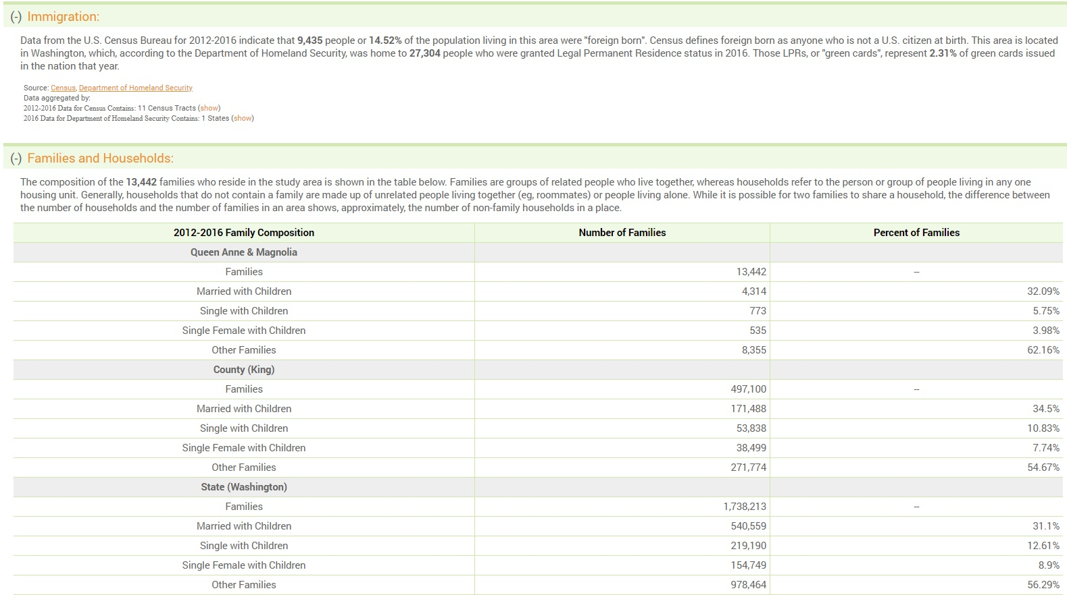
Custom Geographies & Reports
washington.policymap.com

Slide 15
New Proprietary Data
Boxwood Means Inc.
  Census Block level data for:
    # of home sales
    Median sale price
    Loan-to-value ratios
GreatSchools
  District level data for:
    Student test scores
washington.policymap.com

Slide 16
New Proprietary Data
Valassis Lists
  Census block group level data for:
    Quarterly vacancy rates
New Localism Advisors
  Census tract level data for:
    Qualified Opportunity Zones, Social Needs Index
Urban Mapping Inc.
  Census tract level data for:
    Sum of public transit stops within a census tract
    Shortest distance to a public transit rail stop
washington.policymap.com

Slide 17
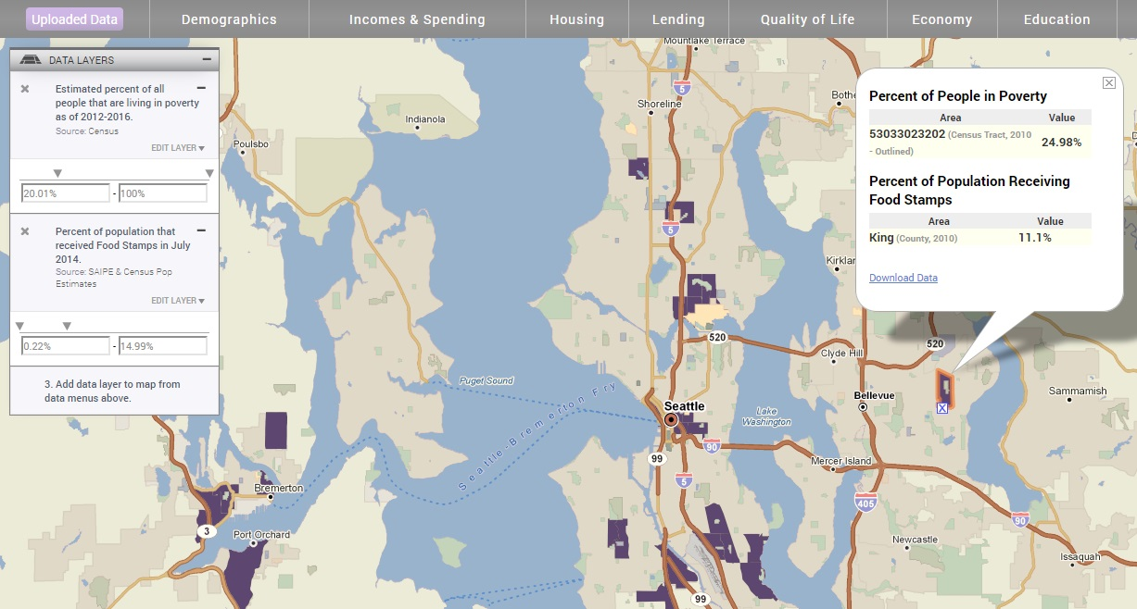
3-Layer Maps
washington.policymap.com

Slide 18
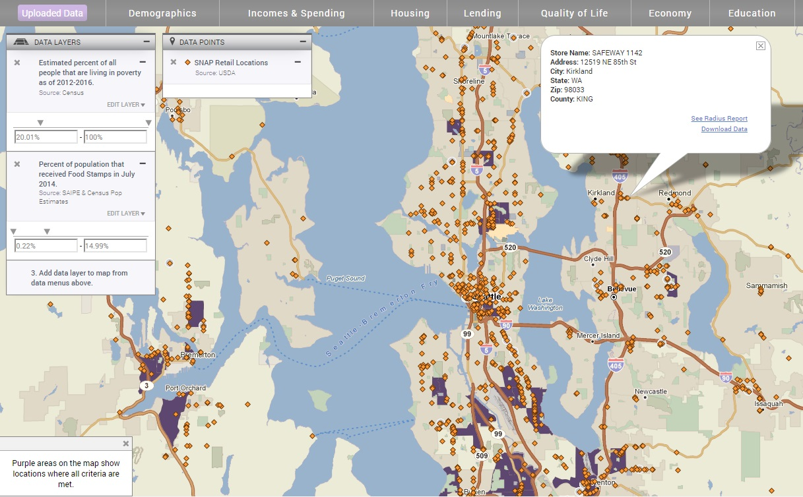
3-Layer Maps
washington.policymap.com

Slide 19
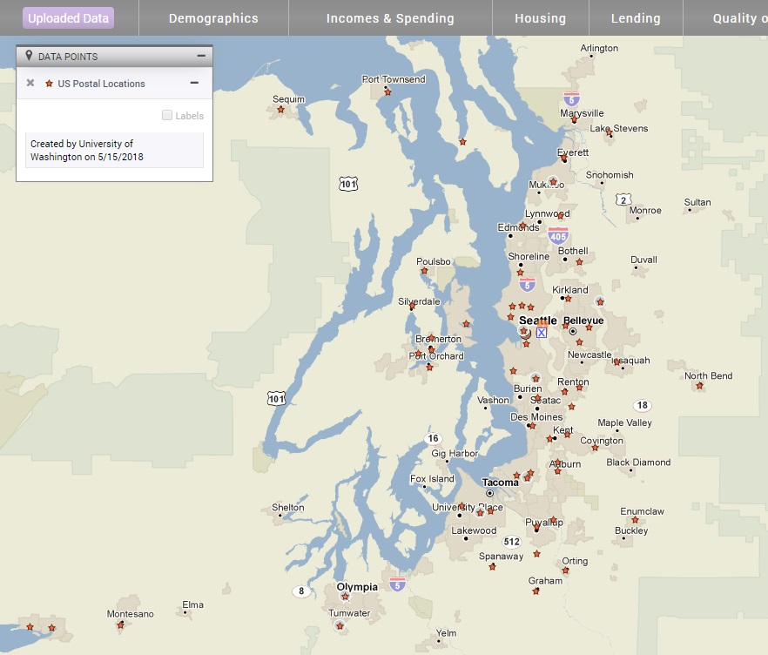
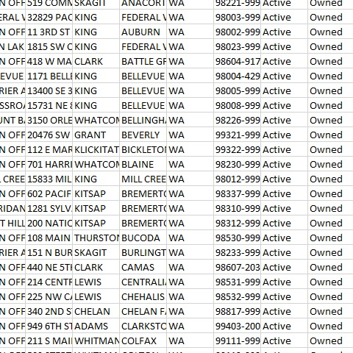
Data Loader
washington.policymap.com

Slide 20
Data Loader
washington.policymap.com

Slide 21

Time’s Up!
About the speakers:
  Name: Matthew Parsons and Kian Flynn
  parsonsm@uw.edu and Flynnk7@uw.edu
  University of Washington Libraries
    Matt is the Geospatial Data and Maps Librarian
    Kian is the Geography and Global Studies Librarian

