Slide 1
Characterizing CA Spotted Owl Habitat with Lidar
Jonathan Kane
Malcolm North
Van Kane
Greg Asner

Slide 2
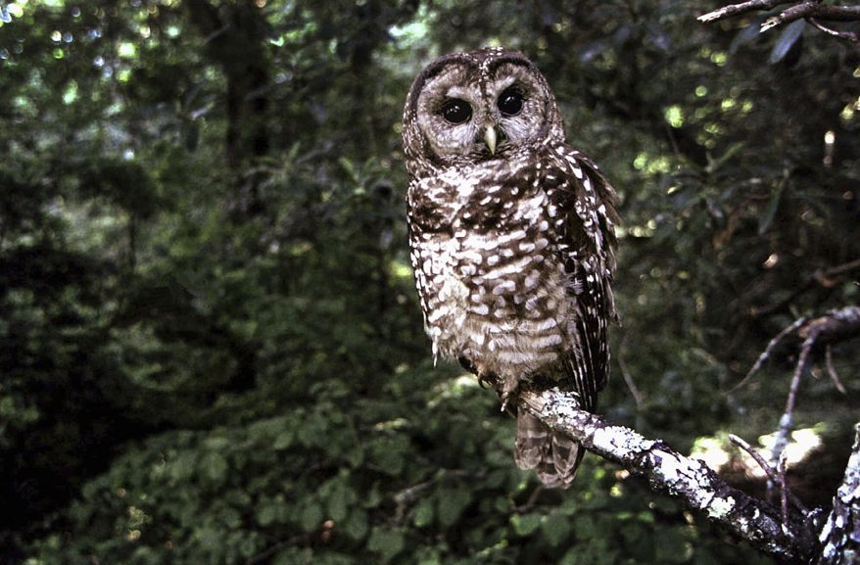
Spotted Owls

Slide 3
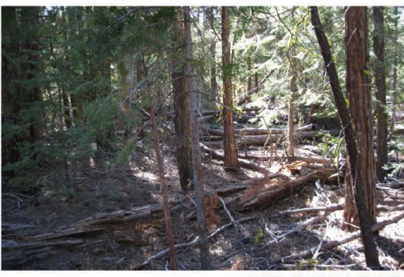
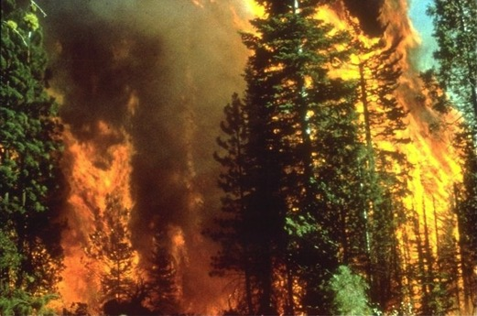
The Problem
Not endangered yet, but close
Believed to love high (>70%) cover forests
Unfortunately, these types of forest are very vulnerable to fire

Slide 4
The Problem
Not endangered yet, but close
Believed to love high (>70%) cover forests
Unfortunately, these types of forest are very vulnerable to fire

Slide 5
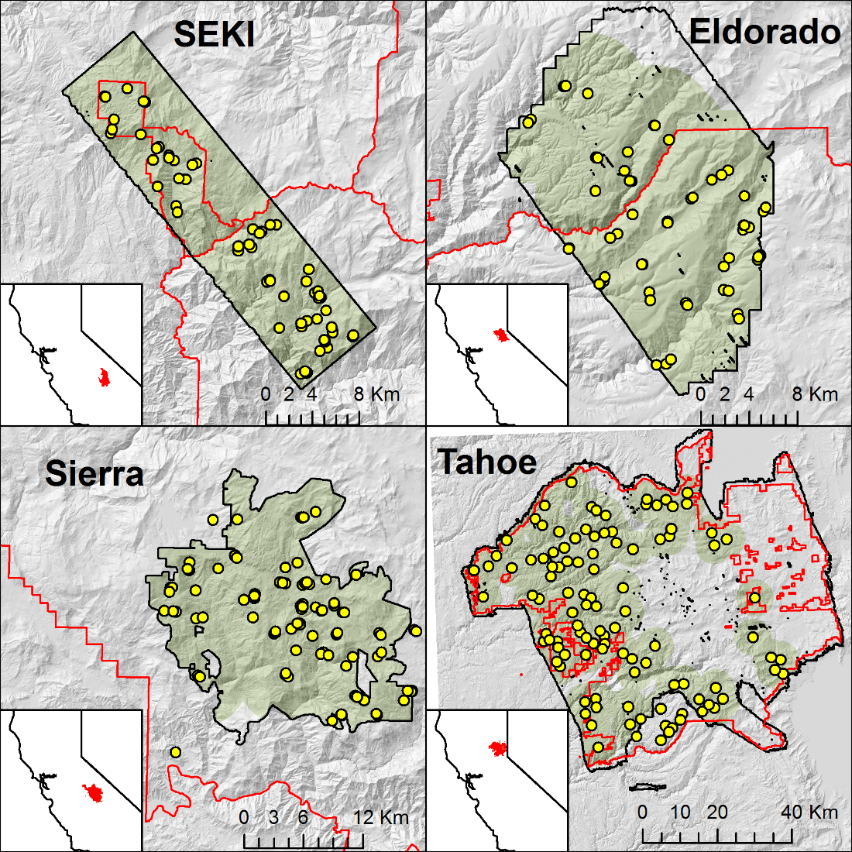
Our Data

Slide 6
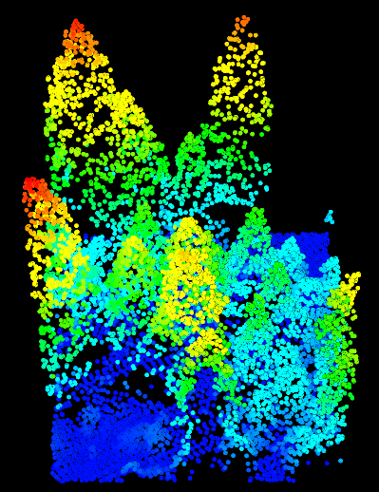
Lidar

Slide 7
Lidar

Slide 8
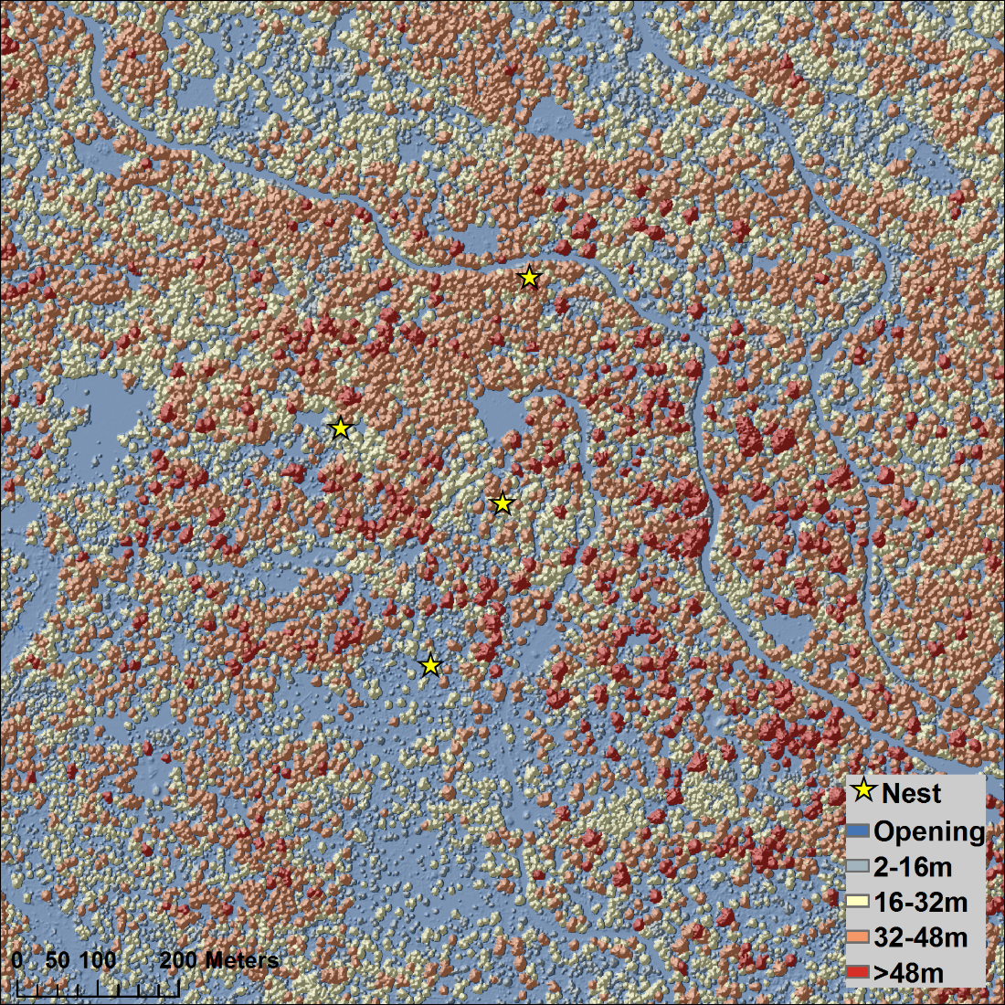
Lidar

Slide 9
Lidar

Slide 10
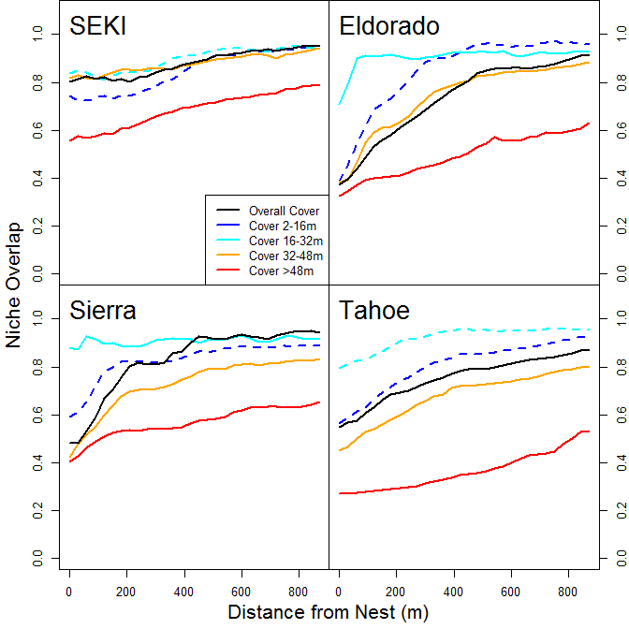
Niche Overlap
Distinction between local area and overall landscape vs distance from nest
Low numbers = more distinct
Most distinct is area in large trees

Slide 11
Niche Overlap
Distinction smallest in SEKI, which has tons of great owl habitat not used for (presumably) territorial reasons

Slide 12
Niche Overlap
Distinction levels off or disappears at about 500m away
Conveniently smaller than legally-mandated protected areas

Slide 13
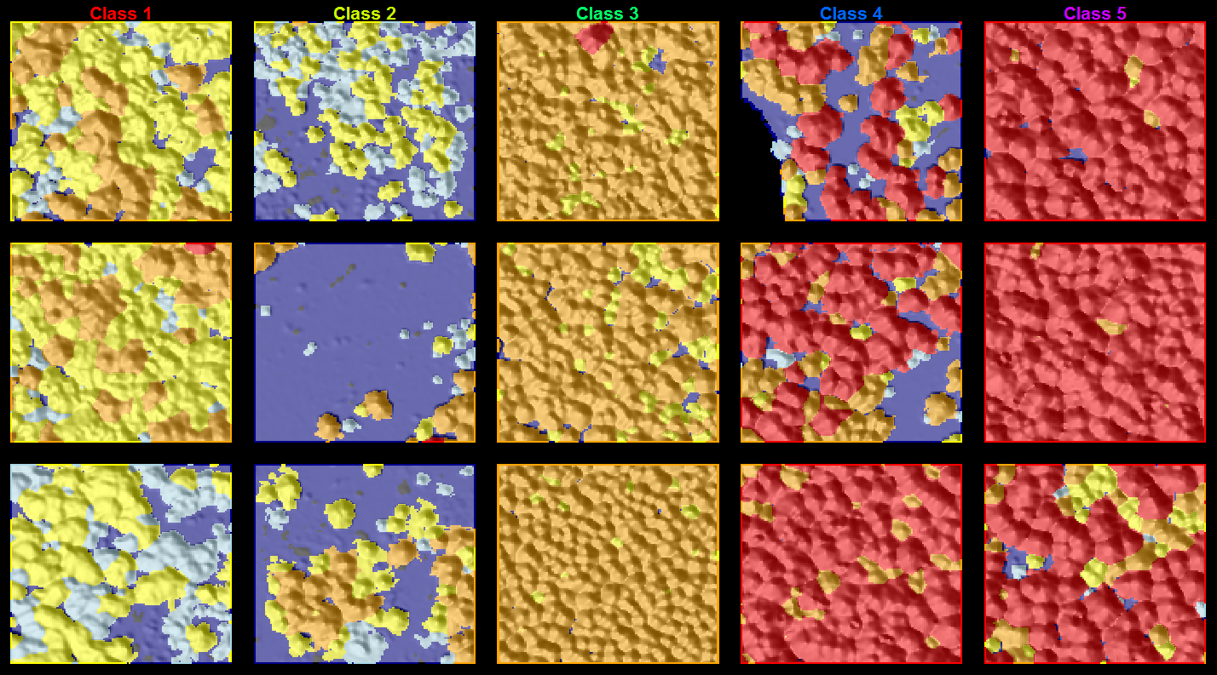
Structure Classes

Slide 14
Structure Classes

Slide 15
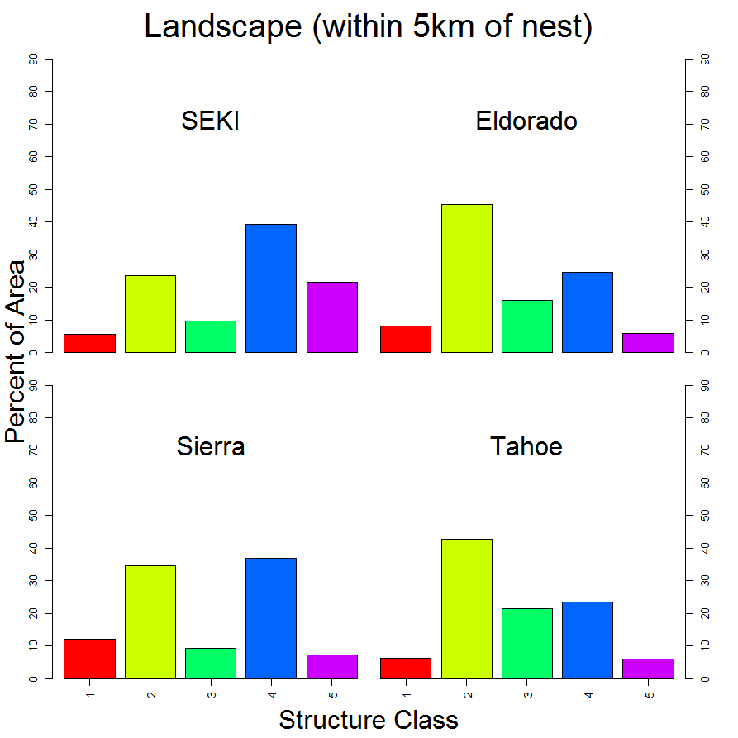
Structure Classes,
Overall Landscape
Class 2 (very open) and 4 (open-tall) prominent
Class 5 (very tall, closed) relatively uncommon

Slide 16
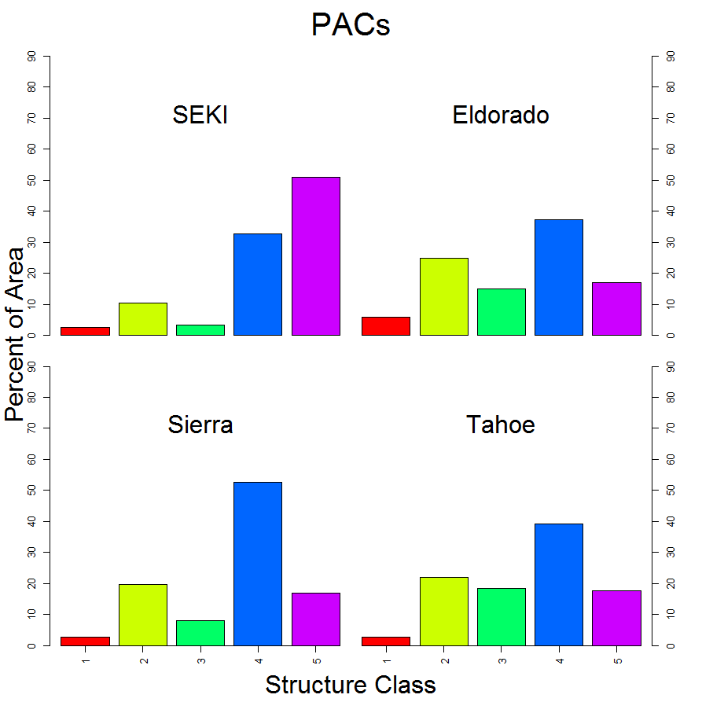
Structure Classes, Core Area
Classes 4 (open-tall) and 5 (very tall, closed) dominate the legally-protected PACs

Slide 17
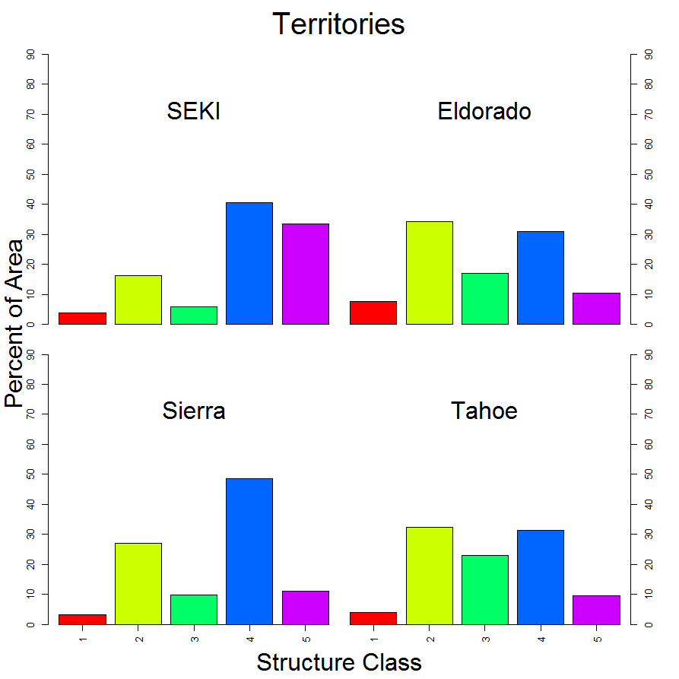
Structure Classes, Whole Territories
Resembles the overall landscape much more closely
Reinforces result that owls seem not to be selecting for forest type outside of the legally-protected areas

Slide 18
Conclusions
Cover is important, but not as important as area in tall trees
Owls appear to be happy to include “sub-par” habitat in their territory starting around 500m from the nest
Managers could potentially have some room to improve fire resilience without harming habitat

Slide 19
Conclusions
Cover is important, but not as important as area in tall trees
Owls appear to be happy to include “sub-par” habitat in their territory starting around 500m from the nest
Managers could potentially have some room to improve fire resilience without harming habitat

Slide 20
Conclusions
Cover is important, but not as important as area in tall trees
Owls appear to be happy to include “sub-par” habitat in their territory starting around 500m from the nest
Managers could potentially have some room to improve fire resilience without harming habitat

Slide 21
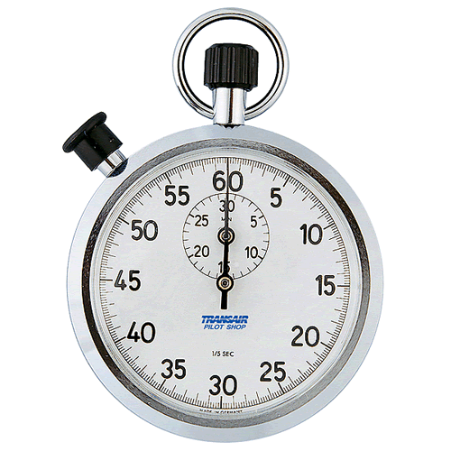
Time’s Up!
About your speaker:
  Name: Jonathan Kane
  Department: SEFS
  Tel: 425-890-1673
  Email: jontkane@uw.edu
  Quick bio: Research Consultant (staff) for 7 years with SEFS, working with remote sensing (particularly Lidar) on forest systems

