Slide 1
The How and Why of Sensory Friendly Libraries
Brett Spencer, Dawn Amsberry, Emily Rimland, Teresa Slobuski
Penn State University Libraries

Slide 2
agenda
Why Sensory Friendly Libraries?
Key Features
Examples from Our Spaces
Tips and Best Practices

Slide 3
Why Sensory Friendly Libraries?

Slide 4



Because we care about all our students’ well-being and success!
Everyone has sensory preferences that help them focus or relax. (Spielmann, 2021)
Image by TMDaub on Pixabay.
Image created by Adobe Firefly.
Image by FotoRieth on Pixabay

Slide 5

Specific Groups of Students with Deeper Sensory Needs:
-Neurodivergence (Lin & Huang, 2017)
-PTSD (Fleming et al., 2024)
-Anxiety & Depression (Keptner et al., 2024)
-COVID Effects (Mark, 2024)
Sensory issues are barriers to their wellness & learning.
Image created by Adobe Firefly.

Slide 6

Sensory-friendly libraries support general student wellness...and sensory social justice for specific groups.
Sensory Social Justice—ability of individuals to modulate stimuli in ways that optimize their cognitive & emotional processing.
We can help students modulate stimuli by providing tools (like fidgets) or designing an adjustable environment.
Image created by Adobe Firefly.

Slide 7
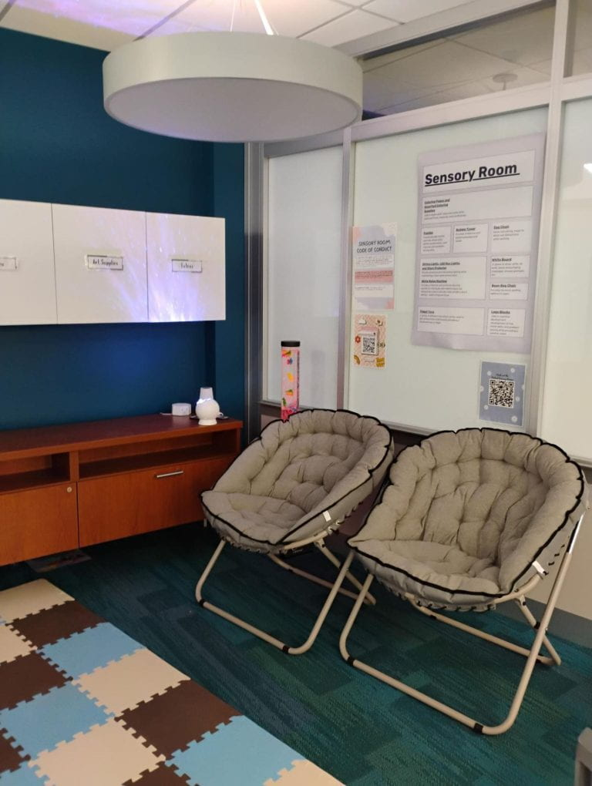
Key Features of Sensory Friendly Libraries

Slide 8
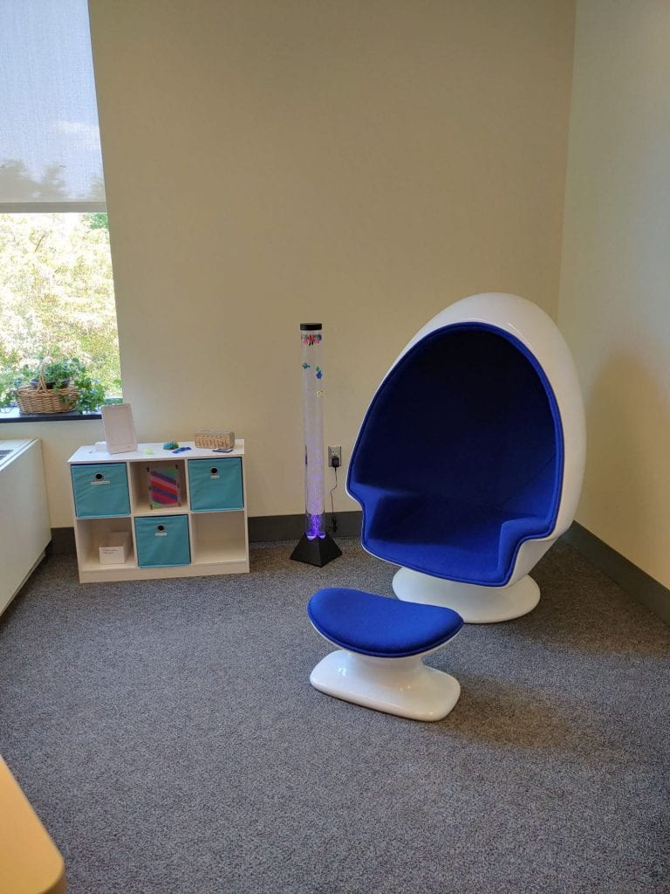
Welcoming Spaces
Fidget-friendly furniture
Equipment examples:
fidget toys, white noise machines, bubble towers, noise-cancelling headphones, sound mixer
Adjustable lighting
Visit our Tech Gallery for more ideas

Slide 9
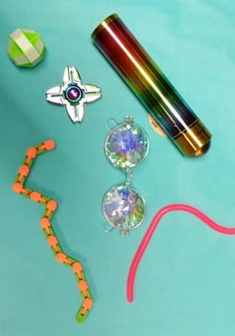
Sensory Tools
Fidget items
Prismatic sunglasses
Snap and click items
Kaleidoscopes

Slide 10
Examples from Our Spaces

Slide 11

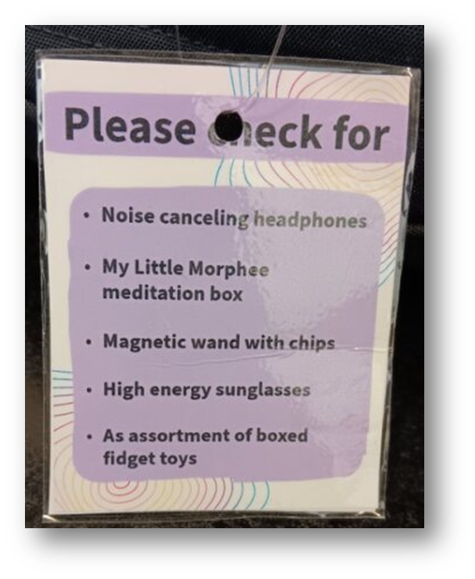
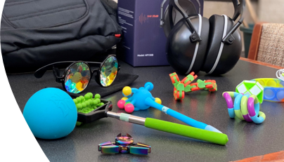
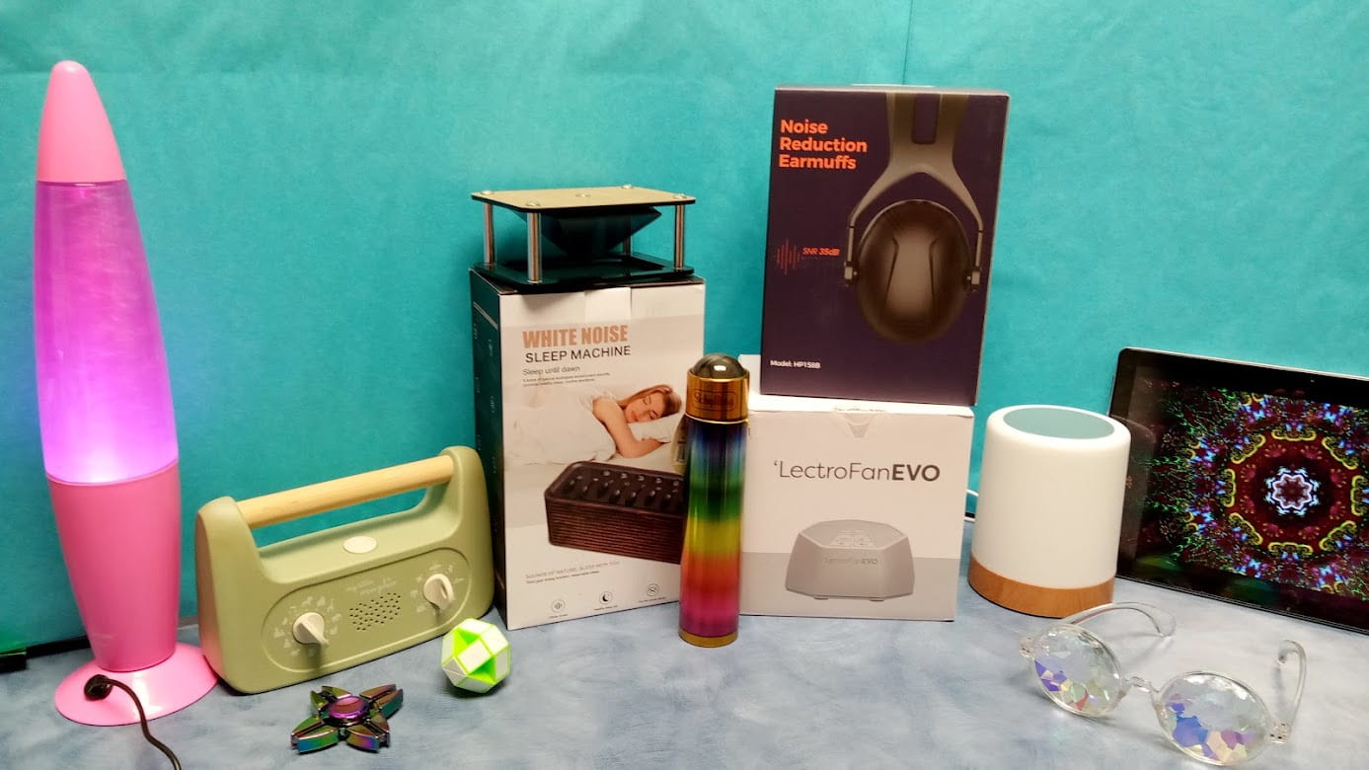
Sensory Kits & Check Outs

Slide 12
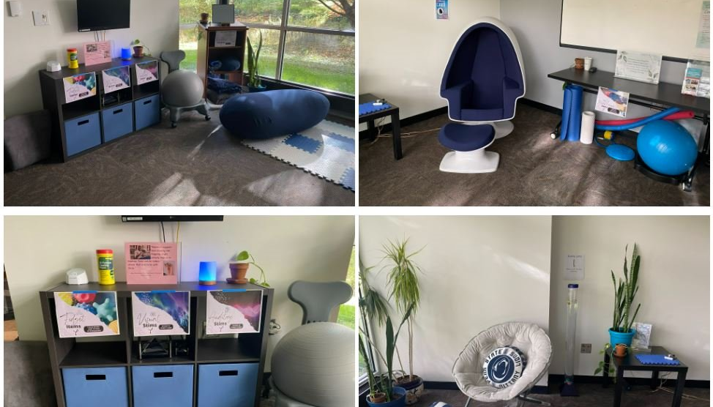
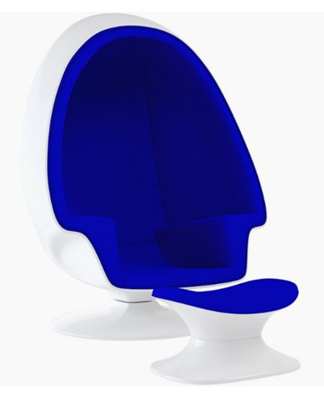
Penn State Berks
Notes:
Only reservable – 90 mins
3d virtual tour online

Slide 13
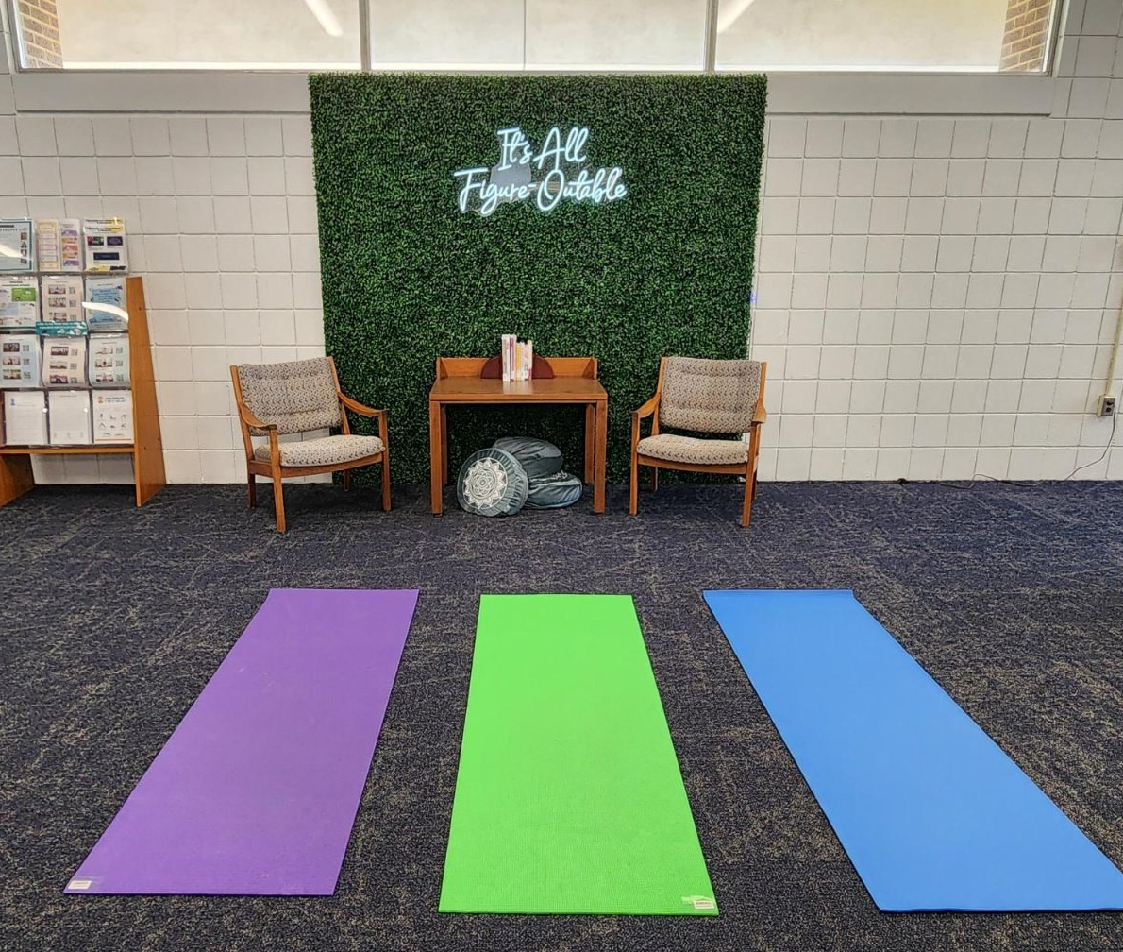
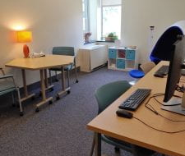
Penn State Fayette & Altoona

Slide 14
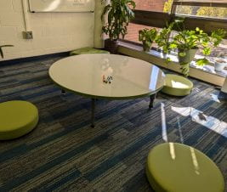
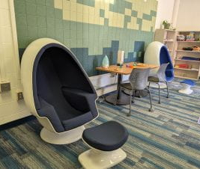
Penn State Brandywine
Notes:
Not reservable
Possibly the largest space
Egg chair is a hit
Notice materials in use when resetting; furniture moves constantly—is moveable
Moved plants away due to needing more light and students want it dark most of the time

Slide 15
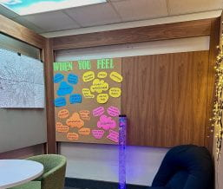
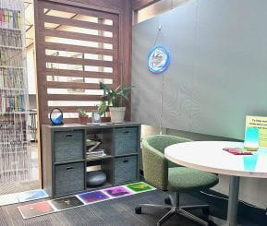
Penn State Dubois

Slide 16
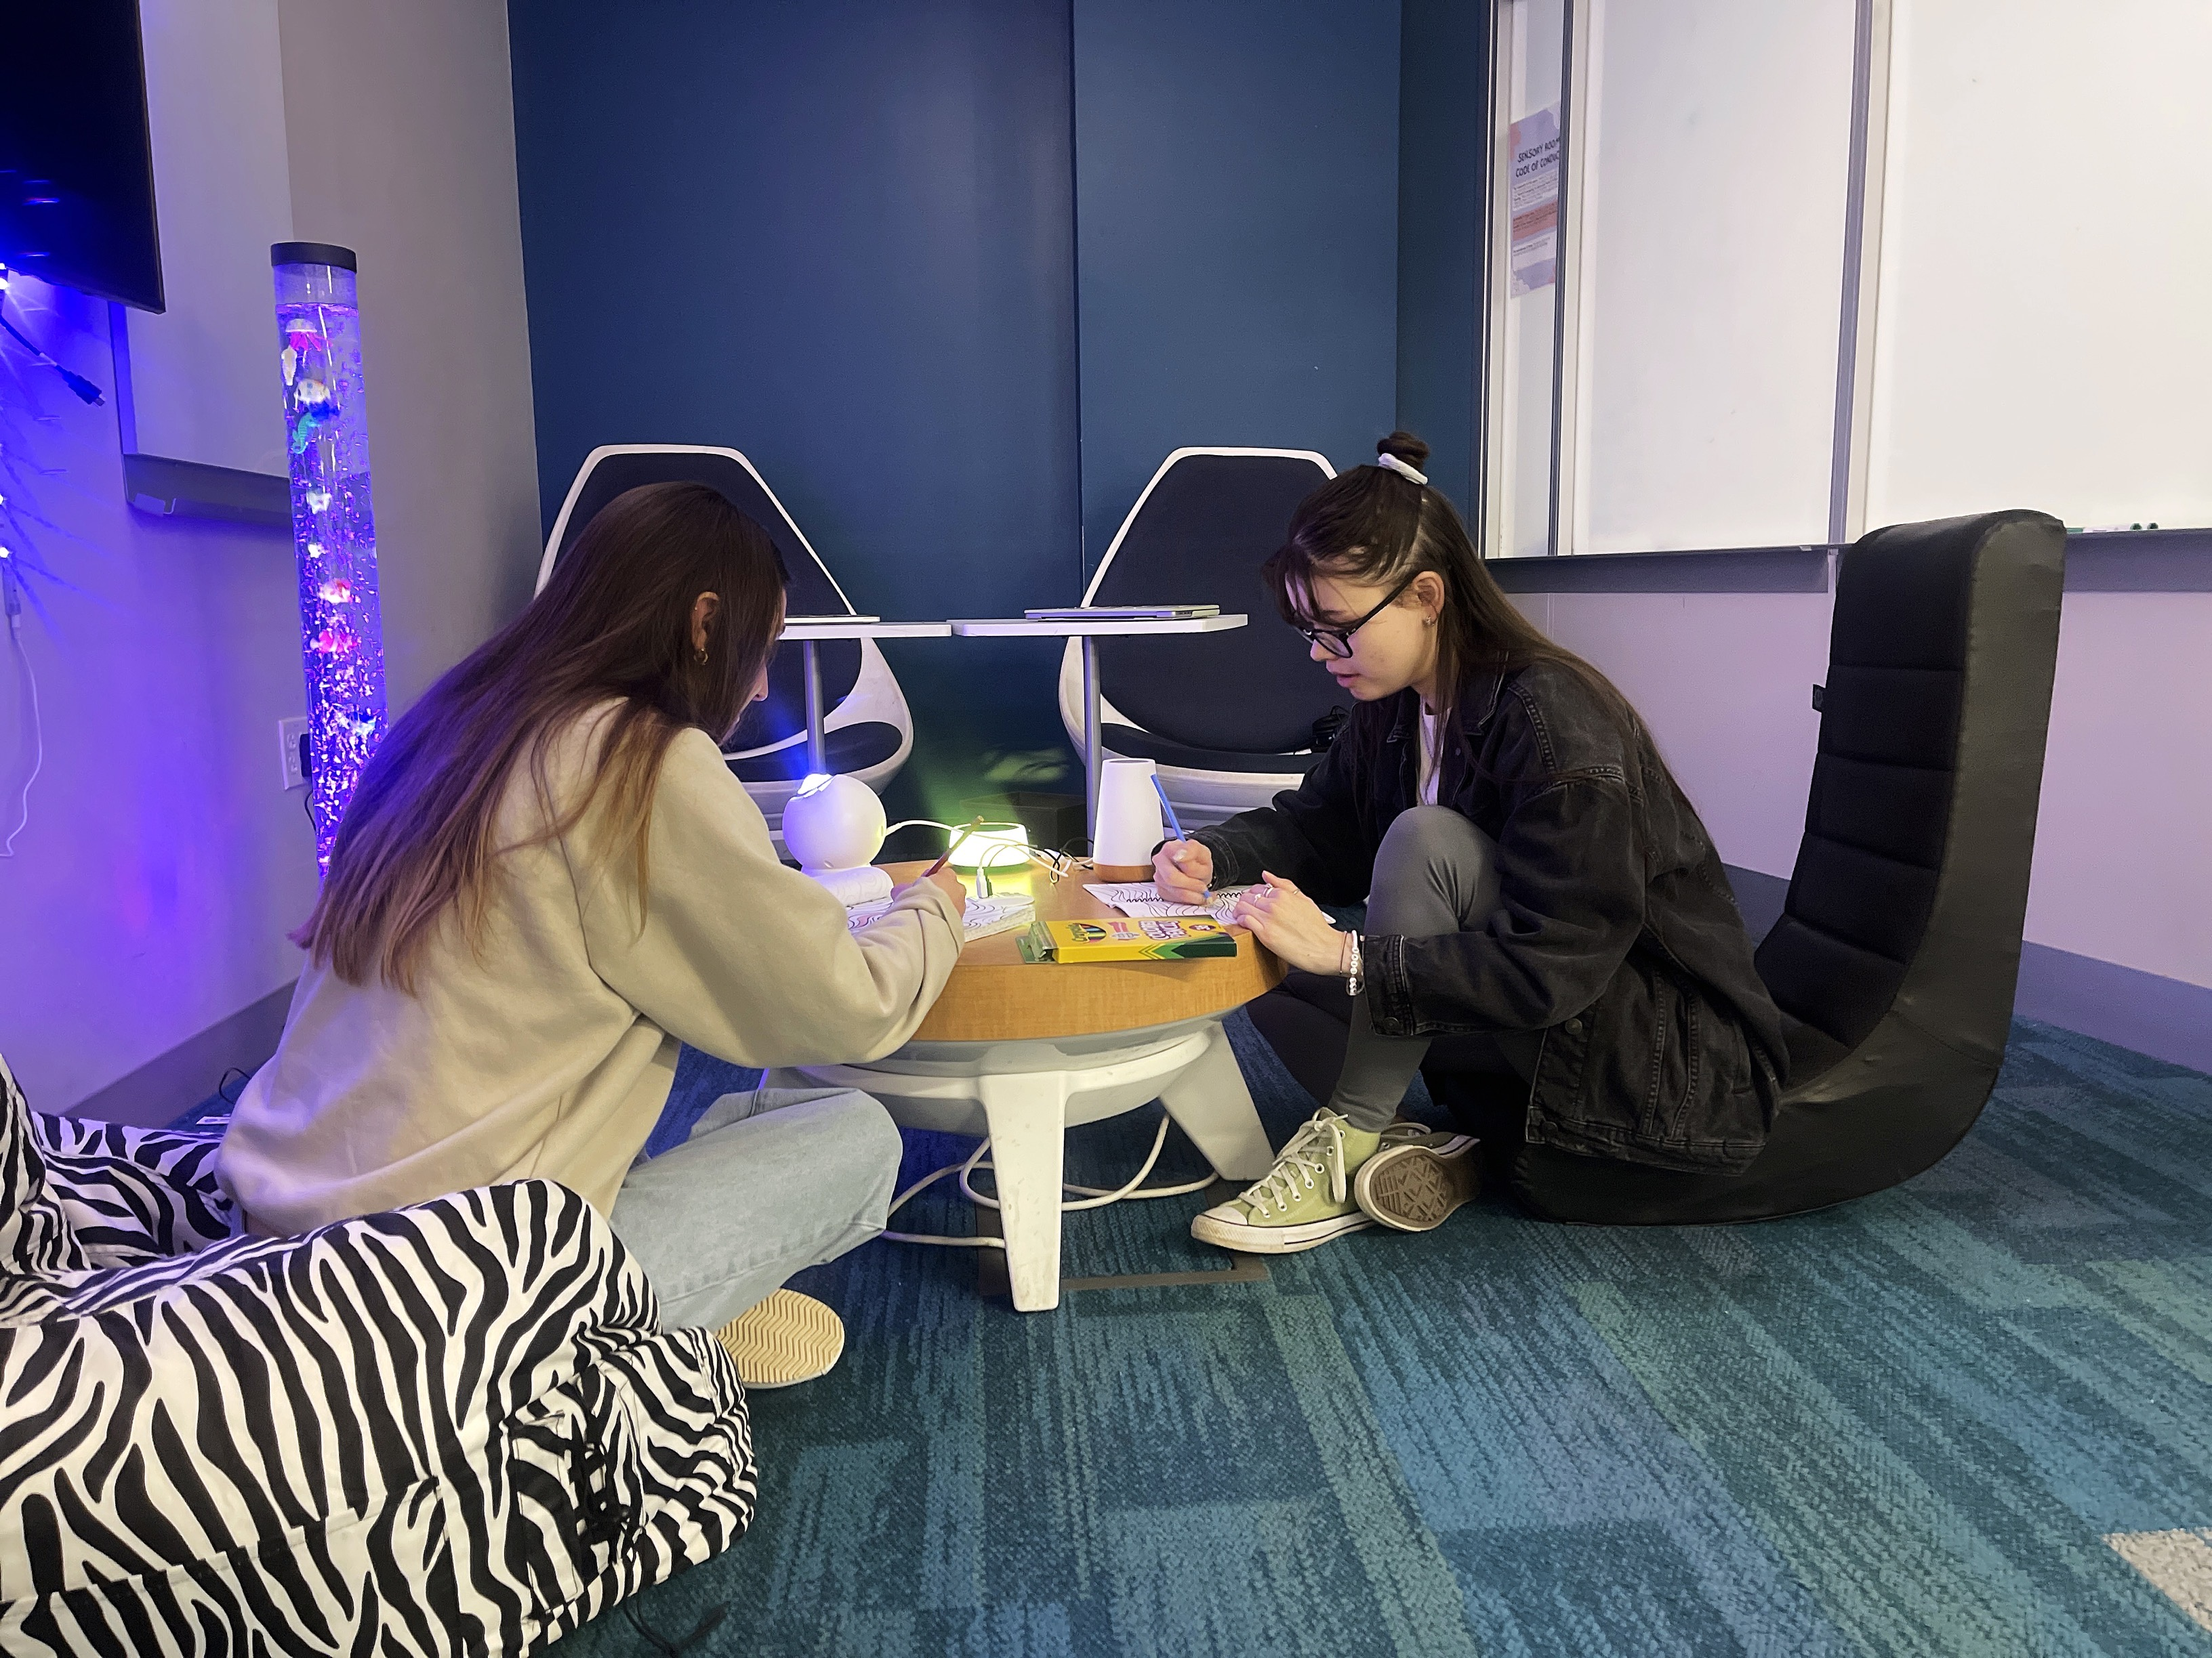

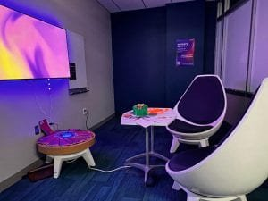
University Park

Slide 17
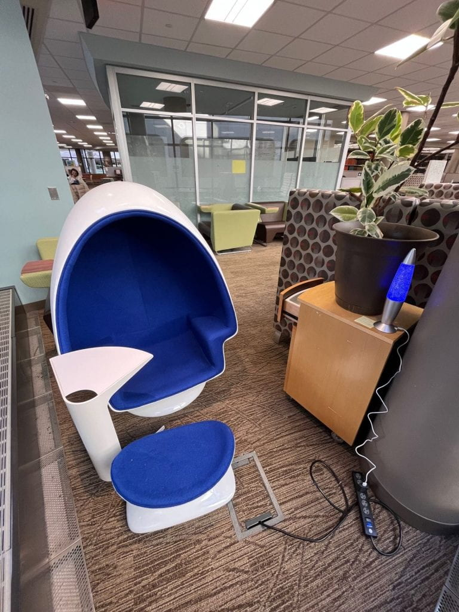
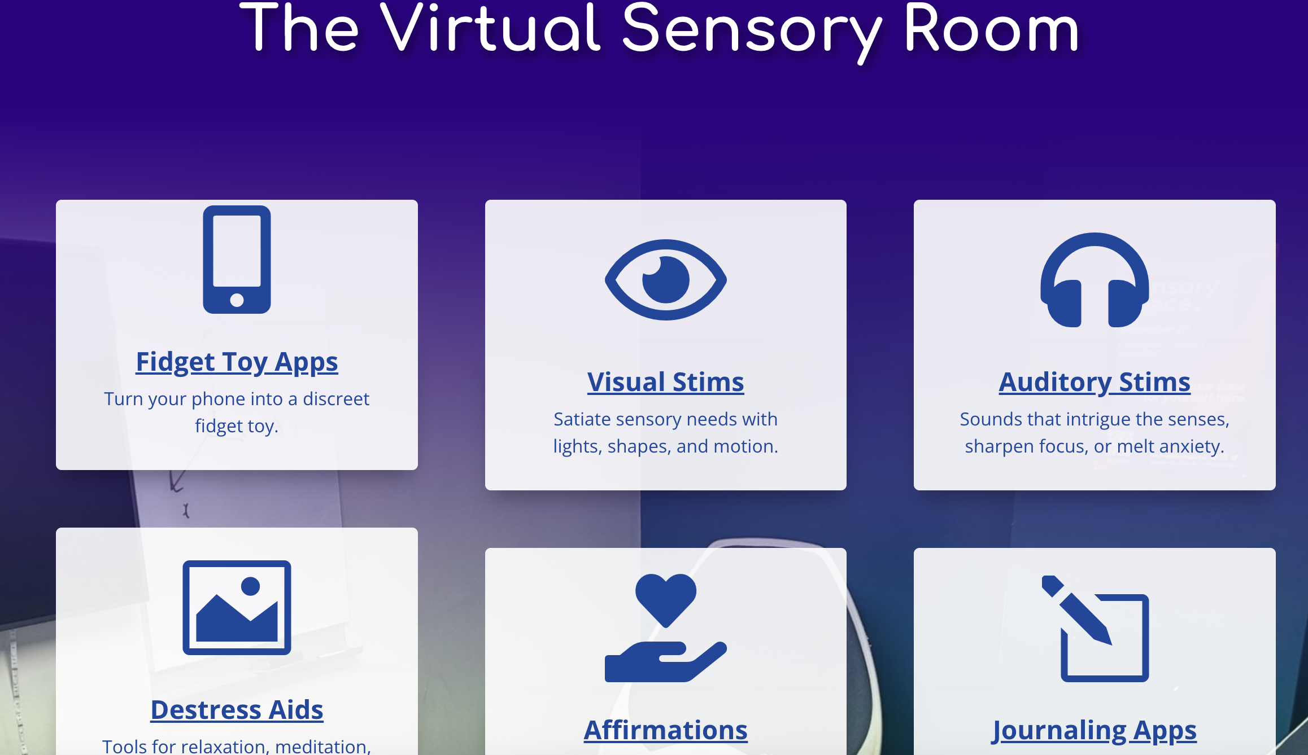
Penn State Hershey + Virtual Sensory Room

Slide 18
Tips and Best Practices

Slide 19
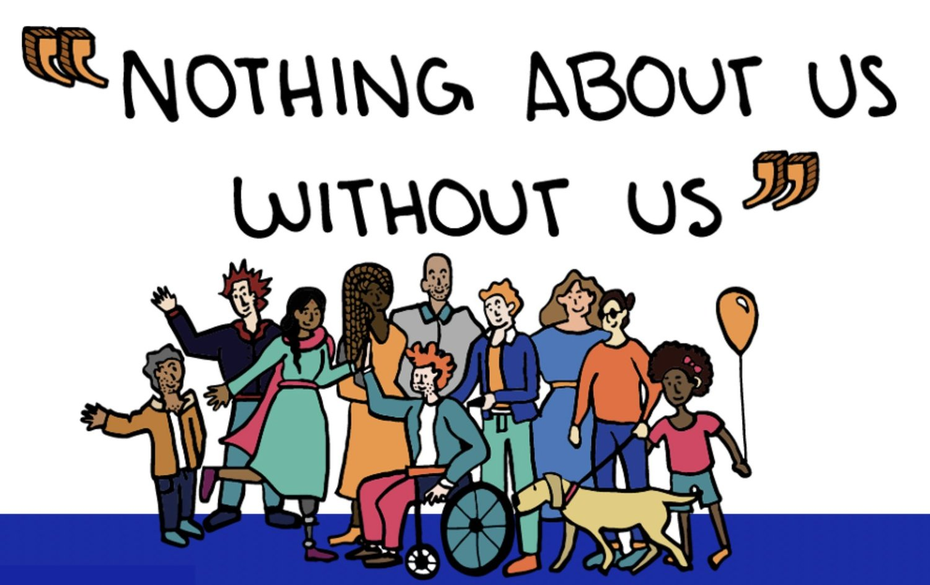
Connect with Your Community
Conduct informal polls, surveys, or interviews
Partner with Student Disability Services, student clubs, or other existing groups to help identify needs or priorities
Consider training needs for employees (both academic and professional staff) beyond ADA requirements
Messaging and education for the community to move from awareness to acceptance to belonging
Image Credit: Disability Equality in Education. (n.d.) Who we are. https://www.disabilityequalityeducation.org/who-we-are

Slide 20
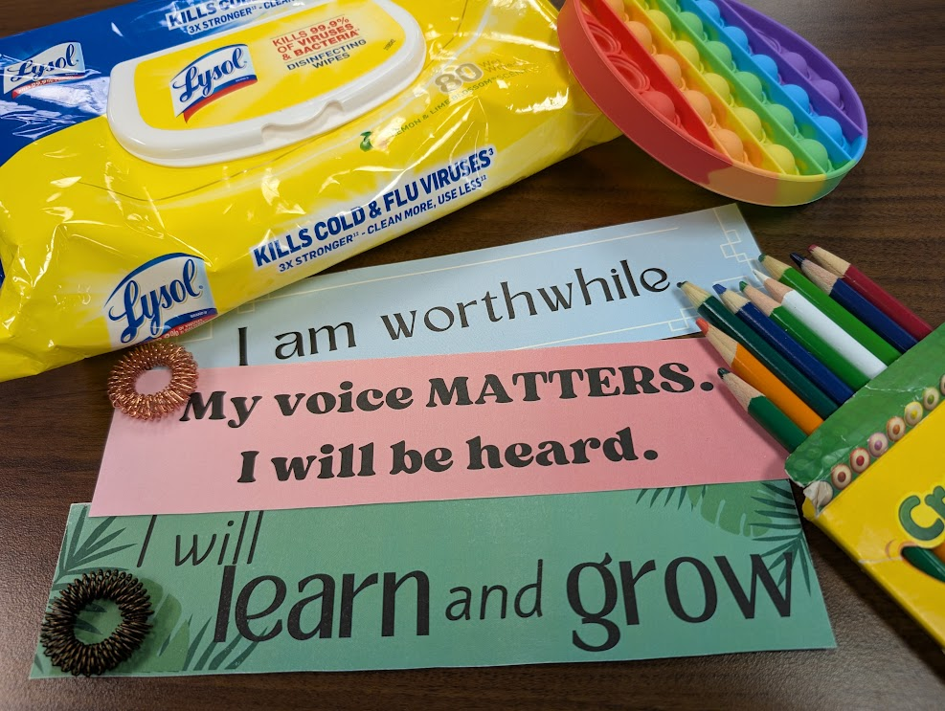
Maintenance and Management
Policies
    Signage and Communication
    To reserve or not to reserve
    Group Management
Sanitation
    Both furniture and tools as well as individuals coming into the space
Organization
    Nothing will stay put if it isn't glued/bolted to the surface
    Regular reset process depending on the community and type of space
Replacement
    Use, damage, and theft

Slide 21
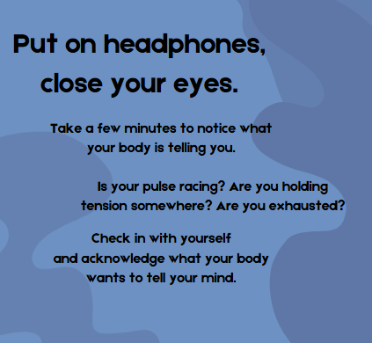
Assessment and Improvements
Anecdotal Data
  What do you observe
    Noting a person is using something
    Items that move or get worn down
  Chalk/whiteboard or virtual feedback submission
    Public feedback has advantages and drawbacks
    Virtual feedback should be quick/immediate
Formal Assessment
  Counts by Days/Hours
  Surveys, Focus Groups, Interviews, or combination of methods that may include demographics
Bringing it to the next level
  After starting on a budget end might want to upgrade
  Adding in Sensory Friendly Programming

Slide 22
References
Fleming, L. L., Harnett, N. G., & Ressler, K. J. (2024). Sensory alterations in post-traumatic stress disorder. Current opinion in neurobiology, 84, 102821. https://doi.org/10.1016/j.conb.2023.102821
Kapp, S. K., Steward, R., Crane, L., Elliott, D., Elphick, C., Pellicano, E., & Russell, G. (2019). ‘People should be allowed to do what they like’: Autistic adults’ views and experiences of stimming. Autism, 23(7), 1782-1792. https://doi.org/10.1177/1362361319829628
Keptner, K. M., Fitzgibbon, C., & O’Sullivan, J. (2021). Effectiveness of anxiety reduction interventions on test anxiety: A comparison of four techniques incorporating sensory modulation. British Journal of Occupational Therapy, 84(5), 289-297.
Lin, L. Y., & Huang, P. C. (2019). Quality of life and its related factors for adults with autism spectrum disorder. Disability and Rehabilitation, 41(8), 896-903. https://doi.org/10.1080/09638288.2017.1414887
Mark, V. W. (2024, July 21). Executive dysfunction. MedLinkNeuorology. https://www.medlink.com/articles/executive-dysfunction
Nuske, A., Rillotta, F., Bellon, M., & Richdale, A. (2019). Transition to higher education for students with autism: A systematic literature review. Journal of Diversity in Higher Education, 12(3), 280–295. https://doi.org/10.1037/dhe0000108
Sarrett, J.C. Autism and Accommodations in Higher Education: Insights from the Autism Community. J Autism Dev Disord 48, 679–693 (2018). https://doi.org/10.1007/s10803-017-3353-4
Seeberger, C. (2020). A sensory-friendly library: Creating inclusive spaces for all. https://www.sensoryfriendly.net/welcoming-neurodiversity-at-a-public-library/
Spielmann, V. (2021, Dec. 20). Your sensory health matters. Here's why [Video]. TEDxMileHigh. https://www.youtube.com/watch?v=kkuFYKb1Acw&t=2s

Slide 23
Questions?
Brett Spencer, Instruction & Reference Librarian, Penn State Berks, dbs21@psu.edu
Dawn Amsberry, Instruction & Reference Librarian, Penn State University Park, dua4@psu.edu
Emily Rimland, Head, Library Learning Services, emily@psu.edu
Teresa Slobuski, Head Librarian, Penn State Brandywine, slobuski@psu.edu
PSU Sensory Friendly Libraries site
PSU Virtual Sensory Room

