Slide 1
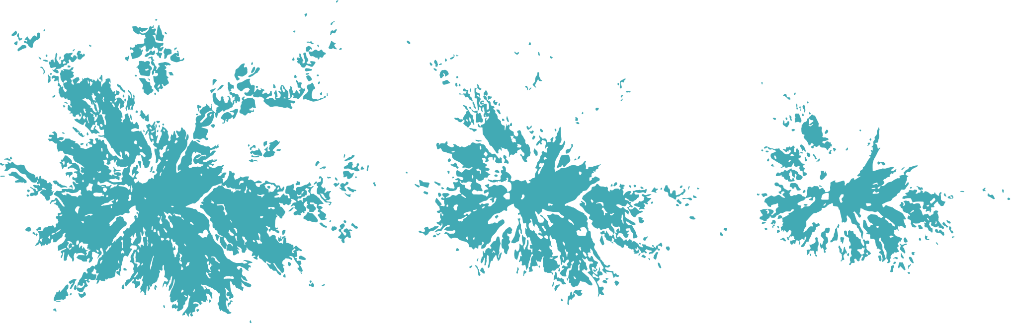
Snow Coverage on Mount Rainier (Tahoma | təqʷubəʔ)
COMPARING 2001 & 2021
BY JESSIE WOLDSTAD
Undergraduate Senior
Geography Data Science

Slide 2
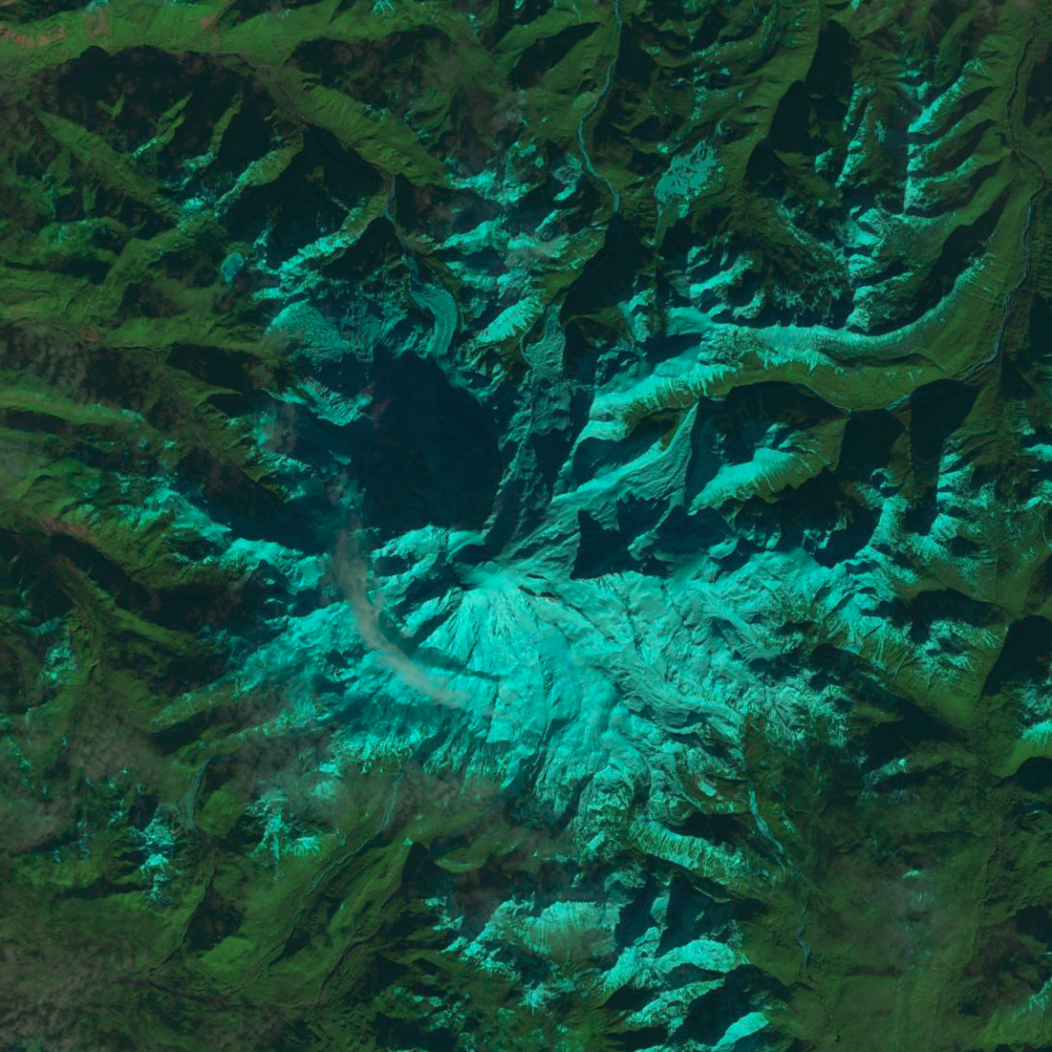
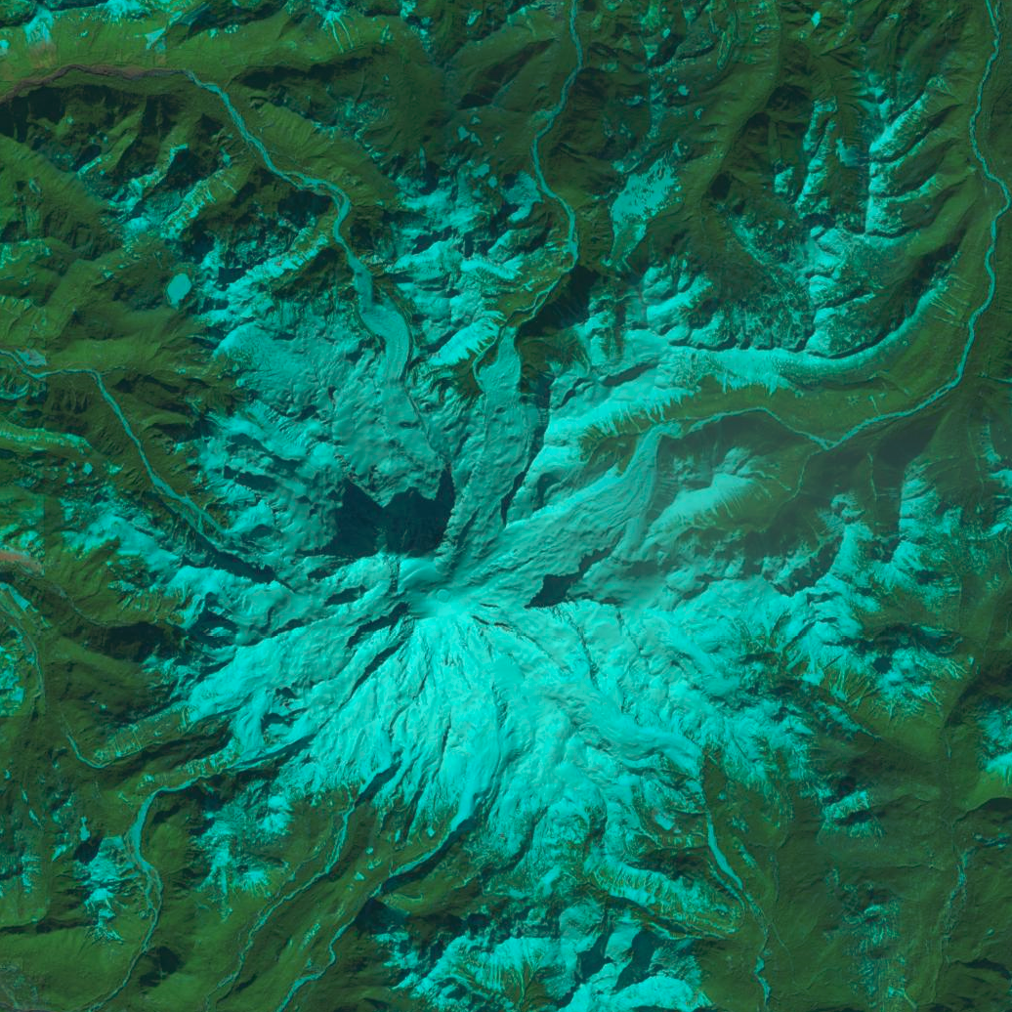
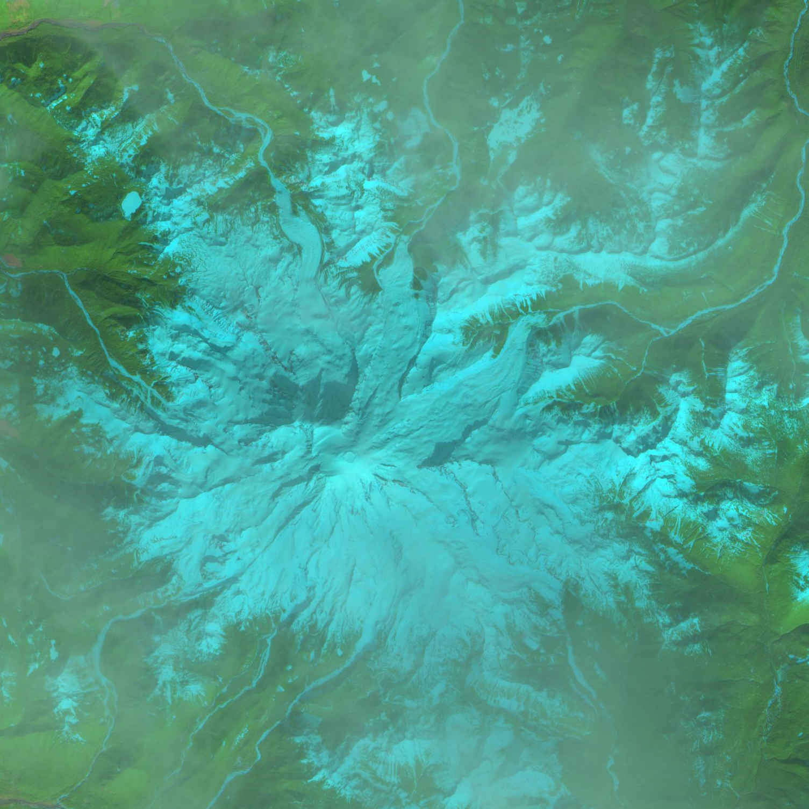
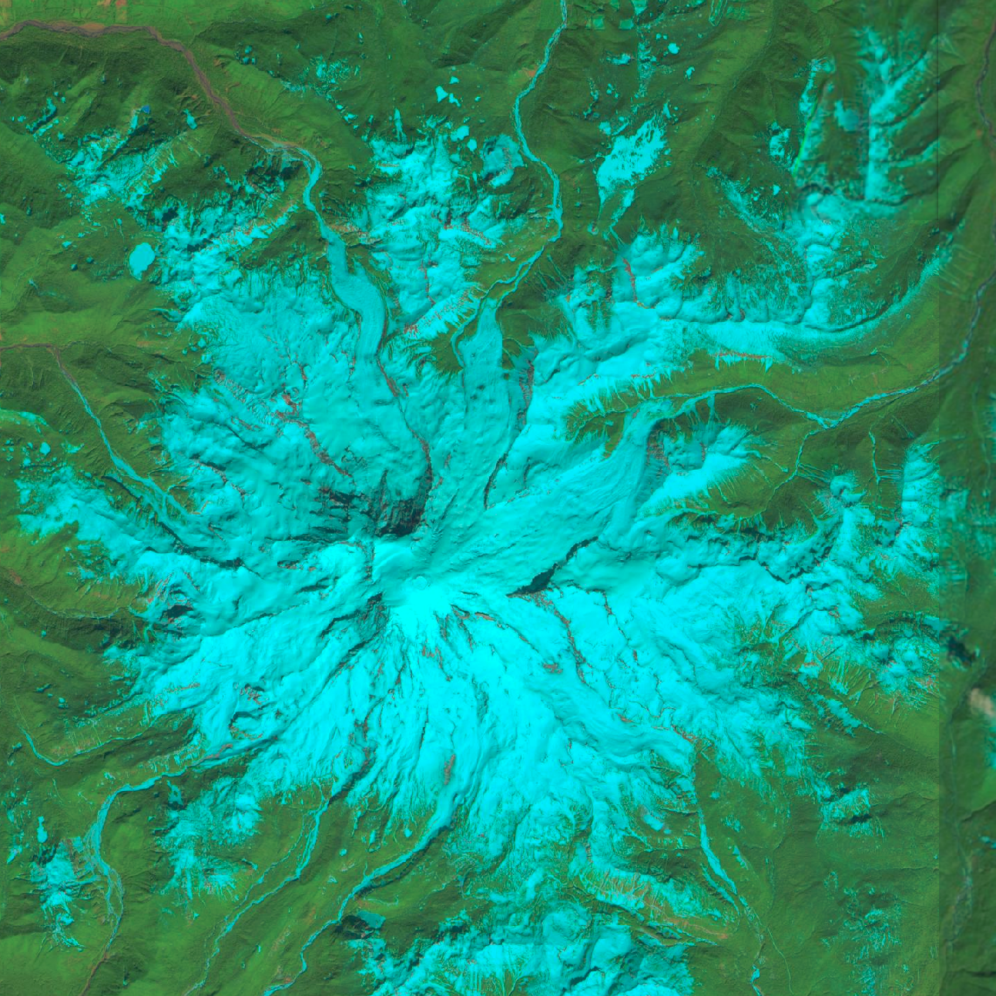
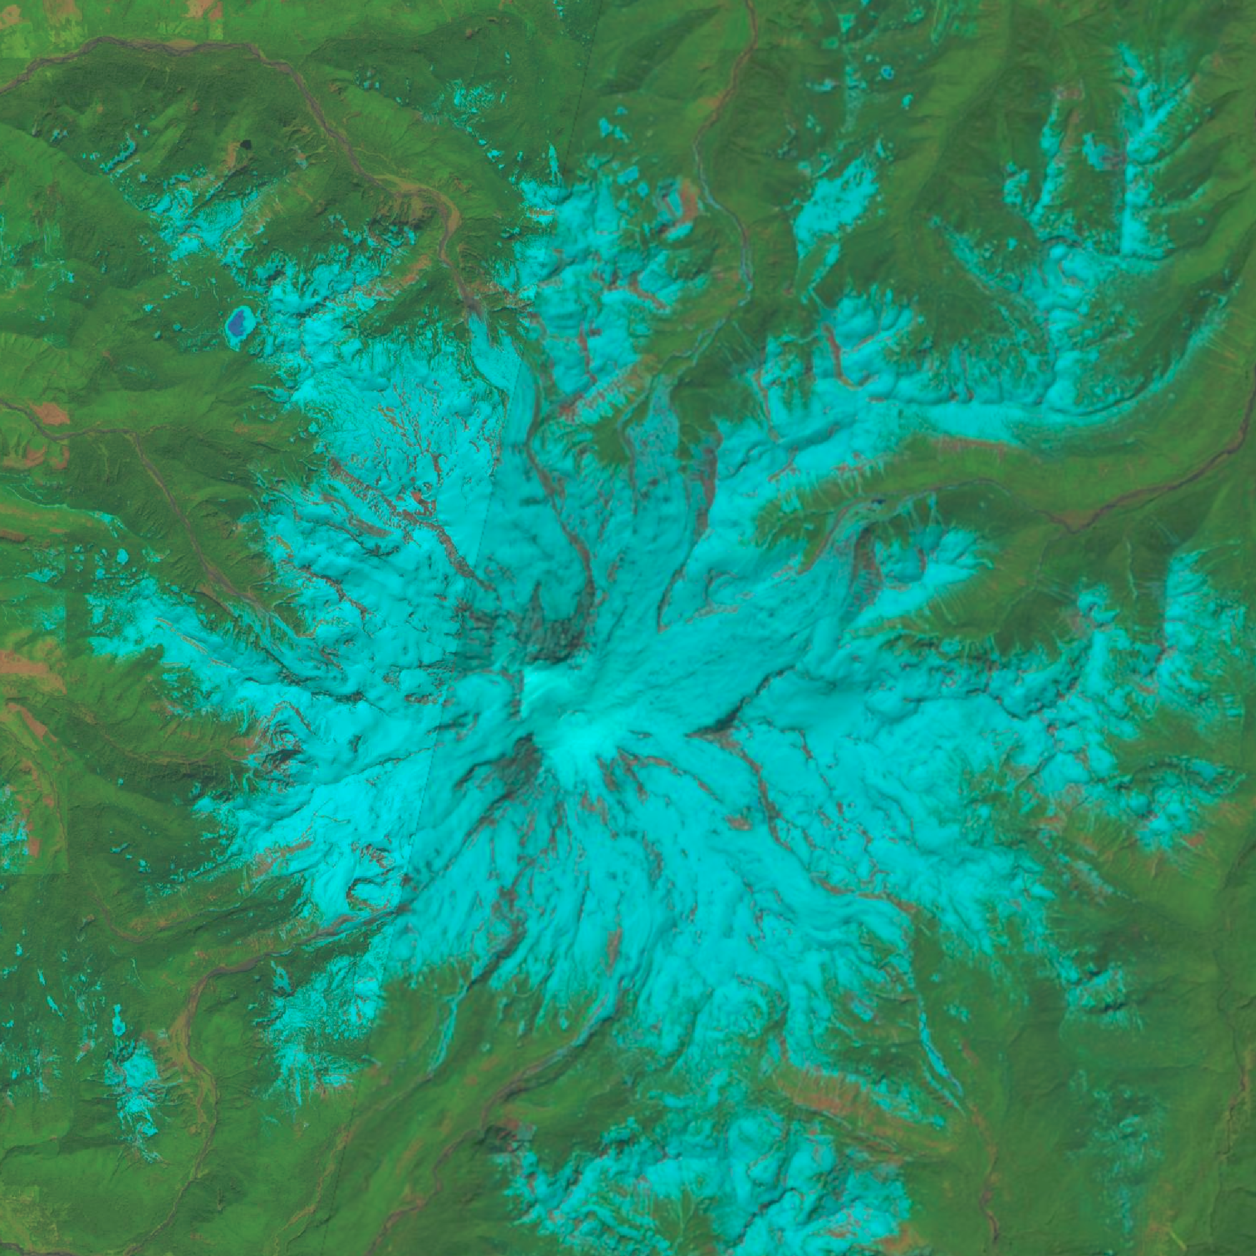
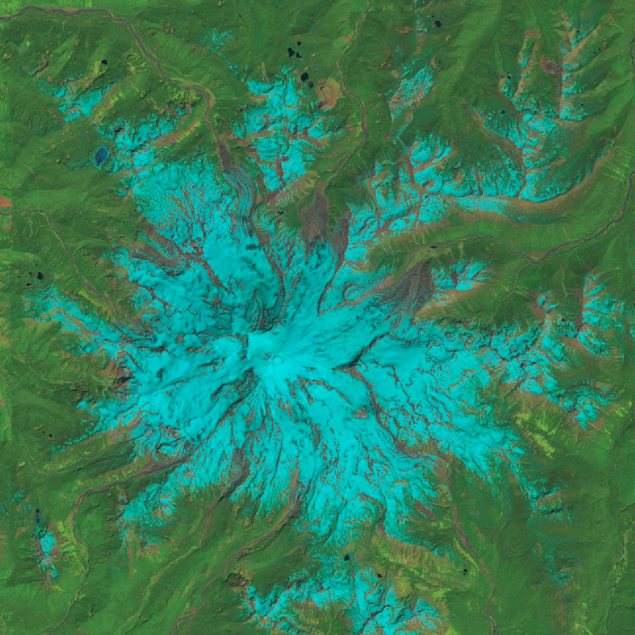
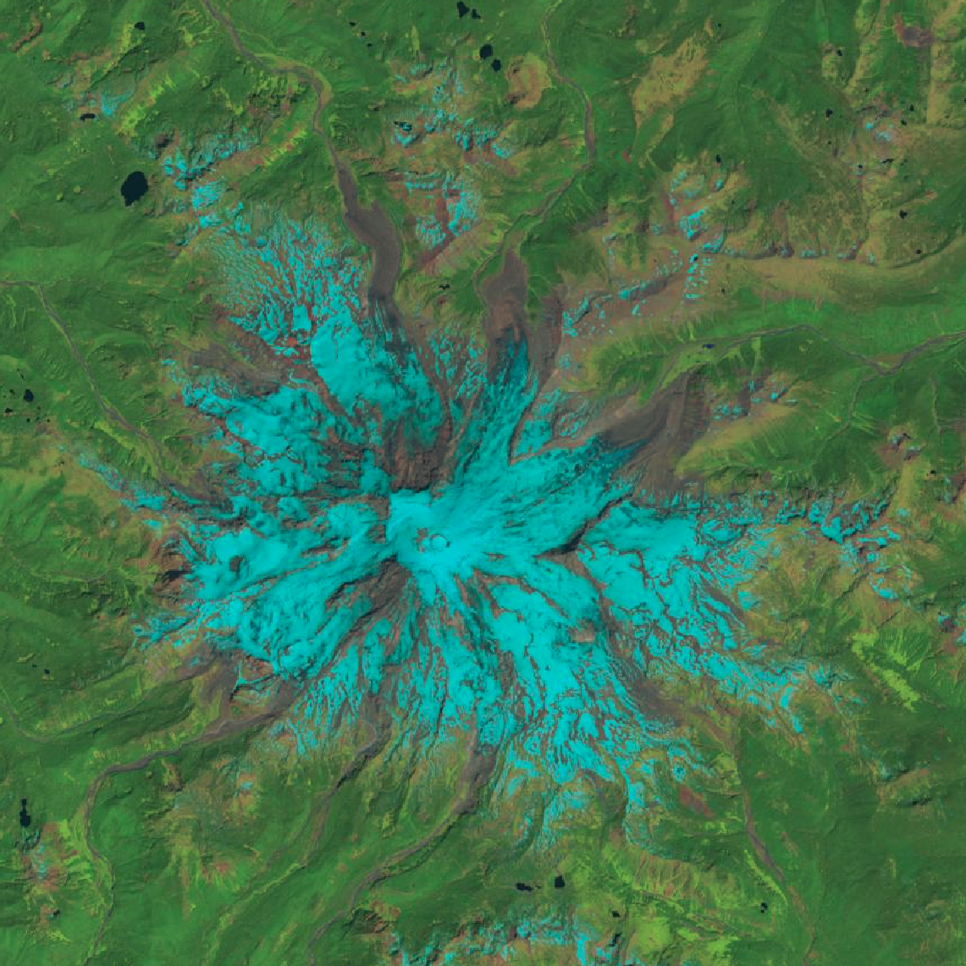
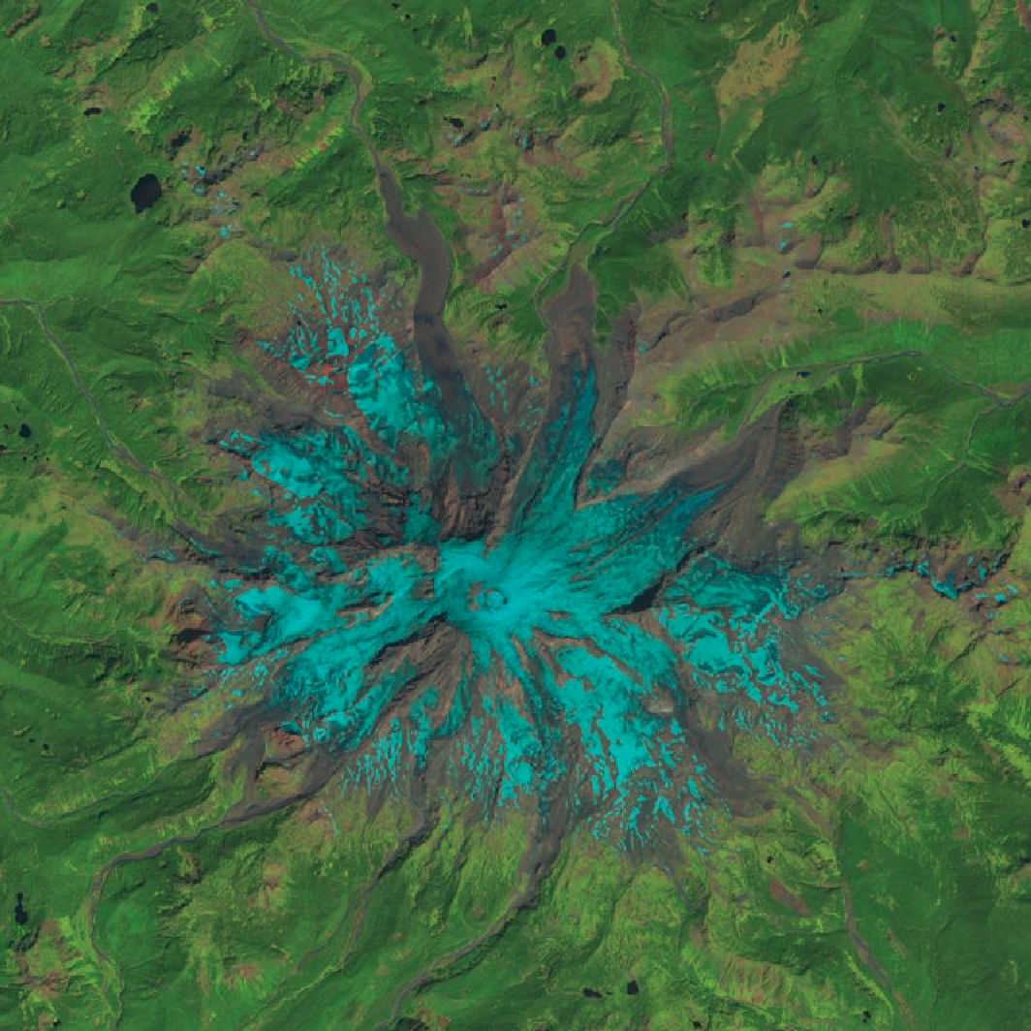
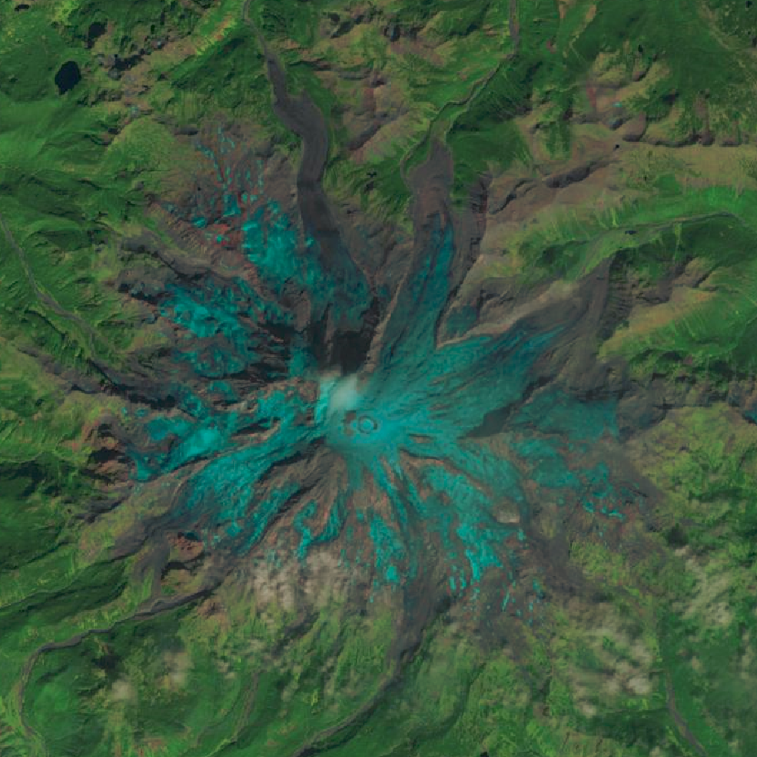
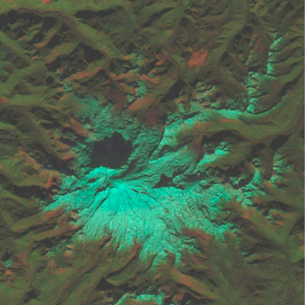
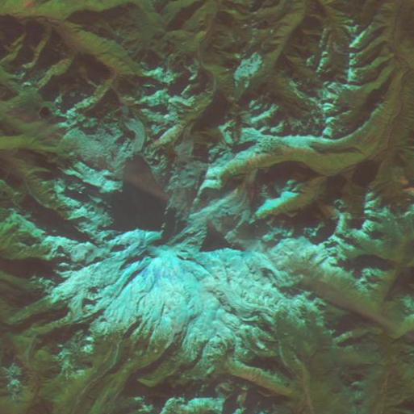
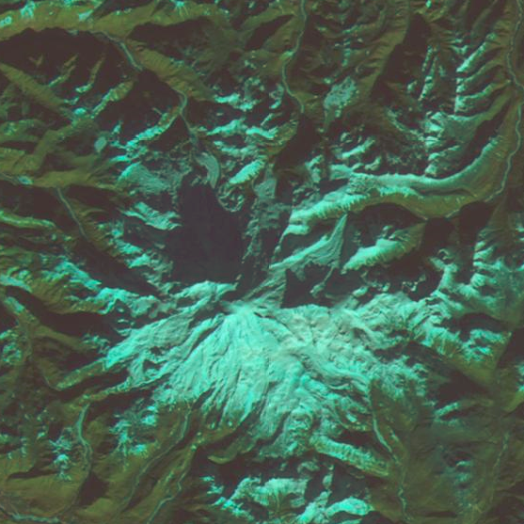
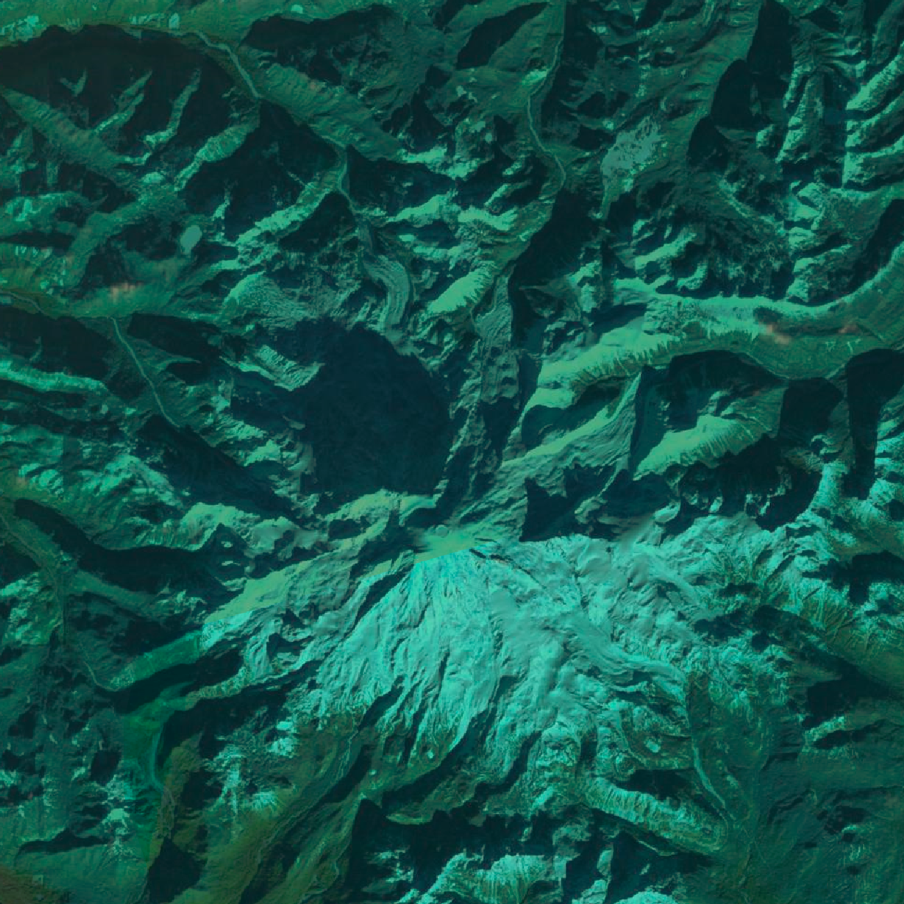
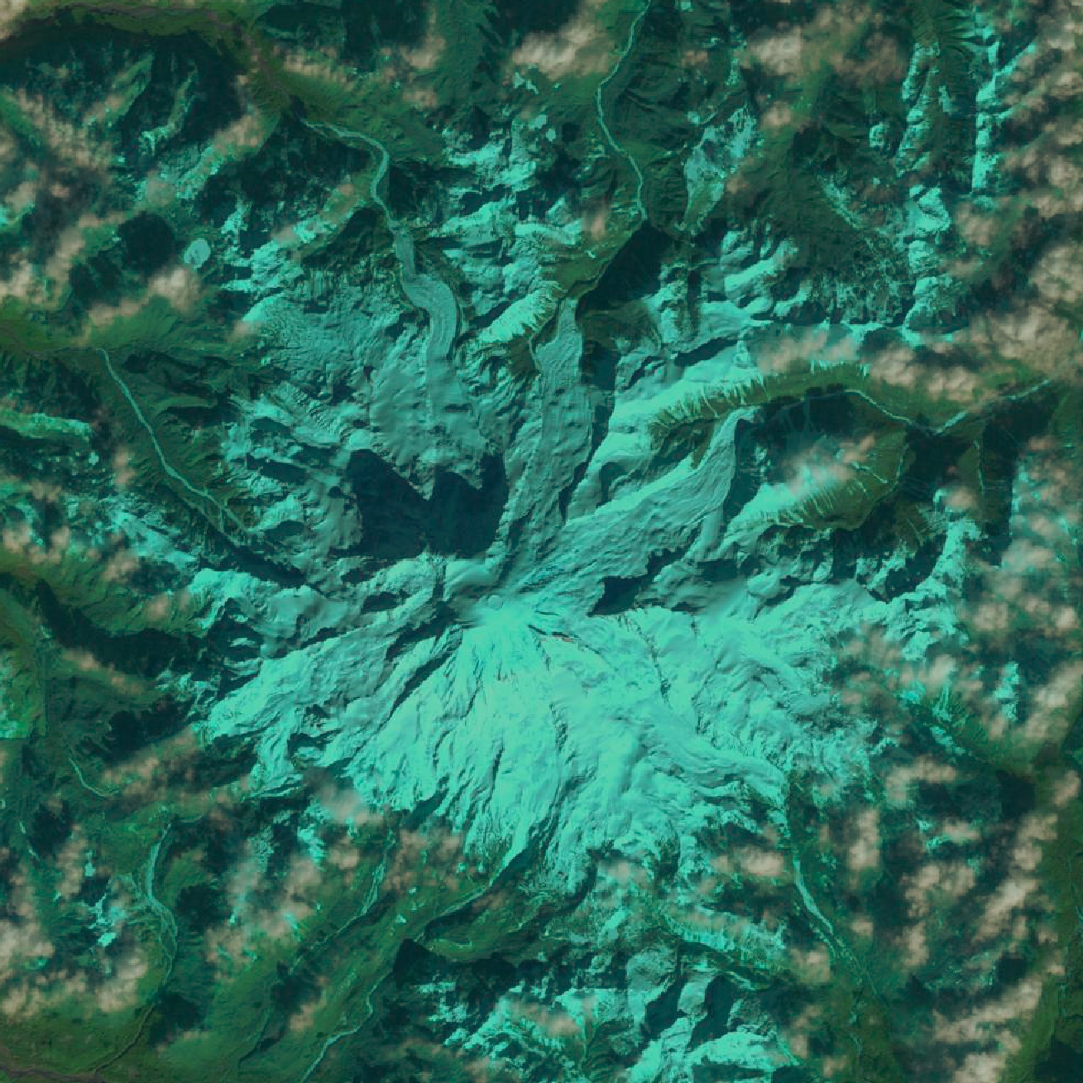
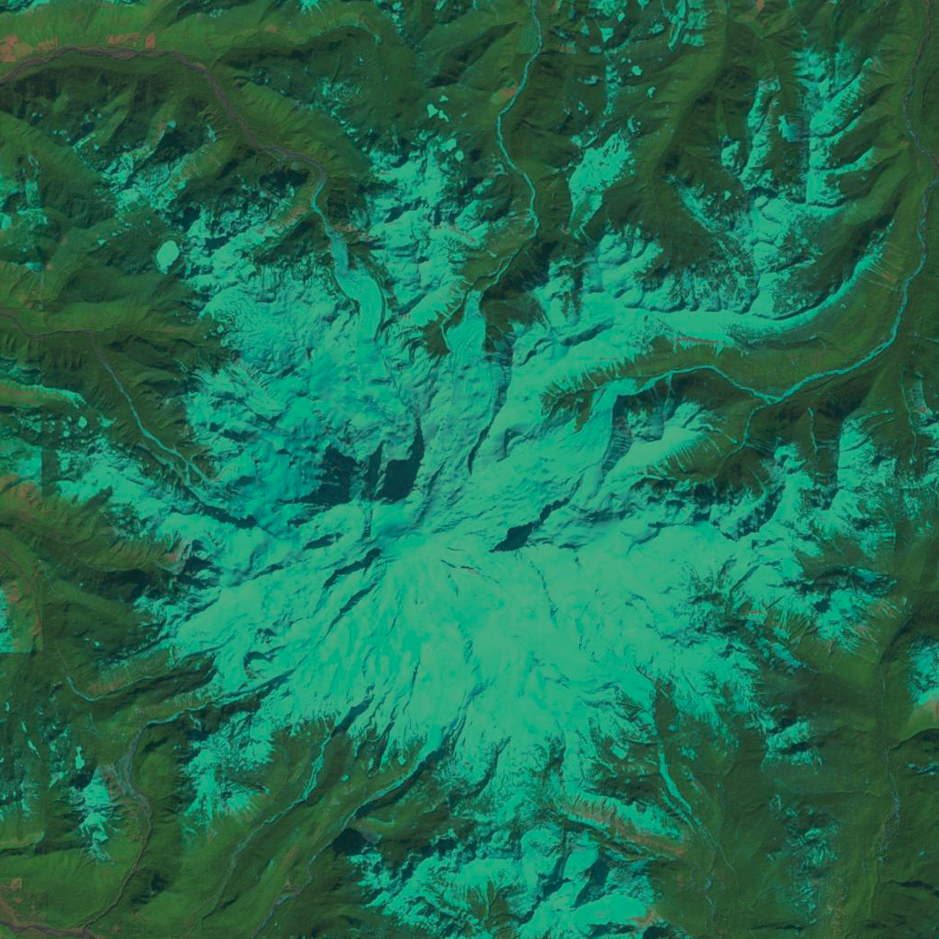
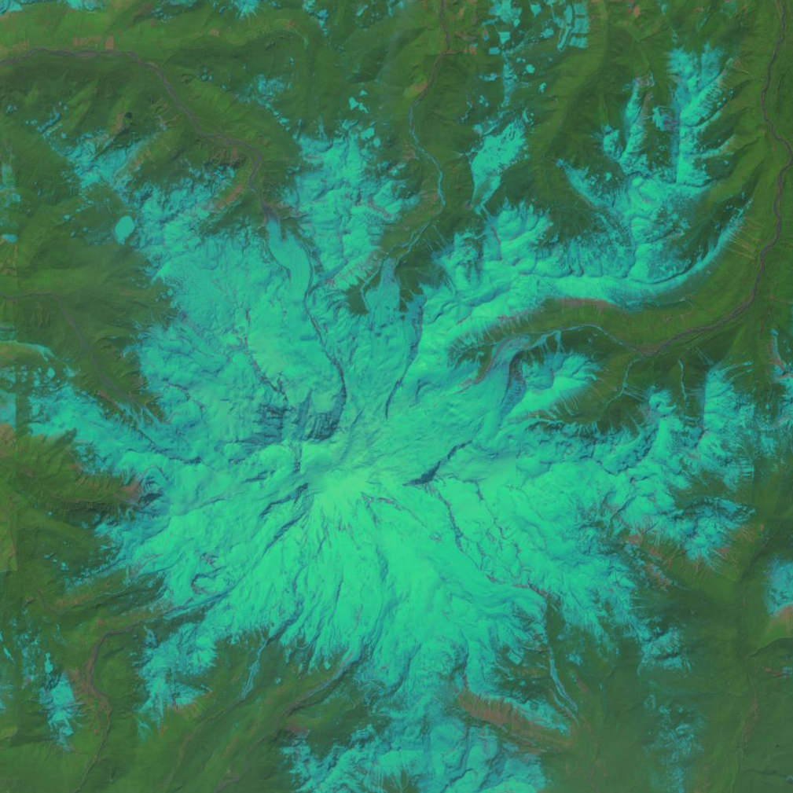
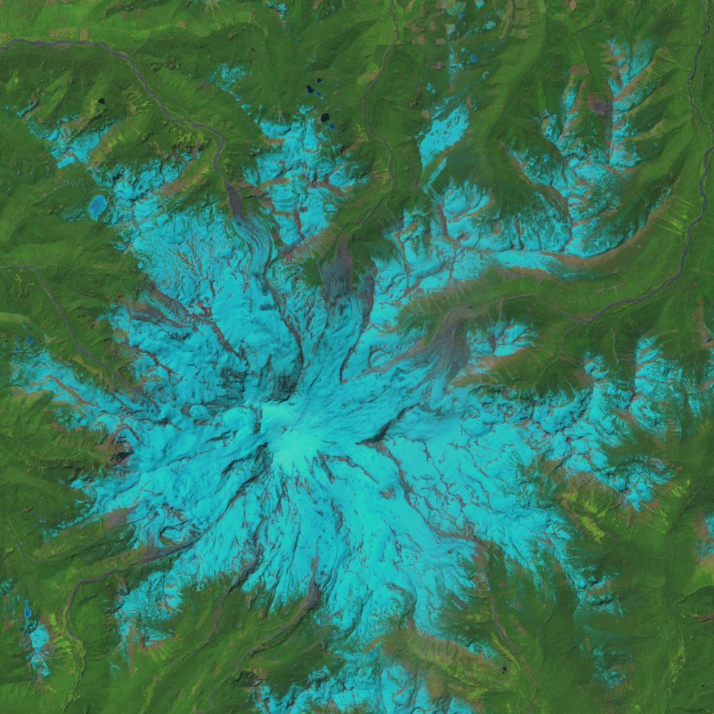
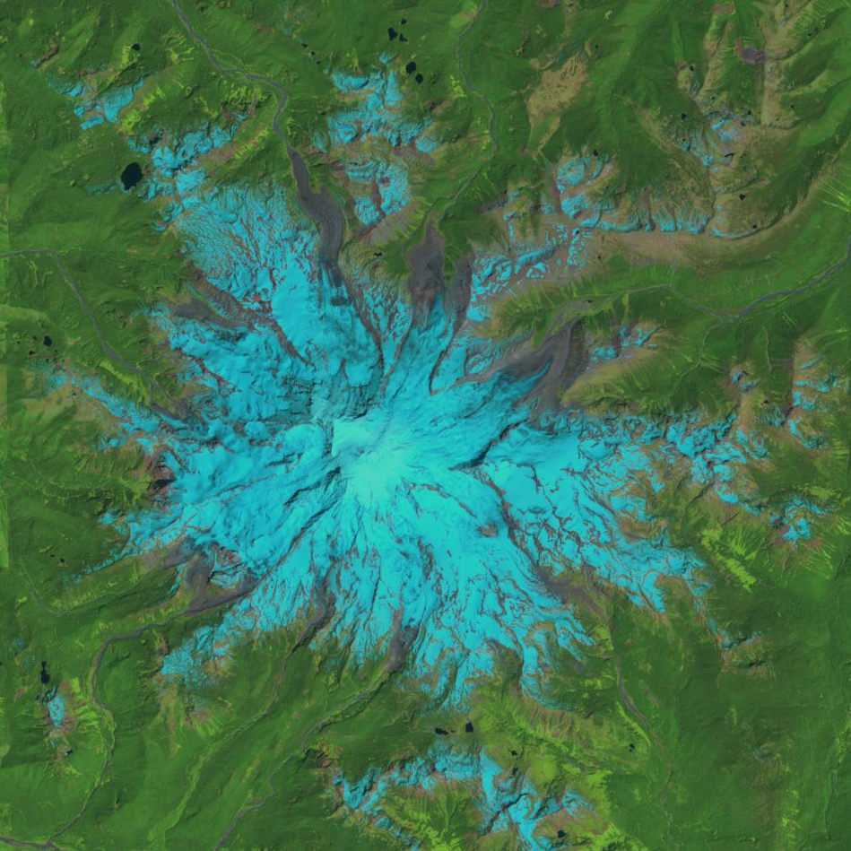
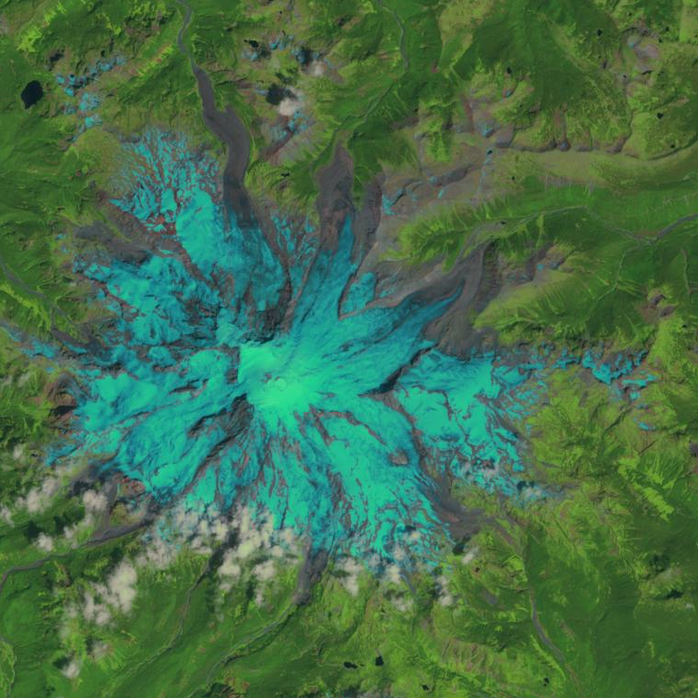
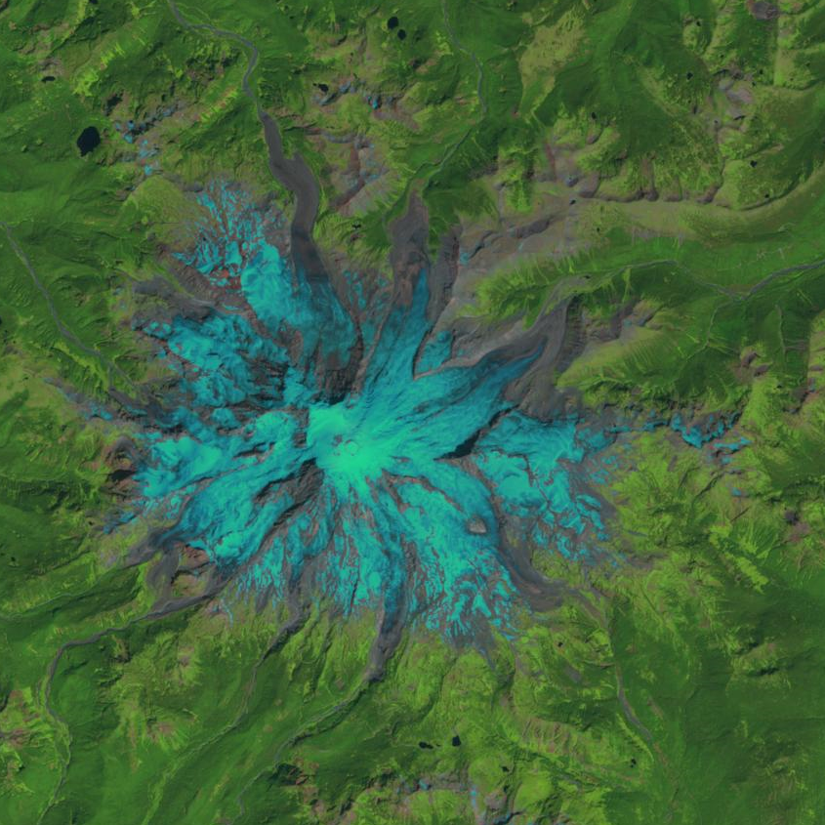
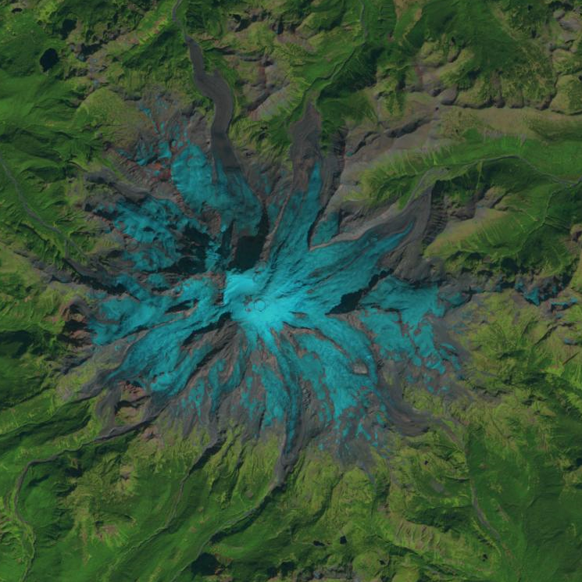
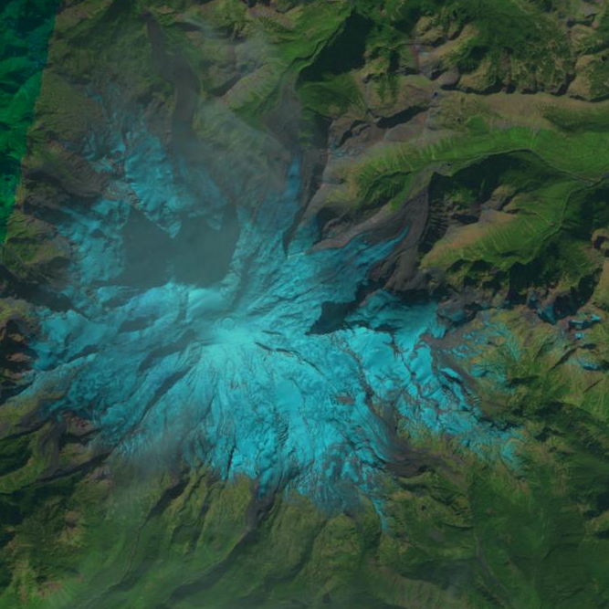
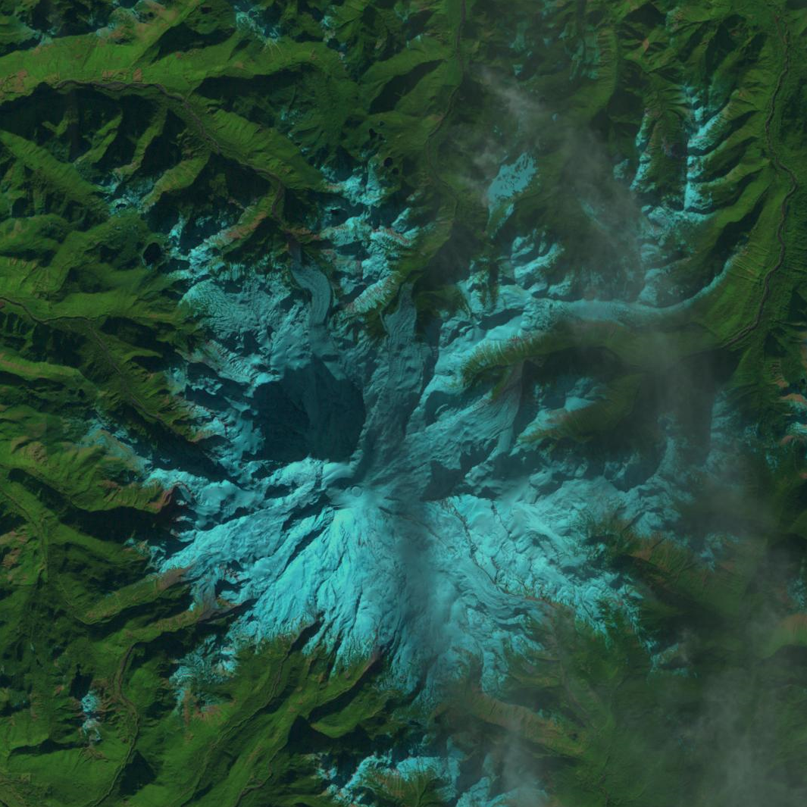
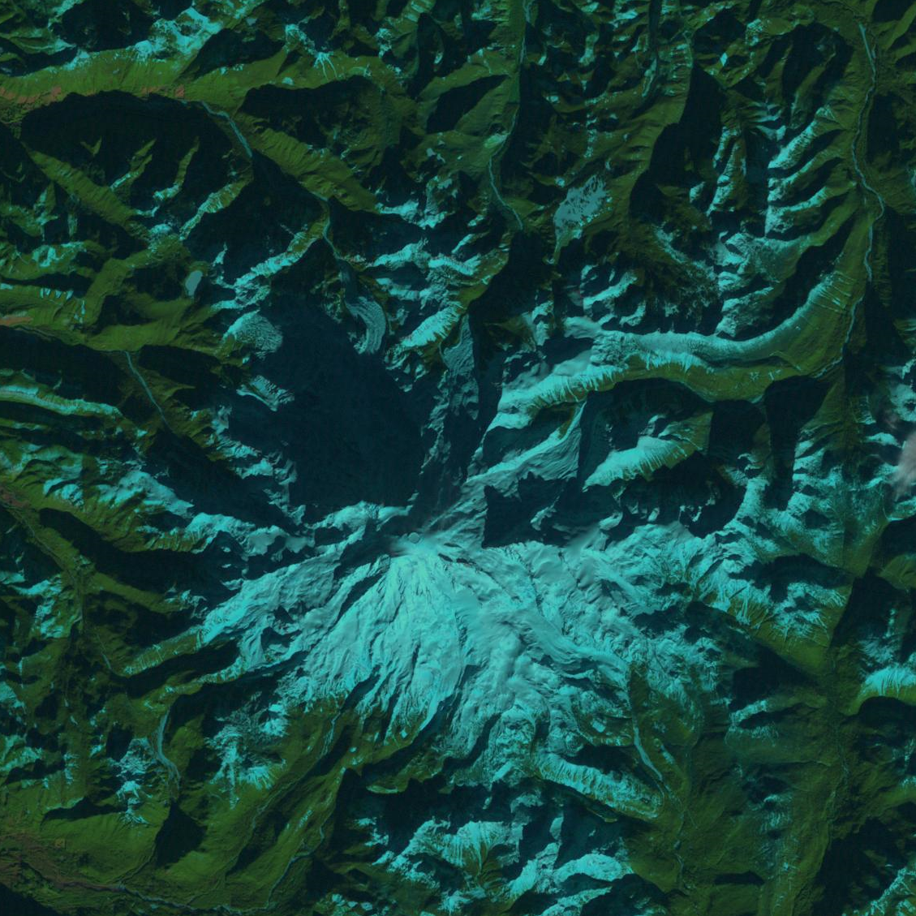
DATA SOURCE + COLLECTION
Dataset requirements:
Depicts snow coverage on Mt. Rainier
Captures temporal change
USGS GloVis:
Satellite imagery
Publicly available data
2021
2001
Satellite images were primarily collected from Landsat 7 and Landsat 8.
  30-meter spatial resolution (1 pixel = 30 sq. meters)
Downloaded in .geoTIFF format (raster image w/ geographic reference)

Slide 3
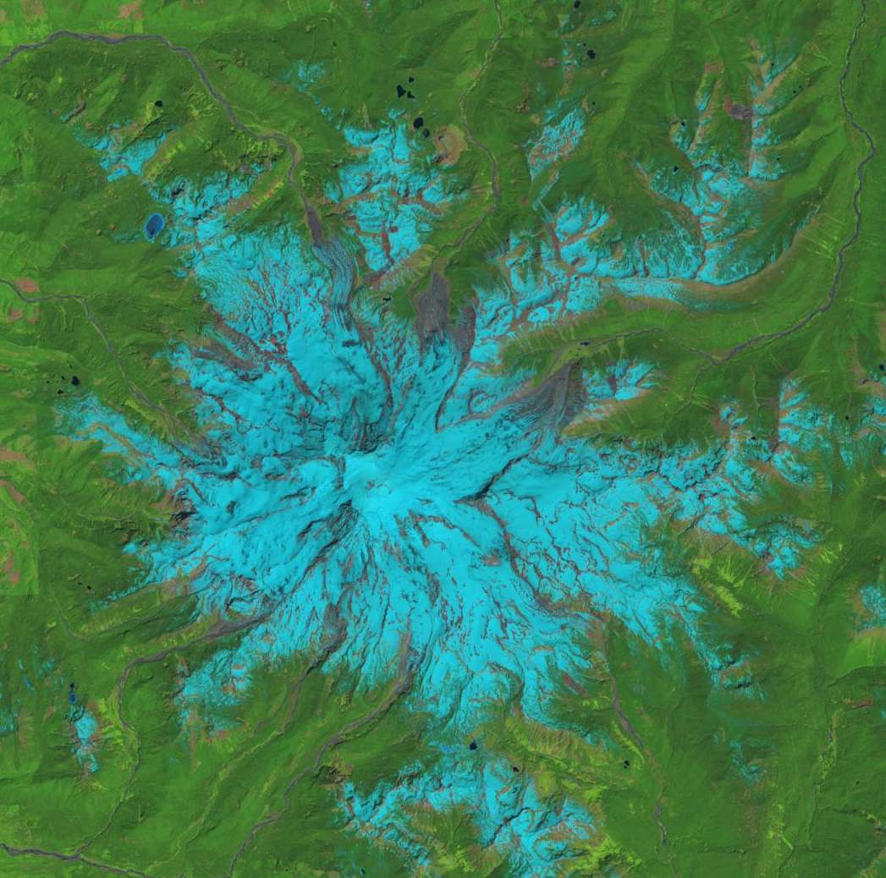
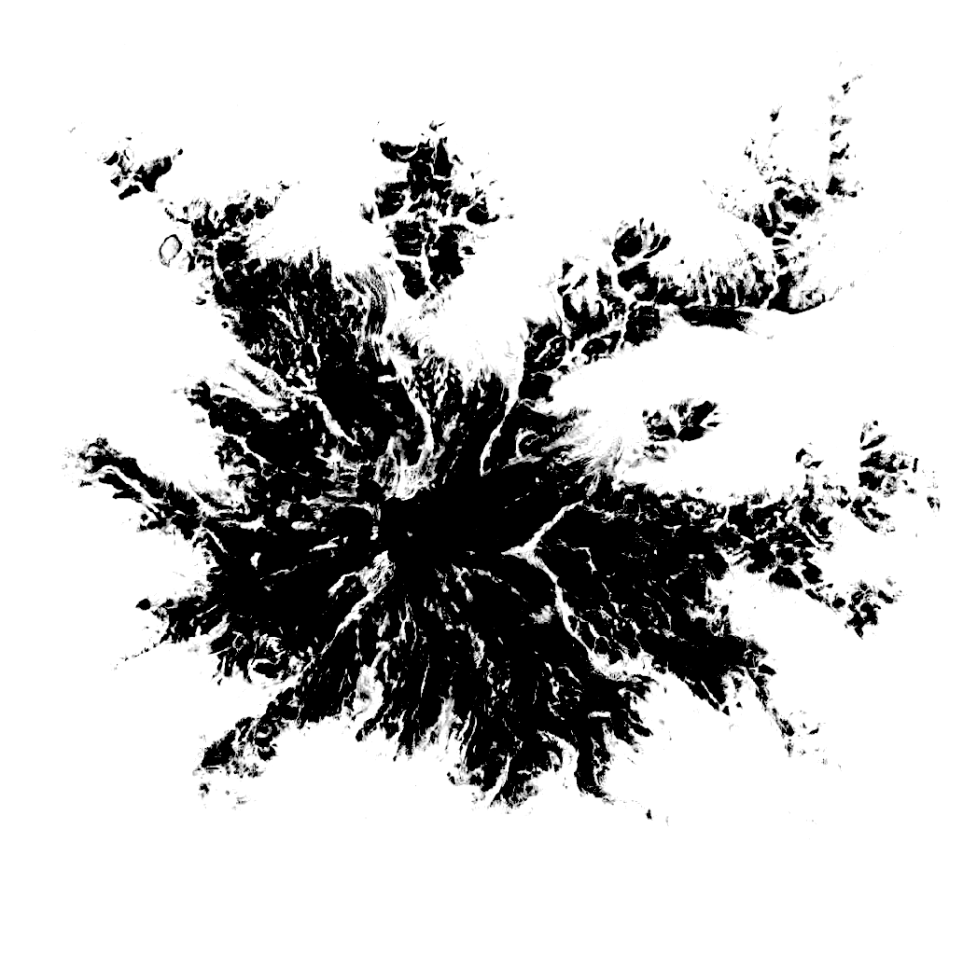
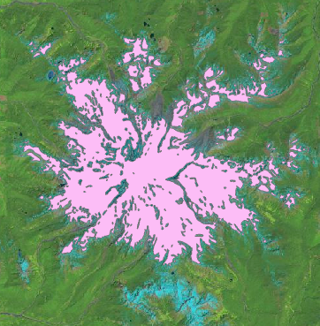
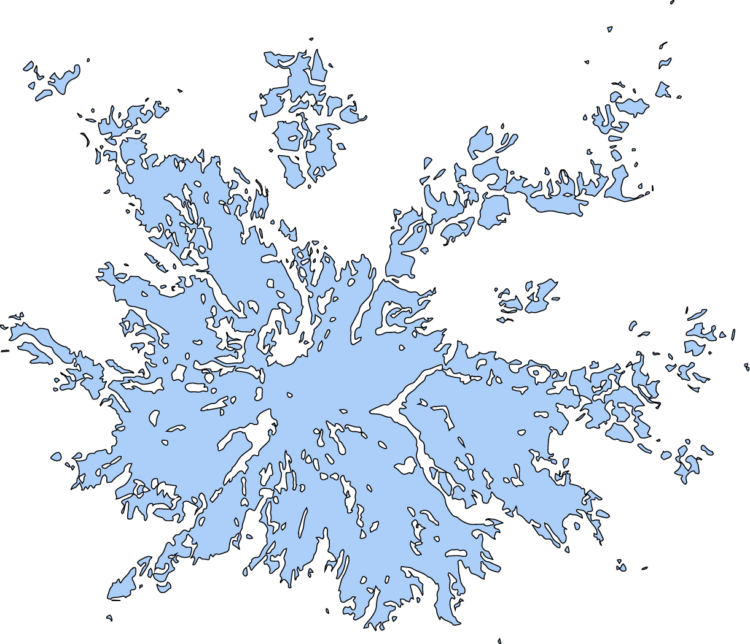
DATA PROCESSING WORKFLOW
STEP 1:..
STEP 2:..
STEP 3:..
STEP 4:..
Original satellite image
File format: .geoTIFF
Program: GIMP
File format: .png
Program: Adobe Illustrator
File format: .dxf
Program: ArcGIS Pro
File format: .shp

Slide 4
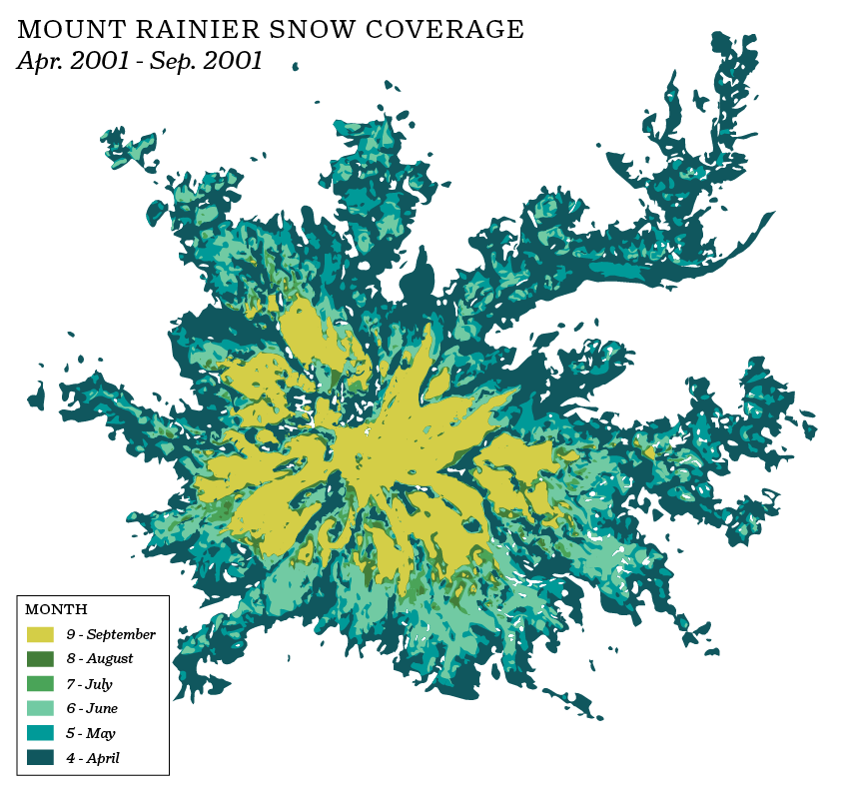
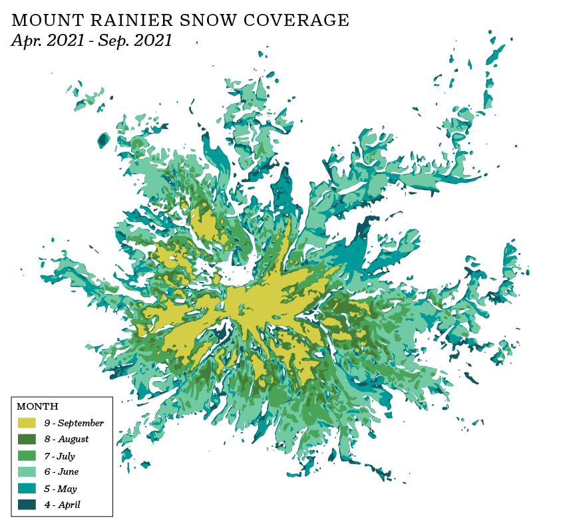
RESULTS & FINDINGS

Slide 5
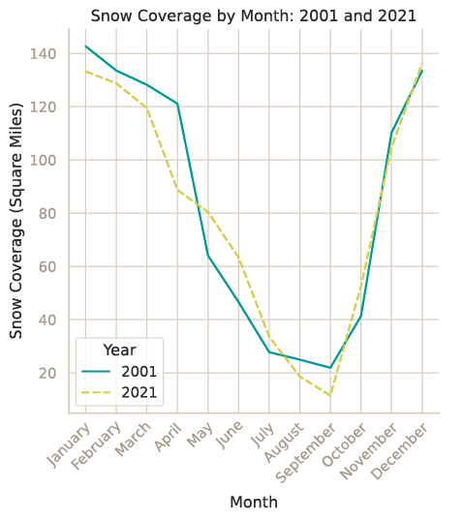
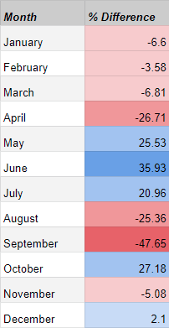
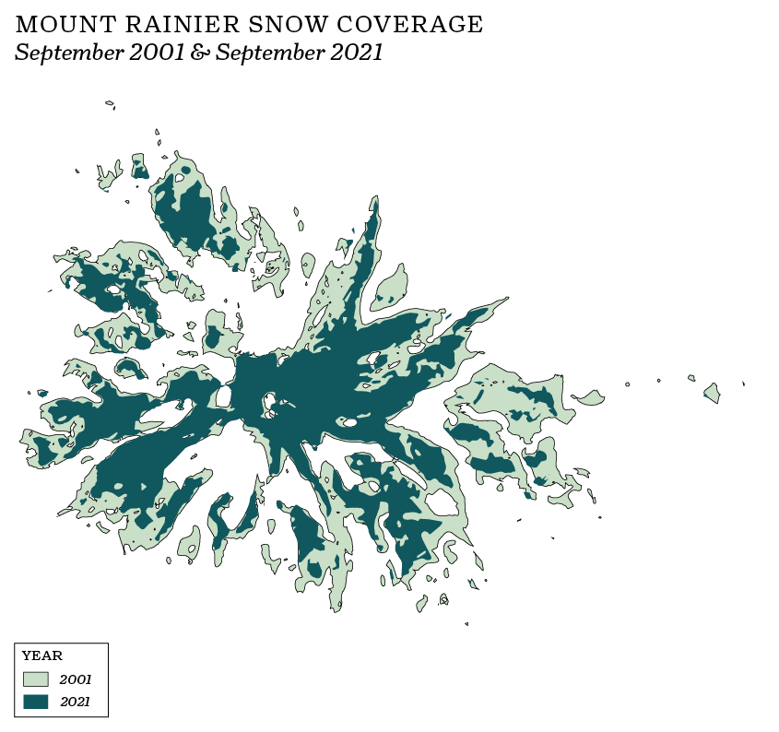
RESULTS & FINDINGS
Fig. 1
Fig. 2
Fig. 3
Fig. 1: The change in snow coverage by month (2001 and 2021).
Fig. 2: Percent difference between 2001 and 2021 snow coverage.
Fig. 3: A map comparing the extent of snow coverage in September of 2021 and 2001.

Slide 6
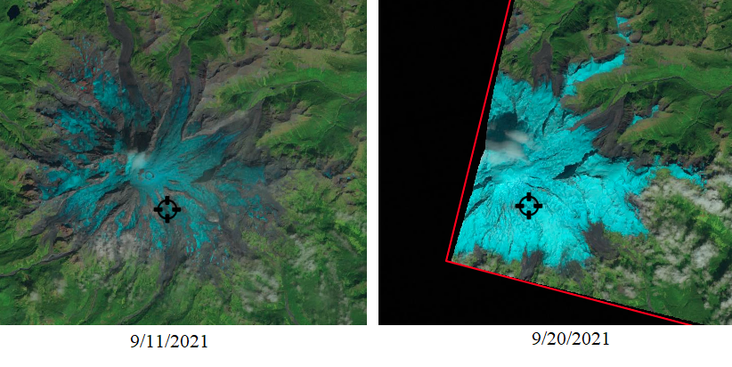
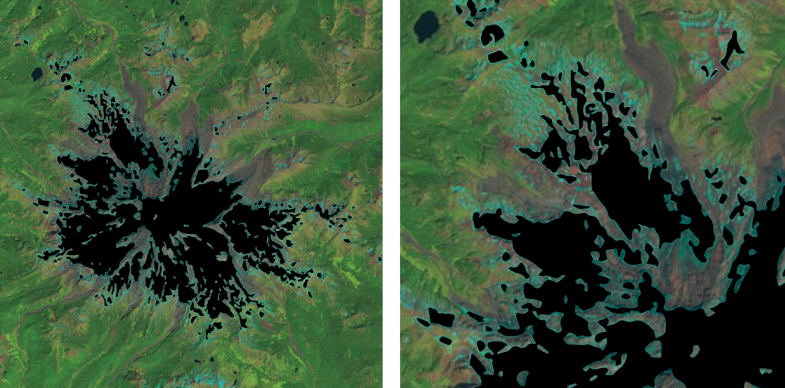
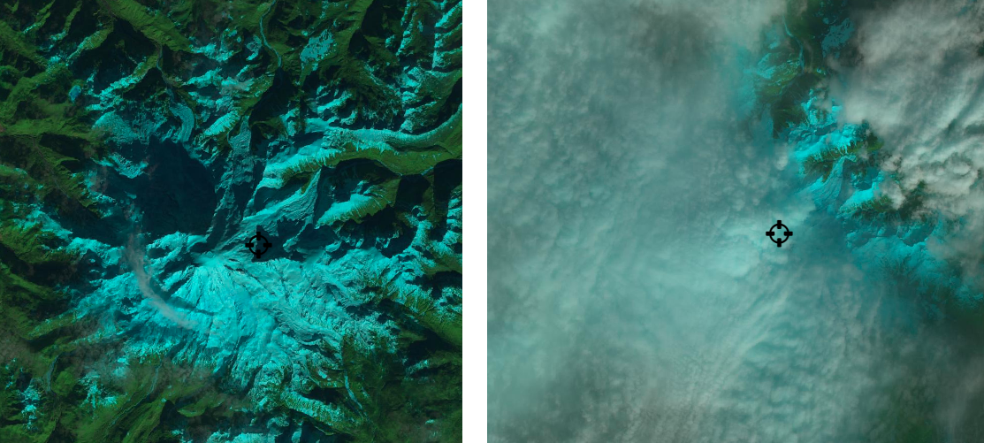
CAVEATS, LIMITATIONS, & DATA VALIDITY
Each satellite image is not representative of its whole month..
These satellite images were taken 9 days apart.
There is a loss of accuracy when converting raster to vector..
Minimal differences between the raster and vector could change the calculated snow area significantly.
Quantifying the accuracy of the data is necessary and the next step in this project.
Finding quality satellite images is difficult, if not impossible, for. some months of the year..
If the area of interest (Mt. Rainier) saw cloudy weather the entirety of a given month, there would be no valid satellite data for that month.
Shadows, clouds, and low spatial resolution impede data processing.

Slide 7
ACKNOWLEDGEMENTS
Thank you Professor Gunwha Oh!
GEOG 458: Advanced Digital Geographies
Thank you Professor Monika Moskal!
ESRM 430: Remote Sensing of the Environment
DATA SOURCE + SOFTWARE
Data source: USGS GloVis
Landsat 7, Landsat 8, Sentinel-2
Programming:
R, Python
Software:
ArcGIS Pro, QGIS, Adobe Illustrator, GIMP

