Slide 1
Spatial literacy in Ocean Science and Technology
Miles Logsdon
School of Oceanography
ONLY 3 WORD SLIDE !!!

Slide 2
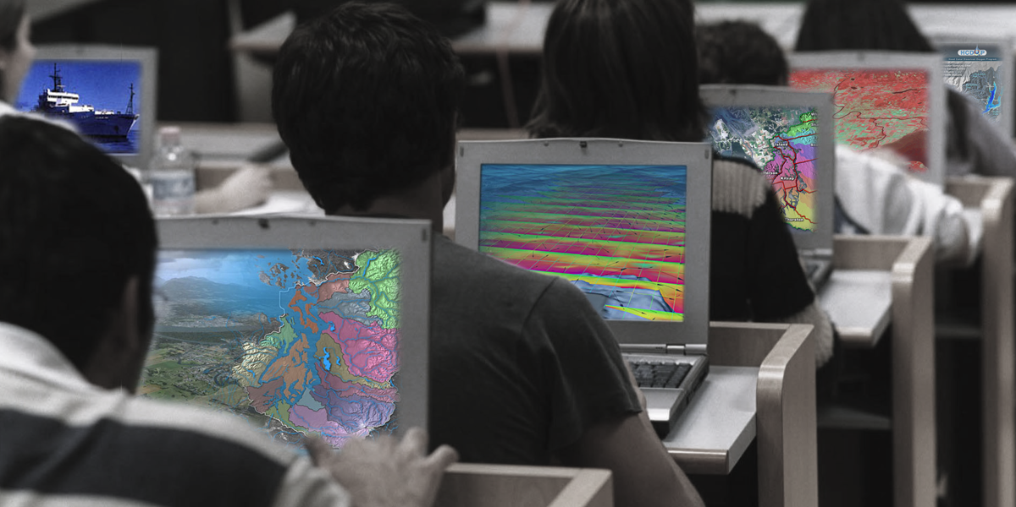
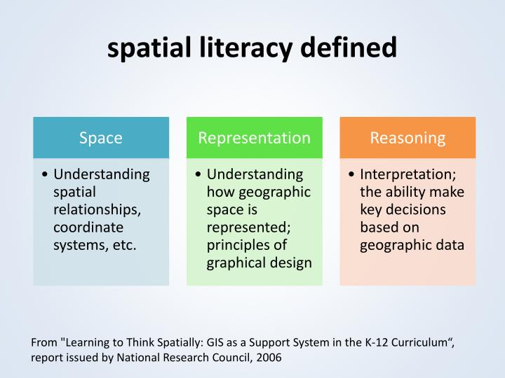
Goodchild, M.F., 1992. Geographical information science. International Journal of Geographical Information Science, 6(1), pp.31-45. Available at: http://www.tandfonline.com/doi/abs/10.1080/02693799208901893.
Goodchild, M.F., 2010. Twenty years of progress: GIScience in 2010. Journal of Spatial Information Science, 1(1), pp.3-20. Available at: http://josis.org/index.php/josis/article/view/32 [Accessed July 25, 2011].
Newcombe, N. S. (2013). Seeing Relationships: Using Spatial Thinking to Teach Science, Mathematics, and Social Studies. American Educator, 37(1), 26-31 and 40.
Werner Kuhn (2012) Core concepts of spatial information for transdisciplinary research, International Journal of Geographical Information Science, 26:12, 2267-2276, DOI: 10.1080/13658816.2012.722637

Slide 3
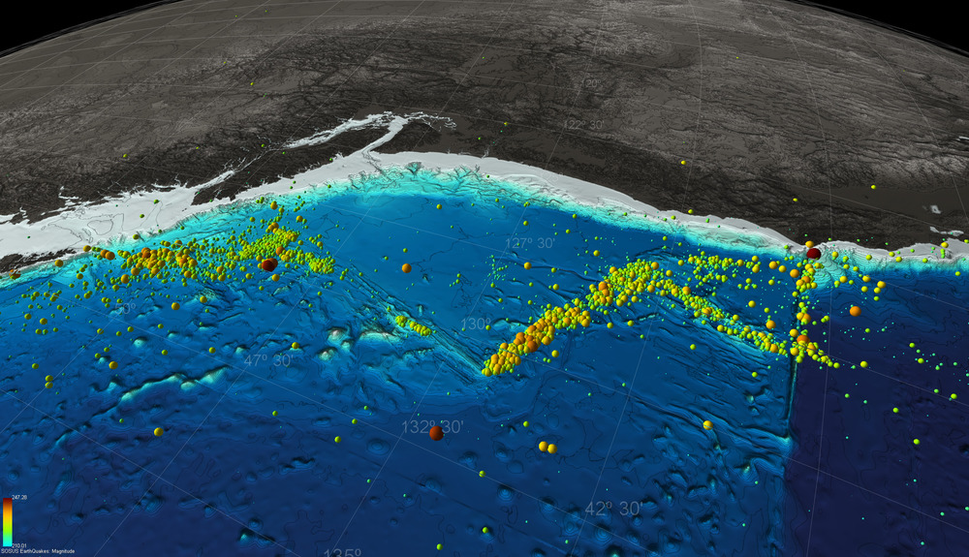
Spatial structures – object, field, surface, networks, regions, area, zone, cell, etc.
Spatial properties – composition, size, shape texture, boundary, center, etc.
Space-time context – location, local, global, site, environment, etc.
Position – distance, direction, orientation
Spatial dynamics - motion, dispersion, diffusion, expand, merge, split, route, convection, etc.
Spatial relations – adjacency, proximity, centrality, distribution, density, pattern, gradient, etc.
Spatial interaction – connection, link, system, ecosystem, etc.
Spatial transformations – scale, rotation, projection interpolation
Representation – map, diagram, overlay, grid, point, line, polygon, etc.
Spatial principles – autocorrelation, heterogeneity, association distance decay, isotropy, congruence.

Slide 4
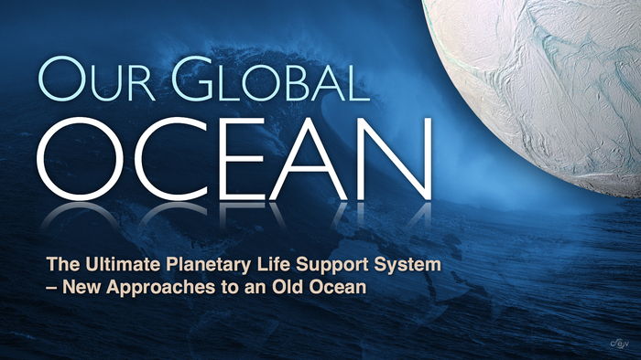
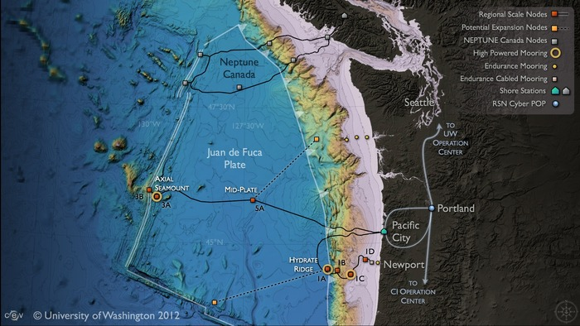

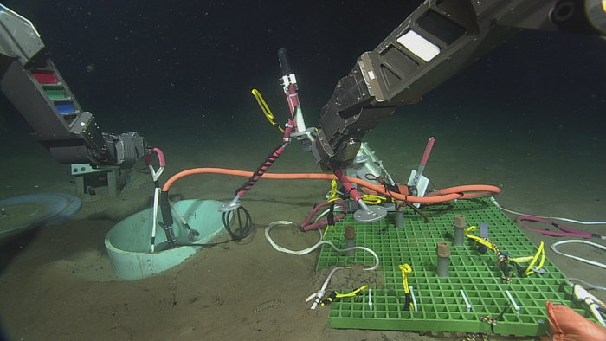
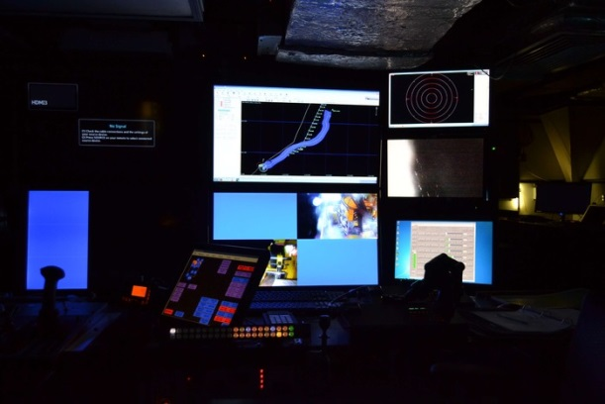

Slide 5
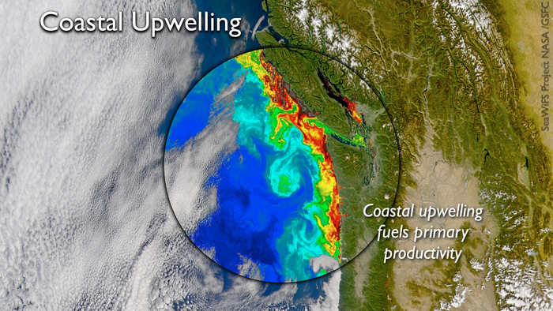
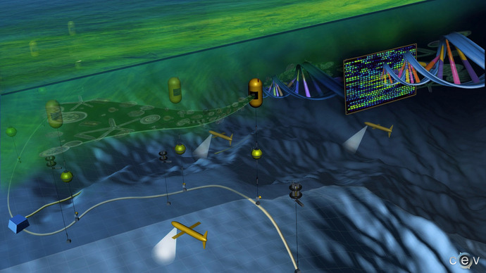
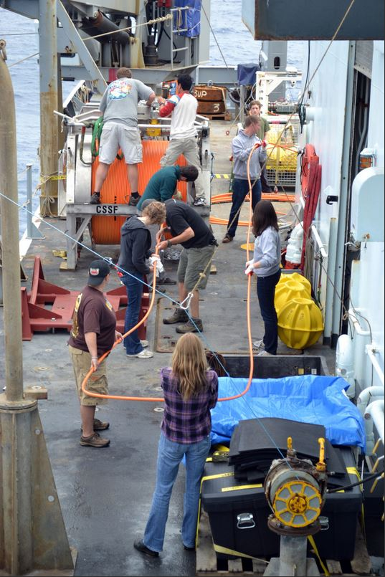


Slide 6
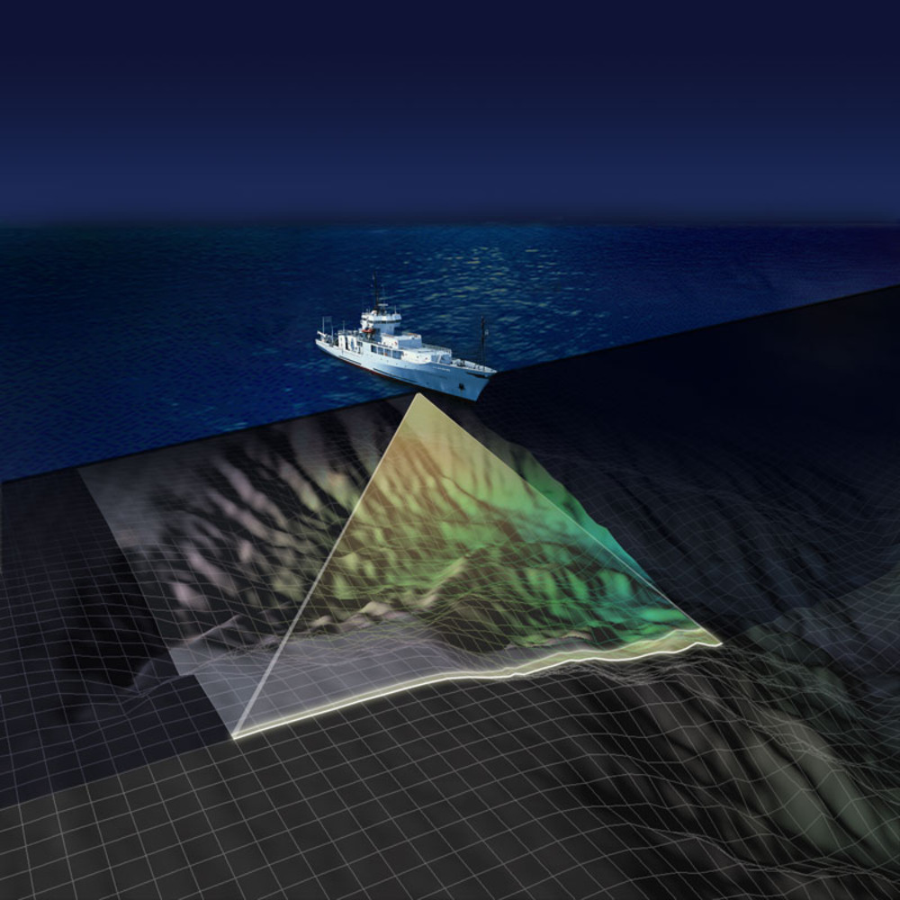
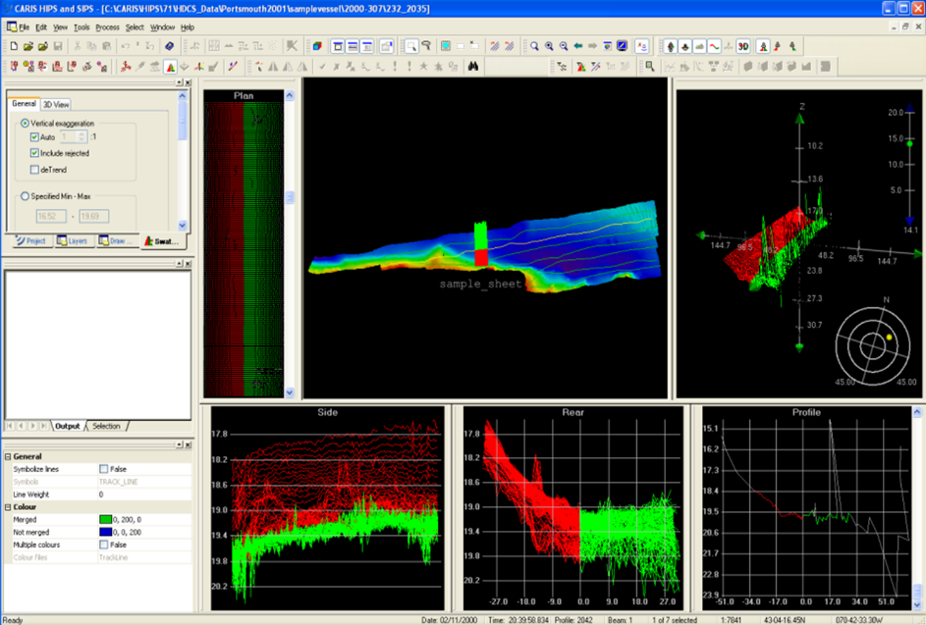
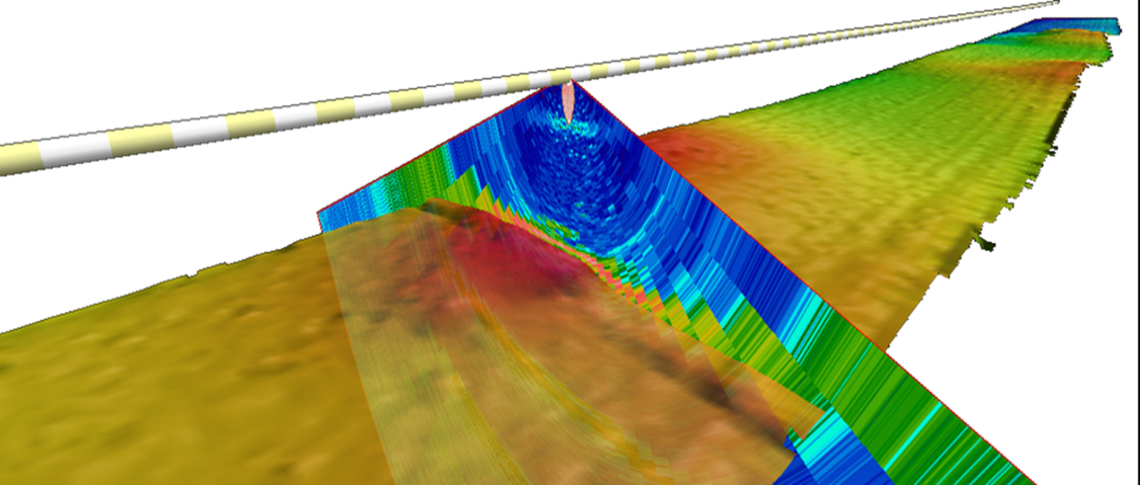

Slide 7
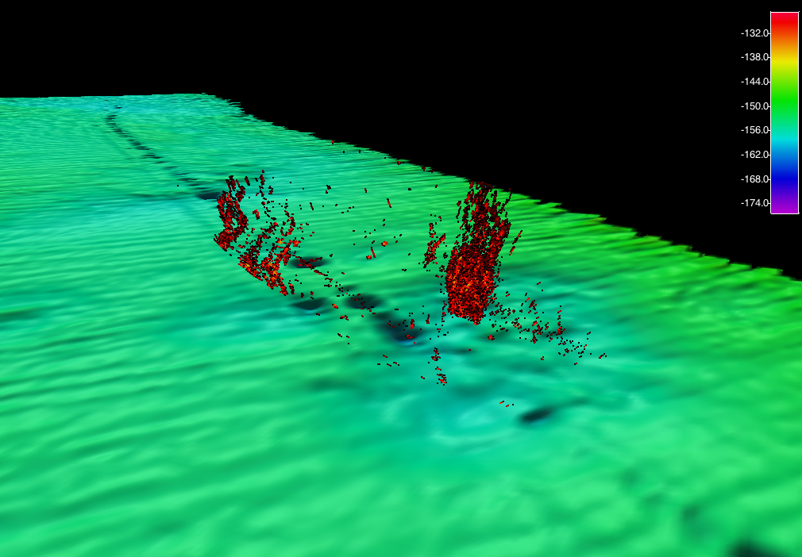
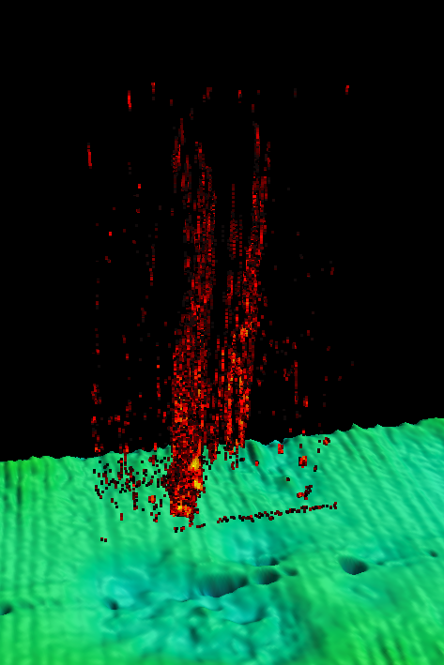
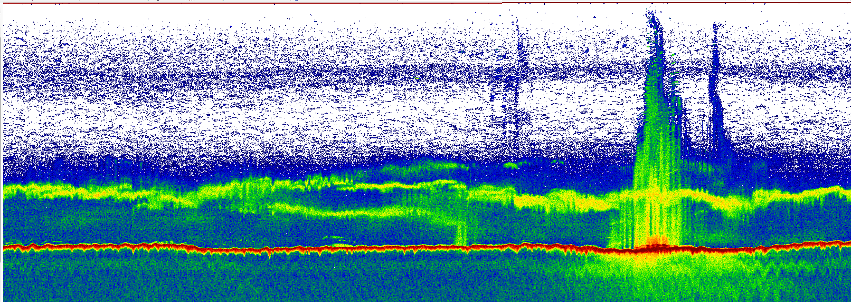

Slide 8
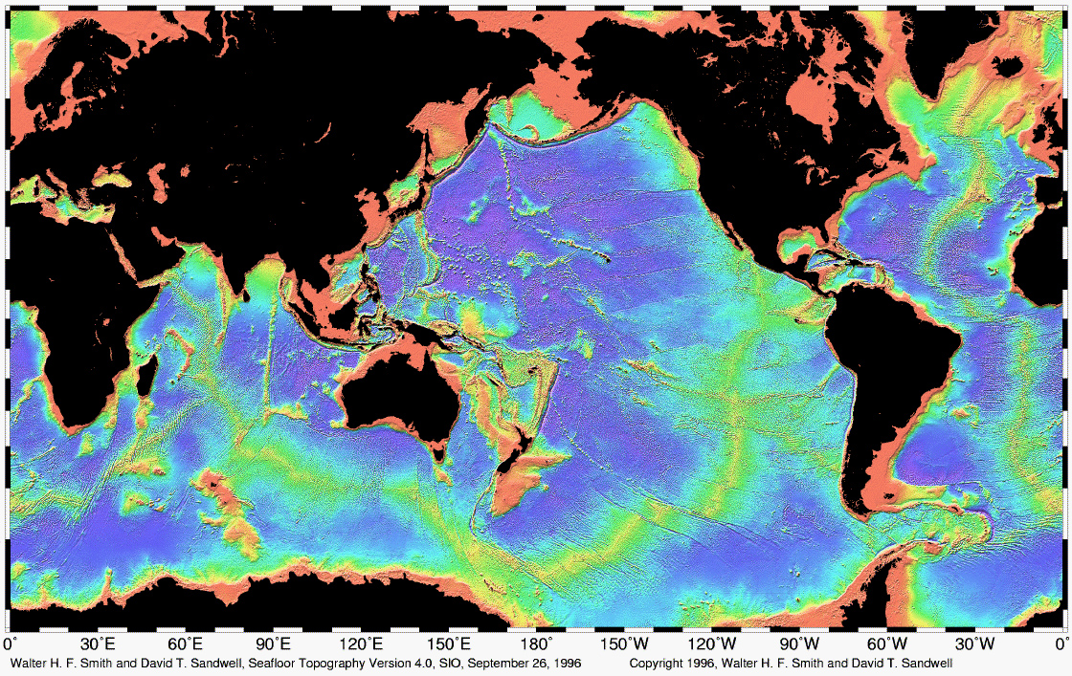

Slide 9
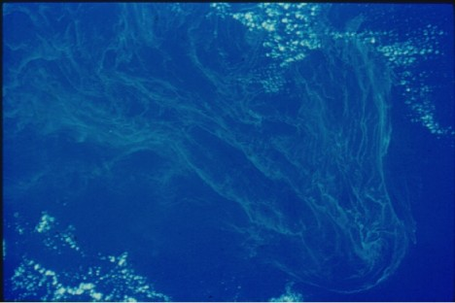
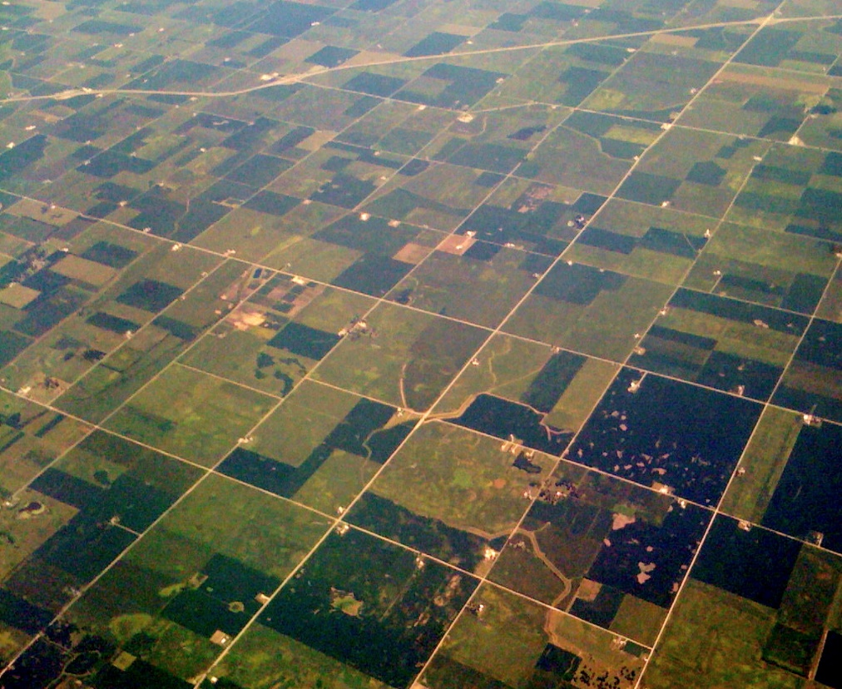



Slide 10
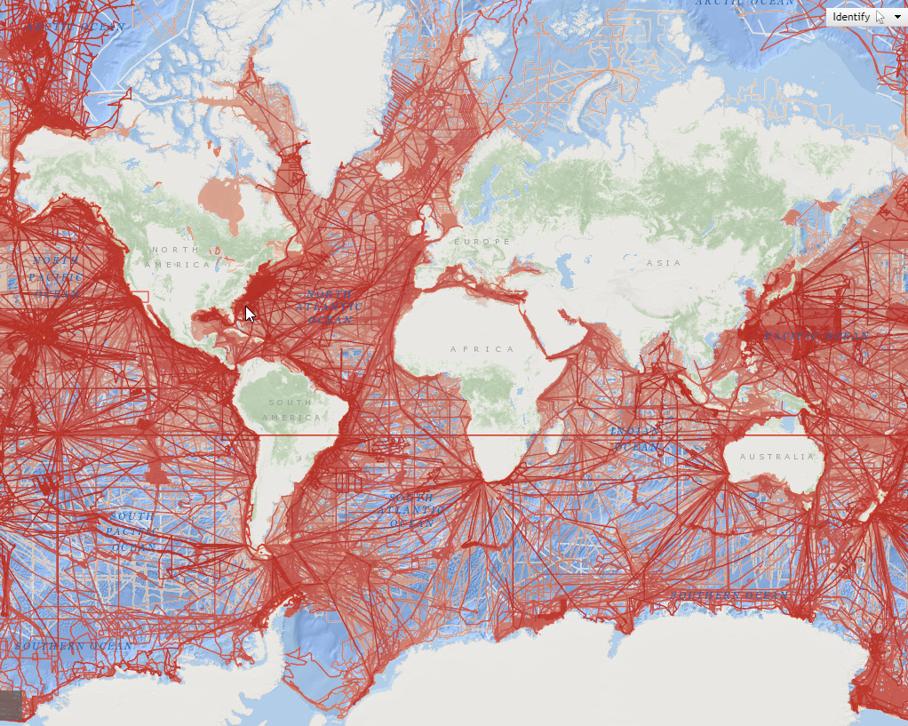

Slide 11
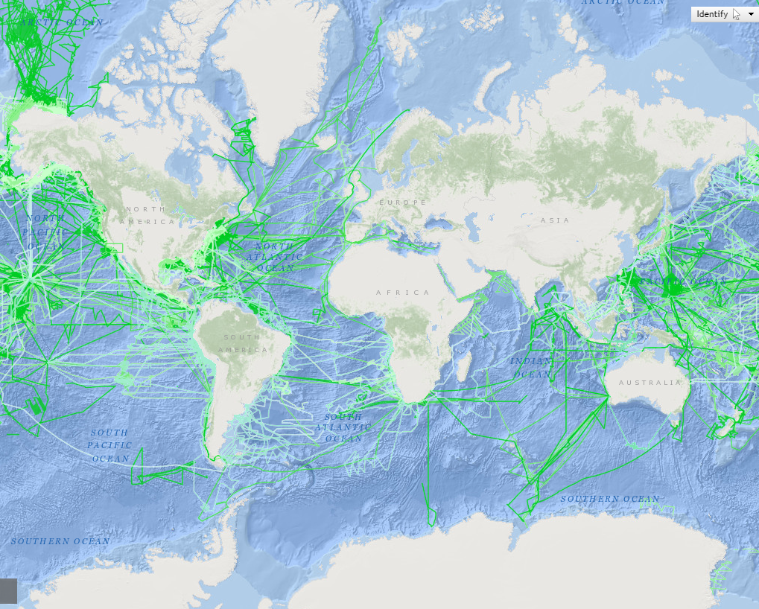

Slide 12
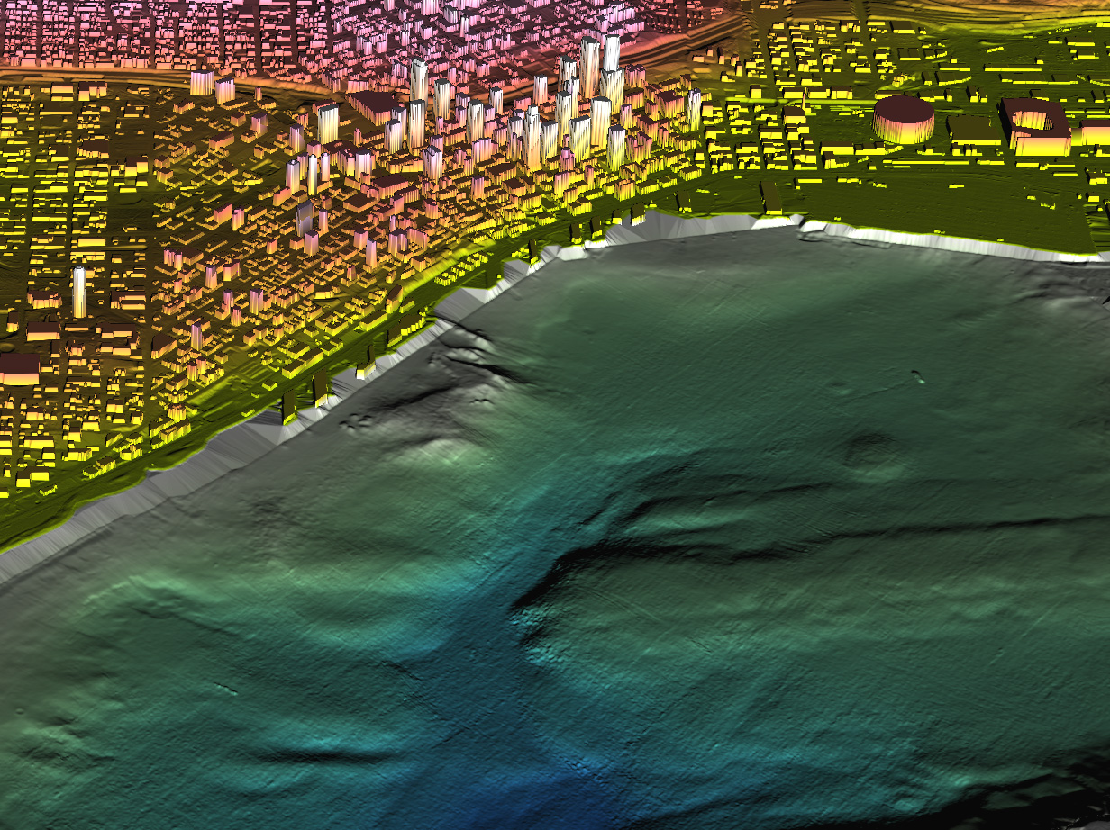

Slide 13
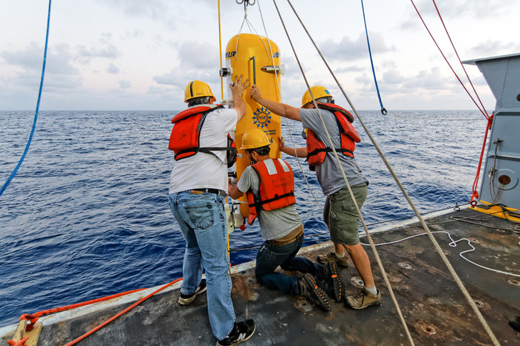
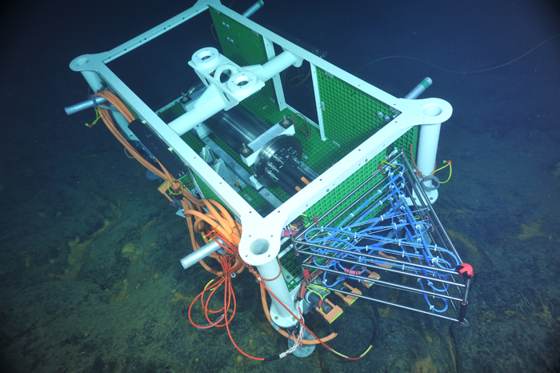
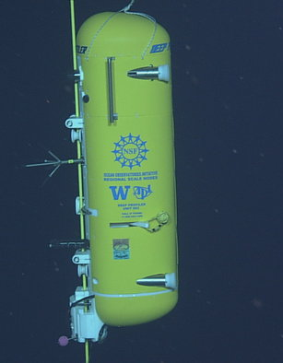
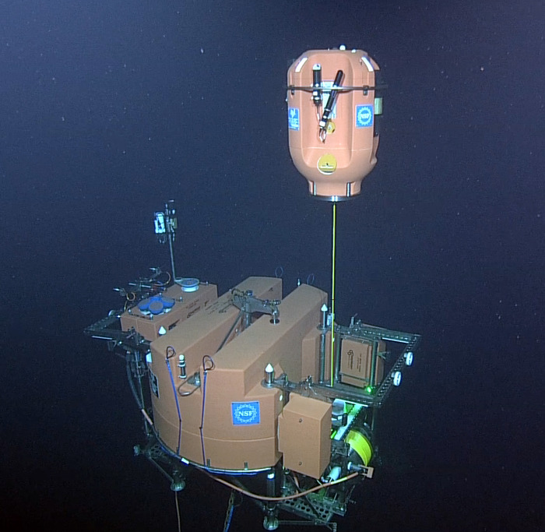
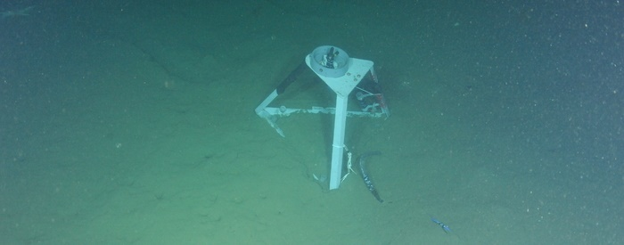

Slide 14
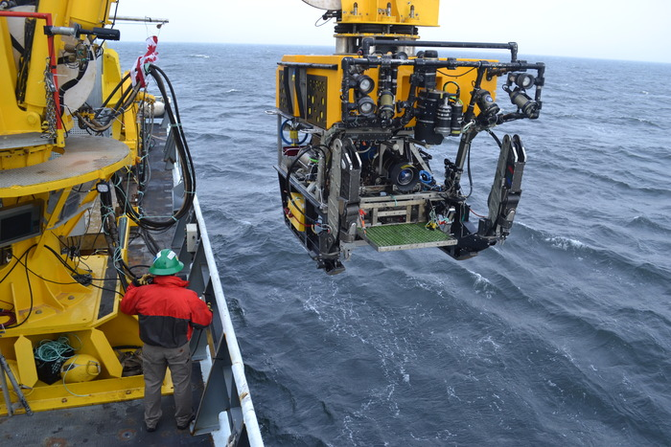
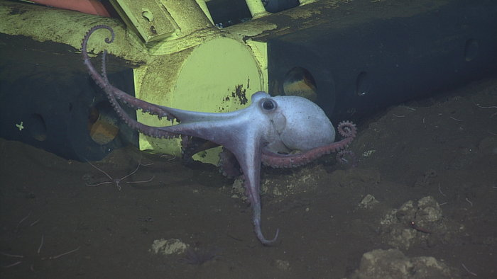
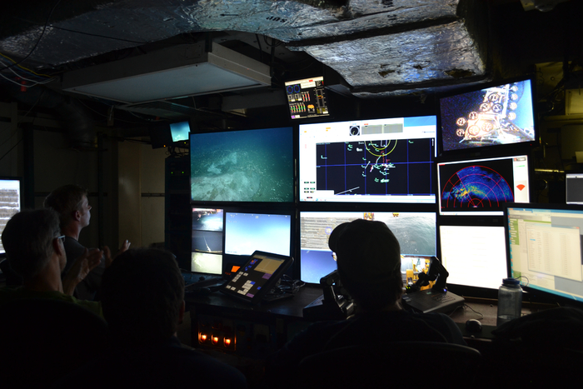
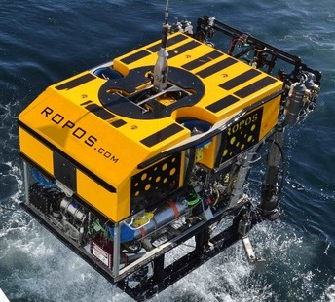

Slide 15
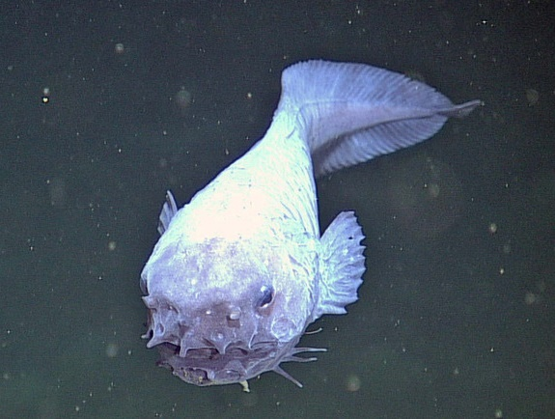
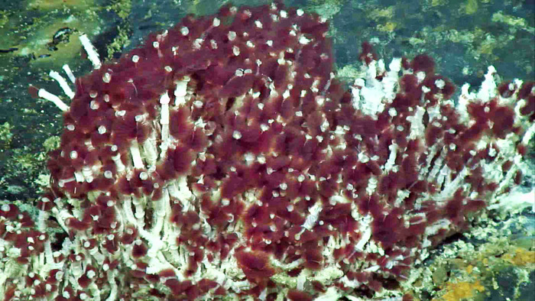
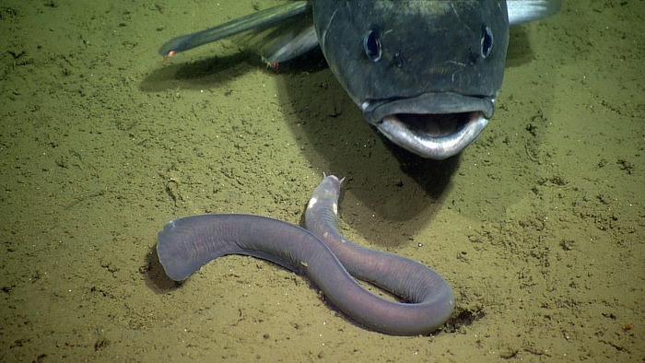
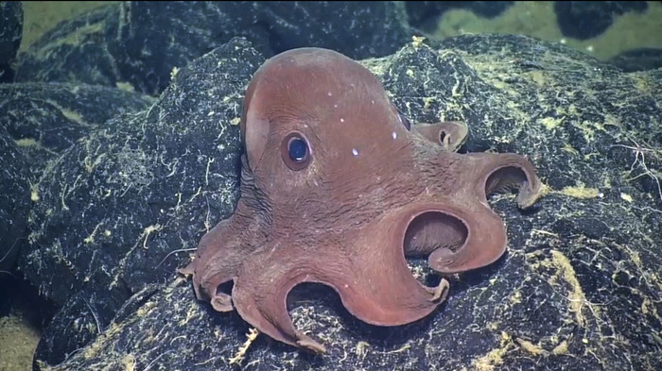

Slide 16
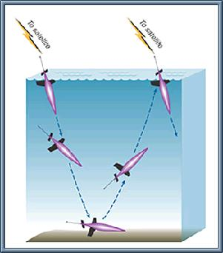
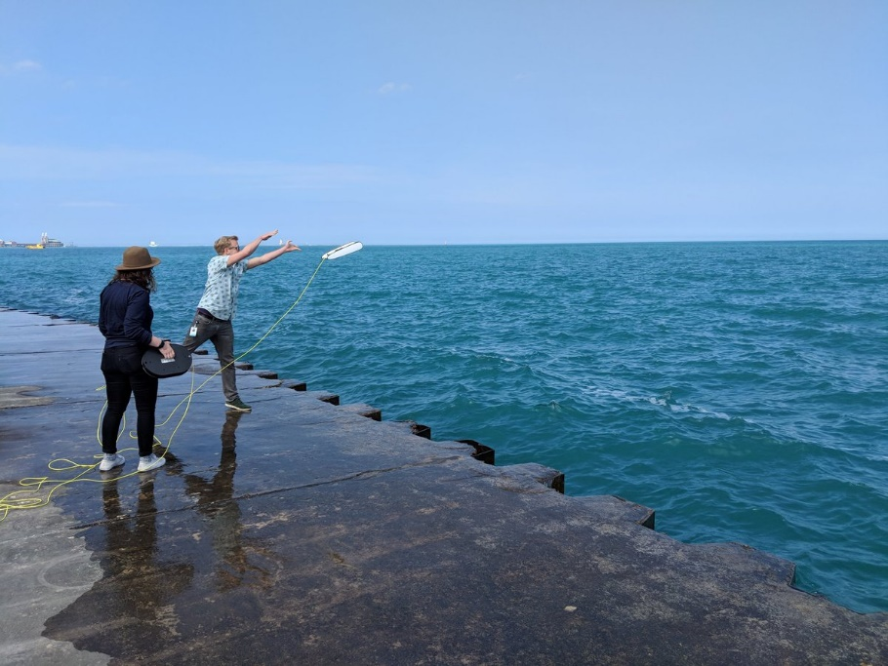
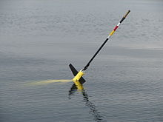
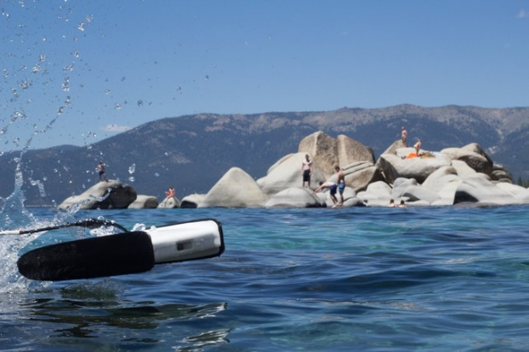
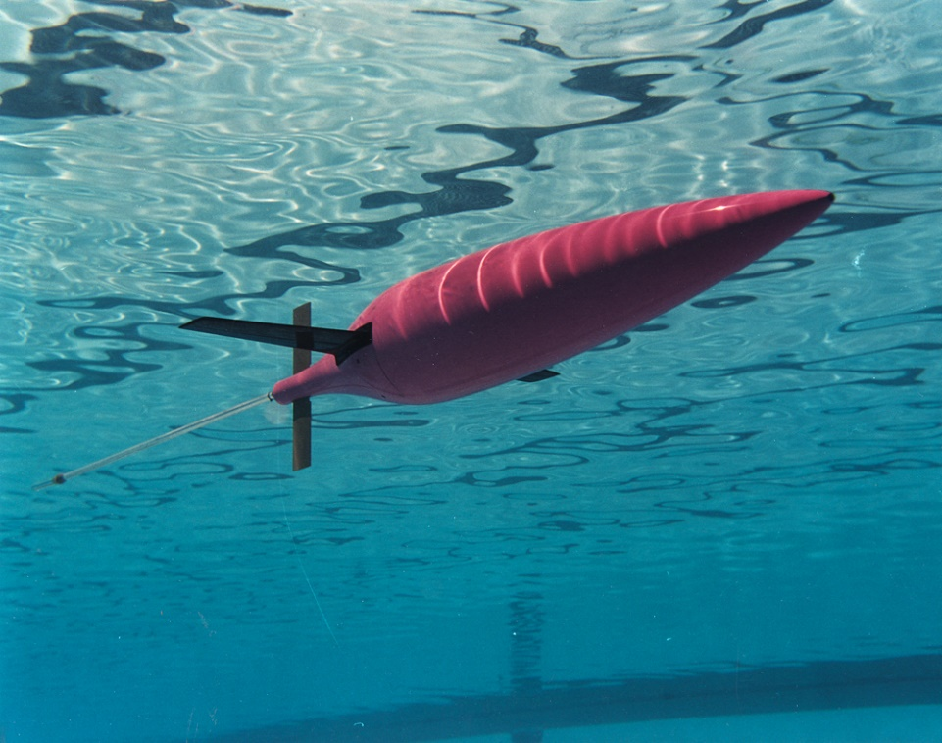
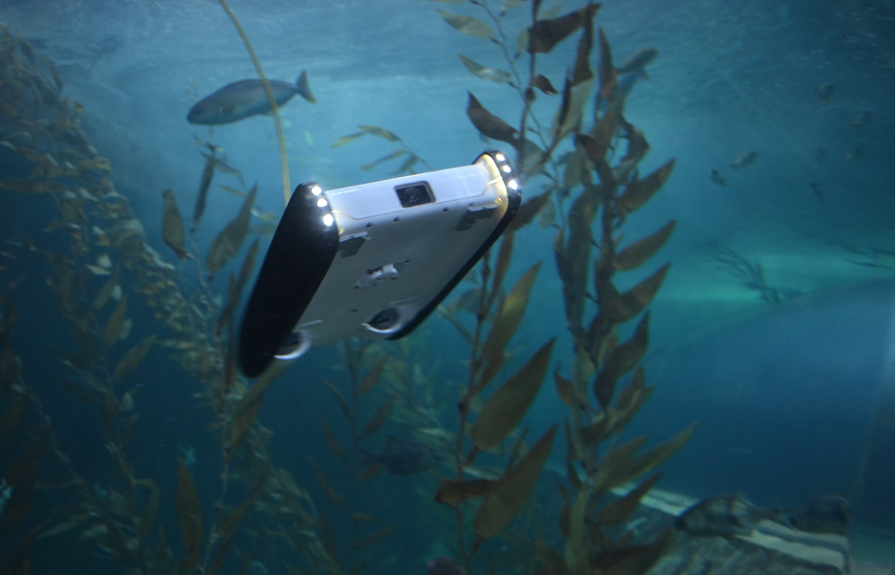

Slide 17
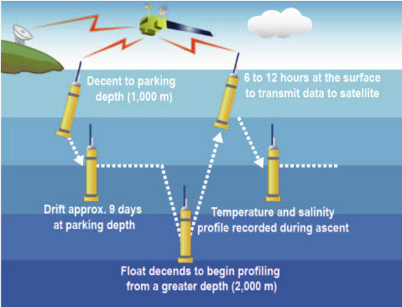
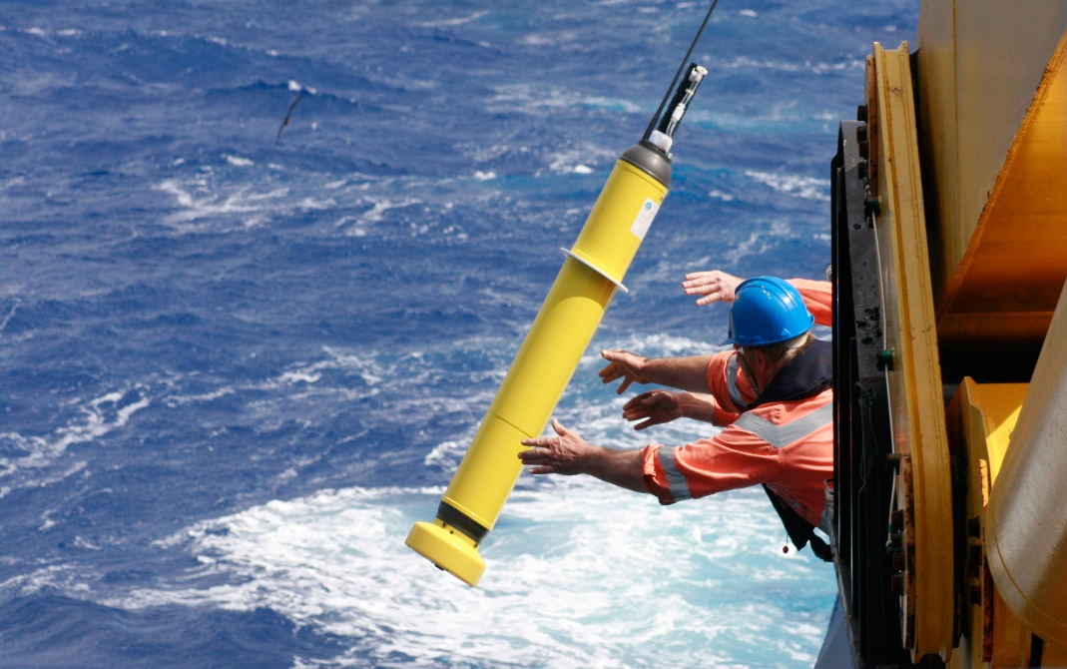
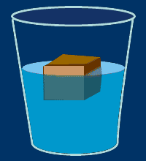
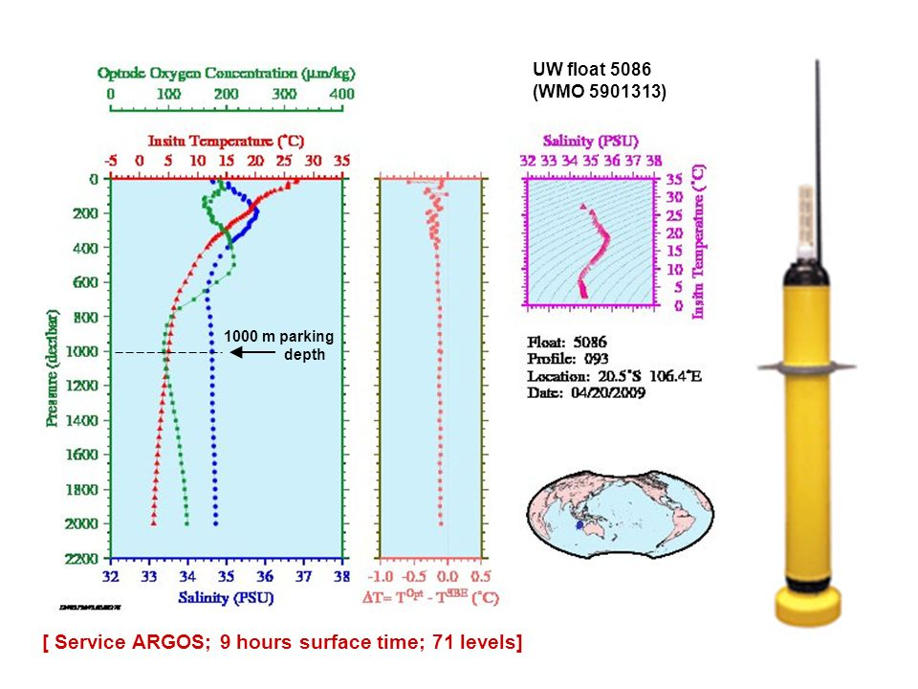
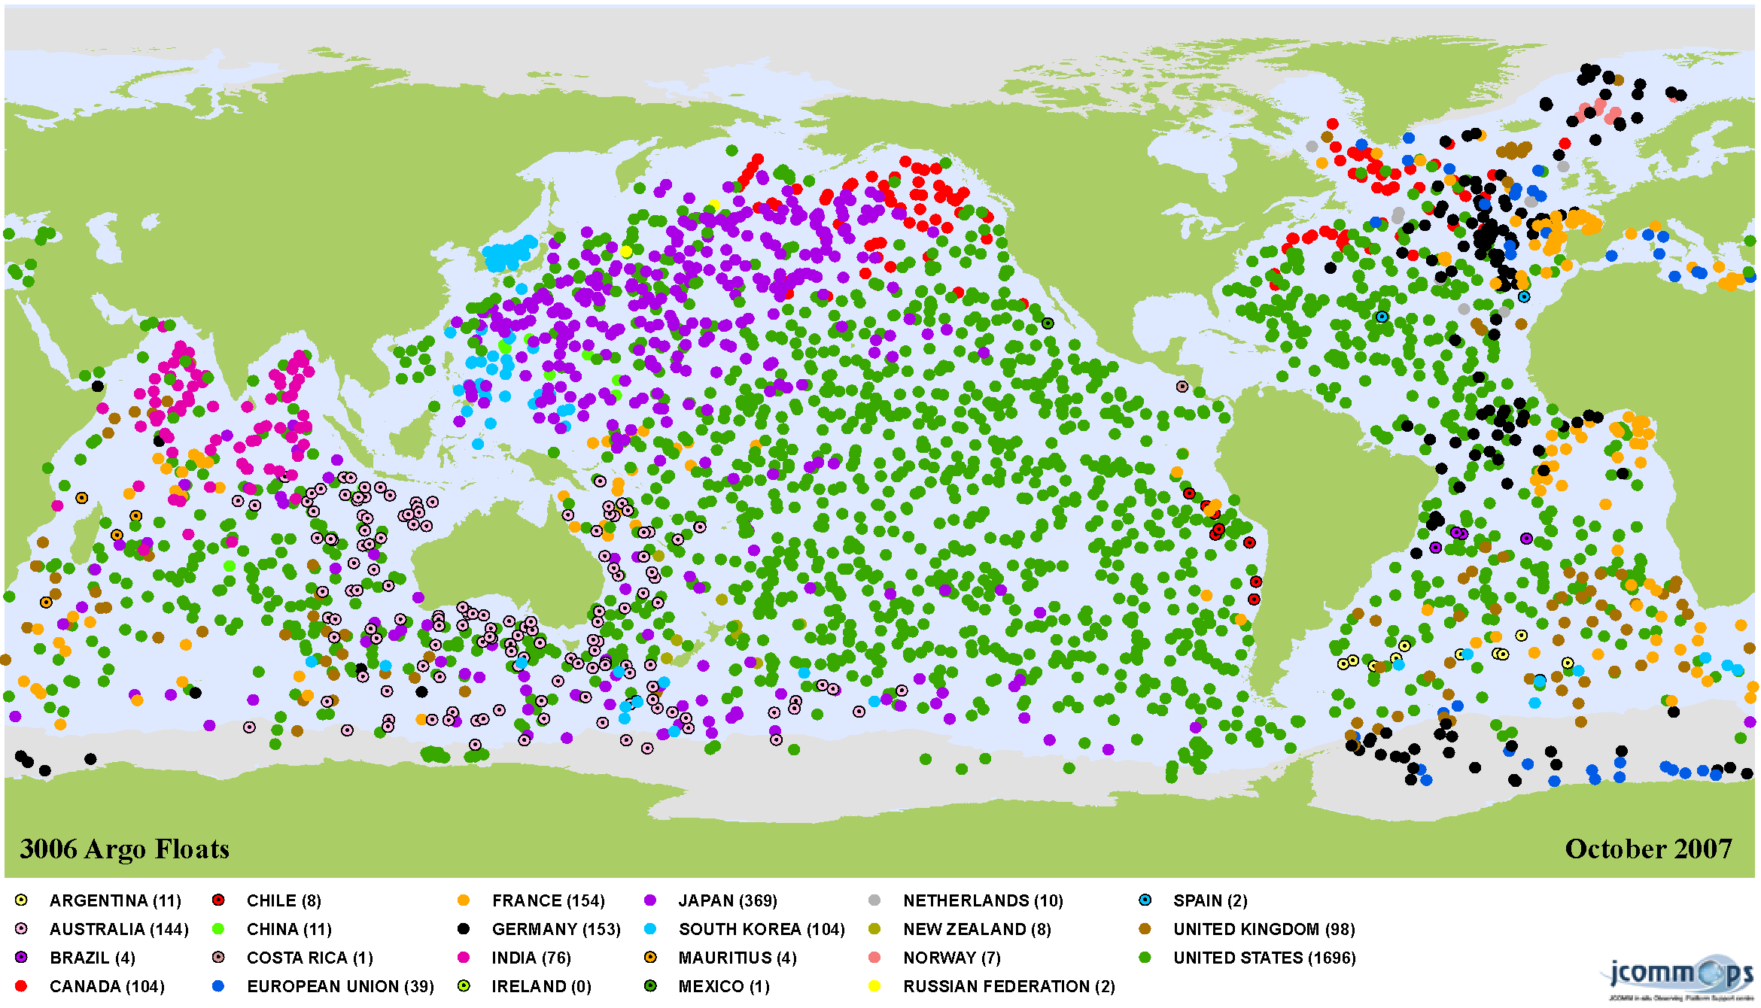

Slide 18
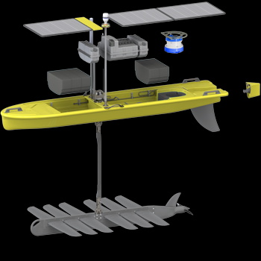
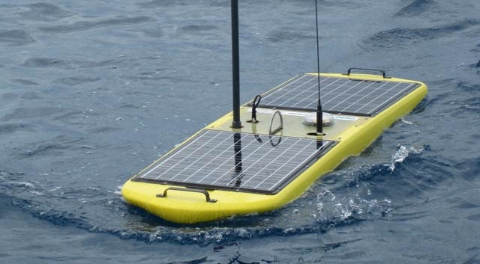
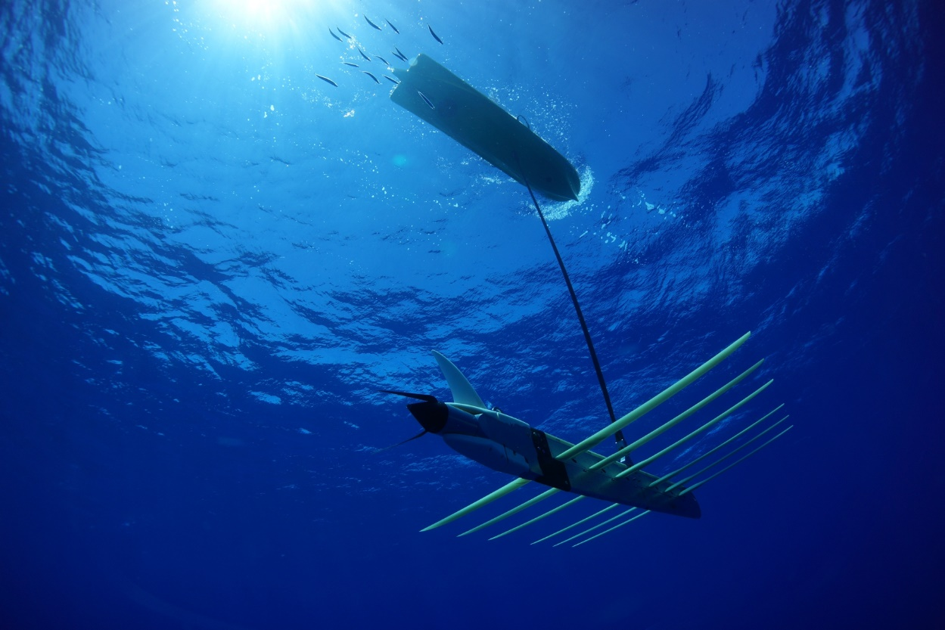

Slide 19
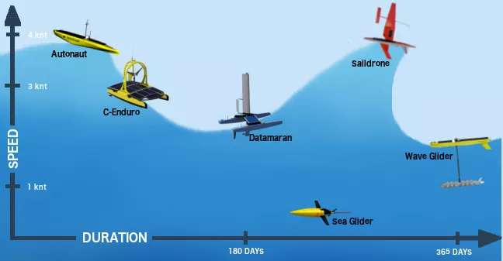



Slide 20




Slide 21

Time’s Up!
About your speaker:
  Name: Miles Logsdon
  Company: University of Washington
  Email: mlog@uw.edu

