Slide 1
Tech Talk:
Qualitative GIS and
ESRI Story Maps
Theodore Davenport
GIS Graduate Staff Assistant at UW Libraries

Slide 2
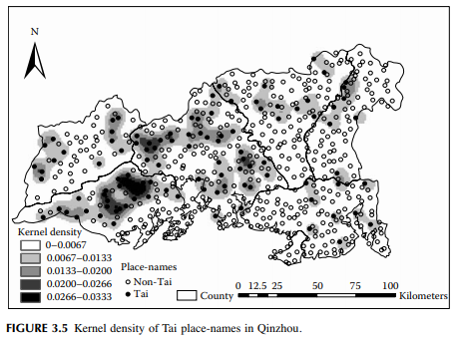
“Typical” GIS…
“Geographic information systems are… digital technologies for storing, managing, analyzing, and representing geographic information.” (Elwood & Cope 2009, p. 2)
Quantitative
Computational
Statistical information
(Wang 2006, p. 41)
Notes:
Tends to be very quantitative, impersonal, all about conveying information

Slide 3

Qualitative GIS
“Approaches that seek to integrate qualitative forms of data into GIS, develop and support qualitative approaches to building knowledge and explanation with GIS, use GIS in research that emerges from multiple or hybrid epistemologies, and theorize previously unrecognized forms of social knowledge” (Elwood & Cope 2009, p. 2)
Display descriptive information
Captures human experience
Mixed methods

Slide 4

Example 1: Mapping the urban asthma experience
Interviews explored asthma management challenges
Dirt, emotions, and environmental triggers
Map of perceived risk to asthma control
Keddem, S., Barg, F. K., Glanz, K., Jackson, T., Green, S., & George, M. (2015). Mapping the urban asthma experience: Using qualitative GIS to understand contextual factors affecting asthma control. Social Science & Medicine, 140, 9-17.

Slide 5
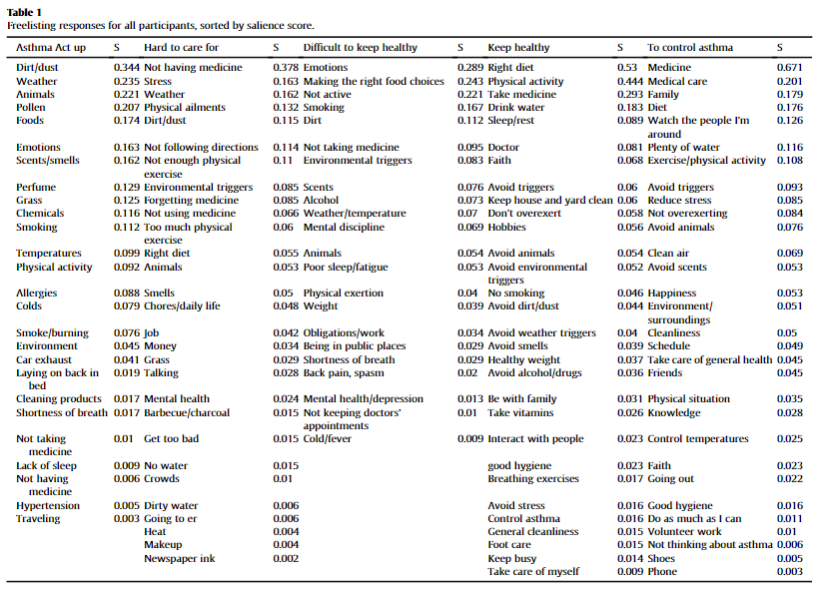

Slide 6
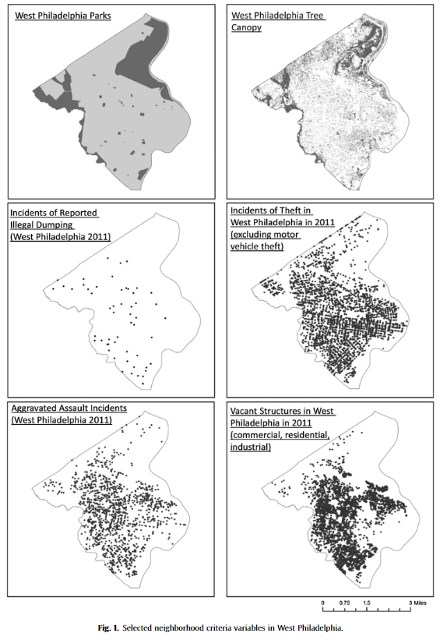
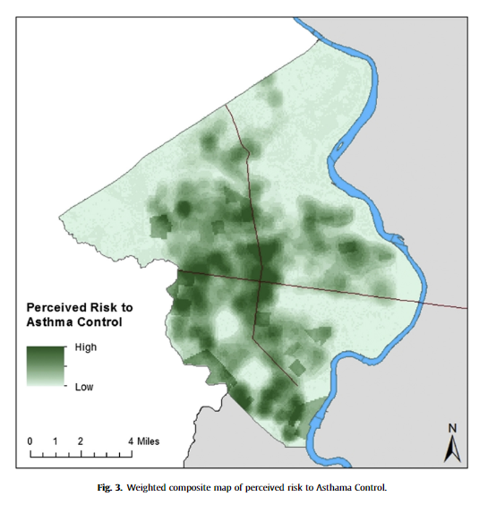
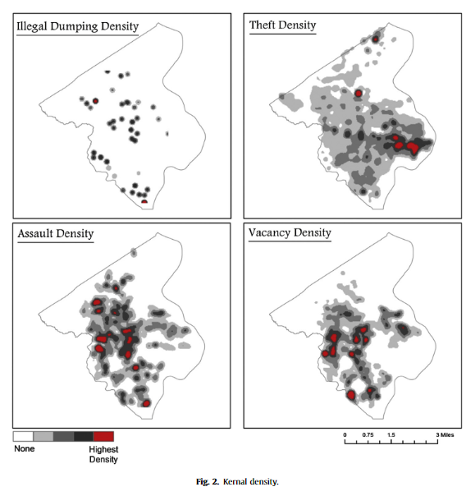

Slide 7
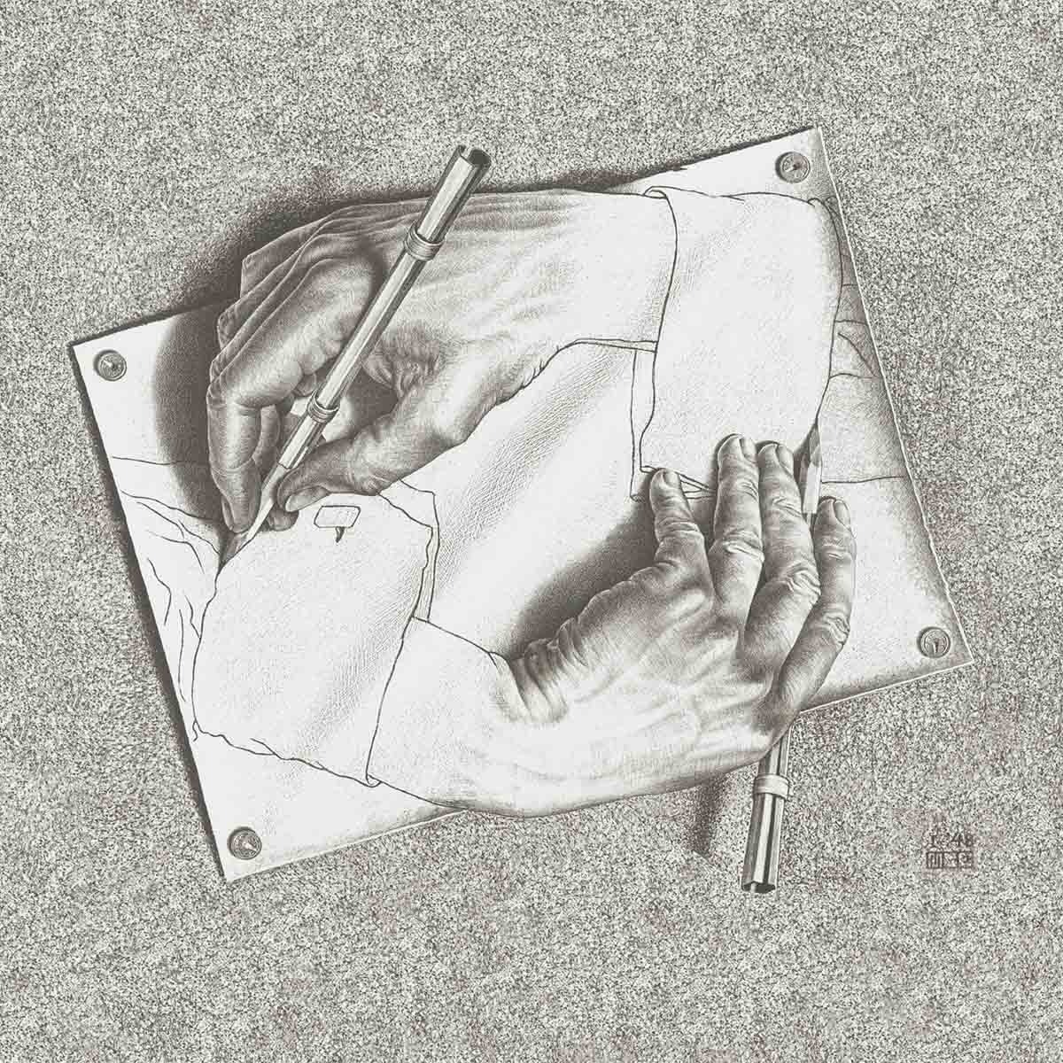
Example 2: Sketch Maps
Digitized sketch maps
Overlay analysis of public space experiences
Boschmann, E. E., & Cubbon, E. (2014). Sketch maps and qualitative GIS: Using cartographies of individual spatial narratives in geographic research. The Professional Geographer, 66(2), 236-248.
“Drawing Hands”
M.C. Escher (1948)

Slide 8
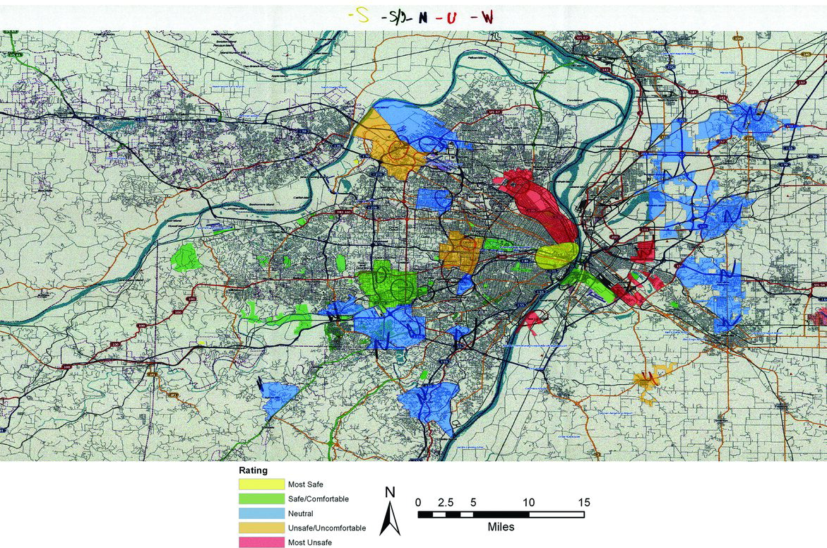
Sketch map of perceived safety from LGBT-identified interviewee - St. Louis, MO

Slide 9
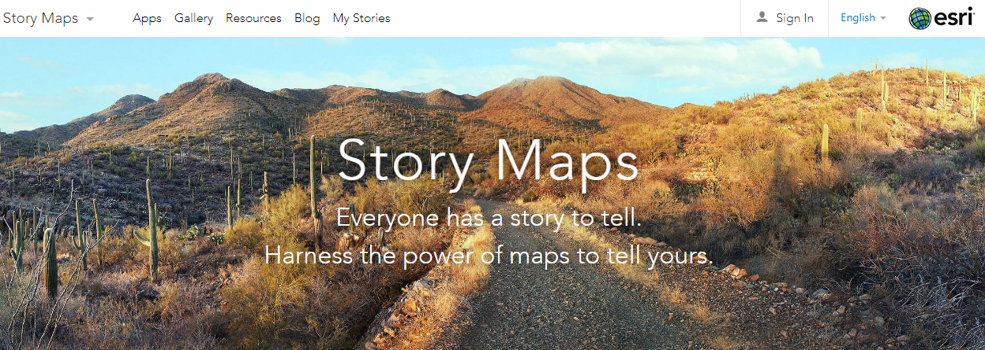
Digital Scholarship:
ESRI Story Maps
Notes:
Story Maps provide a multimedia narrative to:
present a problem
give a virtual tour
illustrate history
show the steps of a process
display other spatially-based information

Slide 10
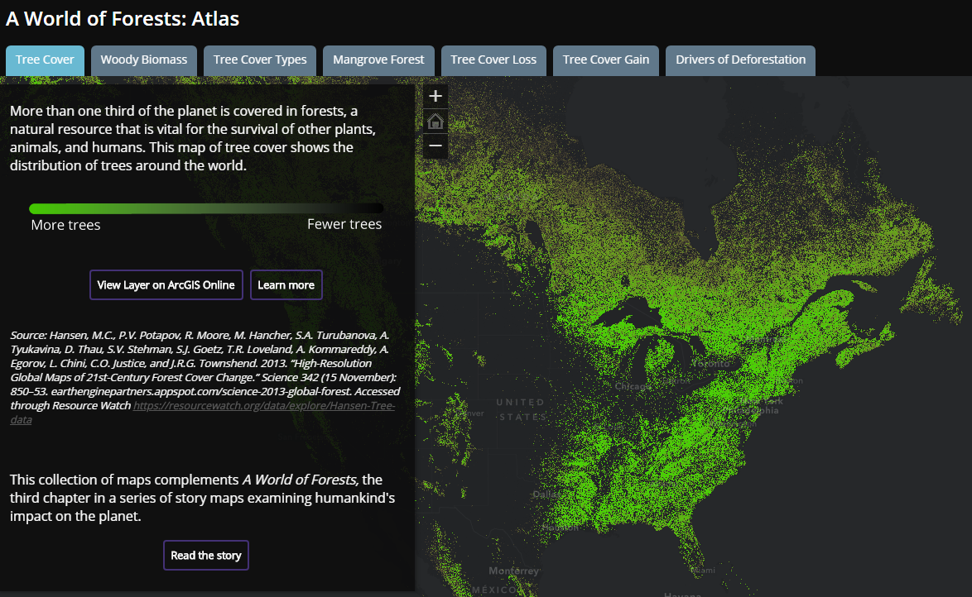
Story Map Atlas:
A World of Forests
Created by ESRI Story Map Team

Slide 11
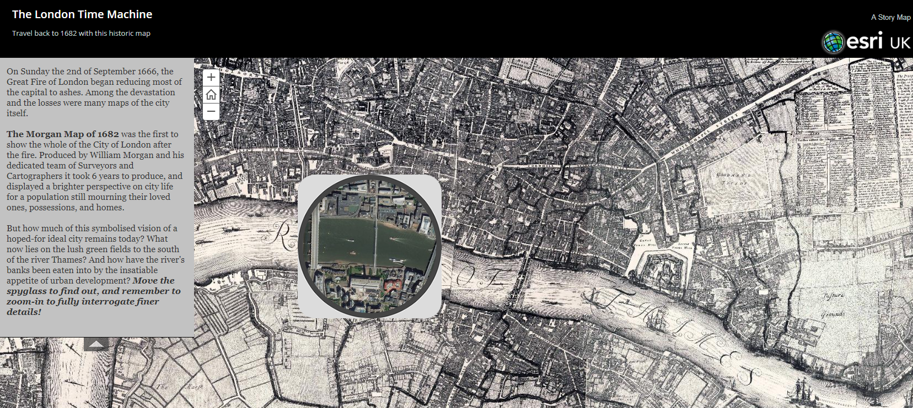
Story Map Spyglass:
The London Time Machine
Created by ESRI UK

Slide 12
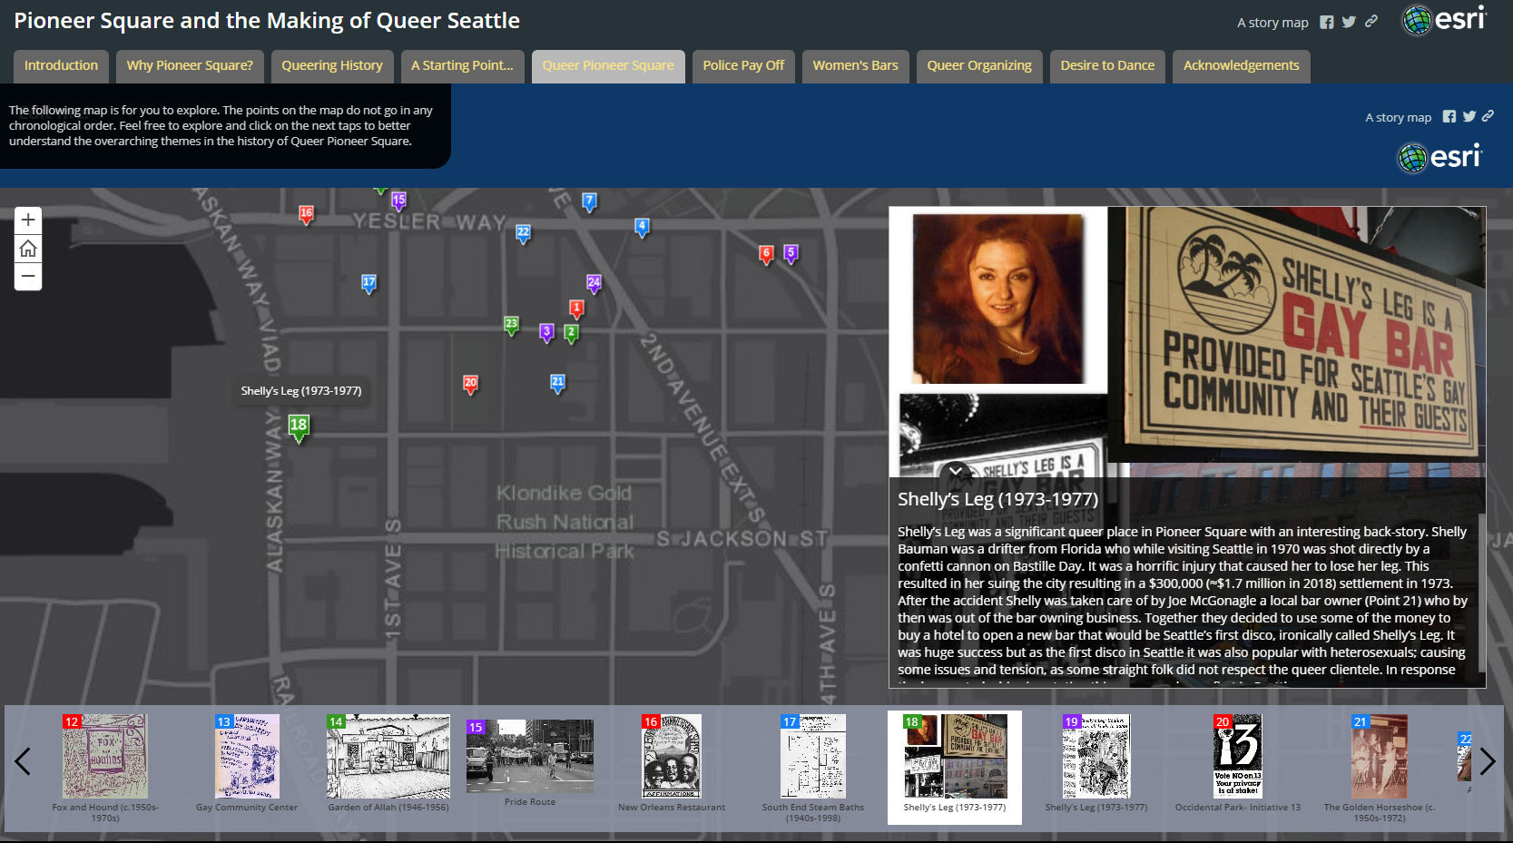
Story Map Tour:
Pioneer Square and the Making of Queer Seattle
Created by
Julian Barr
PhD Candidate
UW Geography

Slide 13


Beyond the Web!
Julian Barr now gives live tours of this Story Map!

Slide 14

Shameless Plug…
Story Map Workshop
May 29, 2019
10:30am – 12pm
Odegaard Library (OUGL) 102
Notes:
Narrative creation and storytelling basics
Overview of ArcGIS Story Map templates
Using the ArcGIS Online Story Map Builder
Create a Story Map Journal and Story Map Series
Publication and sharing options
Examples of advanced functionality

Slide 15
Questions?

Slide 16
Works Cited
Boschmann, E. E., & Cubbon, E. (2014). Sketch maps and qualitative GIS: Using cartographies of individual spatial narratives in geographic research. The Professional Geographer, 66(2), 236-248.
Cope, M., & Elwood, S. (2009). Qualitative GIS: a mixed methods approach. Sage.
Keddem, S., Barg, F. K., Glanz, K., Jackson, T., Green, S., & George, M. (2015). Mapping the urban asthma experience: Using qualitative GIS to understand contextual factors affecting asthma control. Social Science & Medicine, 140, 9-17.
Wang, F. (2006). Quantitative methods and applications in GIS. CRC Press.

