Slide 1
Workflow of Shallow-Water Hydrographic Mapping: Acquisition to Post-Processing
Regina Lionheart

Slide 2
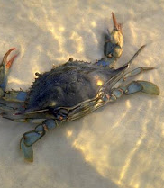
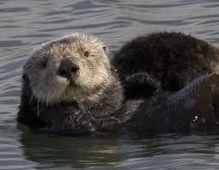
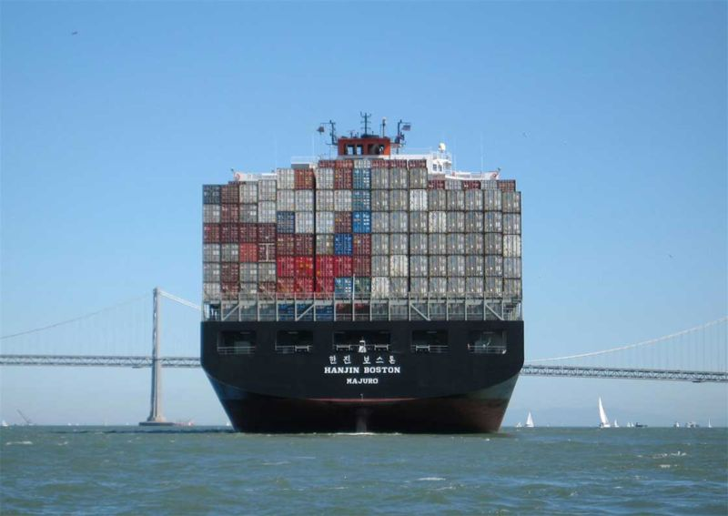
Coastal waters are essential
Critical habitat
Responsible for almost half of the overall oceanic productivity
  Only 10% of ocean surface area
Most commercially utilized parts of the ocean.
Notes:
Coastal oceans are critical habitat for many marine and estuarine organisms, provide half of overall oceanic productivity while only accounting for 10% of ocean surface area, and serve as our direct access point to the ocean. It is critical that we understand these areas of the seas, for safety in navigation and protection of environmentally vulnerable areas,

Slide 3
Coastal waters are essential
Critical habitat
Responsible for almost half of the overall oceanic productivity
  Only 10% of ocean surface area
Most commercially utilized parts of the ocean.
Notes:
*Slow* Coastal oceans are critical habitat for many marine and estuarine organisms, provide half of overall oceanic productivity while only accounting for 10% of ocean surface area, and serve as our direct access point to the ocean. It is critical that we understand these areas of the seas, for safety in navigation and protection of environmentally vulnerable areas. If there’s something to be hit by a vessel, it will probably happen in coastal areas.

Slide 4
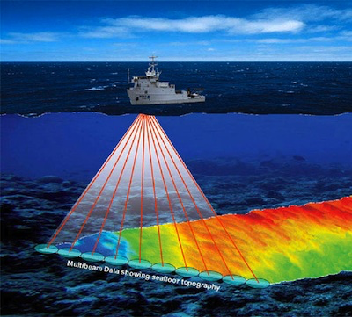
Acquisition
Notes:
This project maps a workflow process used in shallow-water hydrographic mapping, from shipboard acquisition to post-processing analytical techniques, specifically workflow alternative data that detectsquantitative change detection in base surfaces over time, and could serve as aid in navigation. A kongsberg em2040 multibeam sonar was used in order to produce high resolution imagery of the seafloor.

Slide 5
Acquisition
Notes:
This project maps a workflow process used in shallow-water hydrographic mapping, from shipboard acquisition to post-processing analytical techniques, specifically workflow alternative data that detectsquantitative change detection in base surfaces over time, and could serve as aid in navigation. A kongsberg em2040 multibeam sonar was used in order to produce high resolution imagery of the seafloor.

Slide 6
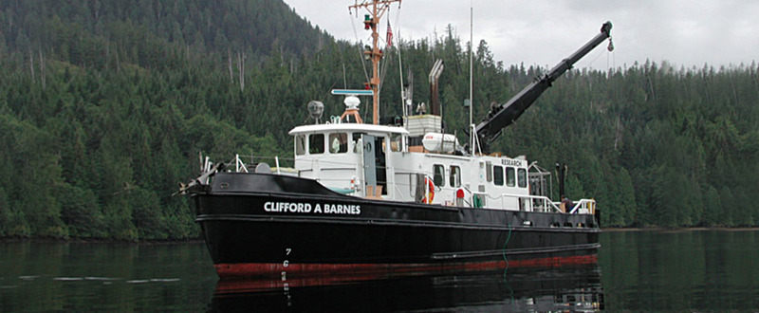
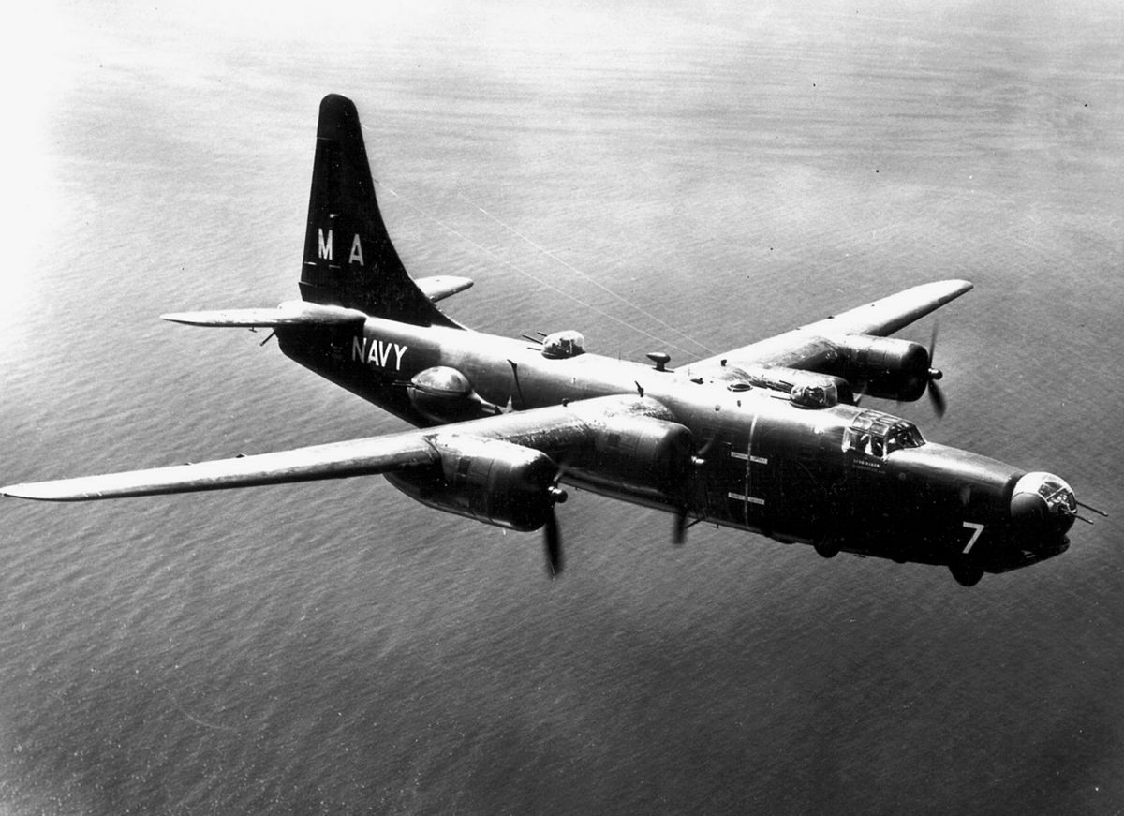
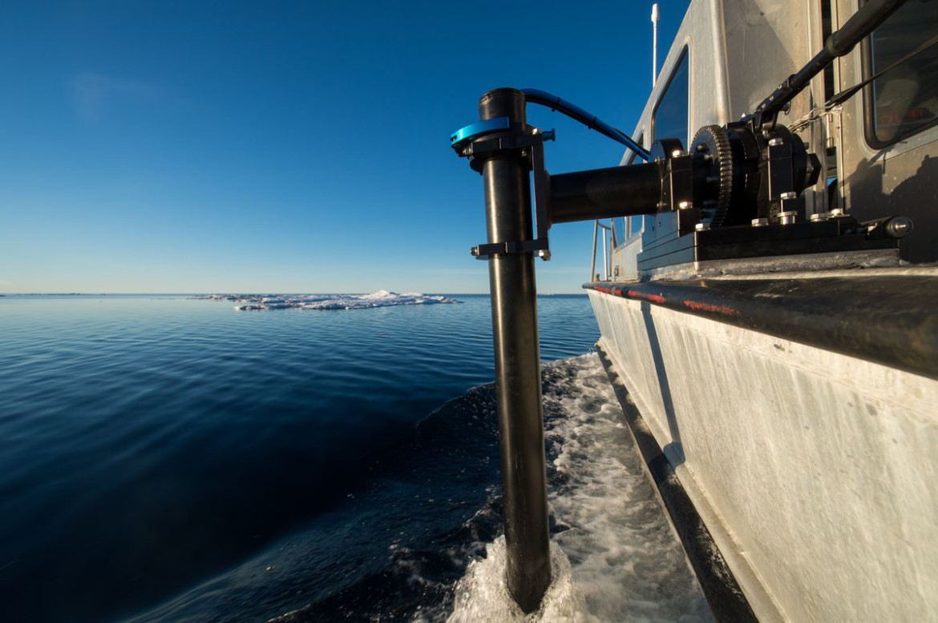
Acquisition
Notes:
The multibeam sonar array was pole mounted to R/V Clifford A Barnes at the University of Washington in Autumn of 2016, and this array was used to survey a sunken PB4Y Navy Bomber, which has been in the lake since 1956.

Slide 7
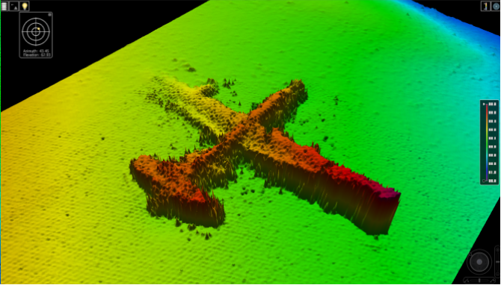
Geospatial Analytics: Layers
Swath Angle
Notes:
The processing section of this project aimed to quantify the differences between two layers used in geospatial analytics through Teledyne CARIS Hips and Sips, a processing software for hydrographic mapping. The first layer is Swath Angle, which renders multibeam data from sonar pings that measure the distance from the ship to the seafloor. You’ll see that this layer shows a spiky surface on the plane, which is unlikely to reflect the actual surface of the sunken object.

Slide 8
Geospatial Analytics: Layers
Swath Angle
Notes:
The processing section of this project aimed to quantify the differences between two layers used in geospatial analytics through Teledyne CARIS Hips and Sips, a processing software for hydrographic mapping. The first layer is Swath Angle, which renders multibeam data from sonar pings that measure the distance from the ship to the seafloor. You’ll see that this layer shows a spiky surface on the plane, which is unlikely to reflect the actual surface of the sunken object.

Slide 9
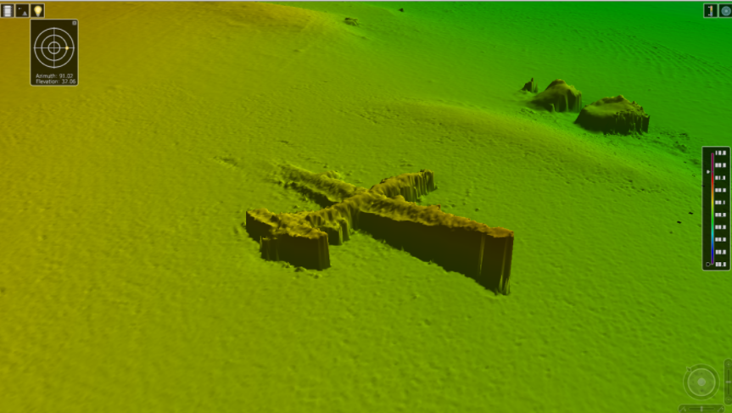
Geospatial Analytics: Layers
CUBE
Notes:
The second layer is the Combined Uncertainty and Bathymetry Estimator algorithm, or CUBE. This algorithm uses multiple hypotheses to represent potential depth variances along the seafloor, and fits the best one to a final layout. This image is mapped in 20 cm resolution, and you can immediately see the clarity of the surface, and the lift of the starboard wing, which becomes more obvious in this layer. This would be one example of a possible obstruction changing over time, as the port side wing could be settling into the substrate, constantly changing the lift of the starboard wing.

Slide 10
Geospatial Analytics: Layers
CUBE
Notes:
The second layer is the Combined Uncertainty and Bathymetry Estimator algorithm, or CUBE. This algorithm uses multiple hypotheses to represent potential depth variances along the seafloor, and fits the best one to a final layout. This image is mapped in 20 cm resolution, and you can immediately see the clarity of the surface, and the lift of the starboard wing, which becomes more obvious in this layer. This would be one example of a possible obstruction changing over time, as the port side wing could be settling into the substrate, constantly changing the lift of the starboard wing.

Slide 11
Geospatial Analytics: Layers
While difference is discernable, it is difficult to draw conclusions.
Notes:
Visually, these two layers are different, but quantifying this difference is important for optimal clarity and layer choice when processing data that could present a danger if incorrectly mapped (for example, sunken structures in commercially trafficked bays).

Slide 12

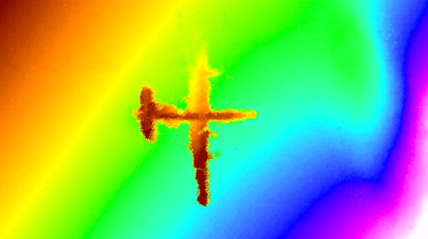
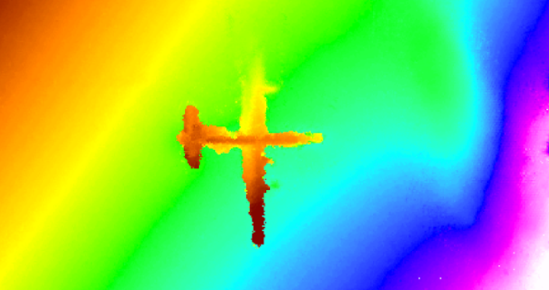
Post-processing: ArcGIS
Swath Angle
CUBE
Notes:
Both layers were exported into ArcGIS, which is a global software package used for making maps and analyzing spatial information. These are the two resulting rasters from that export, clipped to the same size.

Slide 13
Post-processing: ArcGIS
Swath Angle
CUBE
Both of these images are raster layers within ArcGIS, which can utilize a raster calculator to quantify differences between the images.
Notes:
There is little difference between these two layers that can be detected by the human eye, however, tools within ArcGIS are able to quantify the minute differences in spatial layout that could mean the difference between an uneventful cruise and a sunken ship. Additionally, the following technique could easily be applied to changeable surfaces that are variable over time, to quantify how much a particular surface has shifted due to long periods of time or immediate physical perturbation, such as storms or landslides.

Slide 14
Post-processing: ArcGIS
Swath Angle
CUBE
Both of these images are raster layers within ArcGIS, which can utilize a raster calculator to quantify differences between the images.
Notes:
There is little difference between these two layers that can be detected by the human eye, however, tools within ArcGIS are able to quantify the minute differences in spatial layout that could mean the difference between an uneventful cruise and a sunken ship. Additionally, the following technique could easily be applied to changeable surfaces that are variable over time, to quantify how much a particular surface has shifted due to long periods of time or immediate physical perturbation, such as storms or landslides.

Slide 15
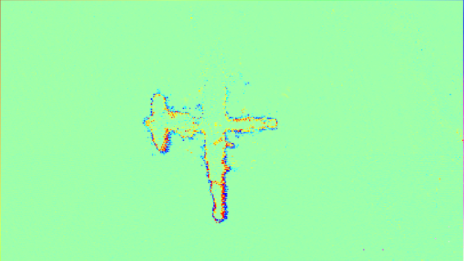
Post-processing: ArcGIS
Swath Angle layer – CUBE layer
=
Notes:
This image is the result of one raster layer subtracted from another, specifically the CUBE layer subtracted from the Swath Angle. The image was then reclassified using the reclassify tool in ArcGIS to colors reflecting five standard deviations away from the mean in a positive and negative direction. The areas with the highest standard deviation are covered in red, on the starboard side of the plane, and you’ll remember that this is the area furthest away from the seabed due to settling over time.

Slide 16
Post-processing: ArcGIS
Swath Angle layer – CUBE layer
=
Notes:
This image is the result of one raster layer subtracted from another, specifically the CUBE layer subtracted from the Swath Angle. The image was then reclassified using the reclassify tool in ArcGIS to colors reflecting five standard deviations away from the mean in a positive and negative direction. The areas with the highest standard deviation are covered in red, on the starboard side of the plane, and you’ll remember that this is the area furthest away from the seabed due to settling over time.

Slide 17
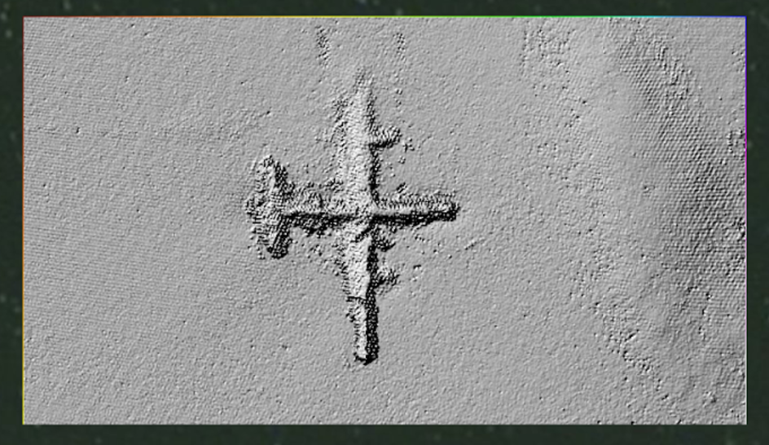
Post-processing: ArcGIS
Final step is to apply Hillshade within ArcGIS.
Allows us to investigate orientation of surface details.
Notes:
The final step in the analytics is to apply the Hillshade layer within ArcGIS, which allows us to investigate the orientation of surface details relative to neighbors, and quantify light tangent differences. This is an interesting image, but it’s not necessarily more effective than just looking at CUBE.

Slide 18
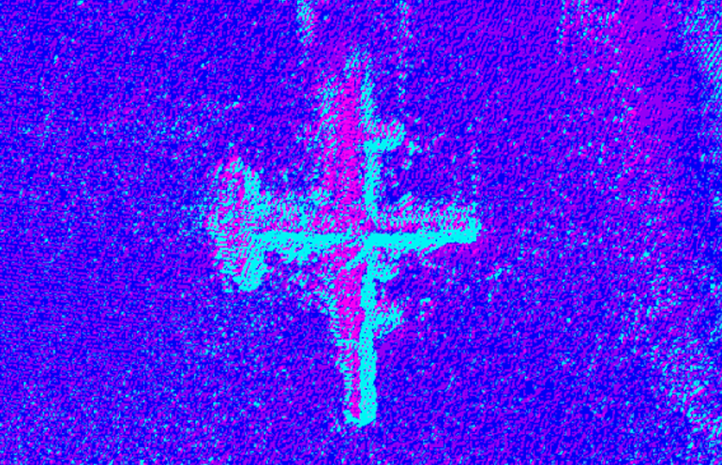
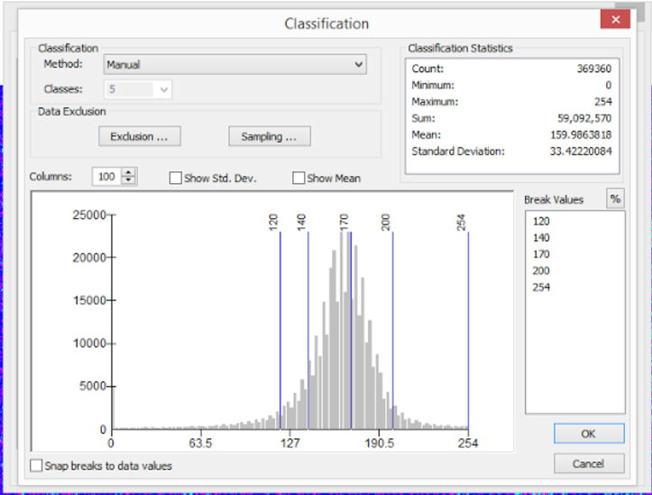
Post-processing: ArcGIS
Notes:
However, the real strength of this comes when we modify properties of the Hillshade raster. The raster is reclassified to 5 new color classes, with break points between bins manually adjusted. The image now shows a truncated visual distribution of values according to tangent light on the object. Within the reclassification statistics, we gain quantified information on solar angle, which is a sliding scale of azimuth intensity. The highest intensity value is 254 out of 256, which is changed from 360 to account for a base 2 system. This value is located on the starboard wing, indicating that it is the highest point on the plane.

Slide 19
Post-processing: ArcGIS
Notes:
However, the real strength of this comes when we modify properties of the Hillshade raster. The raster is reclassified to 5 new color classes, with break points between bins manually adjusted. The image now shows a truncated visual distribution of values according to tangent light on the object. Within the reclassification statistics, we gain quantified information on solar angle, which is a sliding scale of azimuth intensity. The highest intensity value is 254 out of 256, which is changed from 360 to account for a base 2 system. This value is located on the starboard wing, indicating that it is the highest point on the plane.

Slide 20
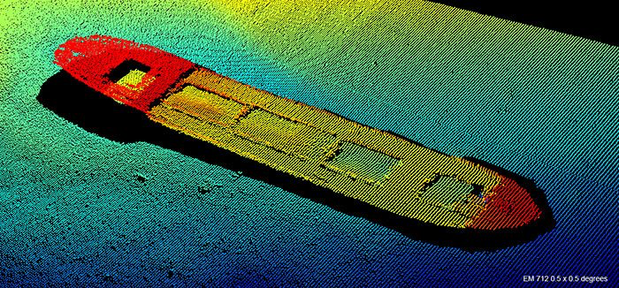
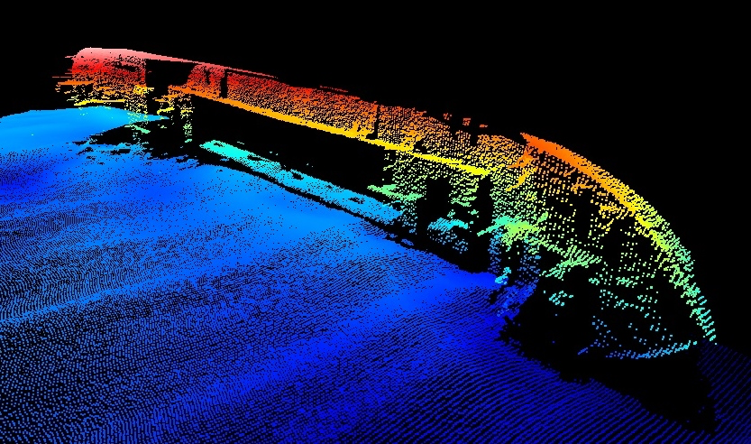
Conclusions
In the case of near shore hydrographic mapping, the CUBE algorithm provides the least variation in measurement and is closest to the ground truth.
Less “ping-dinging” is required to create a clear image, and is overall a more objective picture of the seafloor.
Notes:
In conclusion, we can pretty confidently state that the CUBE algorithm provides a more accurate picture of the seafloor than swath angle, determined by the lack of deviations from the mean value when the raster layers were subtracted. Additionally, the algorithm automatically deletes many visual issues that would otherwise need to be sorted out by hand.

Slide 21
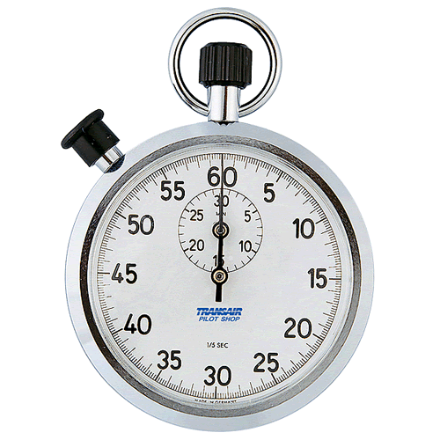
Time’s Up!
About your speaker:
  Name: Regina Lionheart
  Company: University of Washington
  Email: regina16@uw.edu
  Quick bio: Regina is a senior at the University of Washington, majoring in biochemical oceanography and applied calculus and statistics. She has been involved in GIS and ocean technology for the past year.

