Slide 1
Mapping Cholera Data
Corina Geier
Hannah Jolibois
Erika Arias

Slide 2
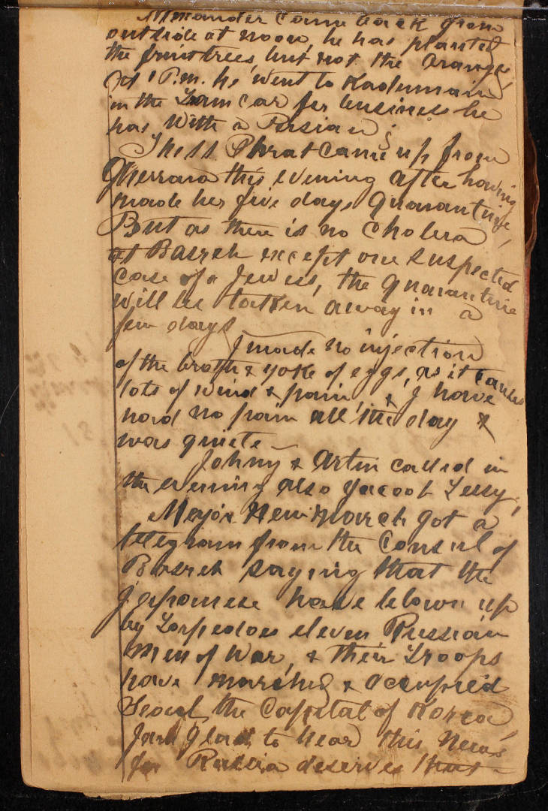
Introduction
Use the Joseph Mathia Svoboda diaries to classify data
Record number of deaths in the Ottoman Empire

Slide 3
Introduction
Use the Joseph Mathia Svoboda diaries to classify data
Record number of deaths in the Ottoman Empire

Slide 4
Limitations
Changes in regional names
Different places shown based on who made the map
  Different languages used
Notes:
30 seconds

Slide 5
Limitations
Changes in regional names
Different places shown based on who made the map
  Different languages used
Notes:
30 seconds

Slide 6
Difficulties with our data
Names of places spelled incorrectly
  Multiple spellings
Coordinates hard to find
  Some locations now nonexistent
  Neighborhood locations
Notes:
30 seconds

Slide 7
Difficulties with our data
Names of places spelled incorrectly
  Multiple spellings
Coordinates hard to find
  Some locations now nonexistent
  Neighborhood locations
Notes:
30 seconds

Slide 8
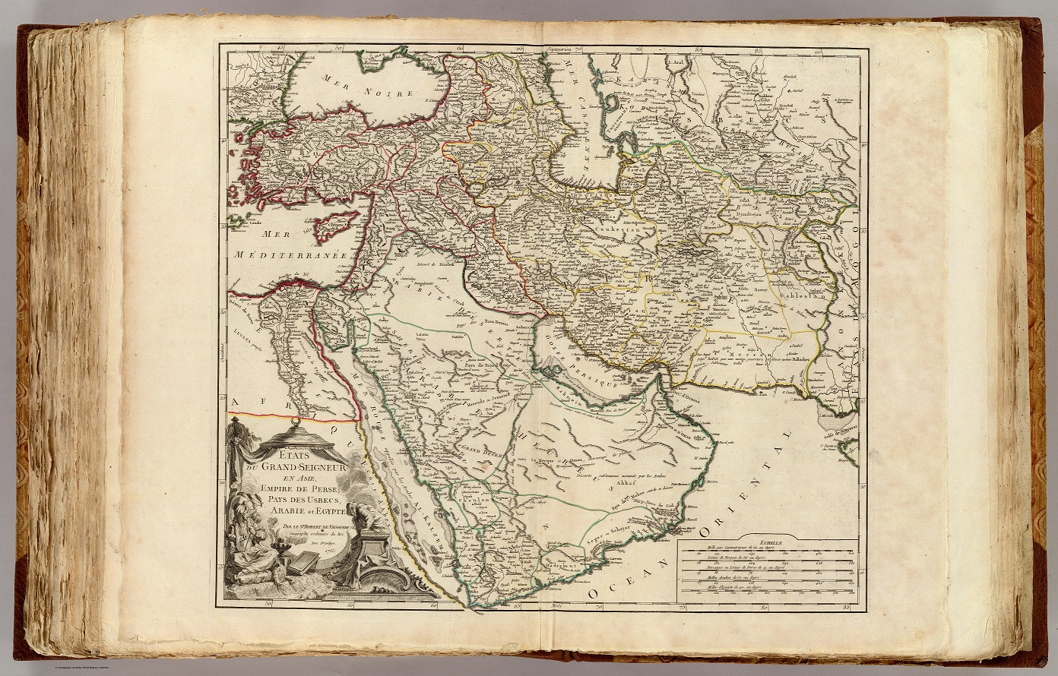
Maps

Slide 9
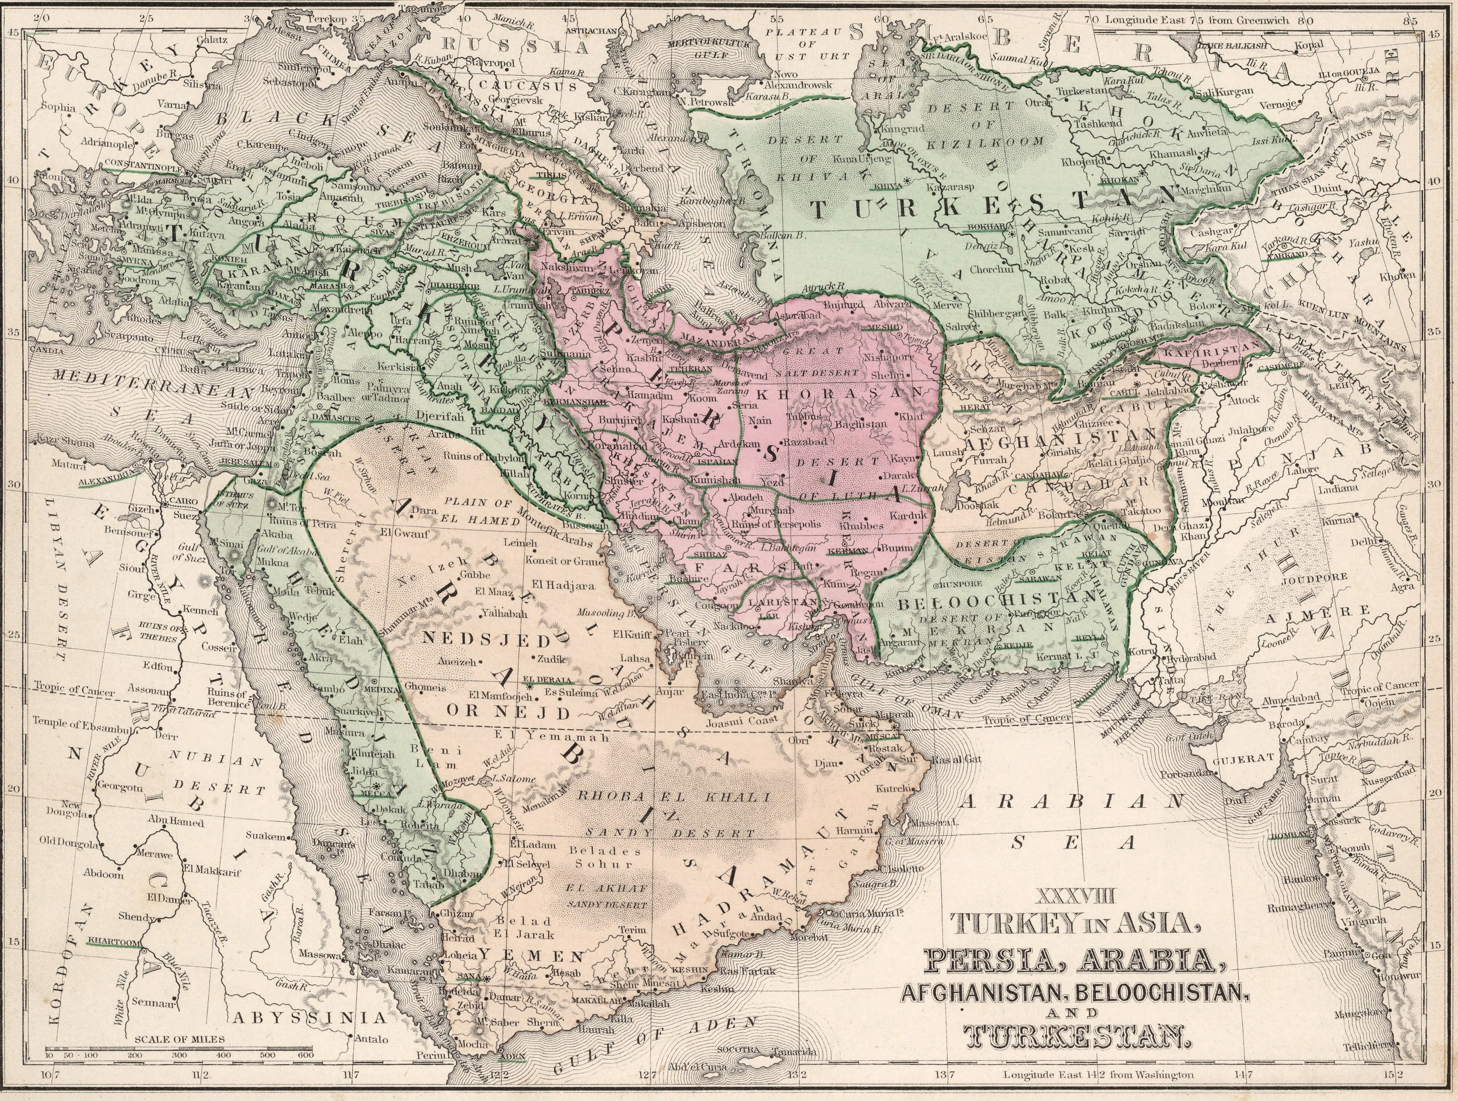
Maps

Slide 10
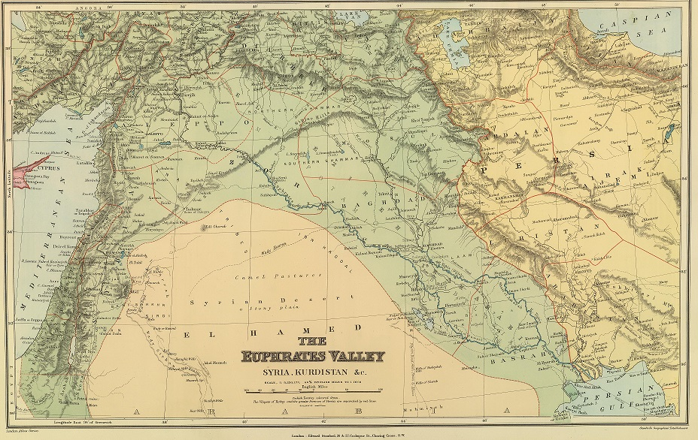
Maps

Slide 11
Combining maps
Overlaying maps
Matching up coordinates for more well known locations

Slide 12
Combining maps
Overlaying maps
Matching up coordinates for more well known locations

Slide 13
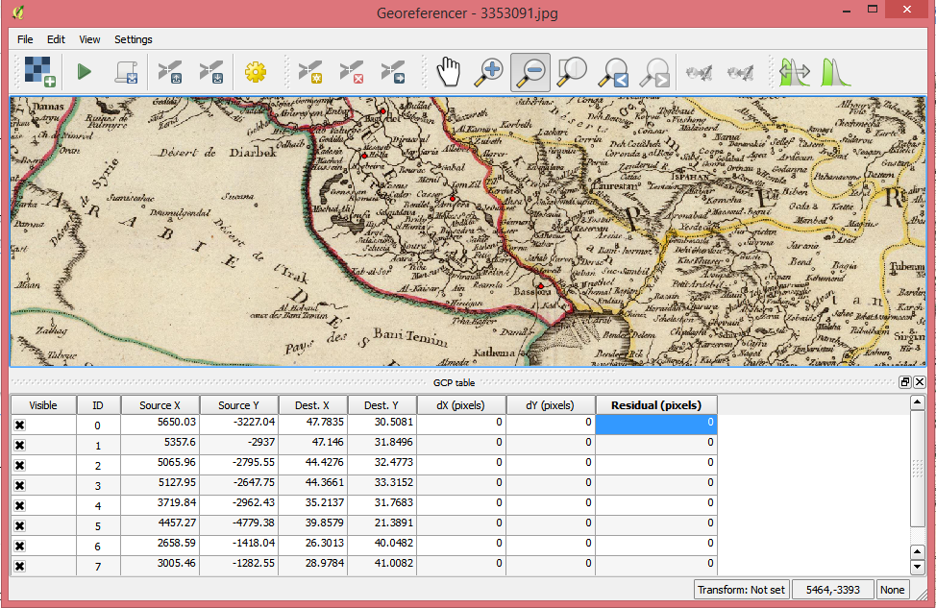

Slide 15
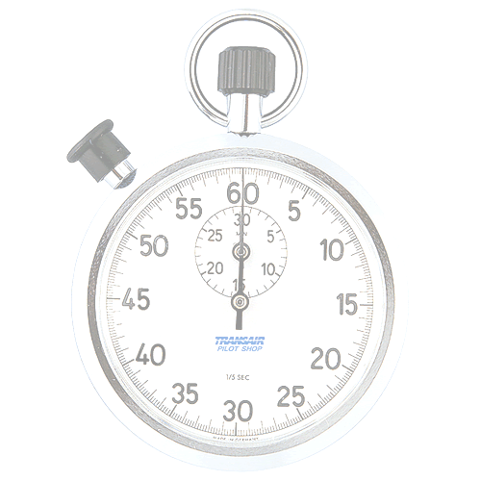
Time’s Up!
About your speakers:
  Newbook Digital Texts Inters
    Corina Geier
      Mathematics
    Hannah Jolibois
      JSIS, Public Health
    Erika Arias
      JSIS, LSJ

