Slide 1
From the Ground Up:
Building a Library Wellness Program
Monica Gingerich, Coordinator for Student Experience and Engagement
Macy Bowman, Graduate Assistant
Megan Gilpin, Education Program Specialist
Penn State University Libraries
Big Ten Academic Alliance Student Wellness Symposium 2025

Slide 2
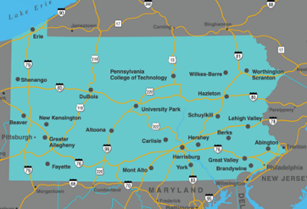
Penn State Libraries landscape
Total enrollment around 90,000
19 physical campuses and World Campus (virtual)
https://datadigest.psu.edu/student-enrollment/Campus structure
Credit: Penn State. Creative Commons
Notes:
Monica

Slide 3

Beginnings
Wellness work dating back to 2014 (and probably earlier)
Formalized with establishment of the LibWell Initiative in 2023
Notes:
Megan
De-Stress Fest began before 2014
We know now that a lot of the outreach work we've been doing (Open Houses, one-off programs) contribute to that sense of belonging and well-being. We just didn't identify it as such.
Penn State formalized an actual wellness initiative in 2023 with the establishment of LibWell.

Slide 4

LibWell
Coordinate and advance student wellness efforts across the University Libraries
Plan and support activities, initiatives, and purchases directly addressing both physical and mental wellness
Identify wellness resources and services related to enhancing academic success
Seek out campus partners and experts in student wellness (because we are not)
Notes:
Megan
LibWell is the leadership group responsible for the wellness efforts at Penn State Libraries. (see above)
It took us time to get our footing. We had to figure out exactly how we were going to make it work, especially since we were supporting work spread out across the Commonwealth of Pennsylvania.
Two big sources of inspiration/help with this work:
*Student Wellness and Academic Libraries, ed. Sara Holder and Amber Lannon
*LOEX 2023 presentation on the StudyWell Initiative (we had already decided on LibWell before attending LOEX) by Laura W. Gariepy, Emily J. Hurst, Sue Robinson, Ryan Pander of Virginia Commonwealth University Libraries.

Slide 5

Distinctive Branding
PR Campaign
Benefits
Easily identifiable to students
This is something that has to do with me and my wellness
Stays the same when transferring from a different campus
Students identify that the Libraries cares about their wellbeing
Notes:
Monica
Worked with our Public Relations and Marketing department to develop a campaign to support the initiative.
If you don't have a PR department, just develop marketing materials that are consistent.

Slide 6

Semester Themes
Opt-in and tailor to the campus
Take a Break Tuesday activities and Whiteboard Wednesday prompts (thank you VCU!!!!)
Coordinated purchases to support TBT activities
Two online programs for any location (including World Campus)
Notes:
Monica
It took us some time to decide how we could be most effective. We cannot be responsible for ALL student wellness work. That is part of everyone's jobs.
Here's how we can best support all students at all locations.
Provide the tools and programs and allow those locations to decide what works best for their students.

Slide 7

Notes:
Megan

Slide 8

Notes:
Megan

Slide 9
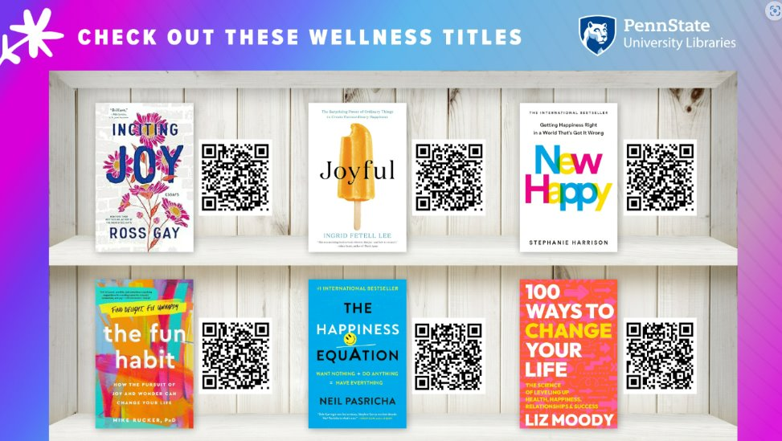
Notes:
Megan

Slide 10
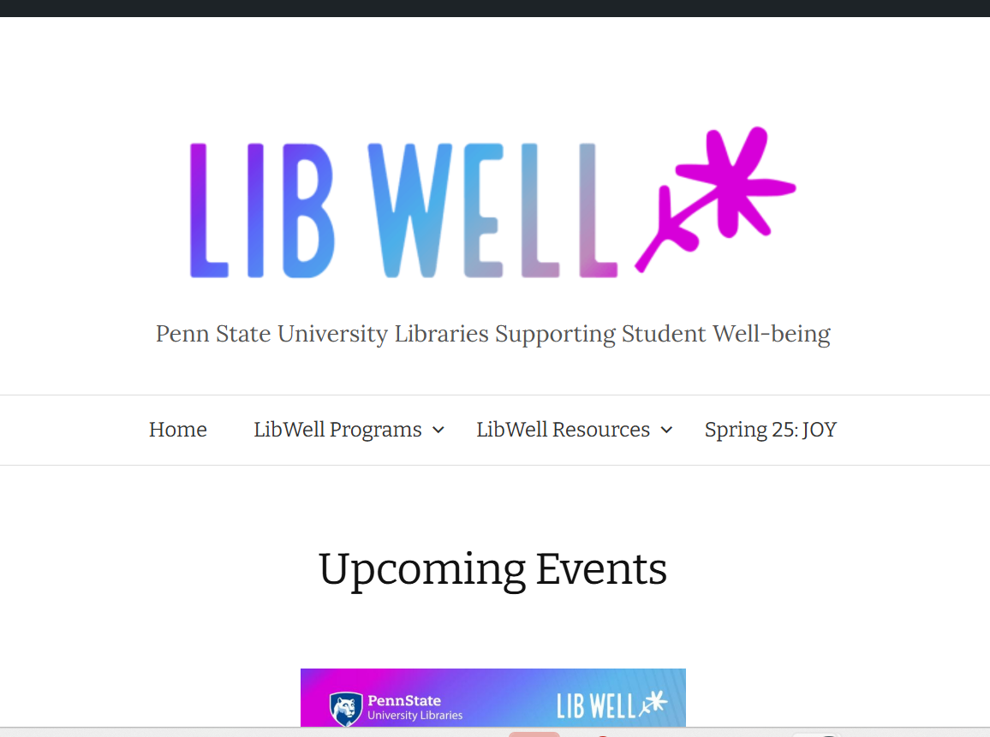
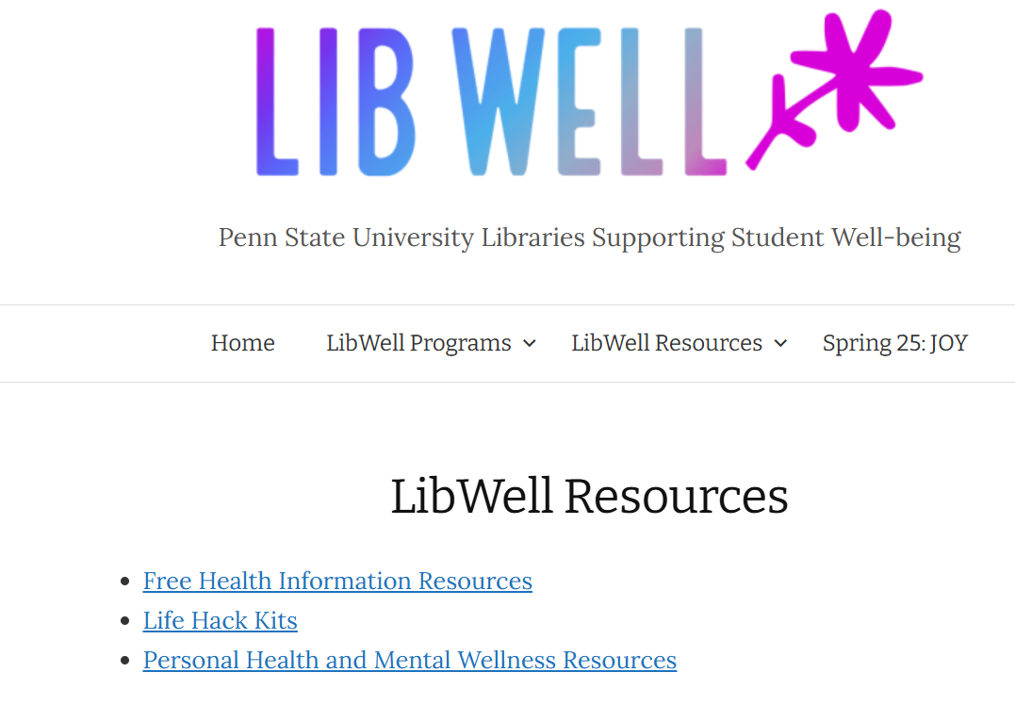

Website
Notes:
Monica

Slide 11
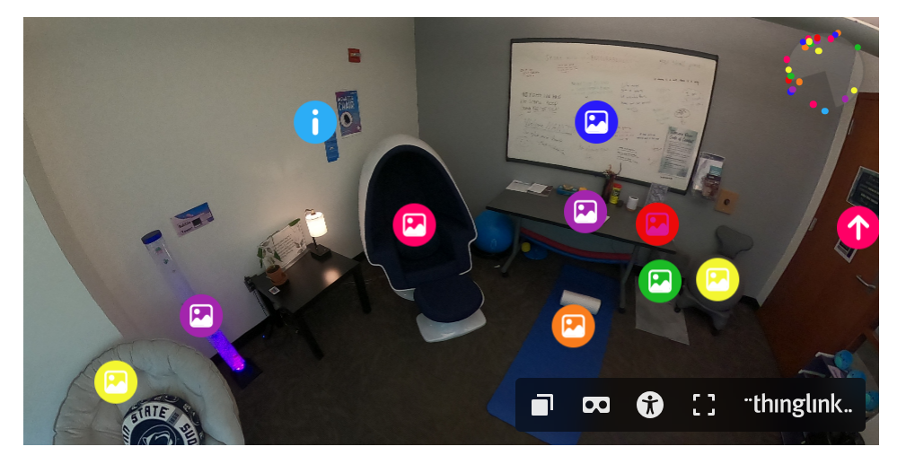
Support for Wellness Initiatives
Funding/supporting general wellness requests outside of the LibWell programming
Sensory Friendly Libraries initiatives: rooms/spaces
Sensory-Friendly Libraries Website
Notes:
Megan
Our library development board identified this as an important area of work and we are fortunate to have been the subject of Giving Tuesday campaigns and endowment funding.

Slide 12

Assessment- Fall 2024
Identifying Wellness Activities Across PSU Libraries
Across the Commonwealth - December 2022-December 2024
Interviews with Head Librarians at Commonwealth campuses.
  Leisure Reading “reading rumble”, wellness corners, sensory kits, crafts, & online wellness programming.
Notes:
Monica

Slide 13

Assessment- Spring 2025
How does UP-Libraries support student wellness?
Sharing Circles with Students
  A third space to study, relax, or work with friends.
  Utilizing sensory space, destress fest activities, & leisure reading collection.
  Understanding what LibWell is and how it can support them.
Notes:
Megan

Slide 14
Future Steps
Safe Haven
Incorporating student feedback into future planning and collaborations
Notes:
Monica

Slide 15
Questions?
Monica Gingerich (mcg5660@psu.edu)
Megan Gilpin (mcg13@psu.edu)

