Slide 1
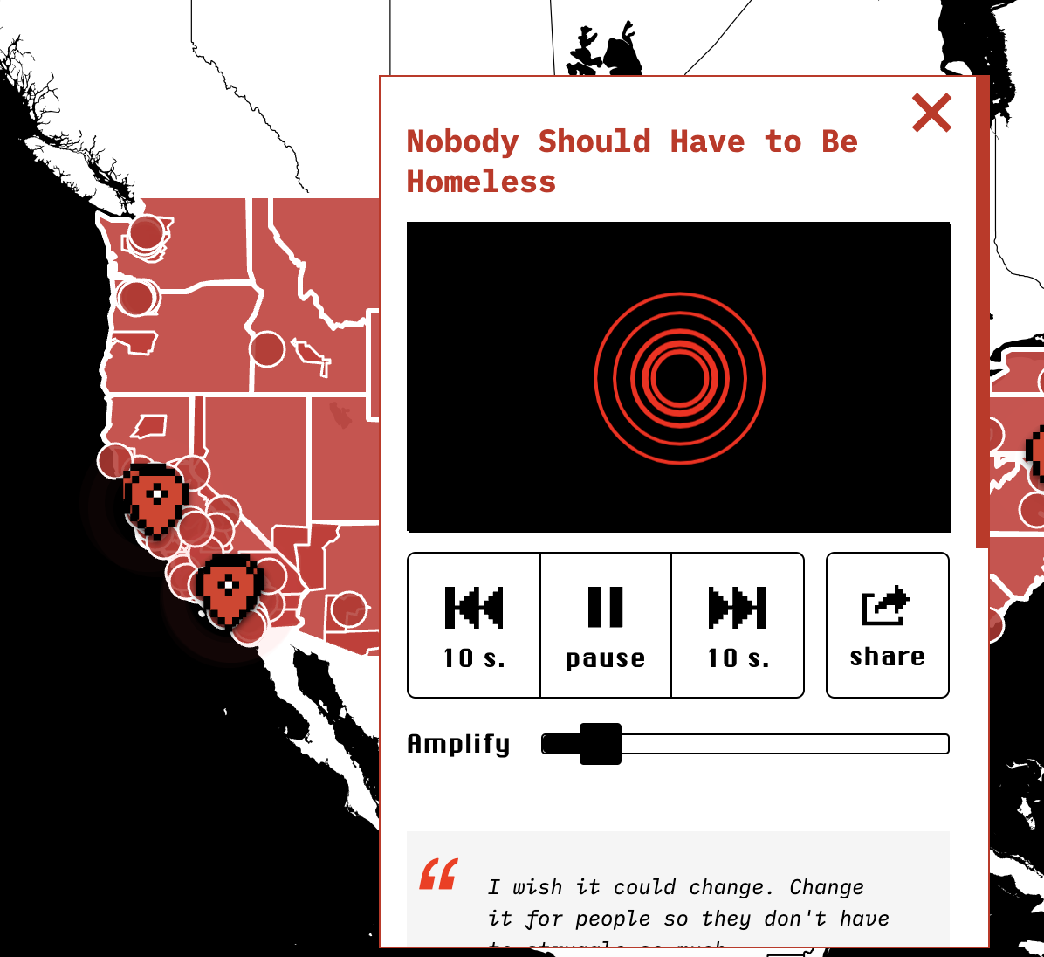
Interactive Digital Story Mapping to Document Housing (In)justice through Community-Based Design
GIS Symposium
University of Washington | May 25, 2022
Brett A. Halperin
PhD Student, Human Centered Design & Engineering,
University of Washington
Designer, the Anti-Eviction Mapping Project
Twitter: @bretthalp
Portfolio: https://bretthalperin.com
www.bretthalperin.com
Notes:
In this talk, I will present the community-based design of interactive digital story mapping to document COVID-19 tenant experiences and housing (in)justice information: eviction data, global housing protection legislation, and housing justice actions as part of the Anti-Eviction Mapping Project (AEMP). Since 2013, the AEMP has conducted oral history interviews to amplify tenant voices by collecting and counter-mapping narratives of displacement and resistance. However, with low resources and dependence on in-kind labor, community-based practices such as these move slowly; as volunteers, we struggle to collect, counter-map, and disseminate housing justice information at a pace that can keep up with the rapidly accelerating rates of eviction and harm inflicted on marginalized communities, especially during times of crisis. Thus, to support social movement organizations in launching digital counter-maps under severe time and resource constraints, I will discuss the community-based design behind the AEMP's free and open-source system built in response to the COVID-19 housing crisis along with key design considerations, strategies, and lessons learned. By sharing these insights, I aim to extend quick-hand guidance on visual story mapping: multimedia and geographic information systems design for social change. I also wish to foster collective listening and generative discussion by extending invitations to experience these stories online at: covid19.antievictionmap.com.

Slide 2
Protections & Housing Justice Actions Map

Slide 3
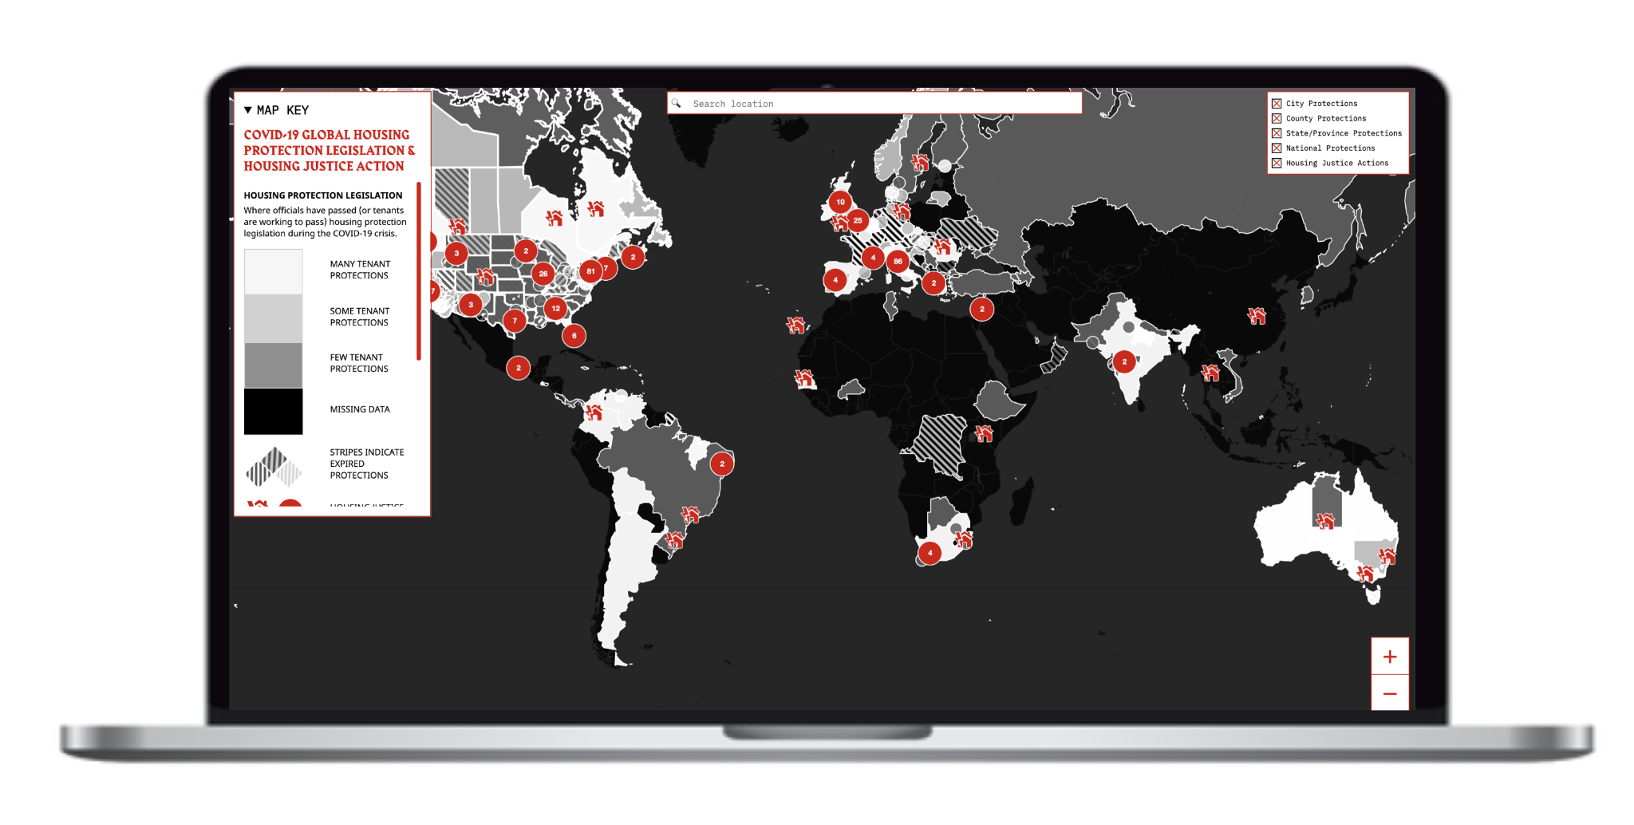
Link to view online at: https://covid19.antievictionmap.com/tenant-protections
Notes:
Priorities: usability (retrieving information - city, county, state level plus iconography), accessibility (disorienting zoom), and language justice (in progress - working on up to 12 languages). Wanted to install our values and aesthetics in the map. Not just about what we work on, but also how we work.
Started involving community organizers and tenants in the design process. Asking them what they might use this for and seeing how it worked – or did not work – for them. We found it was useful for community organizers to cross-check data and see if anything was falling through the cracks. Accentuating the global housing justice actions on the landscapes. Cross-hatching for expiring protections. Aesthetic, neither warm nor cool colors. We also started talking about the role that narrative plays in capturing the hearts and minds, which we get to later, but from the get-go this was a goal, it just took time - it was longer process than working with more traditional datasets.

Slide 4
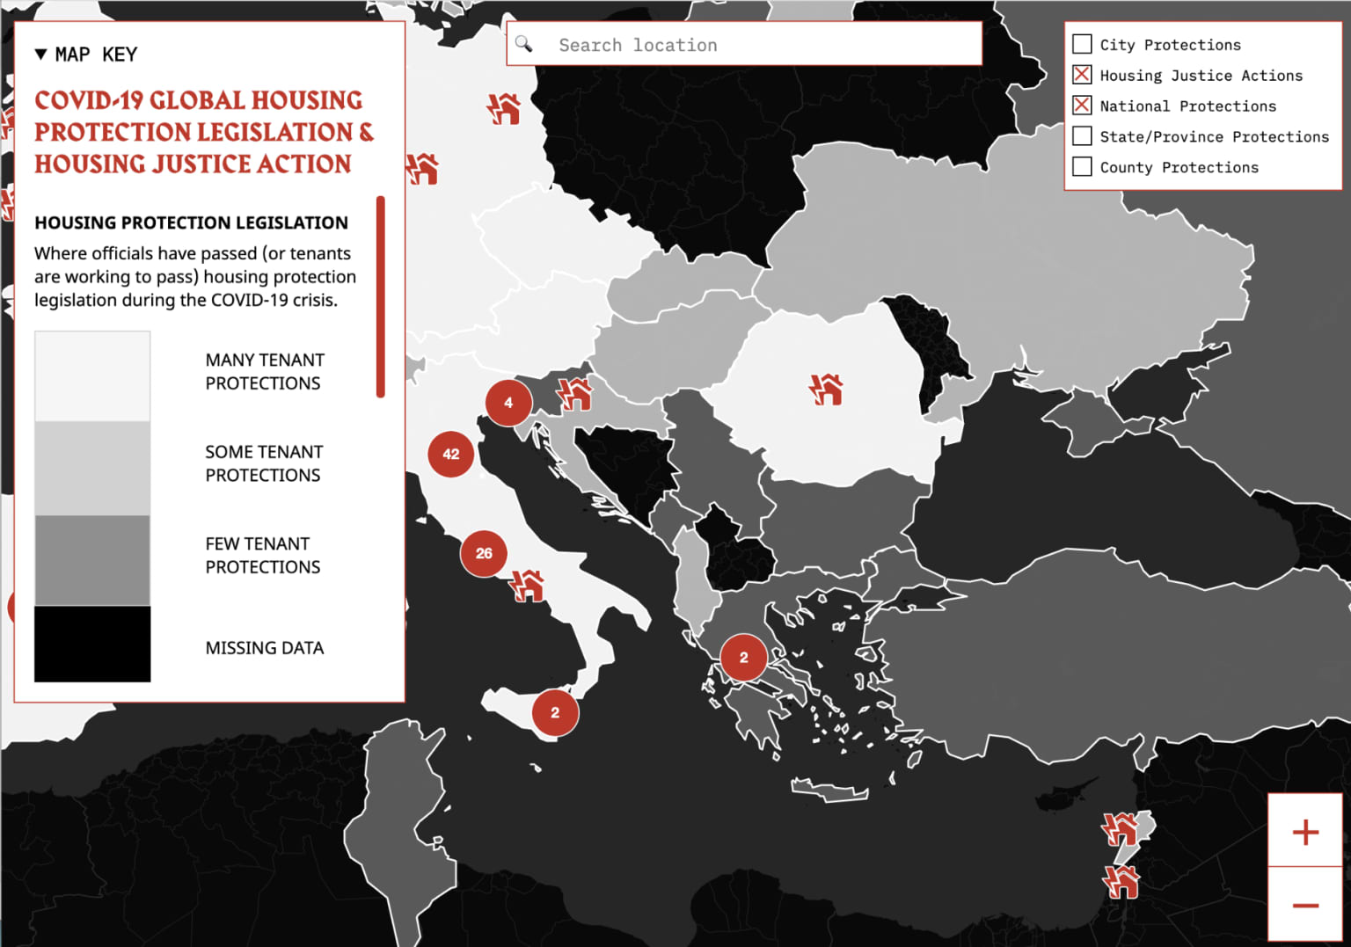
Notes:
Big buttons, sequential pattern, colorblind safe, high color contrast ratio for more accessibility

Slide 5
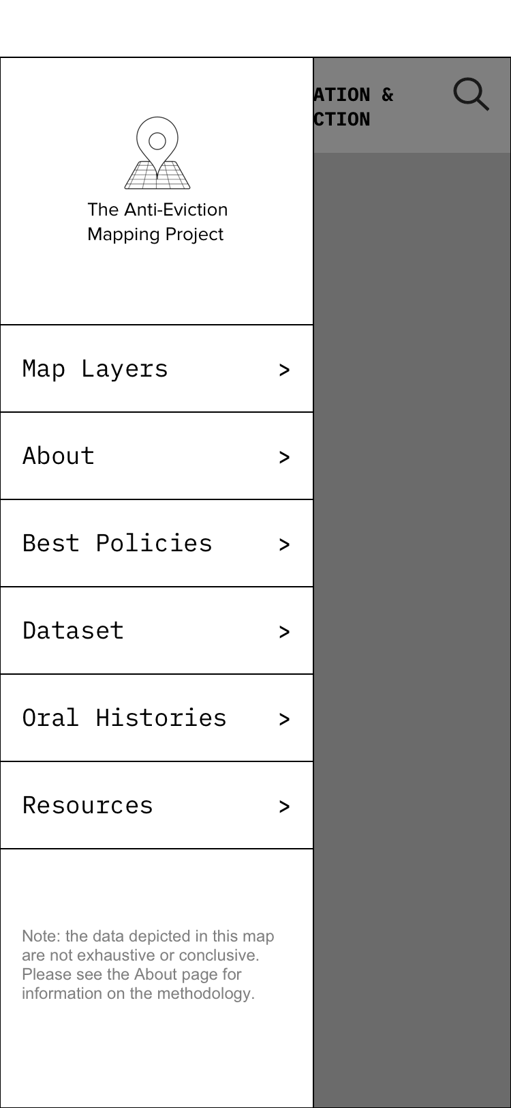
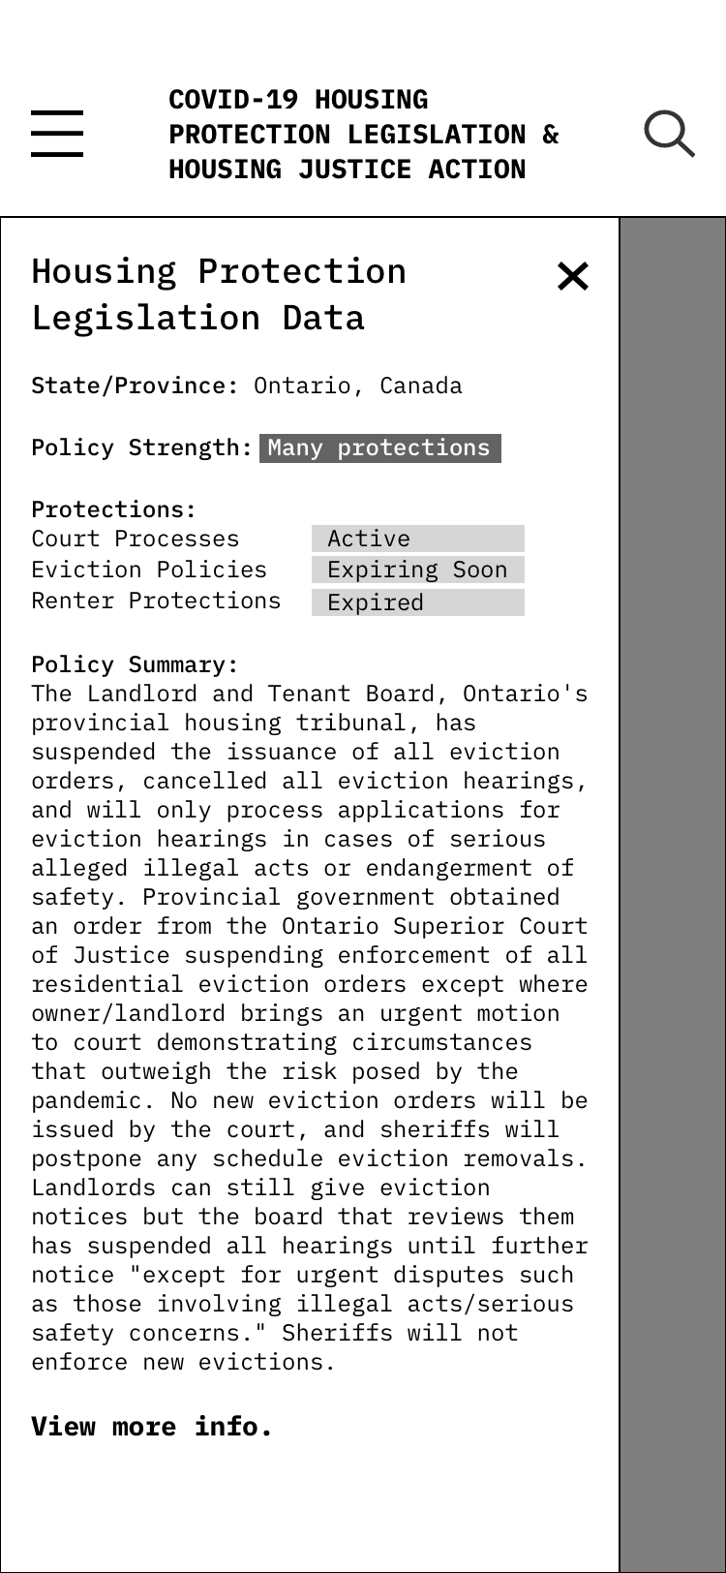
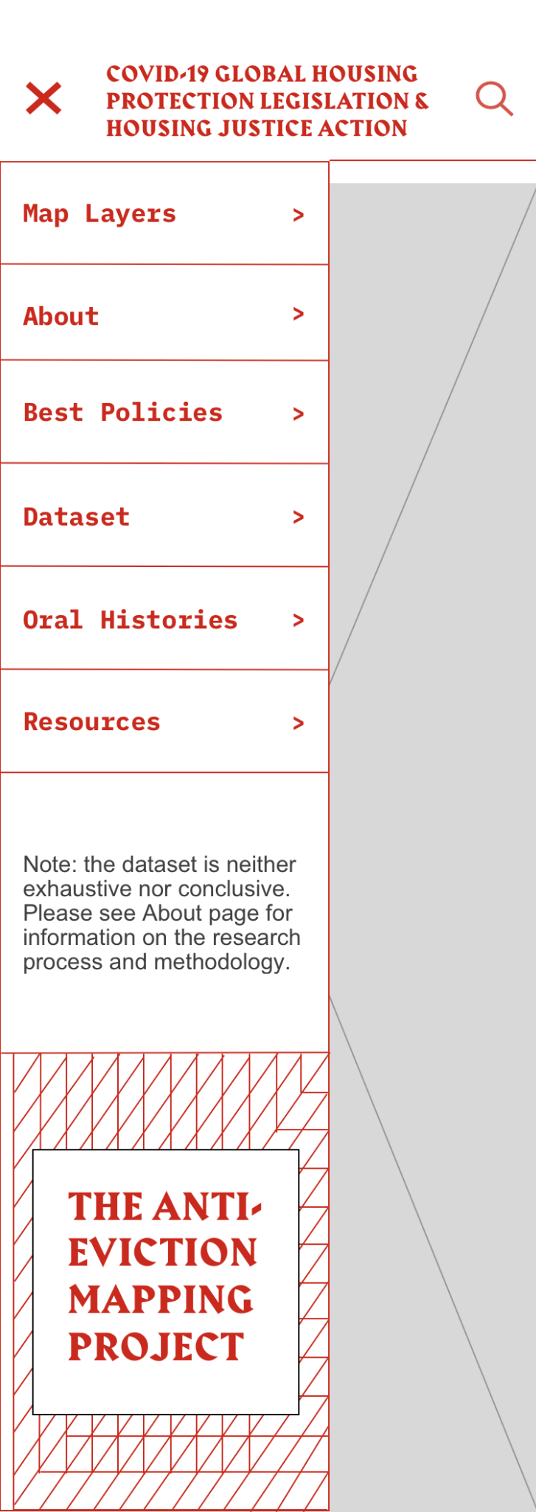
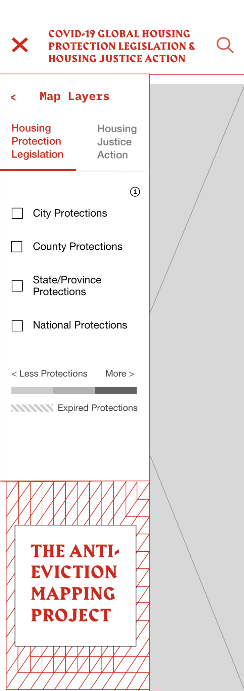
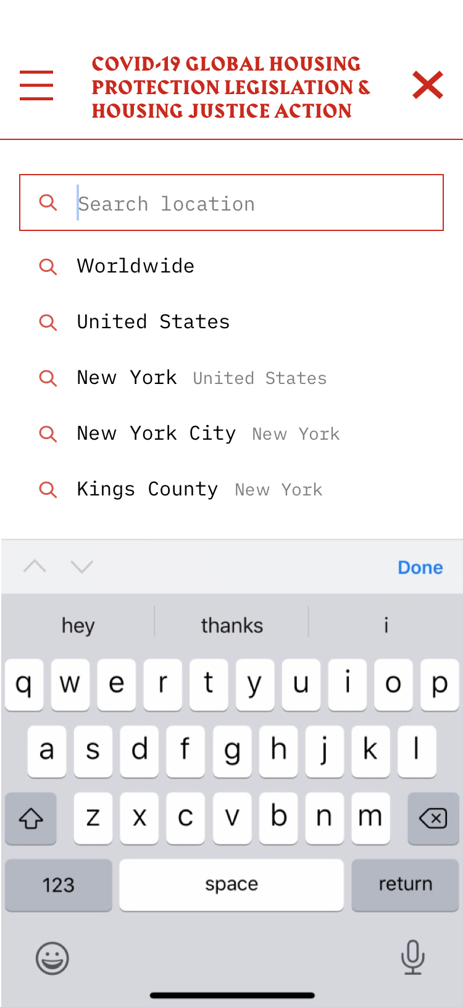
Notes:
Making it work on pocket computers

Slide 6
Evictions Story Map

Slide 7
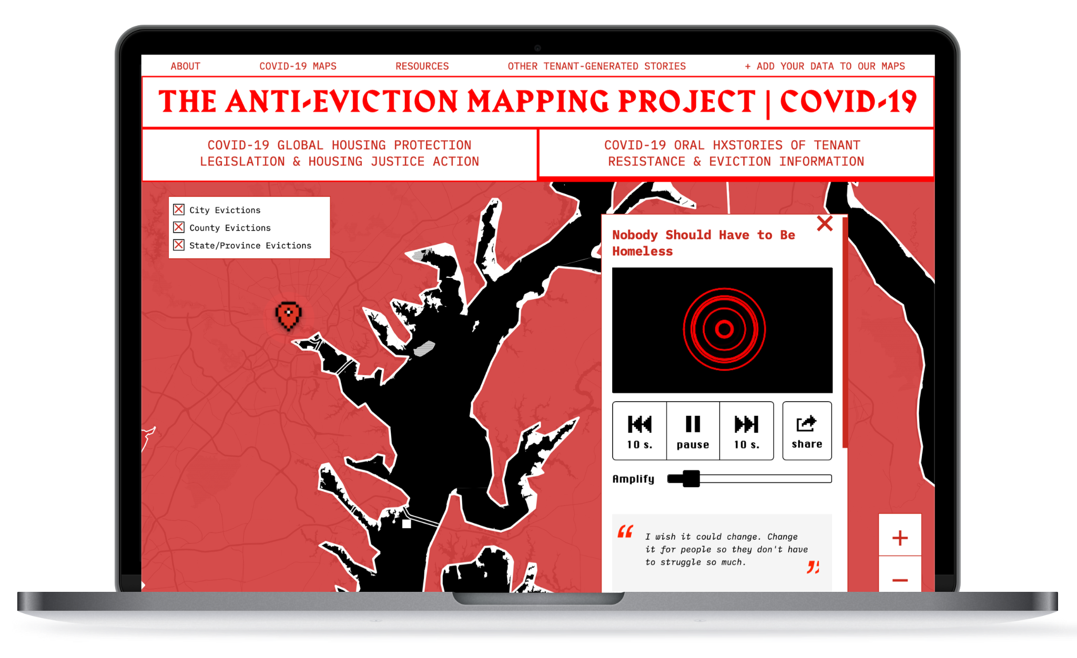
Link to view online at: www.covid19.antievictionmap.com/eviction-stories
Notes:
Two-tab structure for stories (cognitive load), audio-visualizer (classroom partnerships), making it shareable, sensory experiences (voice), share button

Slide 8
Demo
Notes:
We invite you to listen to these stories so that we can foster collective listening, generative discussion about these topics, and hopefully, through this artifact, we can collectively elevate these voices and work to positively change these landscapes together.

Slide 9
THE END

