Slide 1
Suitability Map: Safe Consumption Site in Seattle
Hanna Peterson
R E 370: Data Modeling
Final Project

Slide 2
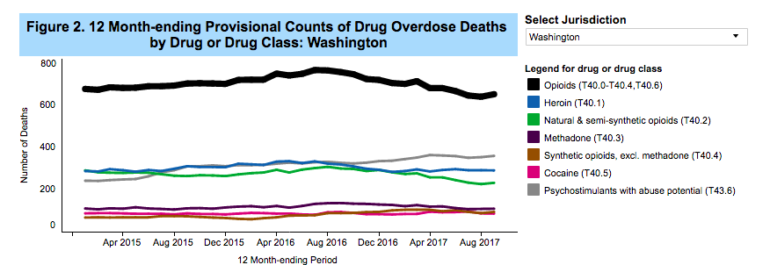
Background
Source: https://www.cdc.gov/nchs/nvss/vsrr/drug-overdose-data.htm

Slide 3
Background
Source: https://www.cdc.gov/nchs/nvss/vsrr/drug-overdose-data.htm

Slide 4
Layers Used
Daytime Population
Lack of Health Insurance
Poverty Rates

Slide 5
Layers Used
4. Poor Mental Health
5. Transportation Patterns
6. Drug Overdoses

Slide 6
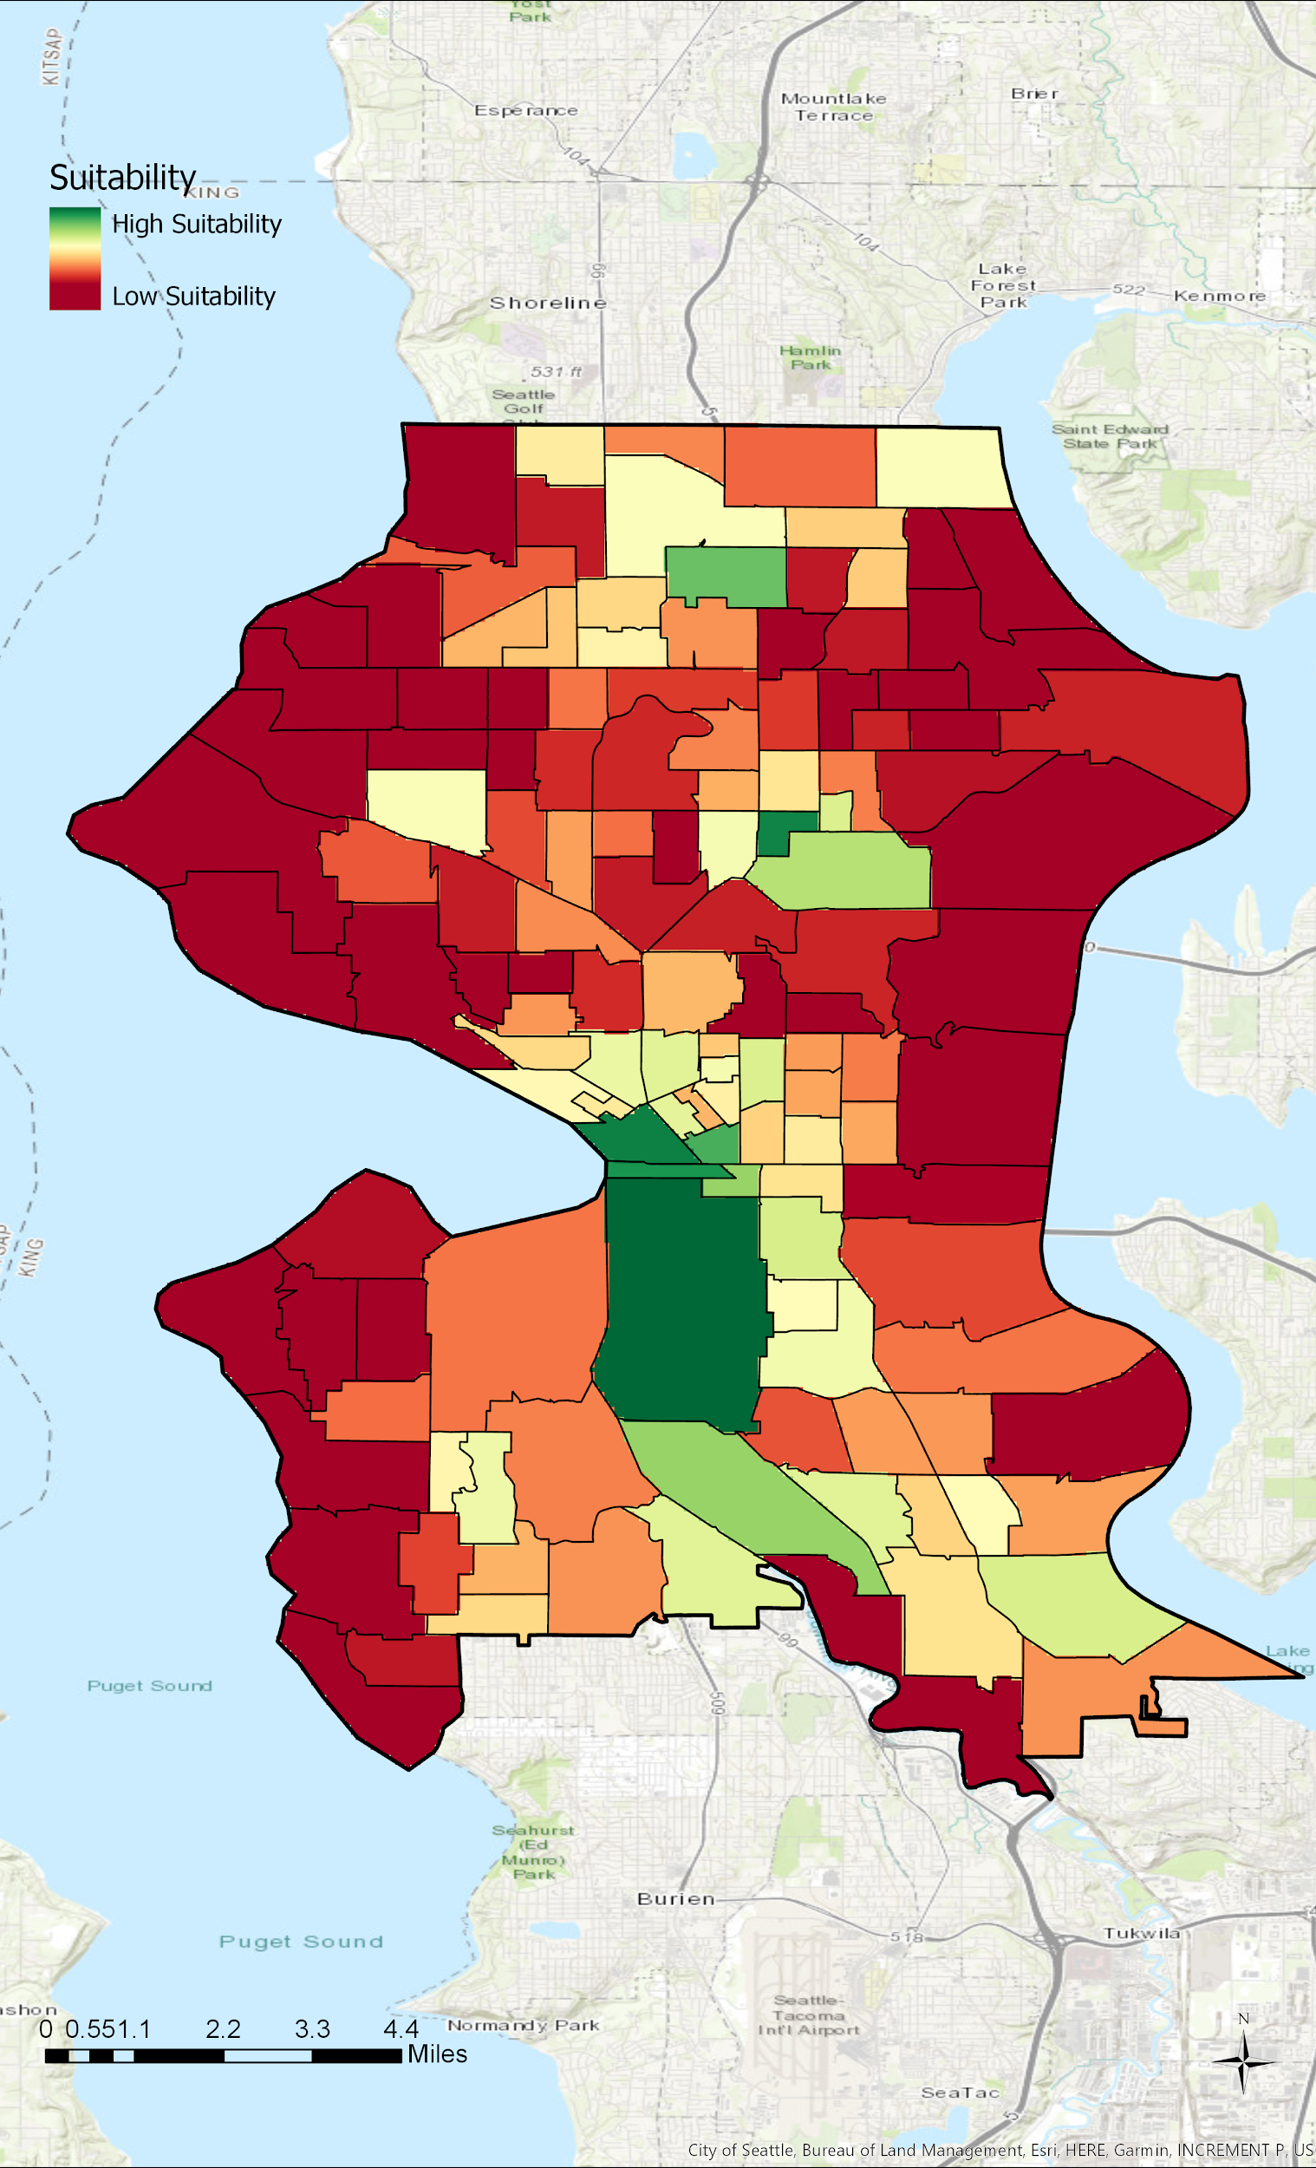
Methods
Pull data from various sources
Map to census tract
Convert polygon layers to raster images
Convert to common scale: MS Large
Weighted Sum: Weighed Drug Overdose Layer Heaviest, Followed by Poverty and Daytime Population

Slide 7
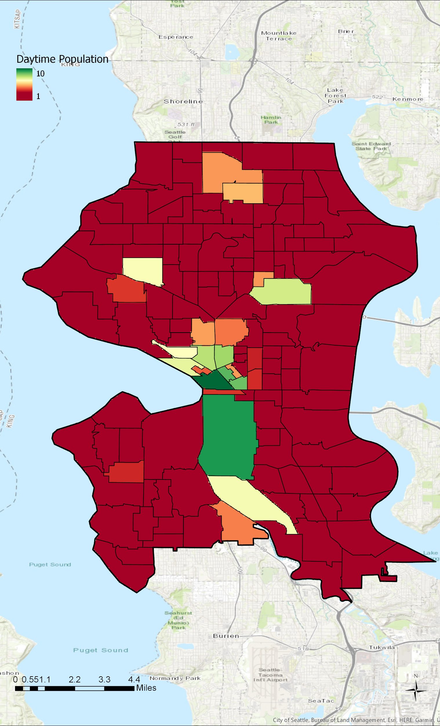
Daytime Population

Slide 8
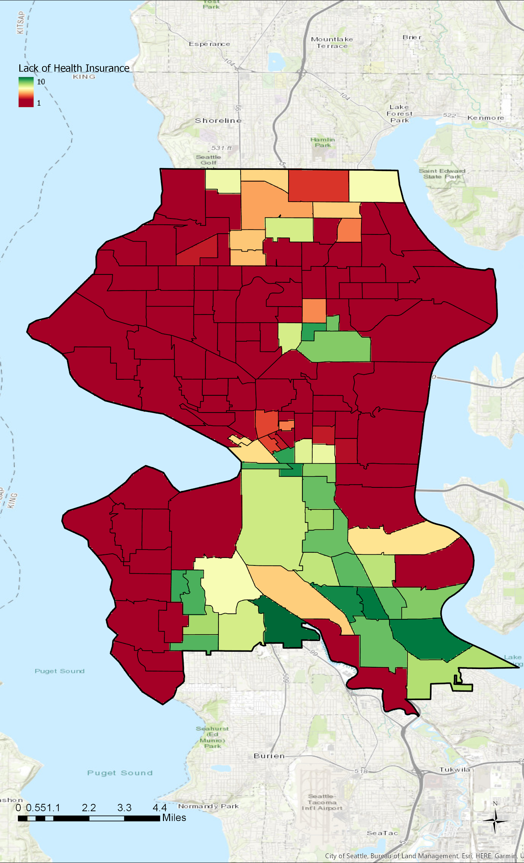
Lack of Health Insurance

Slide 9
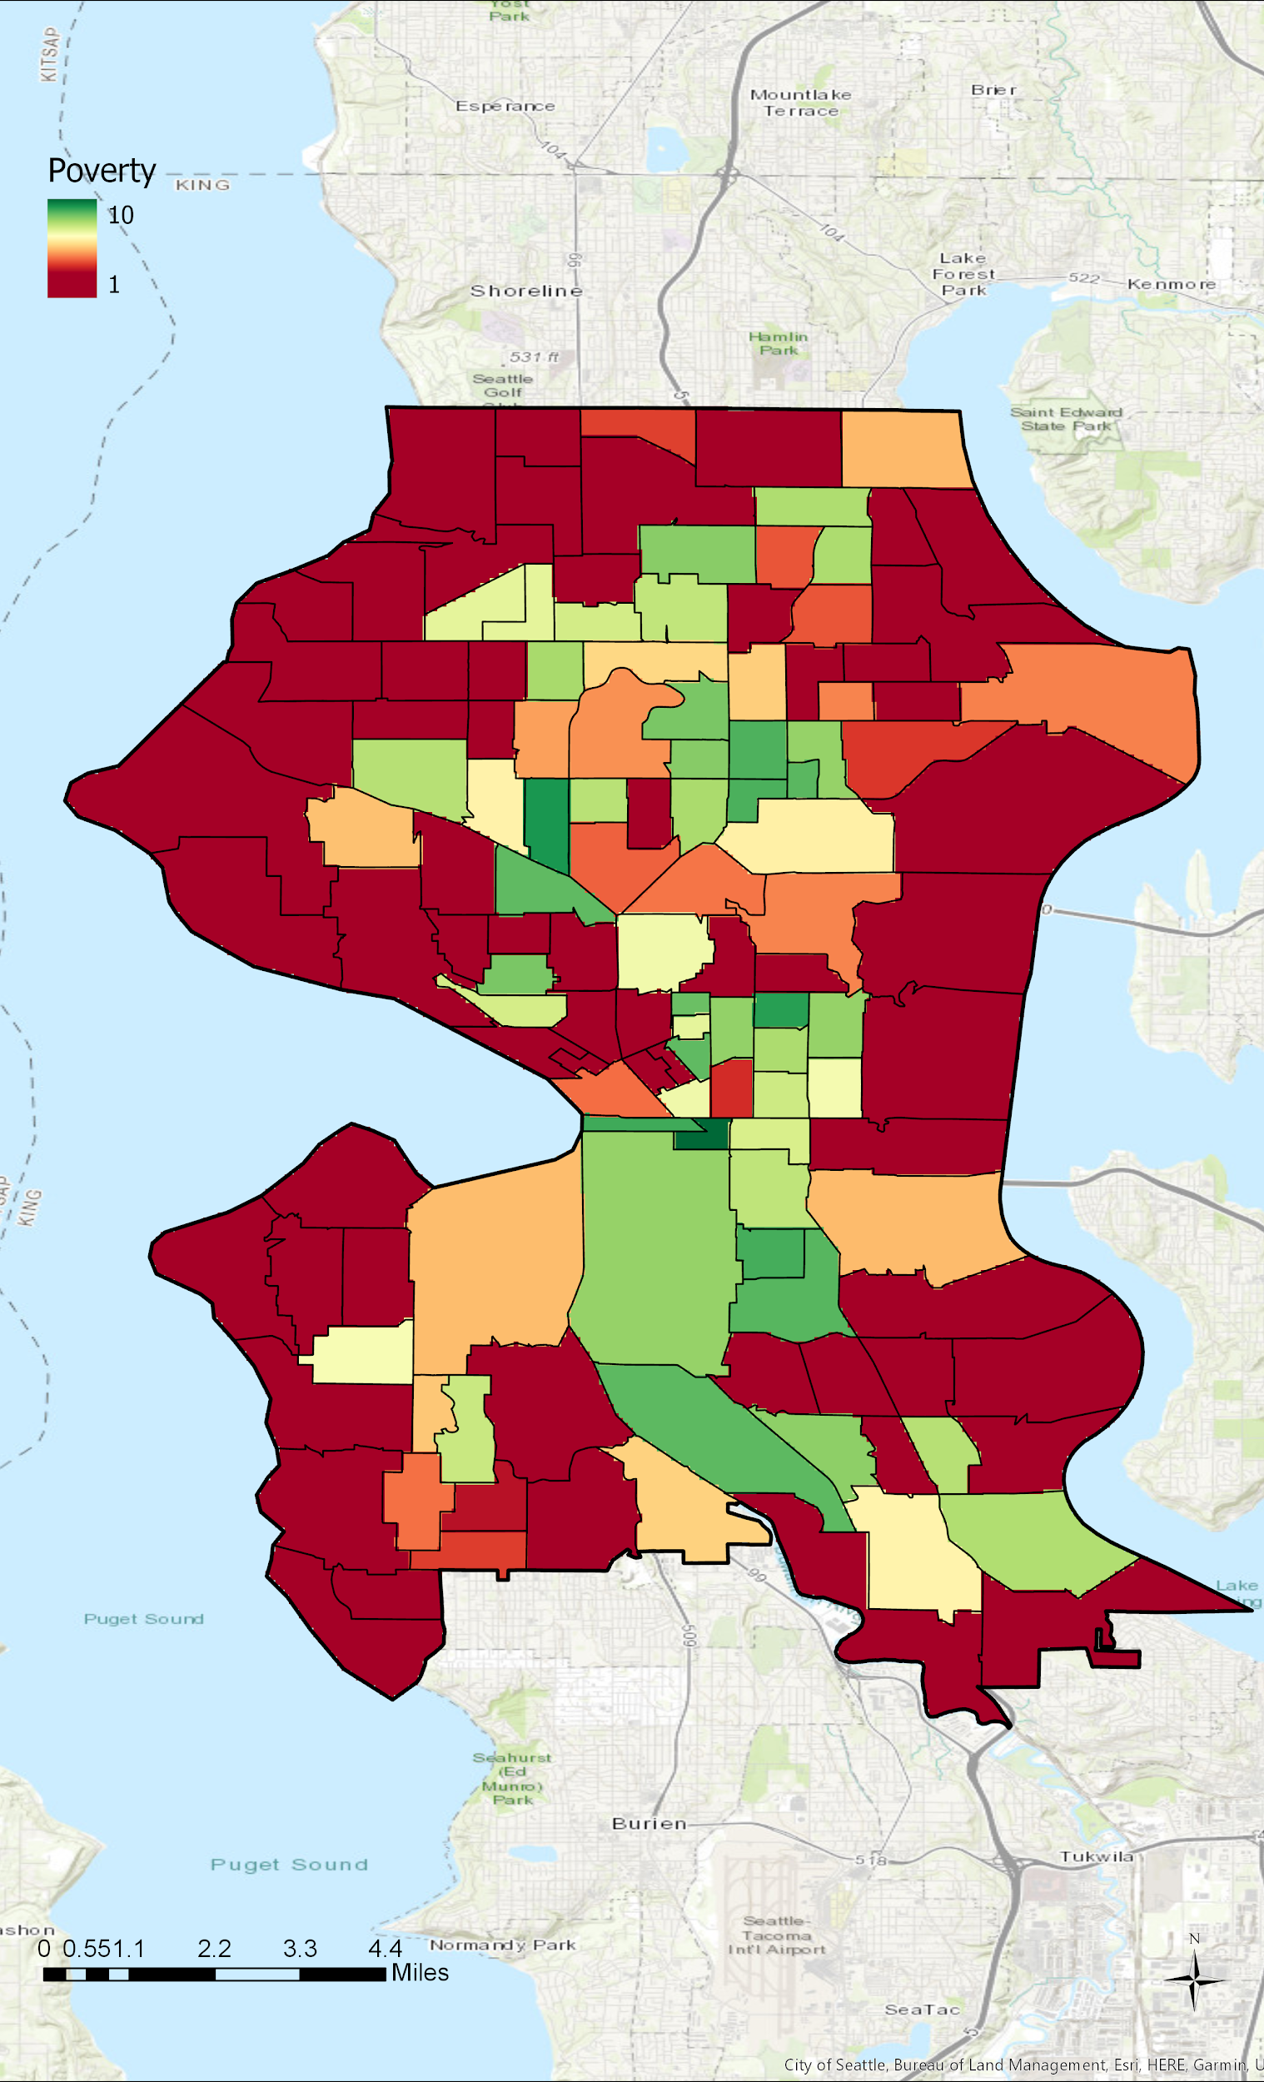
Poverty Rates

Slide 10
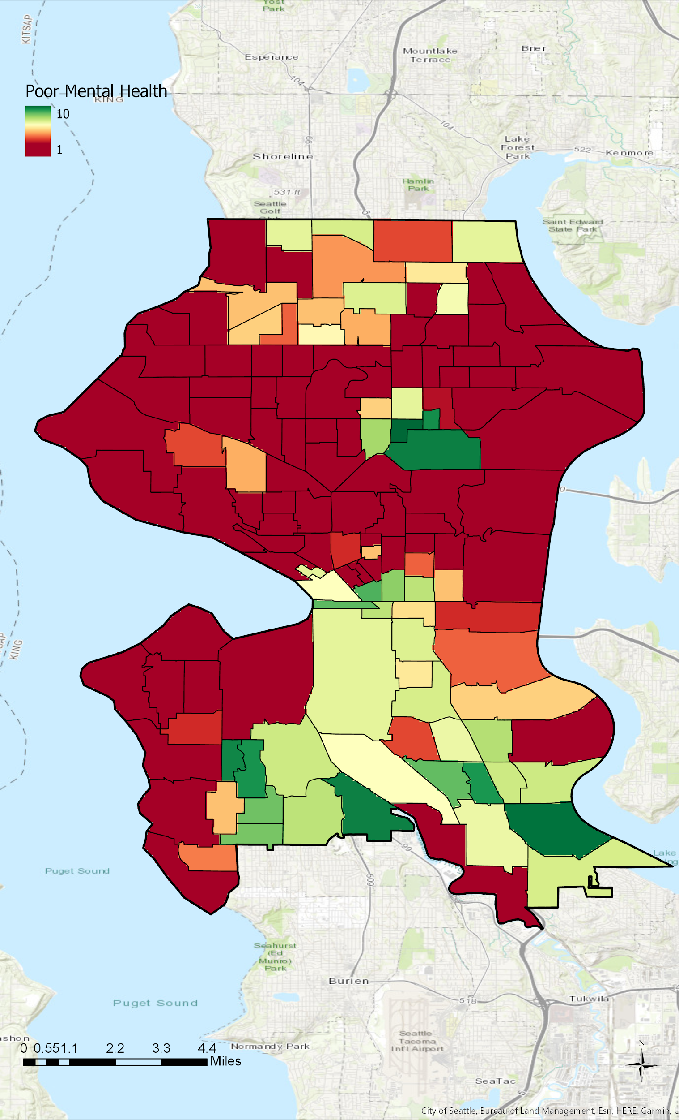
Mental Health

Slide 11

Transportation Patterns

Slide 12
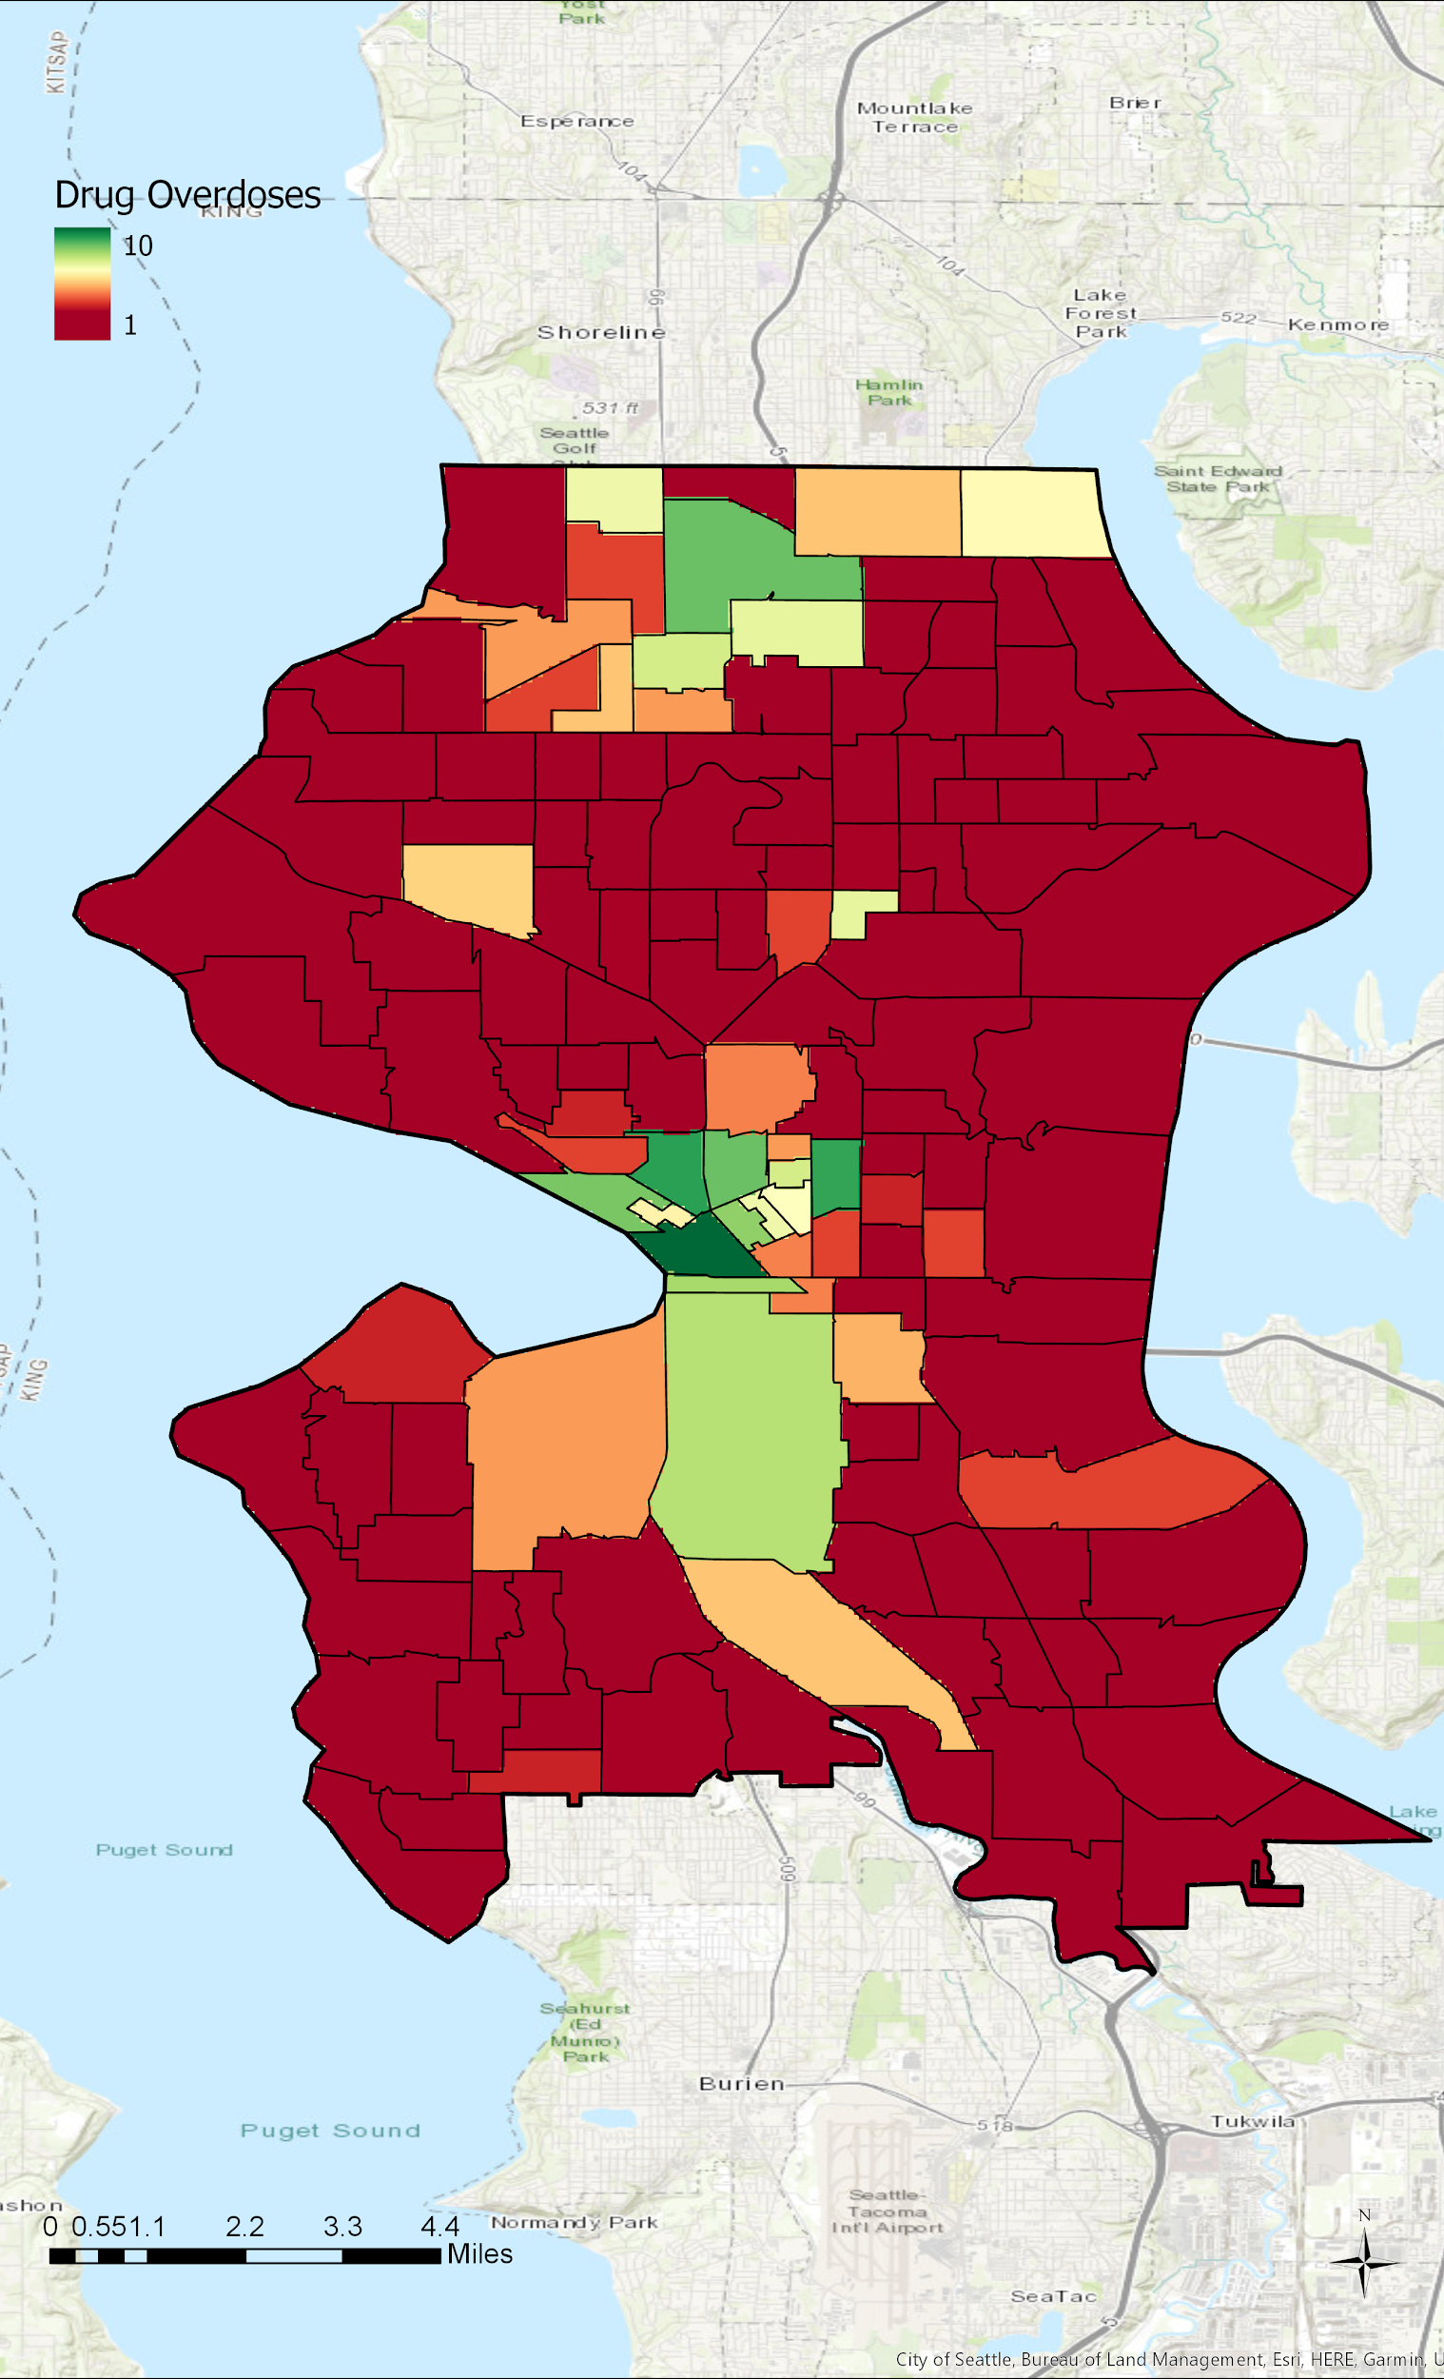
Overdose Rates

Slide 13
Overdose Rates

Slide 14
Final Suitability Map

Slide 15
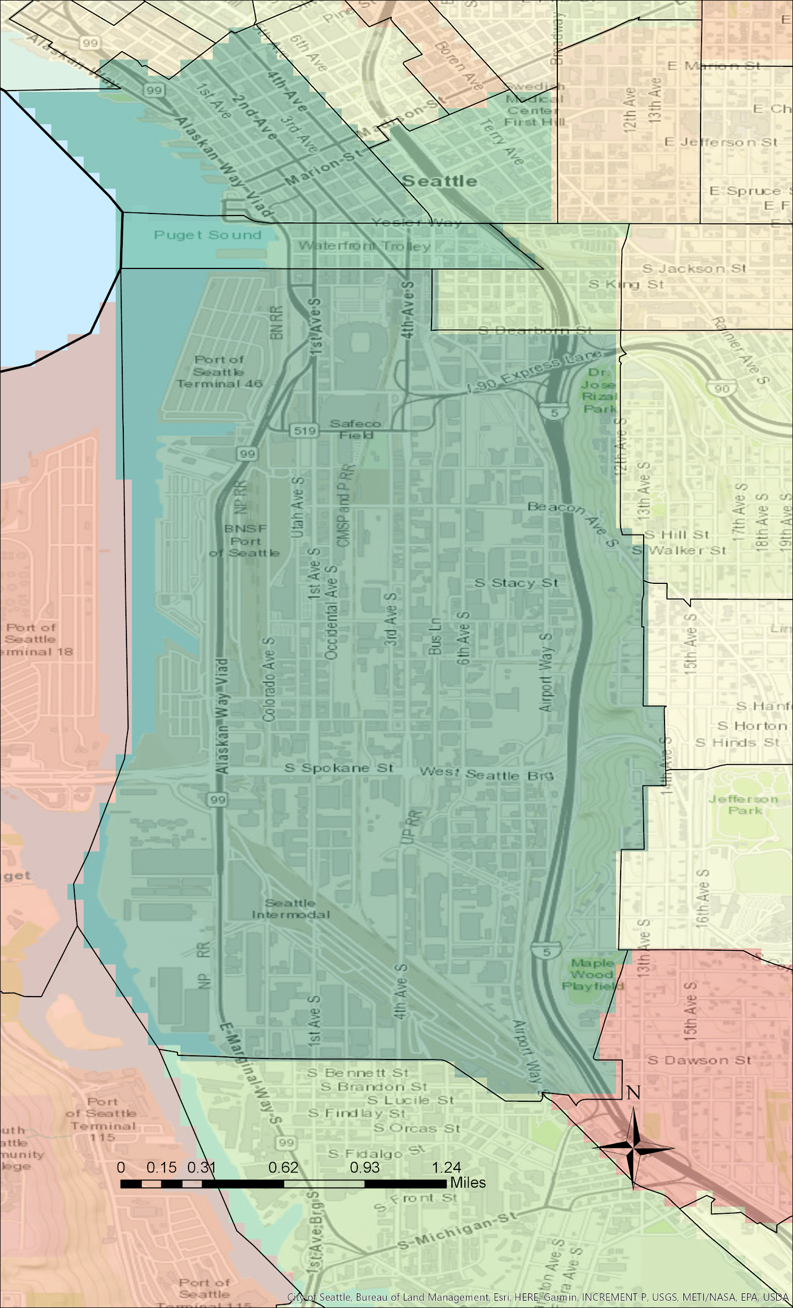
Findings
Most Suitable Site:
Census Tract 93: Sodo

Slide 16
Findings
Most Suitable Site:
Census Tract 93: Sodo

Slide 17
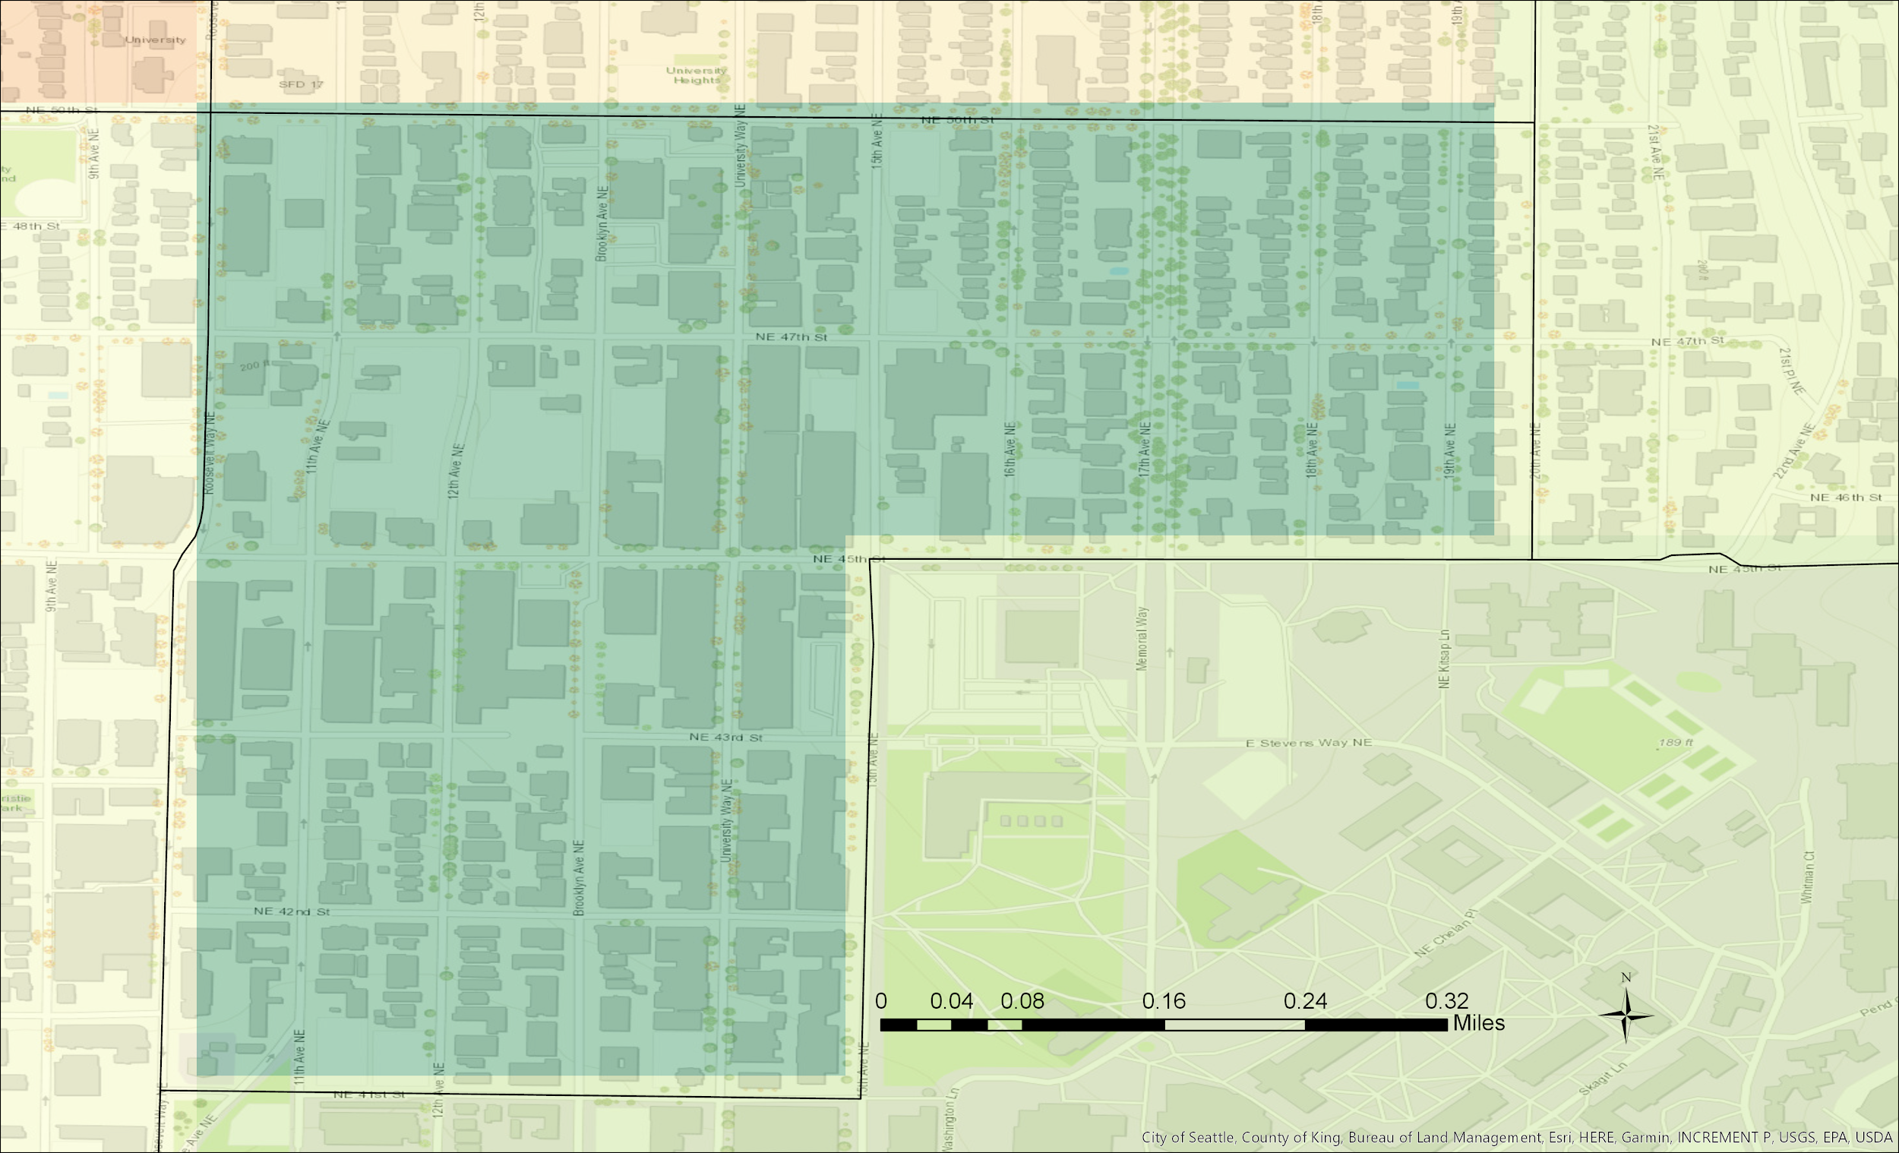
Findings
Second Most Suitable Site:
Census Tract 53: University District

Slide 18
Findings
Second Most Suitable Site:
Census Tract 53: University District

Slide 19
Limitations and Concerns
Self-Reporting of Mental Health
Overdose rates reliability

Slide 20
Future of Project
Build into senior project next year
Use additional GIS layers, other mediums

Slide 21

Time’s Up!
About your speaker:
  Name: Hanna Peterson
  Company: CEP
  Tel: (425) 530 6194
  Email: hannanp@uw.edu
  Social Media: Call/Email
  Quick bio: Hanna Peterson is a junior in the Community, Environment and Planning major at the University of Washington. She hopes to pursue a career in public policy and/or human services.

