Slide 1

Determining Park
Level of Service in the
City of Lake Forest Park
Collene Gaolach

Slide 2
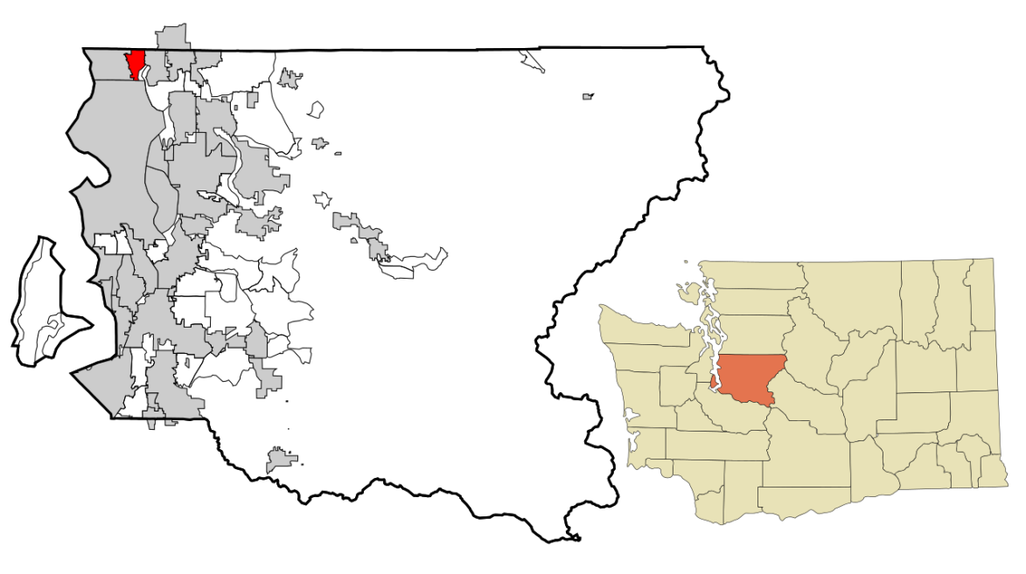
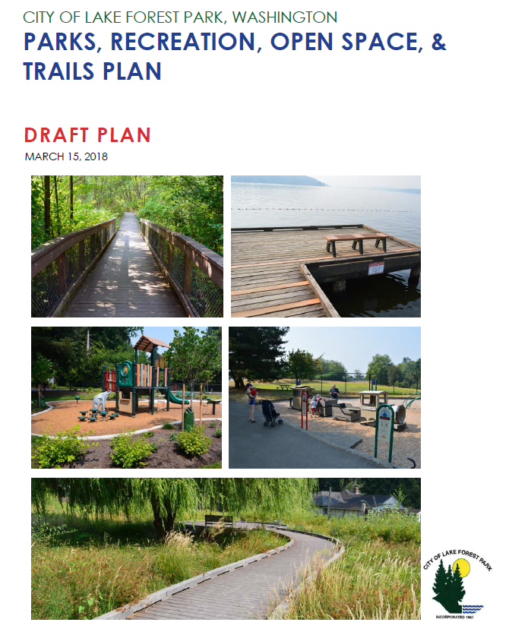

PROST
Fun Fact: the word “prost” translates as “Cheers”!

Slide 3
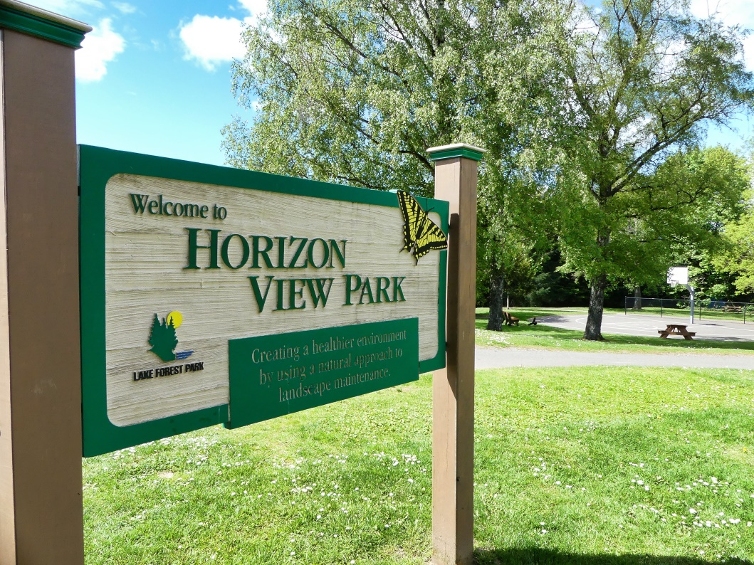

Level of Service (LOS)
A measurement of how well parks and recreational needs of the community are being met
1/2 mile (YELLOW)
1/4 mile (PURPLE)

Slide 4
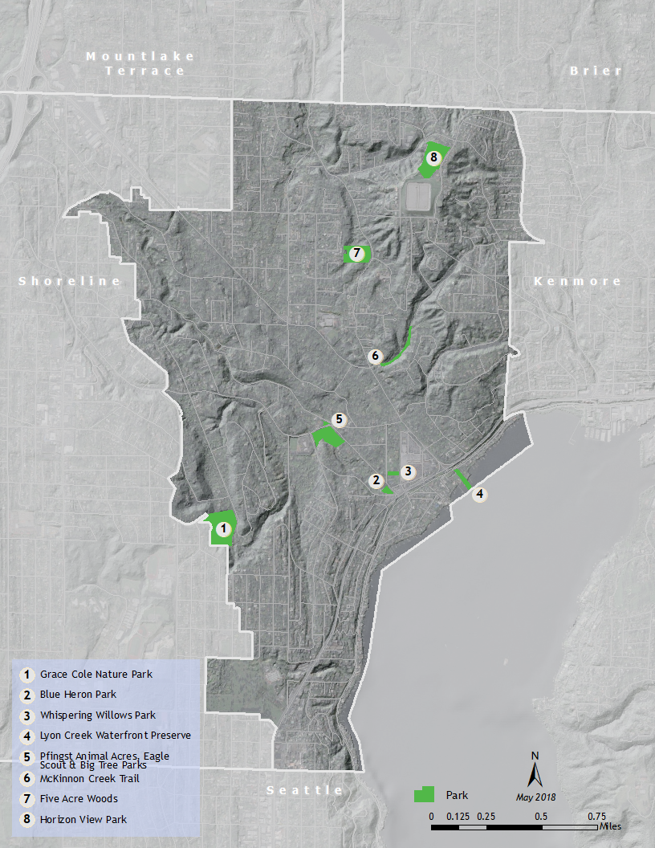
About 1.75 miles W to E
About 3 miles N to S

Slide 5
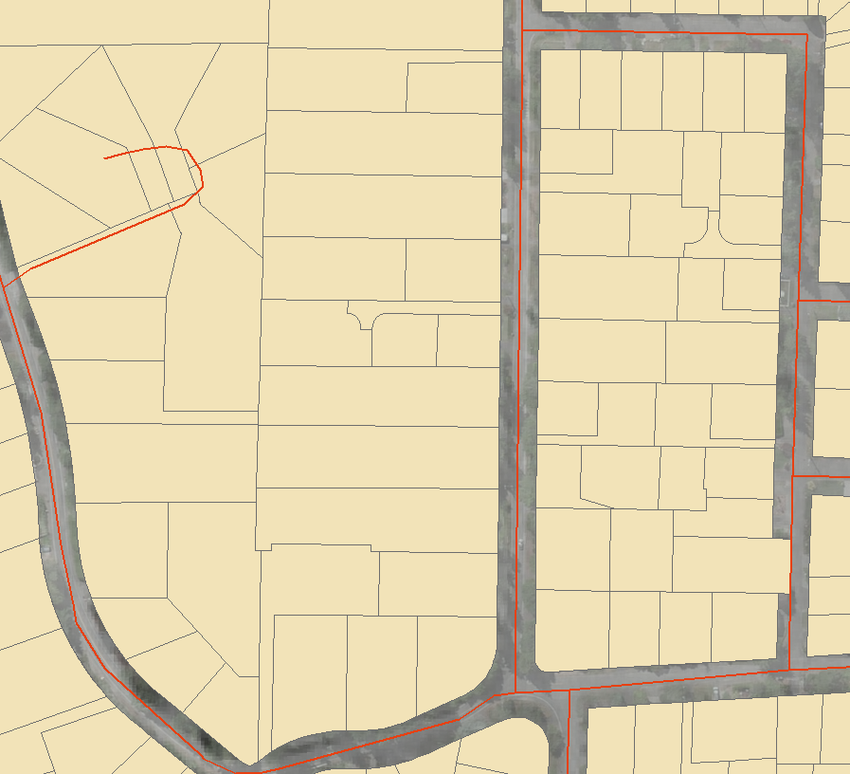
PROST used % of city area to quantify park LOS
67% ½ mile
34% ¼ mile

Slide 6
PROST used % of city area to quantify park LOS
67% ½ mile
34% ¼ mile

Slide 7
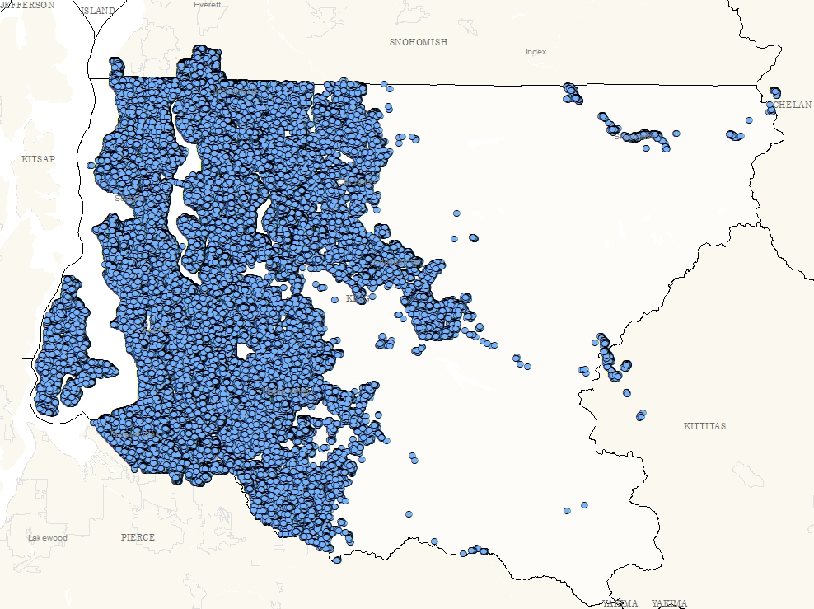
King County GIS
Address Point Data
Notes:
A comprehensive address file containing a point for every addressable site within King County. It is derived from the E 9-1-1 address layer which was created with the intention of assisting emergency responders locate 9-1-1 wireless callers more efficiently. Address points with the site type: ED (Dry Hydrant), EH (Hydrant), ET(Public Telephone) are not included. The layer is overlayed with the Washington County polygon layer and the King County parcel layer. The layer is joined with KCZipcode table to bring in the USPS Zip+4 data fields. The layer is joined with King County Assessor tables to identify primary addresses for each parcel.

Slide 8
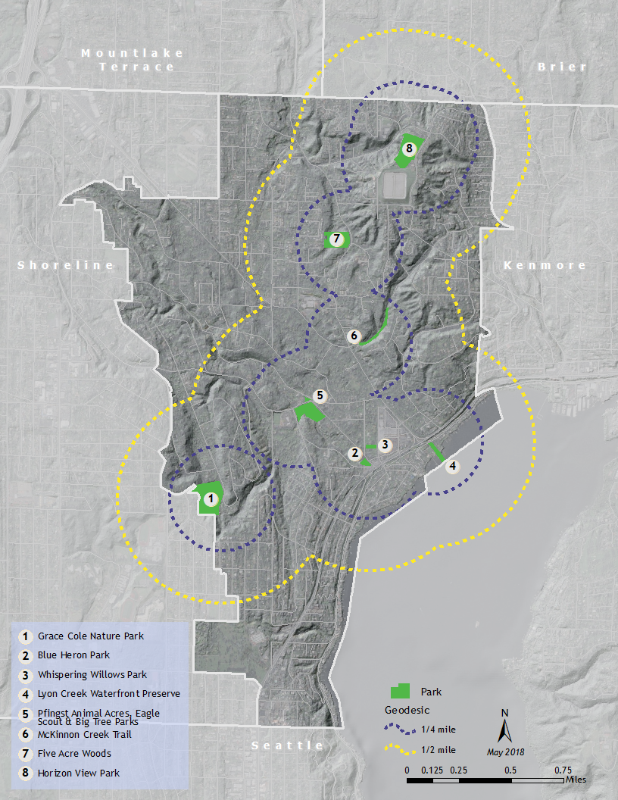

Slide 10
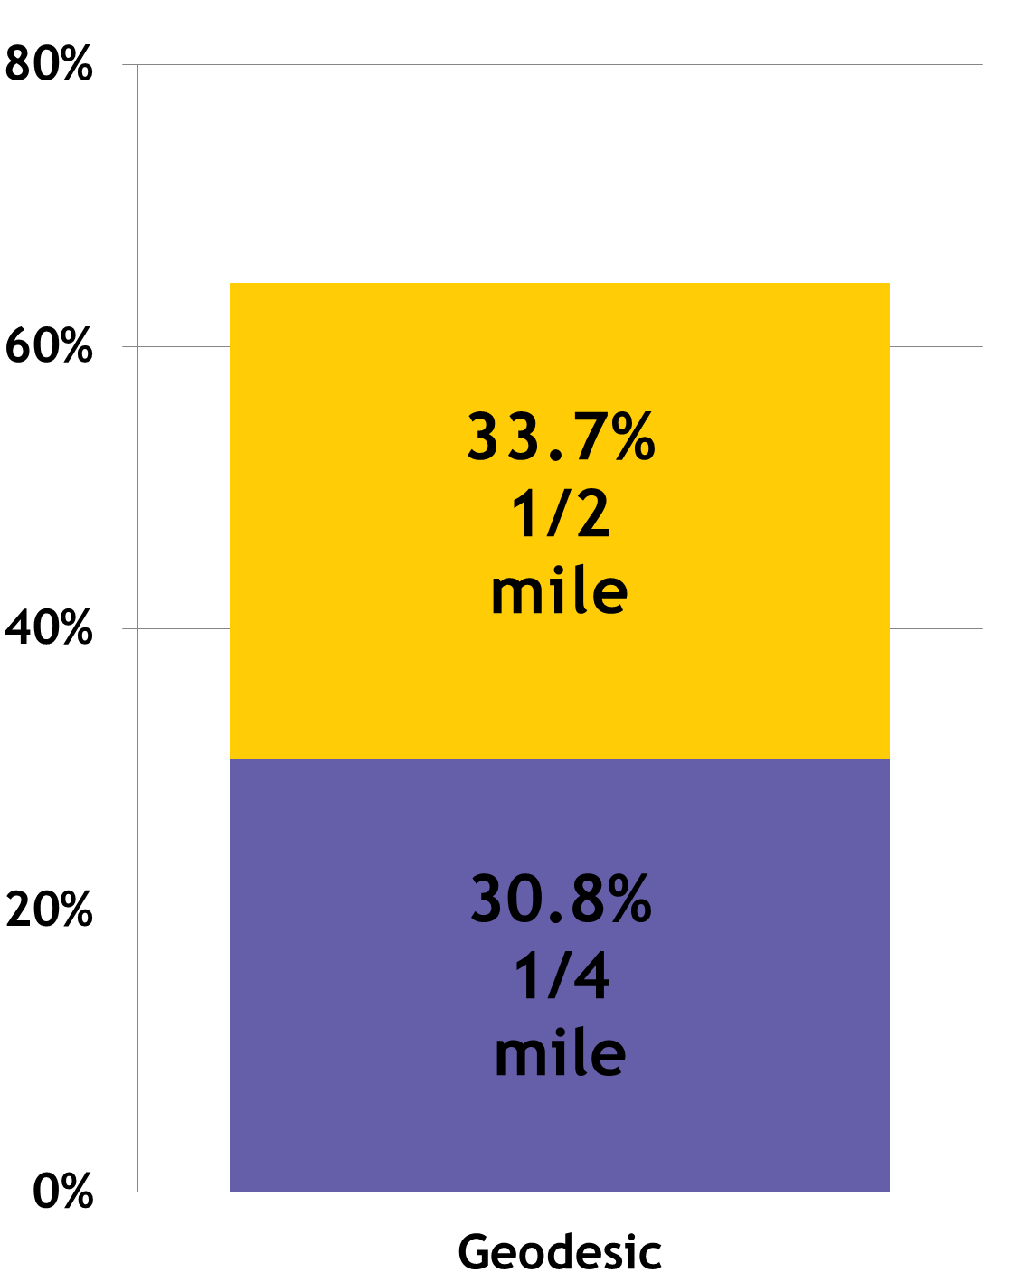
Percentage of LFP Address Locations within Park Service Area

Slide 11



Problem: We don’t fly

Slide 12
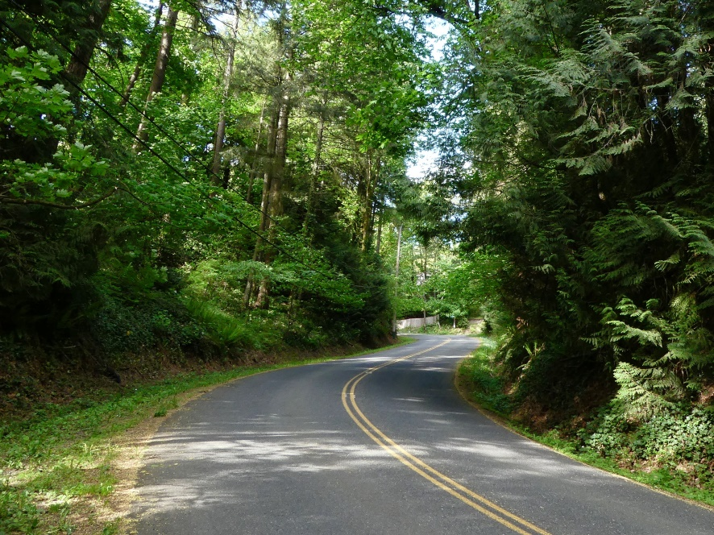
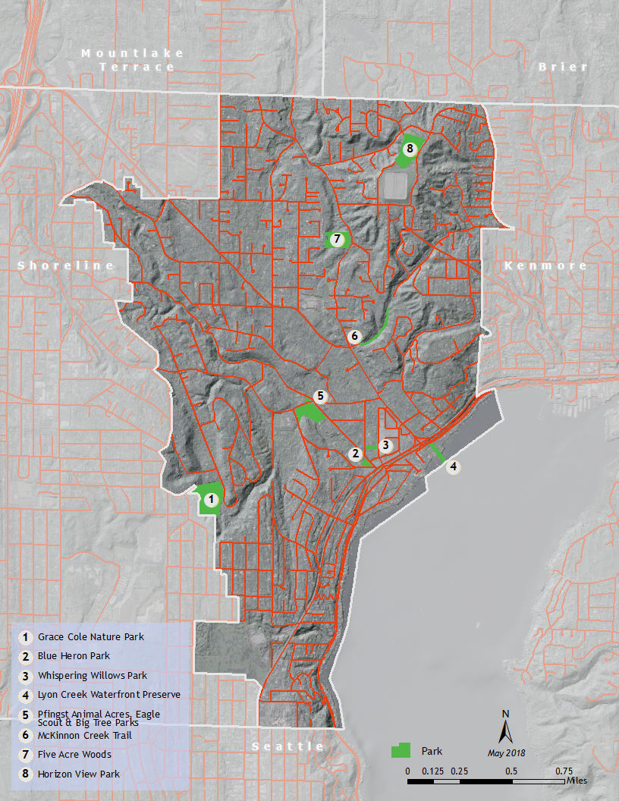
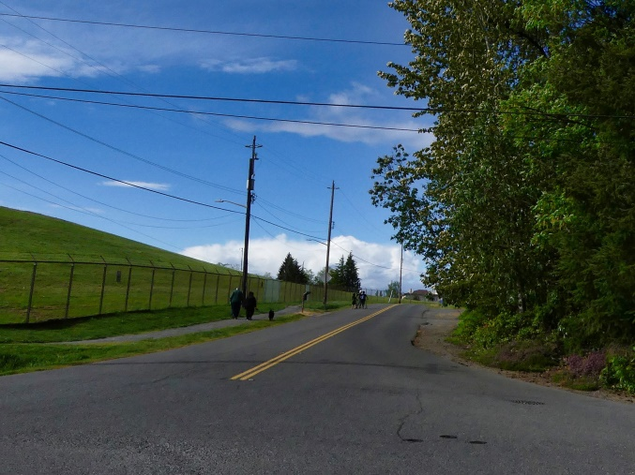
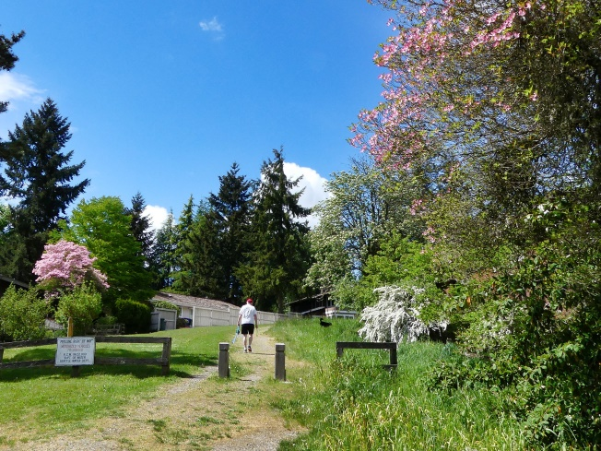

Slide 14
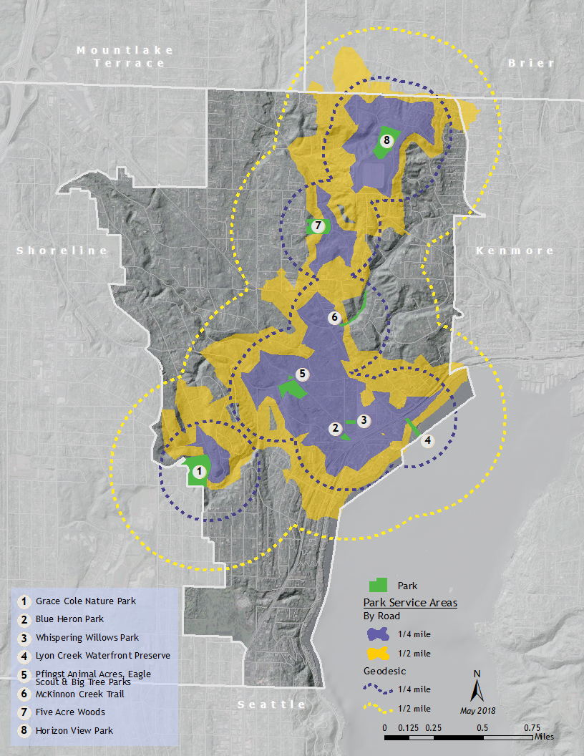

Slide 16
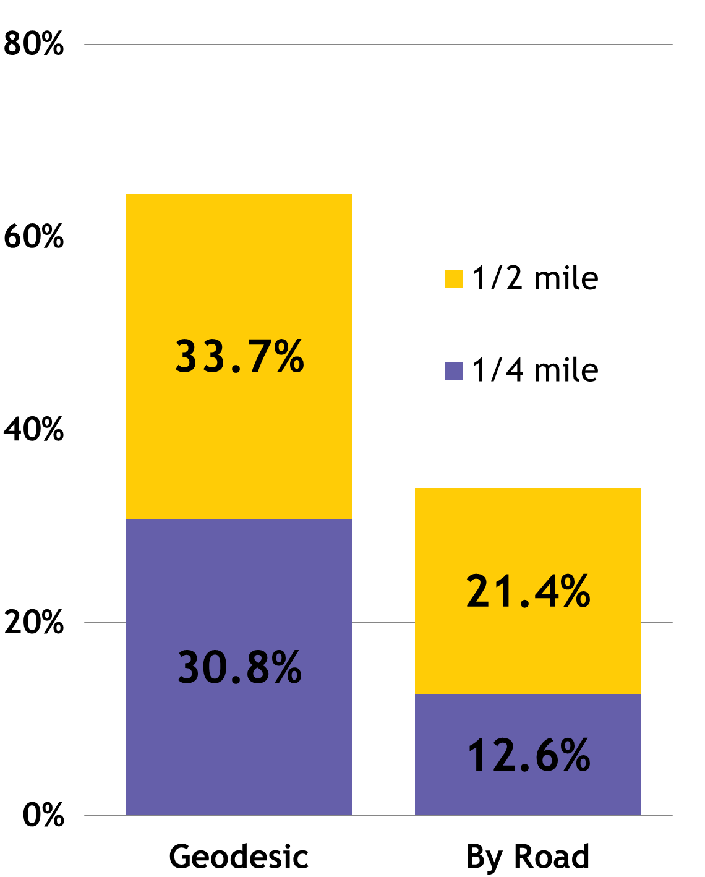
Percentage of LFP Address Locations within Park Service Area

Slide 17
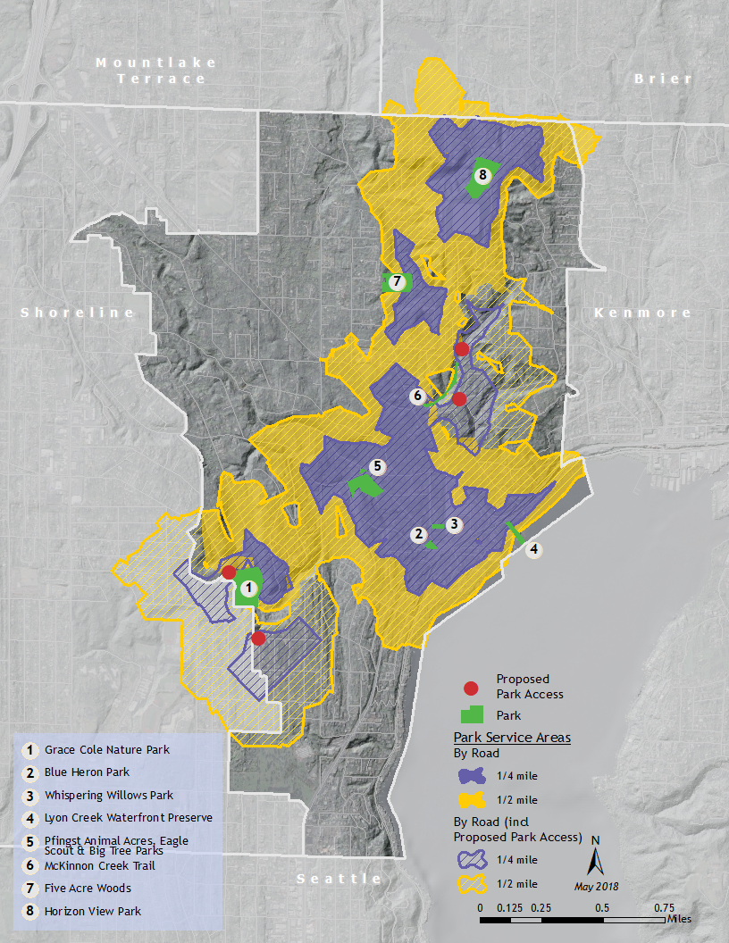

Slide 19
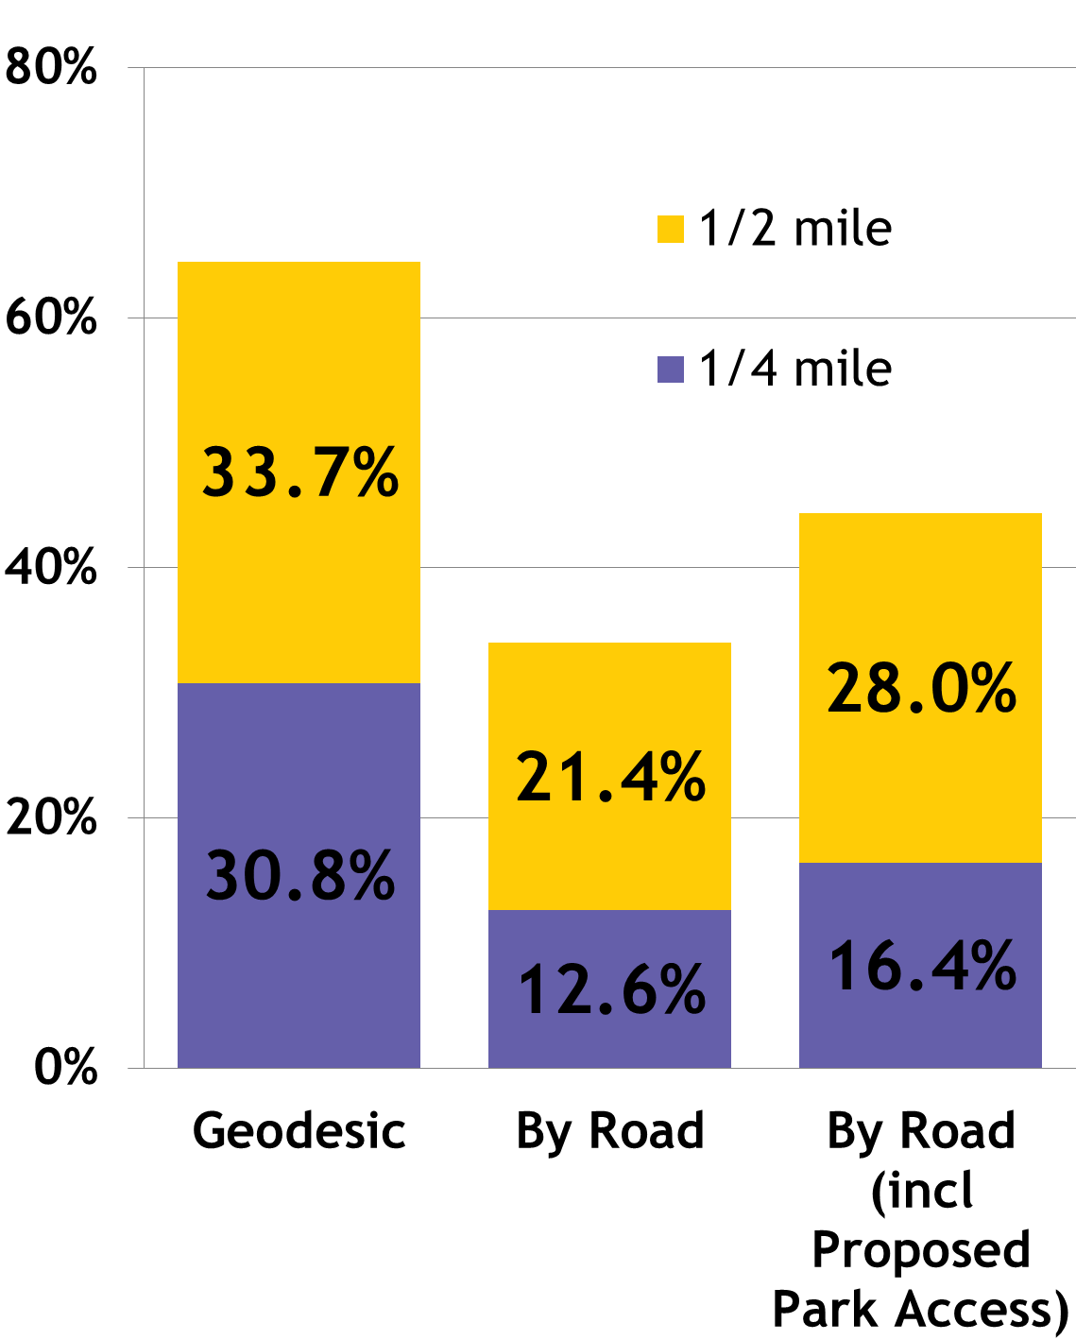
Percentage of LFP Address Locations within Park Service Area

Slide 20


GIS Takeaway:
Know Your Subject!

Slide 21
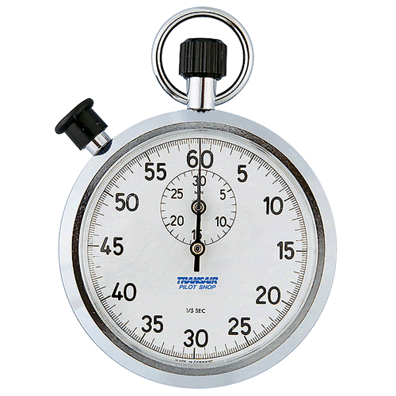
Time’s Up!
About your speaker:
  Name: Collene Gaolach
  Email: rasmuscj@uw.edu
  Social Media: www.linkedin.com/in/collenegaolach
  Quick bio: Collene has been doing GIS since the dawn of time. She’s worked in governmental, non-profit, and environmental consulting organizations. She keeps thinking one day she’ll have this GIS thing figured out. But that day never comes, thank goodness.

