Slide 1
Simulating archaeological surveys with Python
Jacob Deppen
PhD Candidate, Anthropology
Digital Archaeology Research Lab
@jacob_deppen
deppen8.github.io

Slide 2
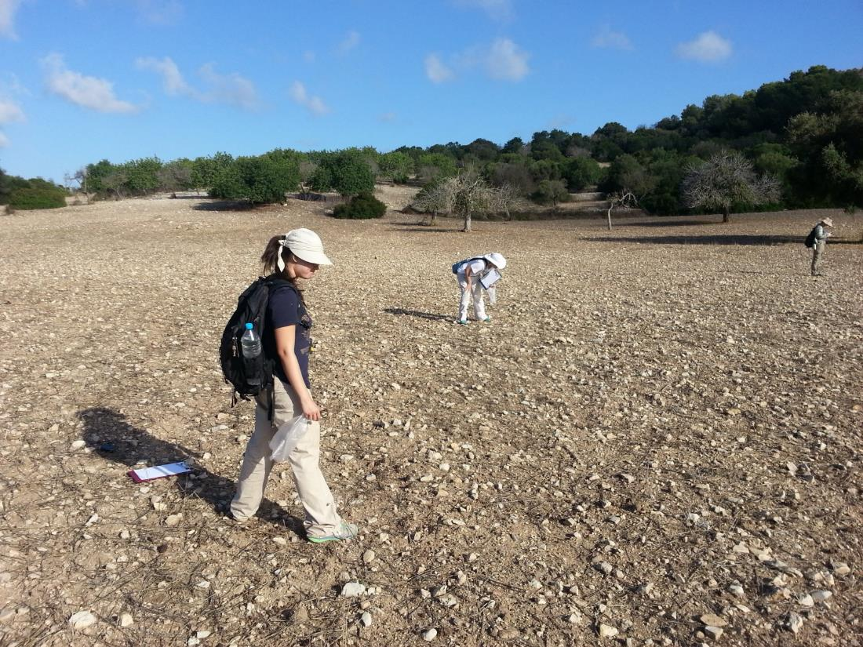
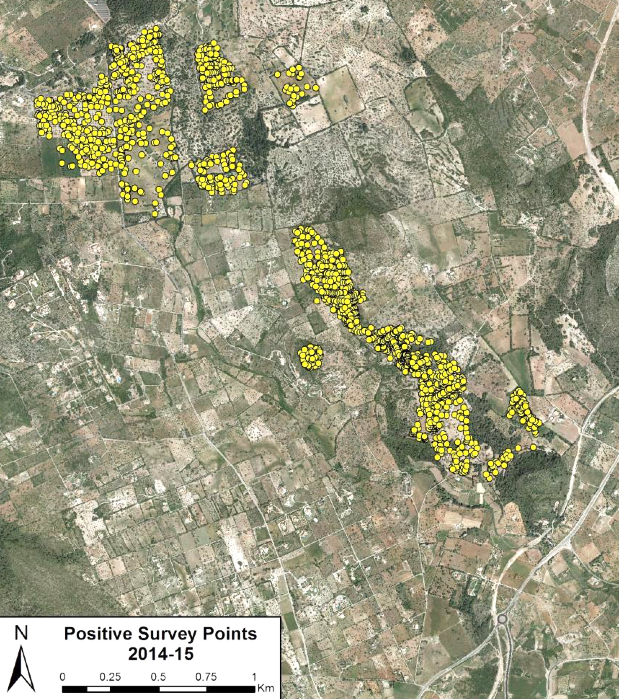
Notes:
Define archaeological survey
What is the typical approach?

Slide 3
Archaeology is fundamentally
NOT reproducible
Notes:
Problem:
Archaeology, or at least archaeological fieldwork, is fundamentally not reproducible. Once an artifact is collected from the field, it cannot be put back in context.
(It is different from other field sciences like ecology because we have less reason to believe our processes are homogeneous across space)
As a result, we have no sense of how our methodological choices impact our observed results.

Slide 4
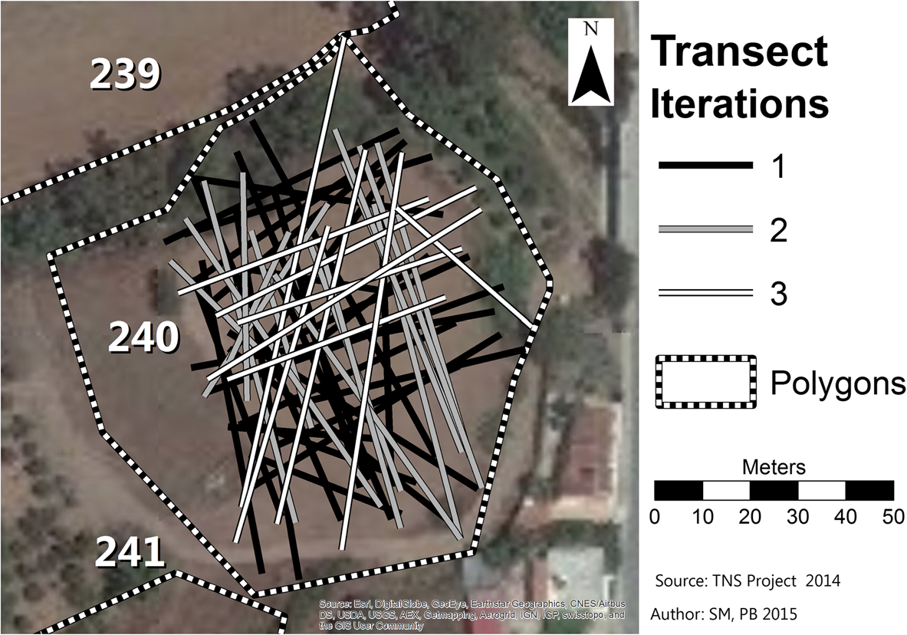
Re-survey
Banning et al. 2017
Notes:
Traditional solutions:
Resurvey

Slide 5
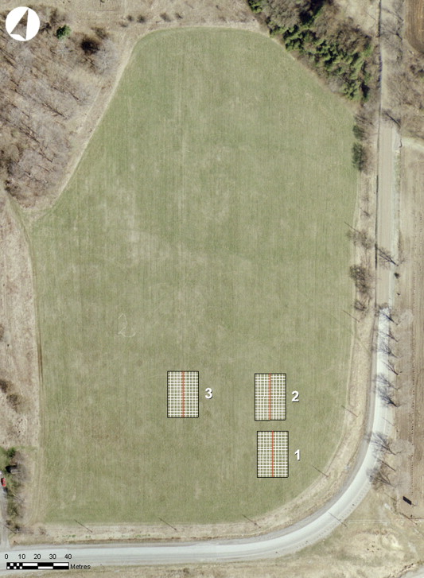
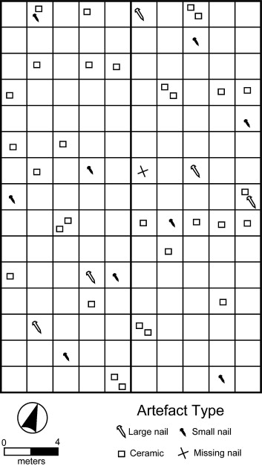
Experimental surveys
Notes:
Controlled, experimental surveys, where a fake landscape is “seeded” with artifacts

Slide 6
Shortcomings
Slow
Expensive
No control of confounding factors
Not scalable
Notes:
Slow
Expensive
Hard to control external confounding factors like surveyor skill
Not scalable to realistic sizes

Slide 7
Solution: Use a computer!
Fast
Cheap (relatively)
Can control confounding factors
Scalable
Notes:
My solution: Use a computer!
Fast
Relatively cheap
Better control of confounding factors
Scalable

Slide 8
Core Python tools
geopandas + shapely
scipy
sqlalchemy
Notes:
Python tools
geopandas and shapely for all spatial manipulation
scipy for parameter distributions
sqlalchemy for database connection

Slide 9
Survey
Area
Coverage
Team
Assemblage
Layer
Feature
SurveyUnit
Surveyor
Notes:
Python package called prospect
Structure
Building blocks of Python classes
[image of code structure]

Slide 10
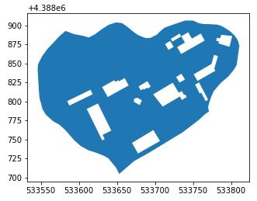
Area
Creation methods:
from shapefile
from shapely
from total area
Specifies:
surface visibility
Notes:
Area
Spatial extent for one survey
contains surface visibility parameter
from a shapely shape
from shapefile
simple square from an area value

Slide 11
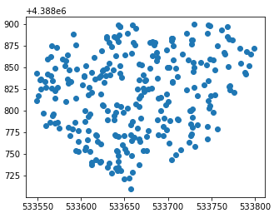
Layers (Assemblage)
Creation methods:
from shapefile
pseudorandom pts
poisson pt process
matern pt process
thomas pt process
Specifies:
ideal artifact observation rate
artifact time penalty
Notes:
Assemblage

Slide 12
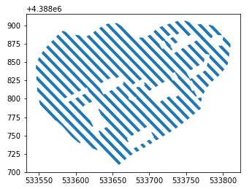
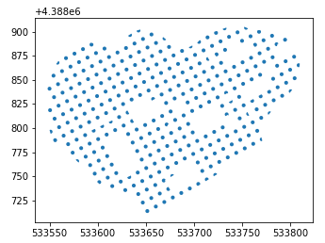
Coverage
Creation methods:
from GeoDataFrame
from shapefile
transects
radials
Specifies:
minimum survey time
(spacing)
(shape of units)
Notes:
Coverage

Slide 13
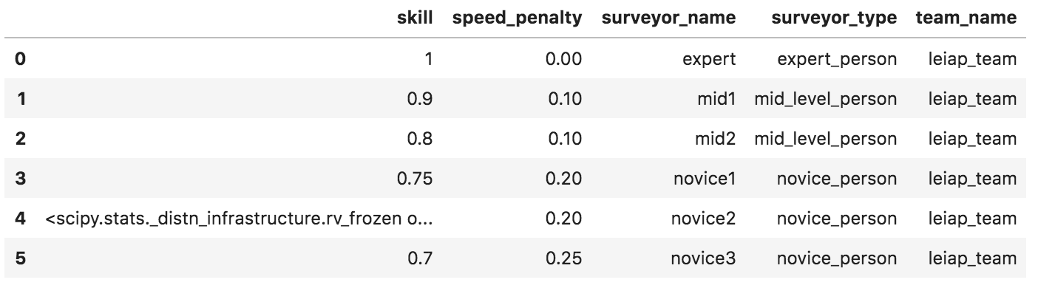
Surveyors (Team)
Creation methods:
Specifies:
surveyor skill
surveyor speed penalty
(assignment method)
Surveyor(
name='novice2',
team_name='leiap_team',
surveyor_type='novice_person',
skill=beta_dist(7, 3),
speed_penalty=0.2
)
Notes:
Team

Slide 14
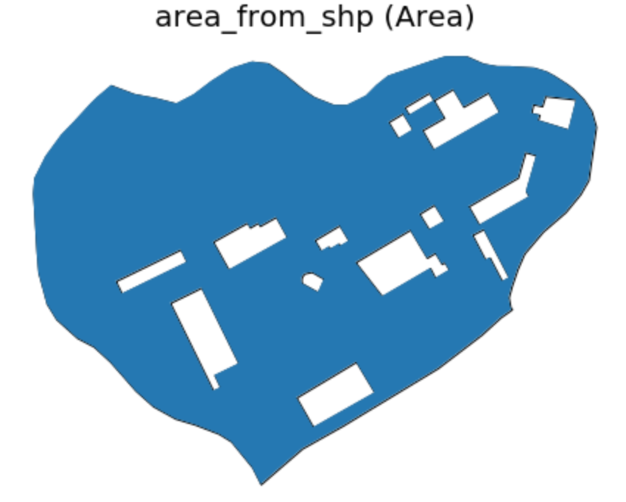
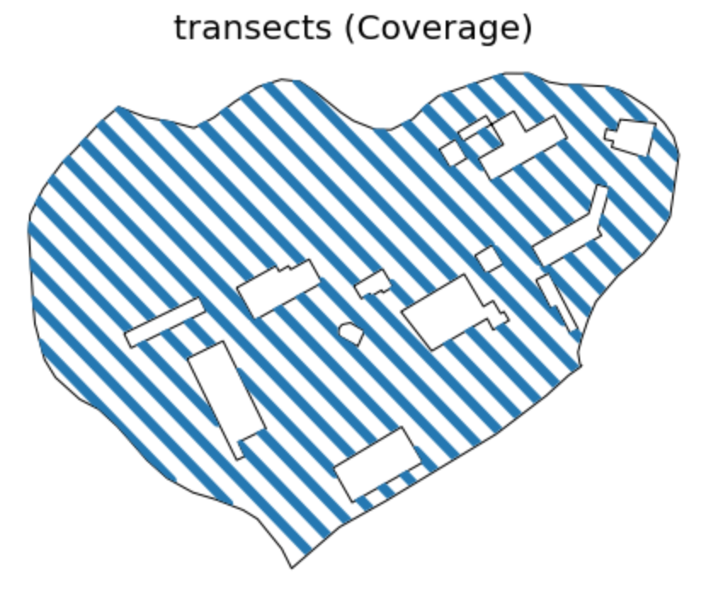
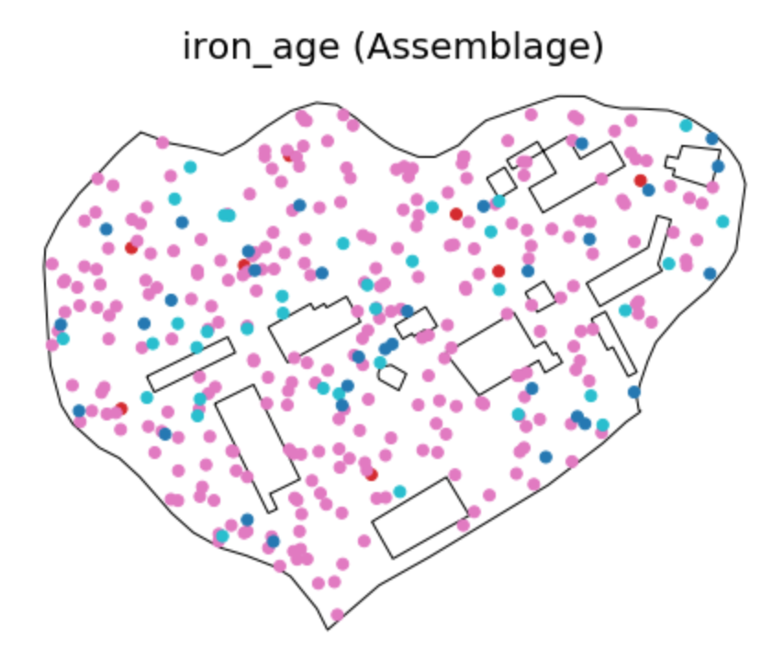
Survey
team
Notes:
Survey

Slide 15
Steps in running a Survey
1. For each artifact:
Get parameter values
  ideal observation rate
  artifact time penalty
  surface visibility
2. For each transect:
Calculate base search time
Allocate surveyors
Get parameter values:
  surveyor speed penalty values
3. Use spatial join to find whether an artifact intersects a survey unit
Record which survey unit it intersects (or NaN)
If intersects, set proximity to 1.0, else set proximity to 0
4. Get surveyor skill values
Notes:
Steps in run
With `Assemblage`
1. Extract `ideal_obs_rate` values (if distribution, select from it) -> `obs_rate`
2. Extract feature `time_penalty` values (if distribution, select from it) -> `time_penalty_obs`
3. Extract surface `vis` values (if distribution, select from it) -> `vis_obs`
- TODO: if raster, extract value from raster
With `Coverage`
1. Extract `min_time_per_unit` (if distribution, select from it)
2. Calculate base_search_time (different methods for transect and radial) -> `base_search_time`
3. Allocate surveyors to survey units based on chosen assignment method
- TODO: implement optimized methods
4. Merge data from `Team` to `Coverage`
5. Extract surveyor speed penalty values (if distribution, select from it) -> `speed_penalty_obs`
Find `Feature`s from `Assemblage` that intersect `Coverage` (via spatial join)
- Record which survey unit it intersects (or NaN)
- If intersects, set proximity to 1.0, else set proximity to 0.0 -> `proximity_obs`
Extract surveyor skill values (if distribution, select from it) -> `skill_obs`
`discovery_prob = obs_rate * vis_obs * proximity_obs * skill_obs`

Slide 16
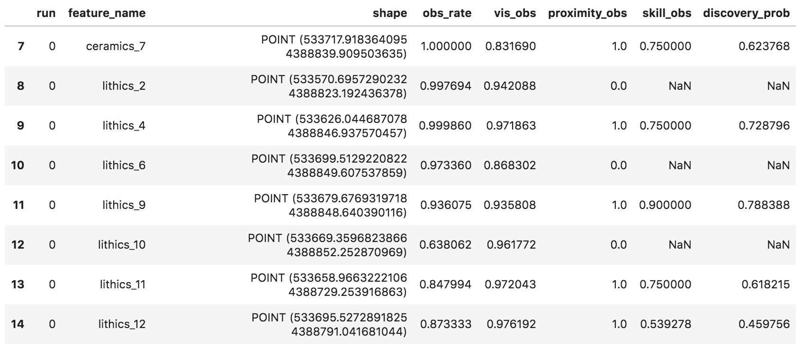
Discovery probabilities
observation rate x visibility x proximity x surveyor skill
Notes:
Discovery outputs

Slide 17
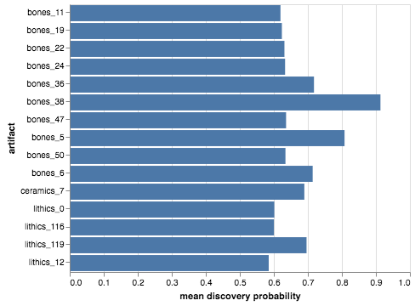
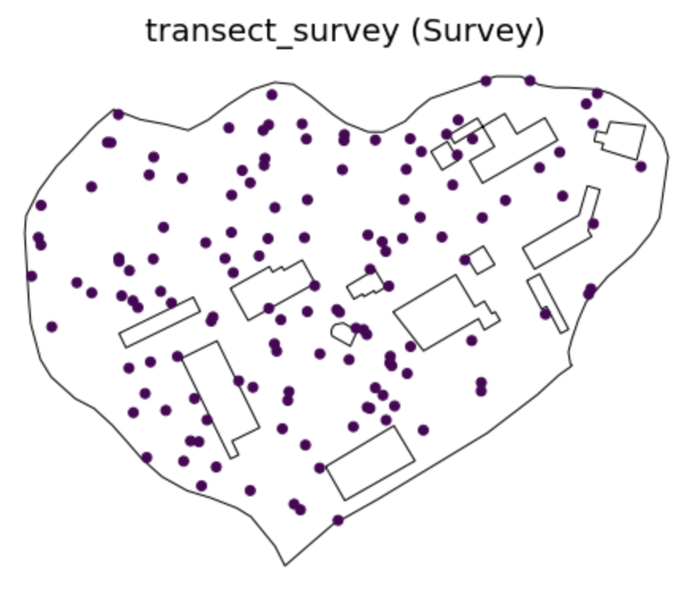
Discovery visualization
n runs = 100
Notes:
Time outputs

Slide 18
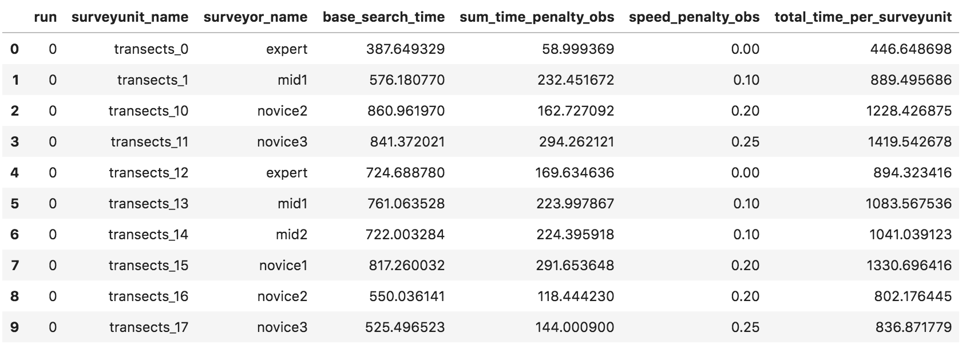
Survey time
base time = search time + sum(artifact penalties)
total time = base time + (base time * surveyor speed)

Slide 19
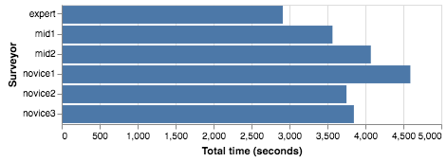
Survey time visualization

Slide 20
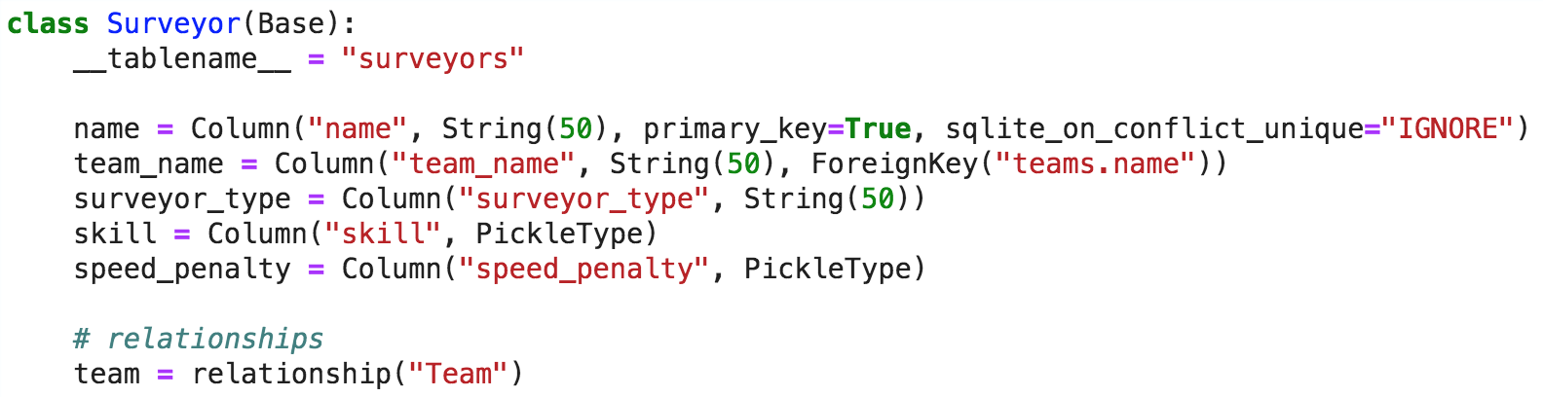
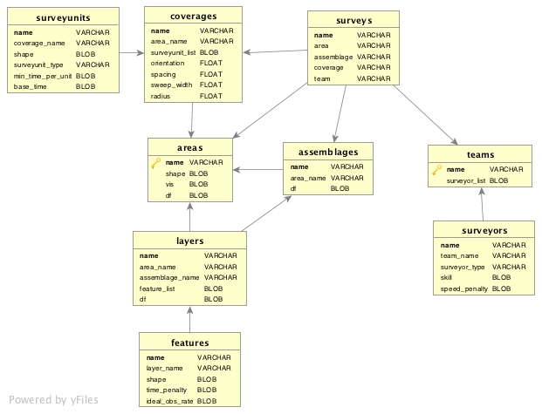
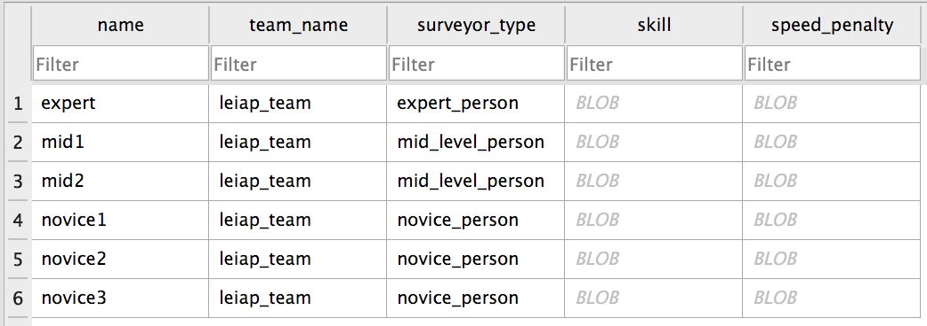
SQLAlchemy

Slide 21
Time’s Up!
Jacob Deppen
Digital Archaeology Research Lab
digarlab.uw.edu
@jacob_deppen
deppen8.github.io

