Slide 1
The Uneven Geographies of Digital Food Apartheid
Mapping Amazon’s “Fresh Cities”
Natalie Vaughan-Wynn
Ph.D. Student, University of Washington Department of Geography
Dr. Jin-Kyu Jung
Associate Professor, University of Washington Department of Geography

Slide 2
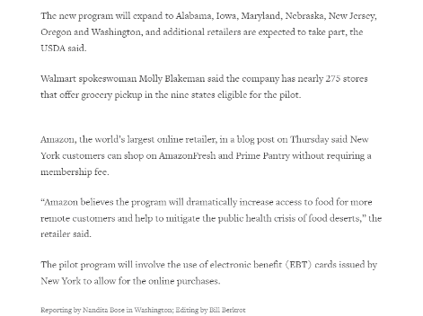
Amazon press release statement, Reuters, April, 2019
“Amazon believes the program will dramatically increase access to food for more remote customers and help to mitigate the public health crisis of food deserts.”
Source: https://www.reuters.com/article/us-usa-food-stamps-internet/u-s-pilot-program-allows-online-grocery-shopping-with-food-stamps-idUSKCN1RU23T

Slide 3
Theoretical Frameworks
Black Geographies
Black Geographies
Digital Geographies
Critical GIS
Neoliberalism: “a hegemonic, economic rationality that deploys market logic as a way to promote social equity” (Summers, 2019)
Racialized social, political, and economic failures produce food injustices ( Penniman, 2018)
Material and digital co-constituted; decisions made by algorithms can reinforce oppressive social relationships (Thatcher and Dalton, 2021; Noble, 2018)
Calls into question ontological and epistemological position, pushes against positivist approach. (Jung, 2020; Pavlovskaya 2018; Elwood, 2017; Elwood and Wilson 2017; Shuurman; 2000)

Slide 4
Digital Food Apartheid
Digital food apartheid aims to name a separateness that exists in racialized capitalist paradigms between people in terms of one’s agency concerning their food that is mediated by, reified through, or materialized from data or digital infrastructure.
A working definition

Slide 5
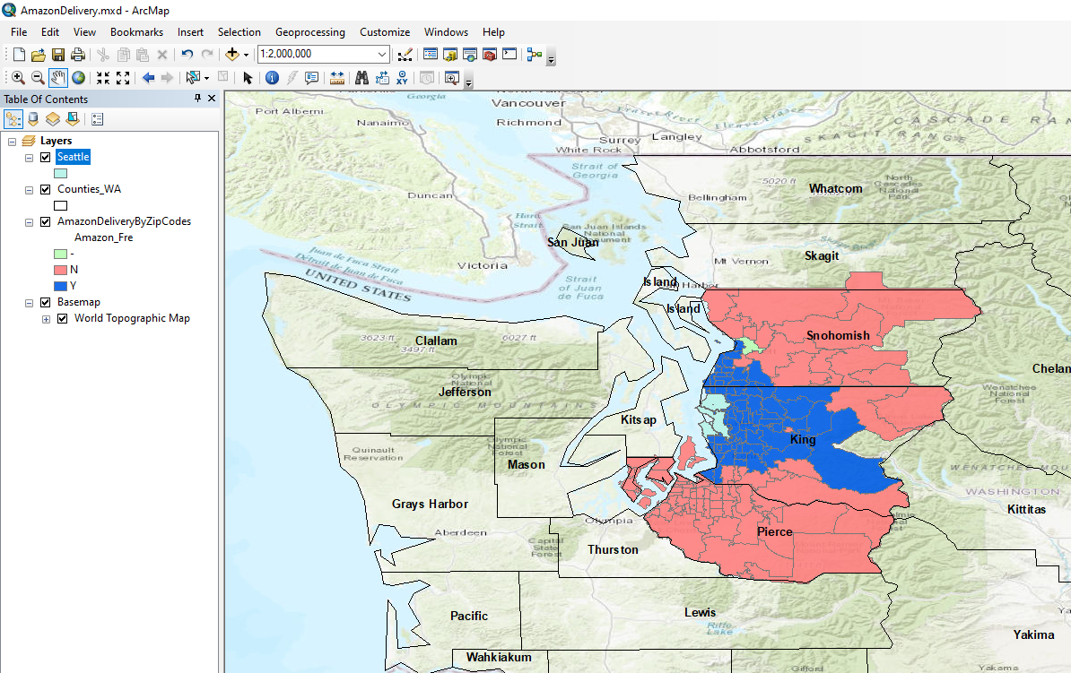
Amazon Fresh Delivery Area- Seattle

Slide 6
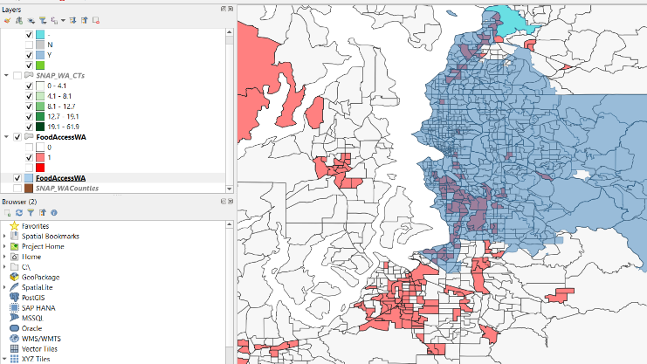
“Fresh City” delivery w/low-access, low-income tracts
Puget Sound

Slide 7
Thank you!
Your thoughts and questions are welcome
nvwynn@uw.edu
Sources:
Elwood, Sarah, and Matthew Wilson. 2017. “Critical GIS Pedagogies beyond ‘Week 10: Ethics.’” International Journal of Geographical Information Science 31 (10): 2098–2116. https://doi.org/10.1080/13658816.2017.1334892.
Noble, Safiya Umoja. 2018. Algorithms of Oppression: How Search Engines Reinforce Racism. New York: NYU Press.
Penniman, Leah. 2018. Farming While Black: Soul Fire Farm’s Practical Guide to Liberation on the Land. White River Junction, Vermont: Chelsea Green Publishing.
Shannon, Jerry, Katherine B. Hankins, Taylor Shelton, Amber J. Bosse, Dorris Scott, Daniel Block, Heather Fischer, et al. 2021. “Community Geography: Toward a Disciplinary Framework.” Progress in Human Geography 45 (5): 1147–68. https://doi.org/10.1177/0309132520961468.
Summers, Brandi Thompson. 2019. Black in Place: The Spatial Aesthetics of Race in a Post-Chocolate City. Chapel Hill: The University of North Carolina Press. https://doi.org/10.5149/9781469654034_summers.
Thatcher, Jim, and Craig M Dalton. 2022. Data Power: Radical Geographies of Control and Resistance.

