Slide 1
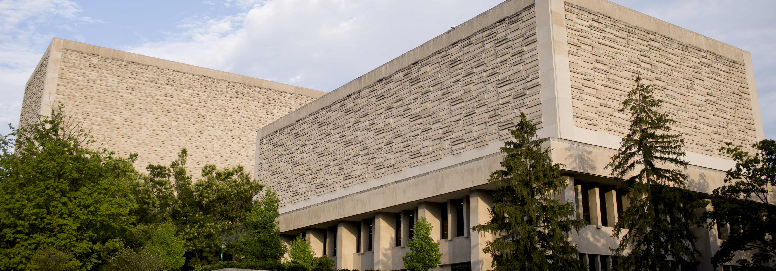


The Friday finish
incentivizing student success and building partnerships
Notes:
Layout used = Intro/Close: Light, Picture, Headline, BOT Subhead, IU
The trident tab is placed on the slide and not part of the master. Copy and paste to other slides if desired.

Slide 2
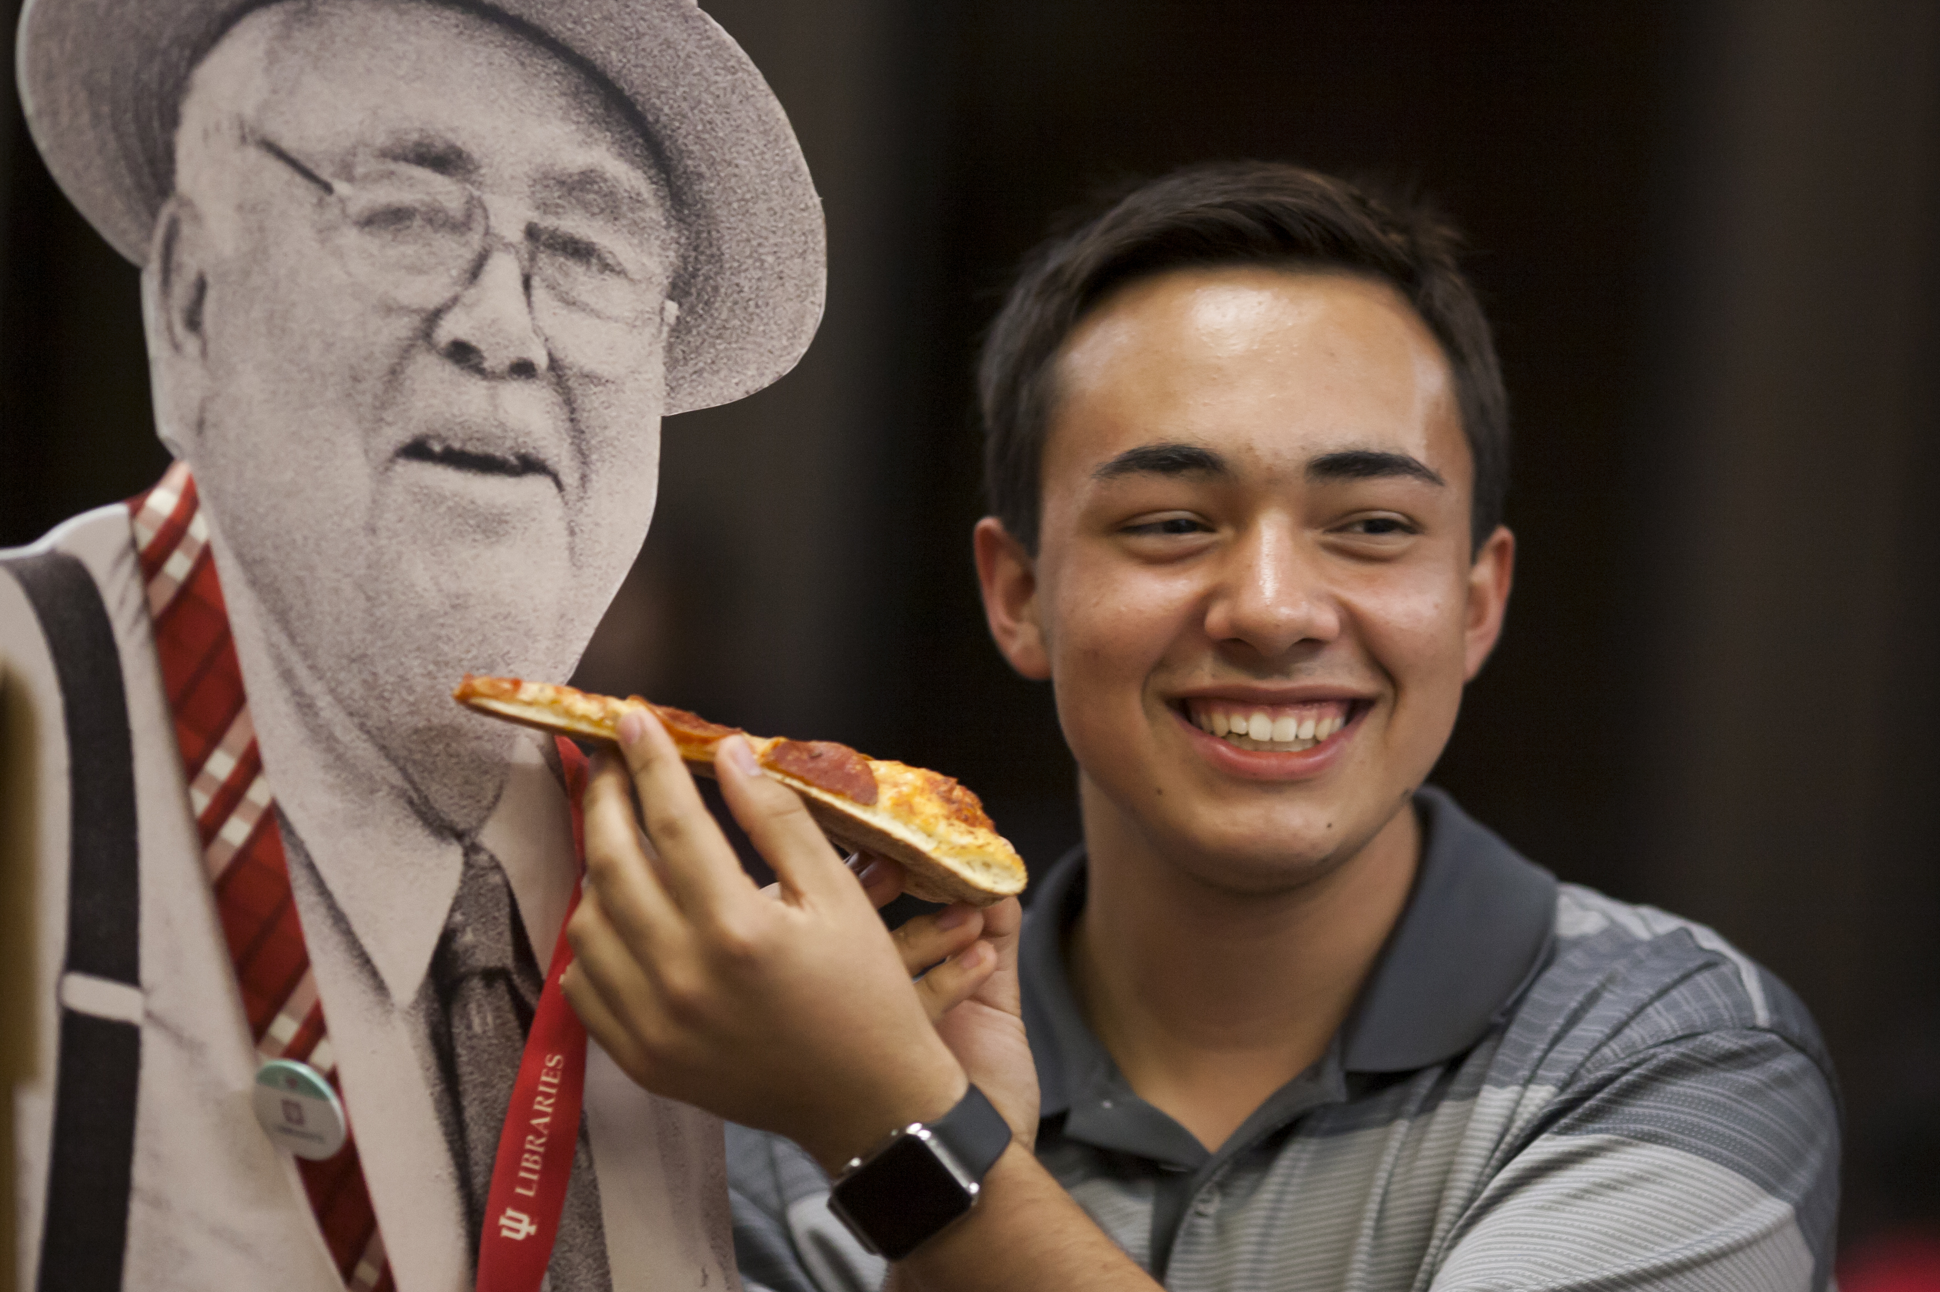
Agenda
01 |
Event Background
02 |
Sponsors and Partners
03 |
Activities that promote student wellness
04 |
Steps to create your own Friday Finish inspired event!
05 |
Questions?
Notes:
Layout used = Light: BOT, Header, List, Footer

Slide 3
The Friday finish EVENT
Notes:
Layout used = Red: Section break, Header, SubHead

Slide 4

Event Background
The issue
Sunday evenings are busy for academic libraries as students struggle to catch up on a weekend's worth of work and hit midnight assignment deadlines.
Our solution
The IU Libraries reasoned that combatting the Sunday Scaries would not only have a positive impact on students’ overall mental health, but with student retention and academic performance. The Friday Finish was created to encourage students to be productive on Fridays before relaxing for the weekend.
The results
Student surveys, gate counts, and study room reservation numbers tell us that the Friday Finish event has been successful in motivating students to come to the library on Friday and stay there throughout the day.
Notes:
Layout used = Light: BOT, Header, Side Content, Footer
Modification = The field for a caption or footnote has been deleted.

Slide 5
"I'm a grad student & I had a hard time managing classes, assignments & lab work. Taking out time for Friday Finish has given me so much joy while being able to explore my creative side & just switch off the academic worries.”
– Student survey response
Notes:
Layout used = Red: Quote, Attribute

Slide 6
Some fun facts…
33
19,800
36.16%
Number of Friday Finishes hosted so far.
Pizza slices served so far.
Increase in the number of reserved Friday study room hours in the 23/24 academic year compared to 22/23.
Notes:
Layout used = Light: BOT, Header, Stats, Footer
Modification = The text box was added and positioned to fit in the gap next to the header.

Slide 7
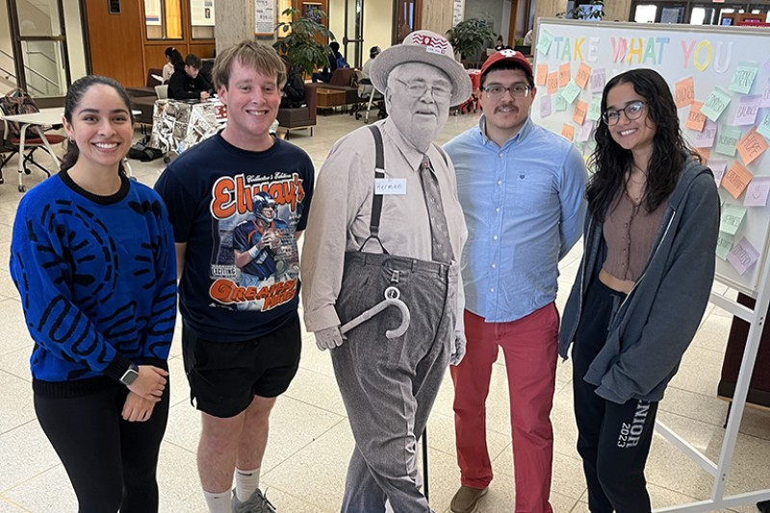
Event Format
10:00 a.m.- Sponsor staff hand out donuts while the Chaos Crew maintains a self-serve coffee bar
11:00 a.m.- Partners arrive to table
12:00 p.m.- Sponsor serves pizza
2:00 p.m.- The event coordinator brings out the afternoon surprise
3:00 p.m.- The Chaos Coordinators bring the afternoon snack to the sponsors to serve
4:00 p.m.- The Chaos Coordinators and event coordinator begin clean up

Slide 8
CAMPUS SPONSORS + PARTNERS
Notes:
Layout used = Red: Section break, Header, SubHead

Slide 9
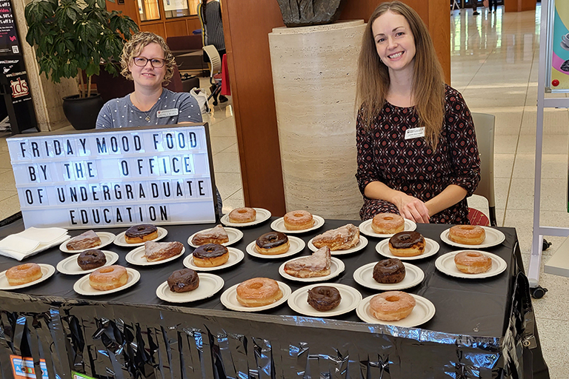
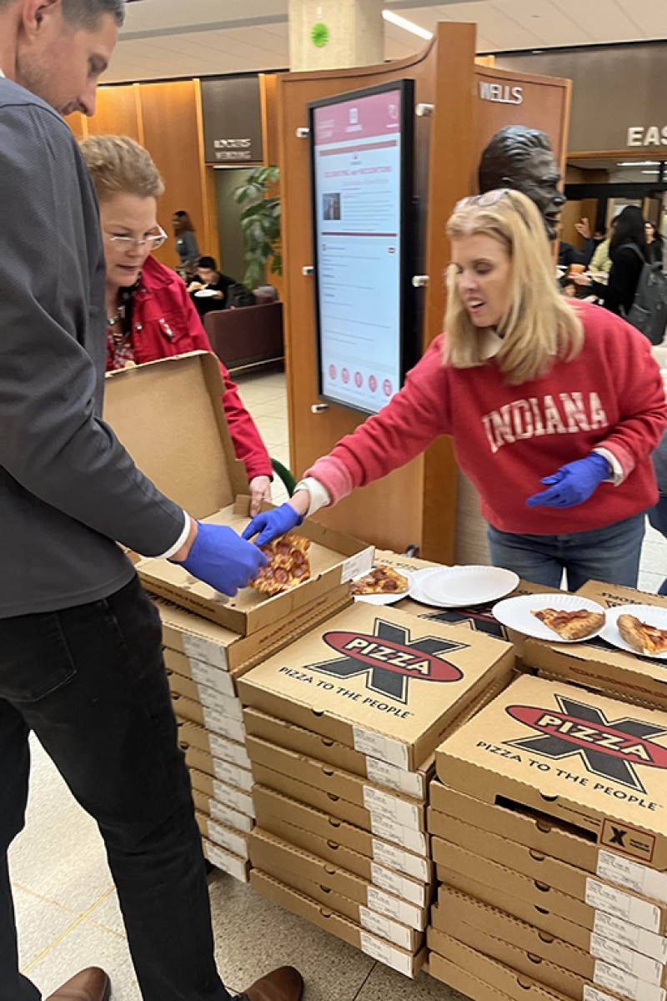
Sponsors
Our event would not be possible without the support of various campus sponsors. In exchange for a $3,000 sponsor fee, they are offered nearly unlimited space and resources to host tables for their student organizations, special projects, or to promote activities of their choosing, such as upcoming performances at the School of Music.

Slide 10

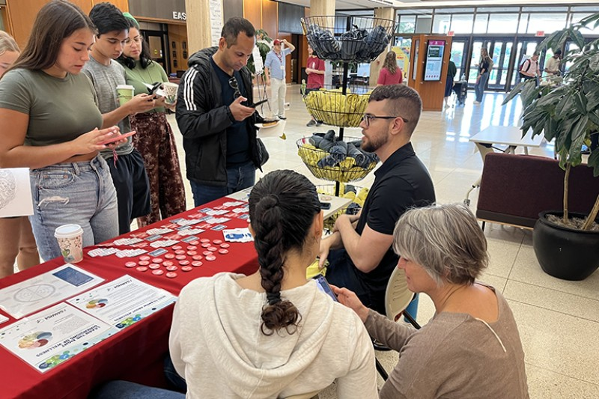
Partners
Our partners differ from our sponsors because they do not pay to attend our event but are invited to table. We only allow partners that align with our goals of either supporting student wellness or providing a “study break.” Some examples of previous partners with a wellness focus include:
The Office of the Chief Health Officer
Substance Use Intervention
Recreational Sports
The Eskenazi Museum of Art, Art Therapist
Notes:
Layout used = Light: BOT, Header, Text, 3 Portraits, Footer

Slide 11
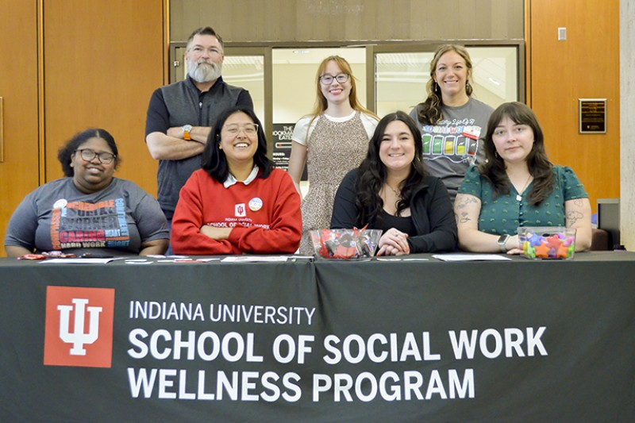
Wellness Coaching
Provided free one-on-one coaching to students and brought a stress relieving activity or resource to share.
The students from the School of Social Work completed this coaching as part of their practicum. This partnership was mutually beneficial because their participation aided master’s students as well as undergraduates seeking support.
In 2023-2024 students made 64 wellness coaching appointments in total.

Slide 12
Wellness ACTIVITIES
Notes:
Layout used = Red: Section break, Header, SubHead

Slide 13

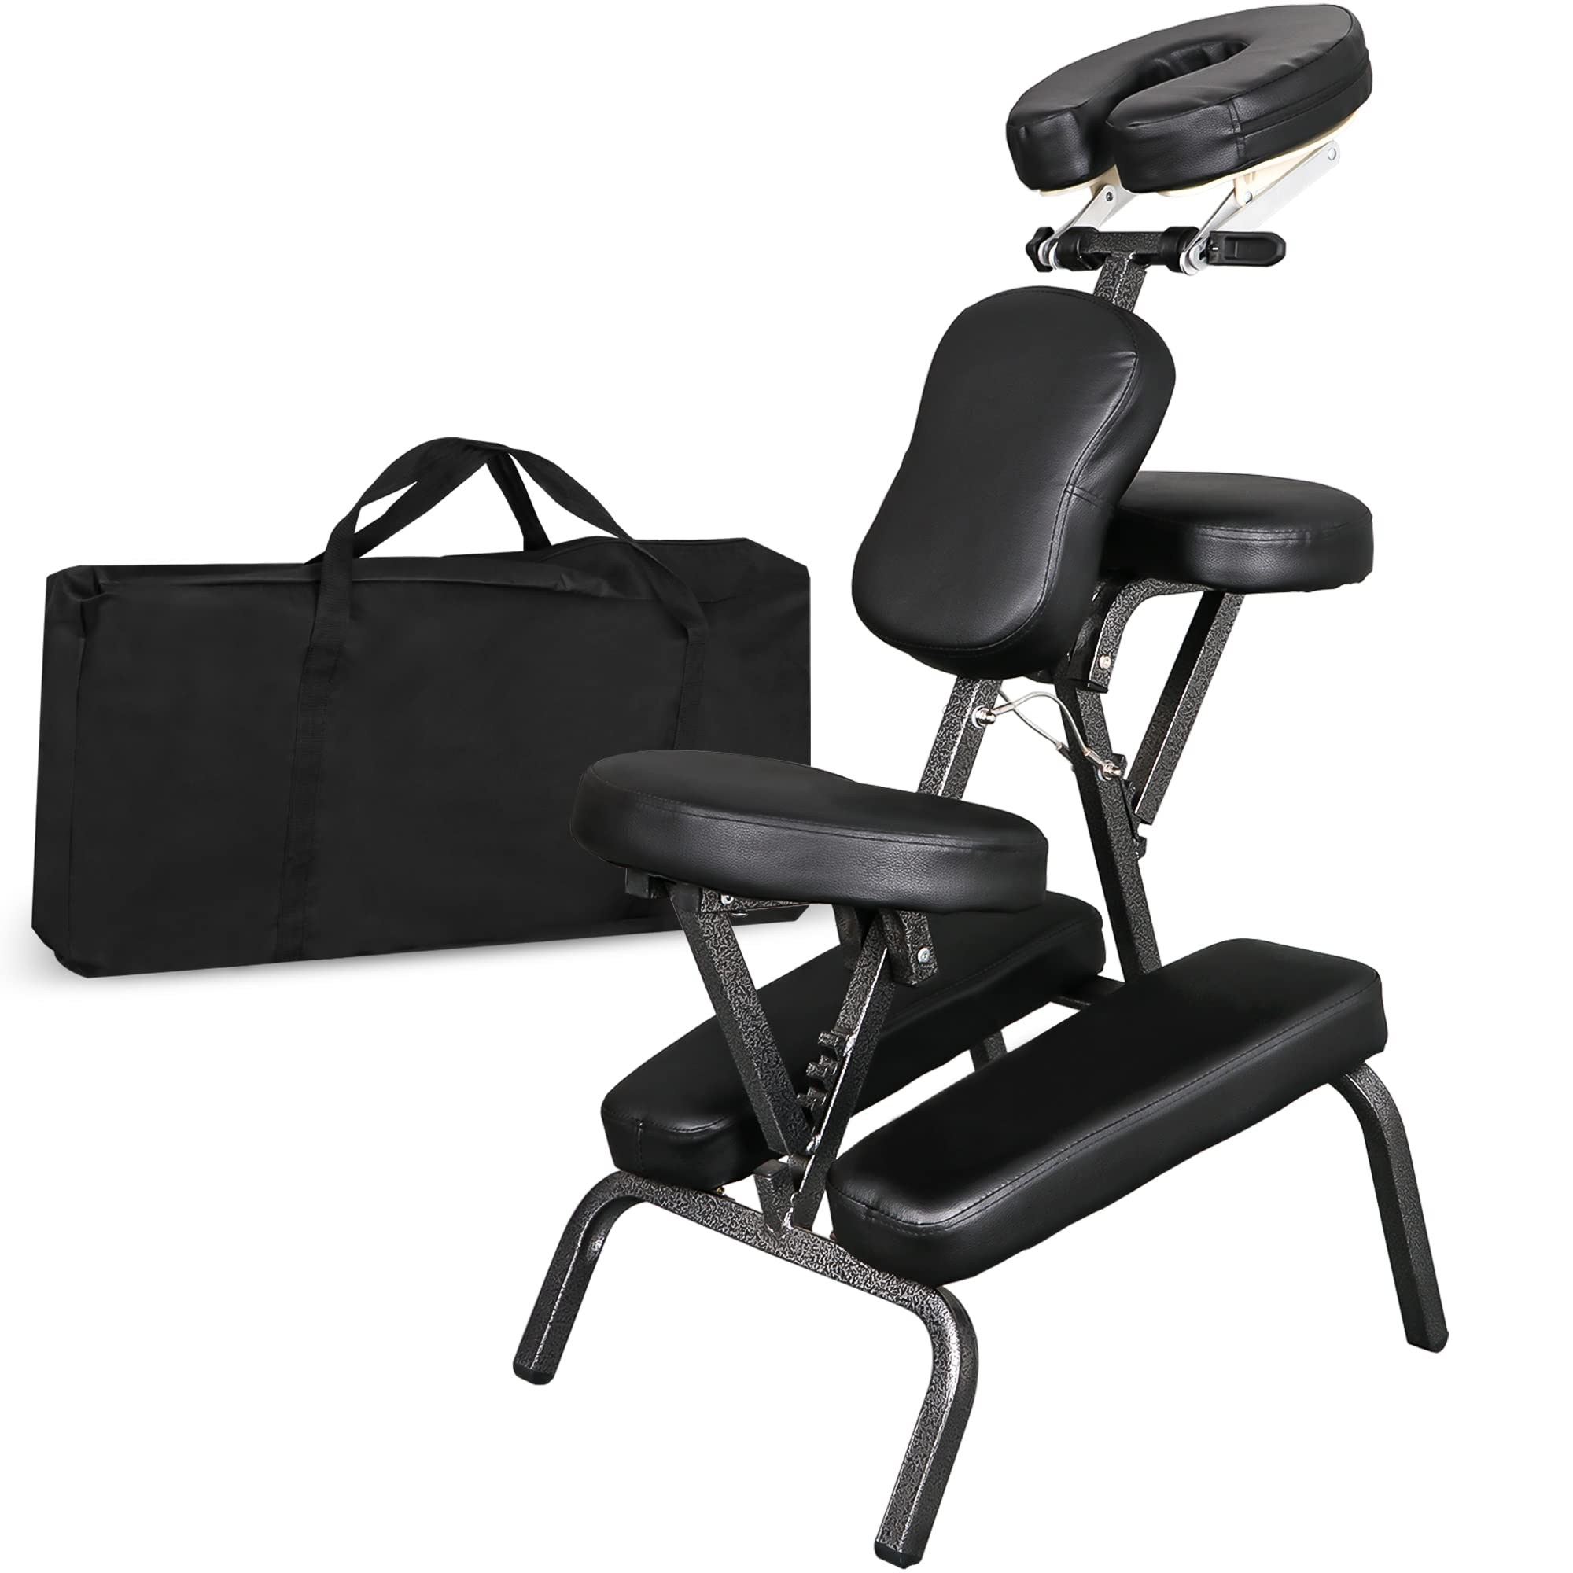
Massage
Things to consider:
Two hours of 5-minute massage slots.
University provided waiver for massage.
Pre-purchased massage chairs were purchased by us for ease of setup.

Slide 14
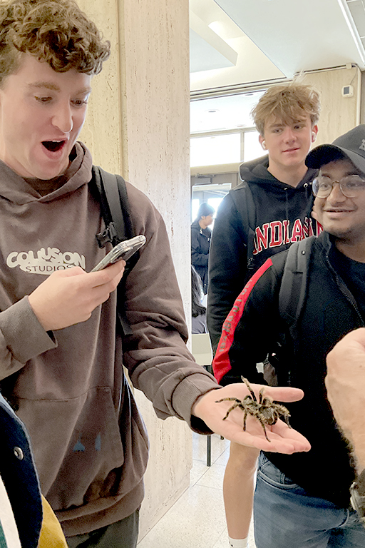
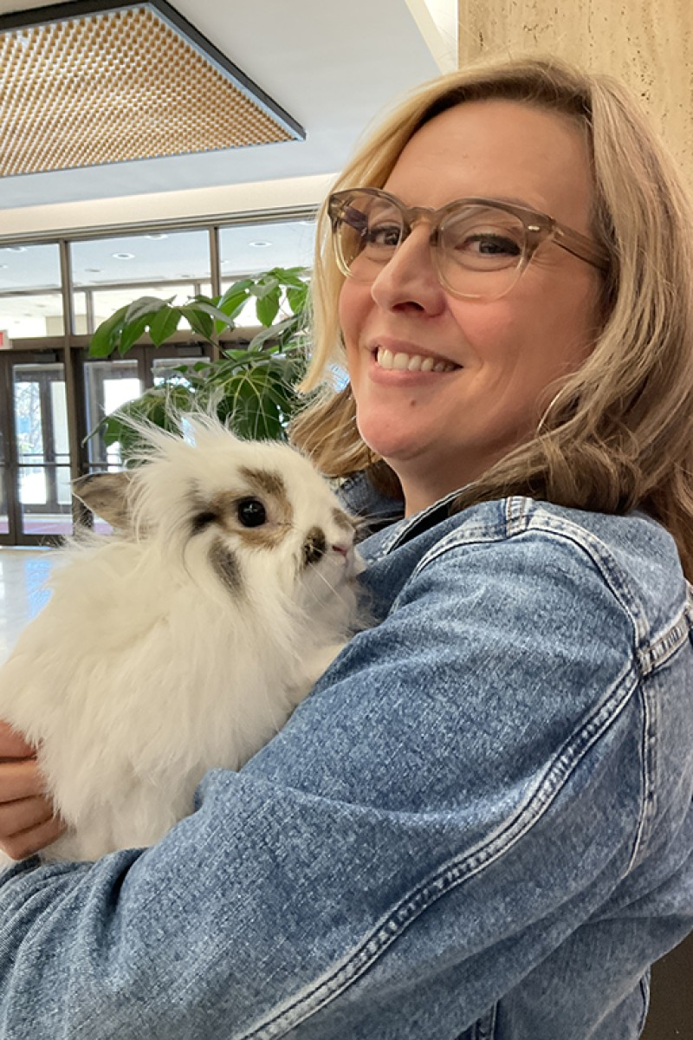
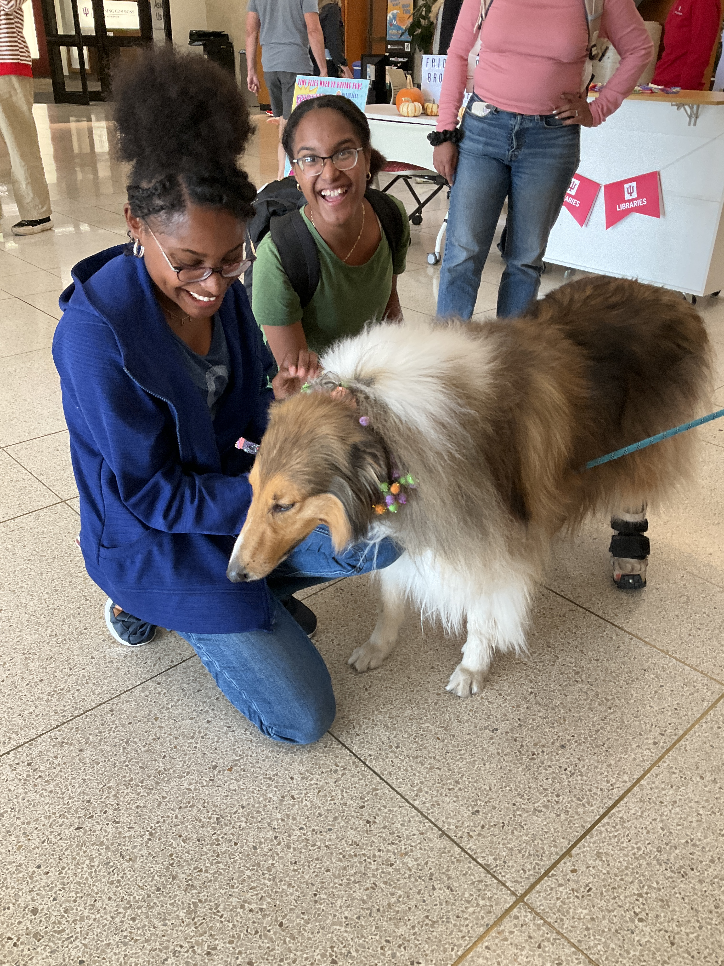
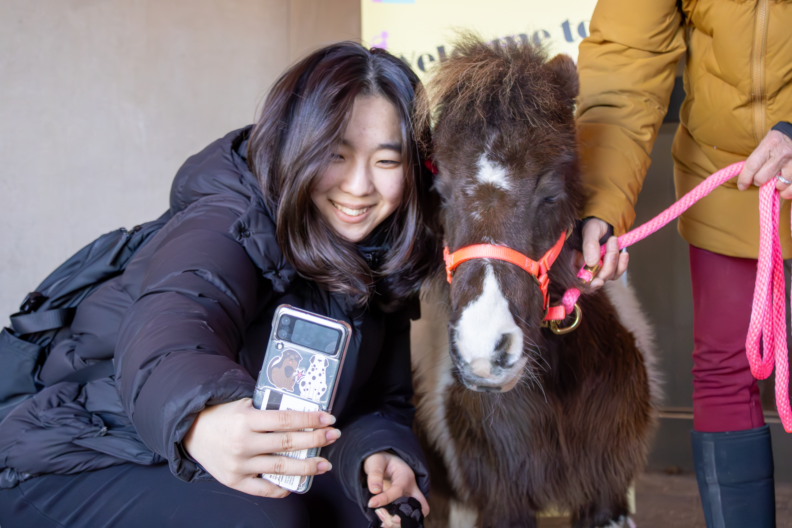
Therapy Animals and Animal Shows
Love on a Leash
People & Animal Learning Services (PALS)
Hedgehog Hannah
Notes:
Layout used = Light: BOT, Header, SubHead, Text, Picture, Footer

Slide 15
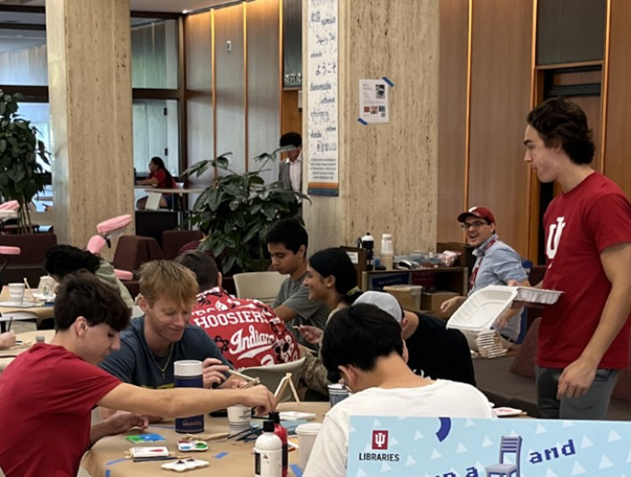
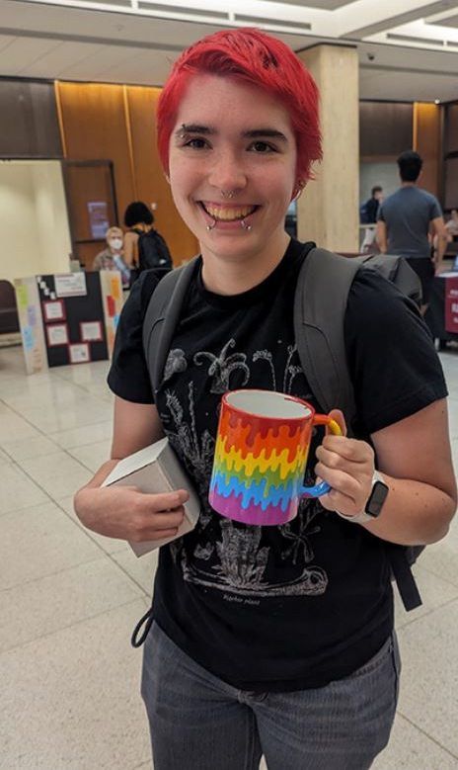
Weekly Craft
Crafts planned in collaboration with the Wells Library Makerspace.
The weekly craft rotates with everything from succulent pot decorating to canvas painting.
We hired a part time student worker to staff the craft tables.

Slide 16
Where to begin?
Notes:
Layout used = Red: Section break, Header, SubHead

Slide 17
Steps to create your own Friday Finish inspired event!
01 |
Determine your sustainable funding plan.
We rely on $3,000 from our sponsors to cover expenses for each Friday Finish event. How much will you need to cover food, staffing, and other costs? To secure sponsors, we send out an interest form to various campus units before each semester with event information and the payment agreement.
03 |
Seek out your staff, partners, and sponsors.
This event would not be possible without our “Chaos Crew” and event coordinator. Who will run your event? Many campus units will be interested in participating. We make sure to vet units that have a focus on student wellness/ retention- otherwise it could easily become a normal tabling event.
02 |
Develop a schedule template.
Each week our schedule remains the same with the afternoon snack, craft, and special surprise content being the only thing that switches. Feel free to use our schedule to inspire your own template.
04 |
Promote on social media!
Our Instagram account increased dramatically both in reach and in number of followers once we started promoting the Friday Finish. We published our weekly “menu” of events on Instagram the week of the event to activate excitement.
Notes:
Layout used = Light: BOT, Header, 4 List, Footer

Slide 18
Questions?
Lindsey Schaffer
laschaff@iu.edu
812-856-4746

