Slide 1
Go for the Green:
Fostering Student Financial Health
Holly Flynn
Big Ten Academic Alliance
Student Wellness Symposium
Thursday, April 24, 2025

Slide 2

Wellness Wheel
The Eight Dimensions of Wellness [https://en.wikipedia.org/wiki/Wellness_%28alternative_medicine%29] by DaisyFig under Creative Commons Attribution-Share Alike 4.0 International license].

Slide 3
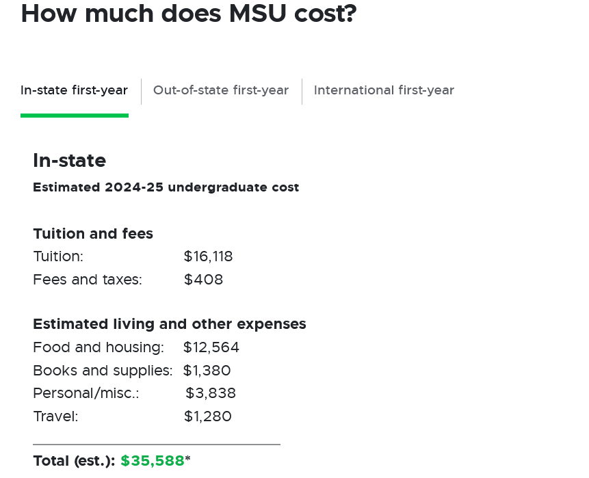
College Costs and Student Loans
At MSU, 95% of first year students receive financial aid of some kind.

Slide 4

Go for the Green Financial Literacy Team
MSU Libraries
MSU Credit Union
Office of Financial Aid
Human Development and Family Studies Department
Transfer Student Success Center
MSU Extension

Slide 5
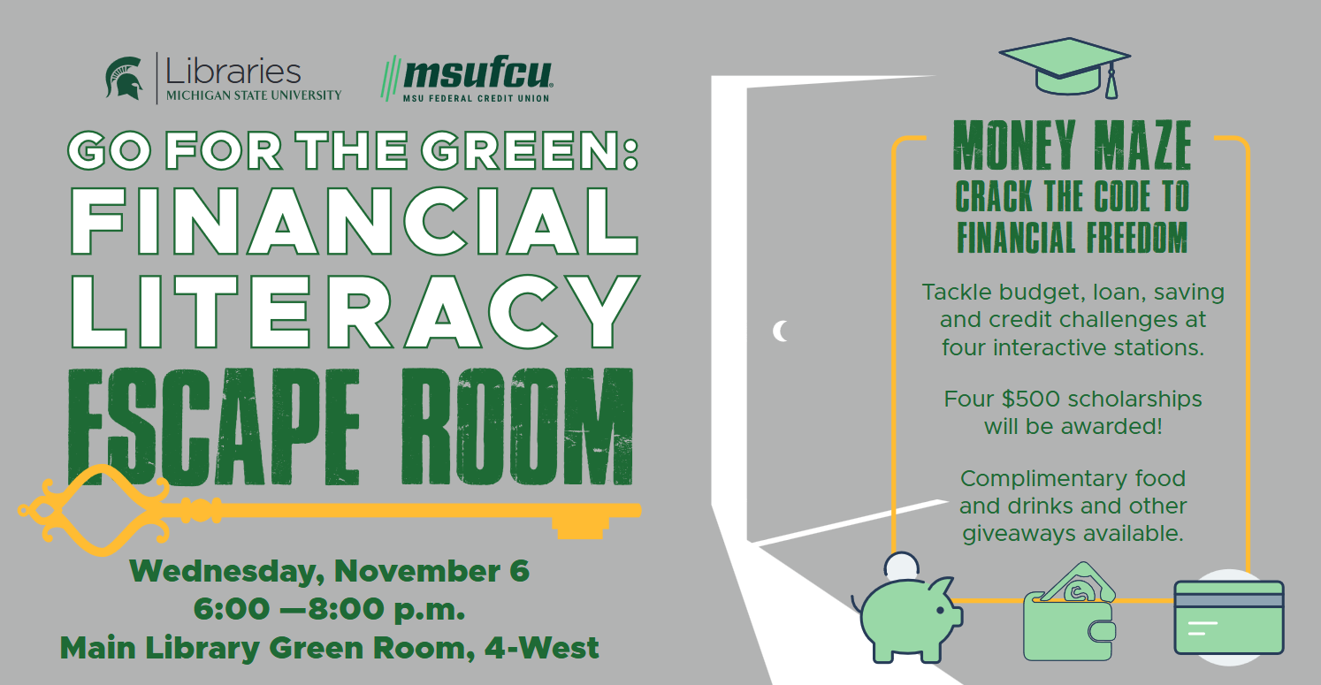
Financial Literacy Events in the Library

Slide 6
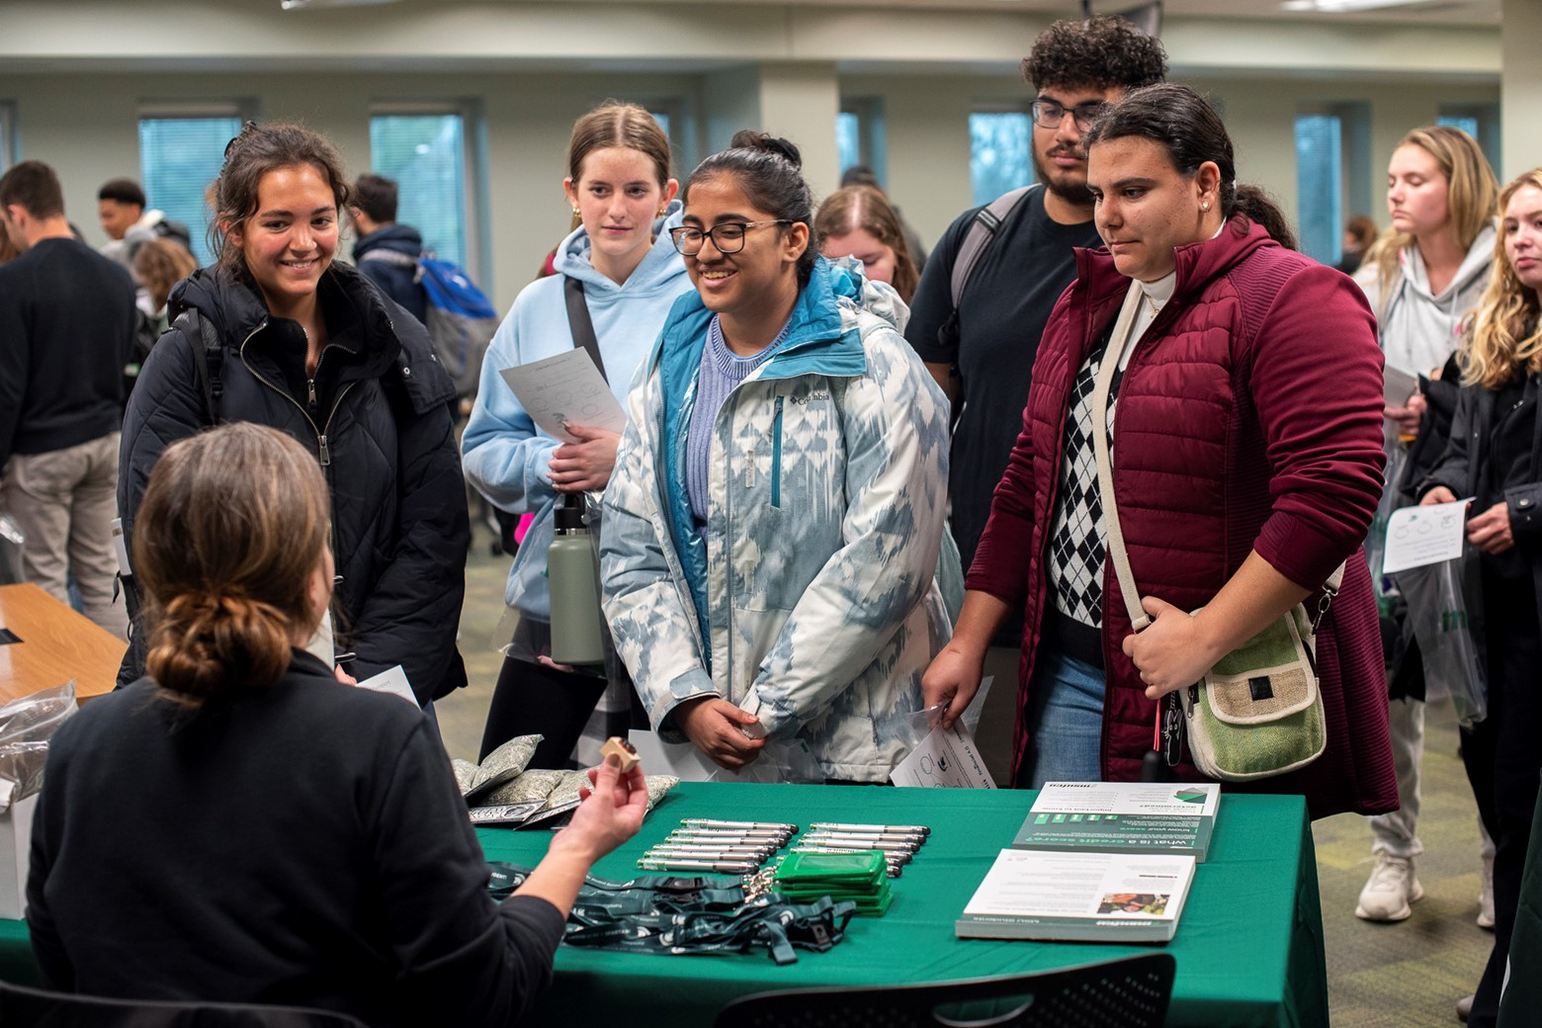
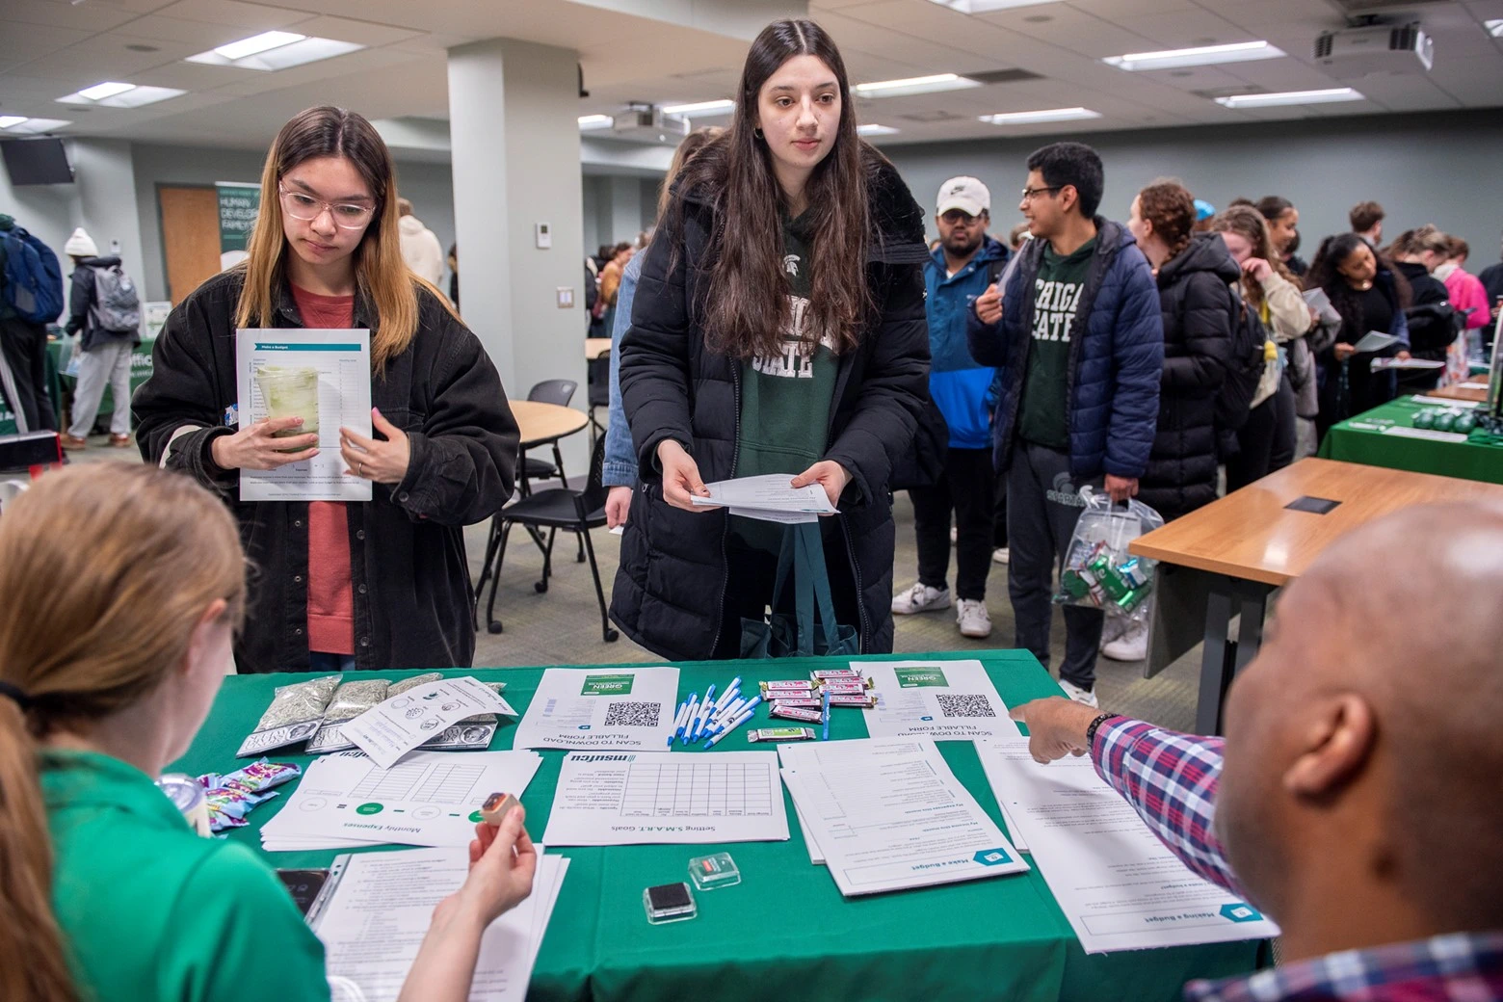
Participants

Slide 7
Scholarship Questions
Provide a tailored strategy from the resource fair that you learned to manage your money in college.
When does loan repayment start for federal loans?
How do interest rates affect loan repayment?
What steps should you take to work on establishing credit?
What is a high yield savings account?
What are some examples of expenses?
What is one benefit of having a savings account?

Slide 8
After Attending the Fair, I Learned…
How to manage student loans
The impact of interest rates.
About loan repayment practices.
Strategies to establish credit.
The advantages of having a checking account.
The advantages of having a savings account.
The importance of making a monthly budget.

Slide 9


Slide 10
Thank you!
Holly Flynn
flynnhol@msu.edu

