Slide 1
UW Data Collaborative
A New Hub for Innovative Data
Matt Hall

Slide 2
Why the UWDC?
Motivated by several needs:
  Expanding number and types of complex data
  Highly valuable but risky

Slide 3
Why the UWDC?
Motivated by several needs:
  Expanding number and types of complex data
  Highly valuable but risky
  Growing expectations for open access
  Need for standardized protocols
Critical infrastructure missing most at universities

Slide 4
UWDC Objectives
Provide infrastructure for sensitive data
Foster collaboration across campus

Slide 5
UWDC Objectives
Provide infrastructure for sensitive data
Foster collaboration across campus
Equalize data accessibility
Enhance training
Facilitate data discovery

Slide 6
What is the UWDC
Mission to collaborate, supported by two critical infrastructures
Secure Computing System
Administrative Management System

Slide 7


UWDC Data Enclave
Public Internet

Slide 8
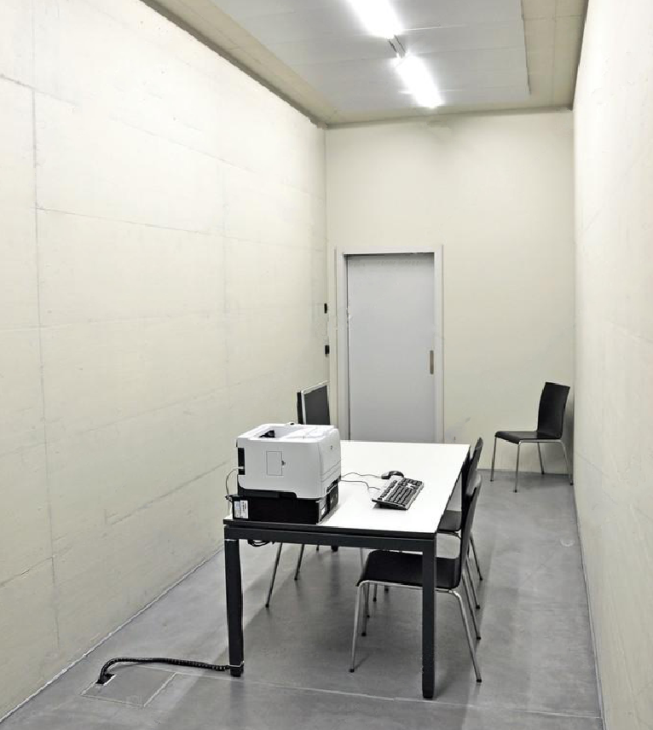

UWDC Data Enclave
Public Internet

Slide 9
UWDC Data Enclave
Public Internet

Slide 10













UWDC Data Enclave
UW Network
User Desktop
Public Internet
Public Internet
  Strictly regulates in- and out-bound traffic
  Virtual access via UW VPN and two-factor authentication
  High performance systems with premier software

Slide 11
UWDC Data Enclave
UW Network
User Desktop
Public Internet
Public Internet
  Strictly regulates in- and out-bound traffic
  Virtual access via UW VPN and two-factor authentication
  High performance systems with premier software

Slide 12
UWDC Data Enclave
UW Network
User Desktop
Public Internet
Public Internet
  Strictly regulates in- and out-bound traffic
  Virtual access via UW VPN and two-factor authentication
  High performance systems with premier software

Slide 13
UWDC Administration
Manages Data
  Data agreements
  File organization
  Reporting requirements

Slide 14
UWDC Administration
Manages Data
  Data agreements
  File organization
  Reporting requirements
Manages access
  Screens applications
  Viability and contribution
  DSA & ethical commitment

Slide 15
UWDC Administration
Manages Data
  Data agreements
  File organization
  Reporting requirements
Manages access
  Screens applications
  Viability and contribution
  DSA & ethical commitment
Manages transfers
  Uploads of programs/data
  Downloads of output

Slide 16

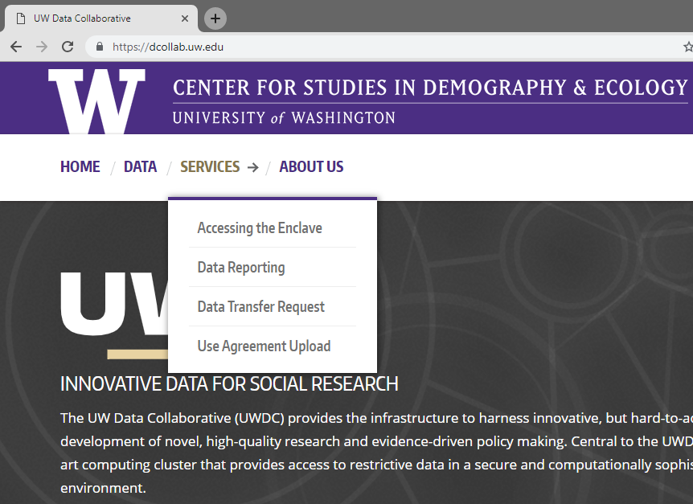
UWDC Administration
Manages Data
  Data agreements
  File organization
  Reporting requirements
Manages access
  Screens applications
  Viability and contribution
  DSA & ethical commitment
Manages transfers
  Uploads of programs/data
  Downloads of output
dcollab.uw.edu

Slide 17
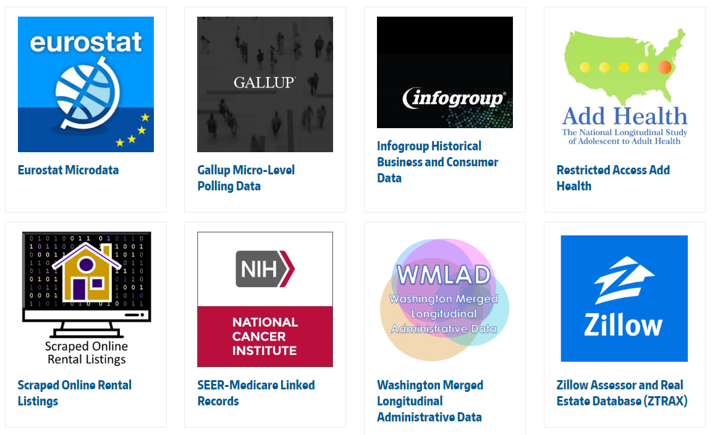
Early Adopters
Partnerships across campus

Slide 18
Early Adopters
Partnerships across campus

Slide 19
Next Steps
Lots of testing
  Of technical features of enclave and system security
  Of user experience
  Of computational power/capacity
  Of administrative processes
Creation of analytic products
Campus outreach
Seek additional funding
Develop training opportunities

Slide 20
Acknowledgements
Support from STF, PHI, CSDE, & Urban@UW
Made possible by hard work of:
  Meher Antia
  Kyle Crowder
  Sara Curran
  Matt Dunbar
  Nancy Garland
  Matt Hall
  Chris Hess
  Phil Hurvitz
  Derek Fulwiler
  Alan Li
  Jeremy Pritchard
  Matt Weatherford
  dcollab.uw.edu

Slide 21
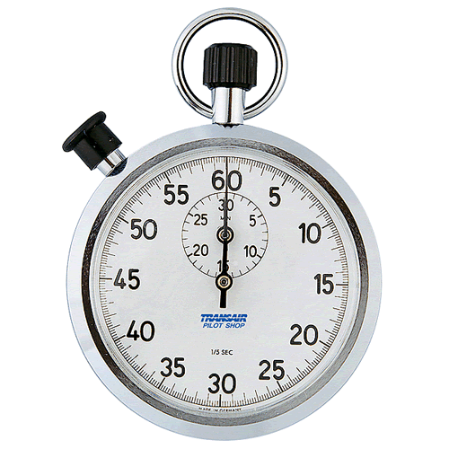
Time’s Up!
About your speaker:
  Name: Matt Hall
  Company: CSDE @UW
  Tel: 607-616-6687
  Email: hallmatt@uw.edu

