Slide 1
Disrupting Gentrification:
Tacoma Community Land Trust
Michael Monroe
RE: 370 Data Modeling
Final Project

Slide 2
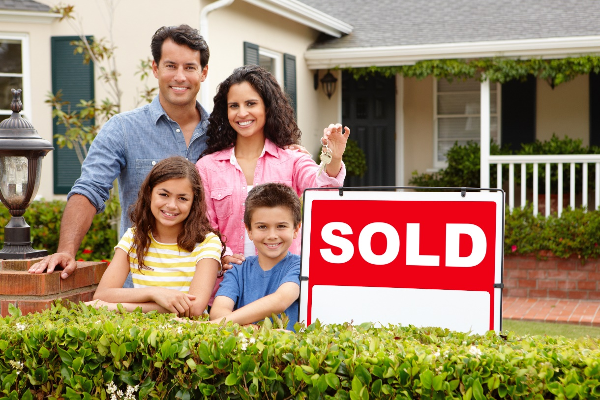
Community Land Trusts
Nonprofit community organization
Homeownership opportunities for low-income people
Homes stay affordable in perpetuity

Slide 3
Community Land Trusts
Nonprofit community organization
Homeownership opportunities for low-income people
Homes stay affordable in perpetuity

Slide 4
Community Land Trusts
Nonprofit community organization
Homeownership opportunities for low-income people
Homes stay affordable in perpetuity

Slide 5
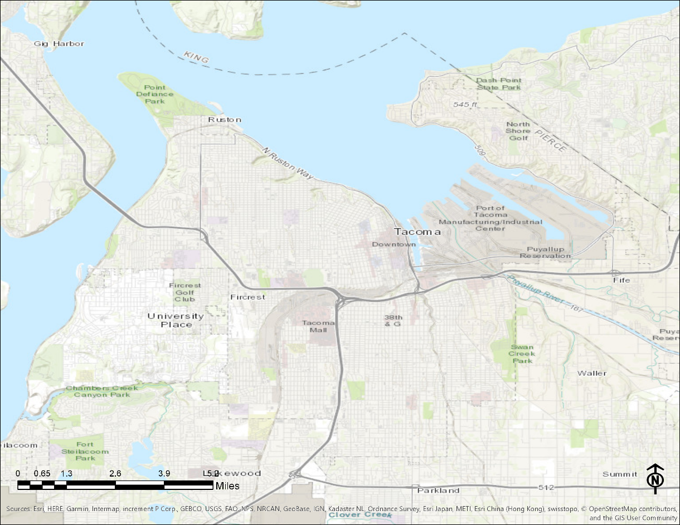
City of Tacoma
Population: 211,277
Median Income: $53,553
Racial Demographics:
  African American: 10.1%
  Asian: 9.1%
  Hispanic or Latino: 11.3%
  White: 59.7%
Avg. Commute: 27 mins
Source: Census.gov Quick Facts

Slide 6
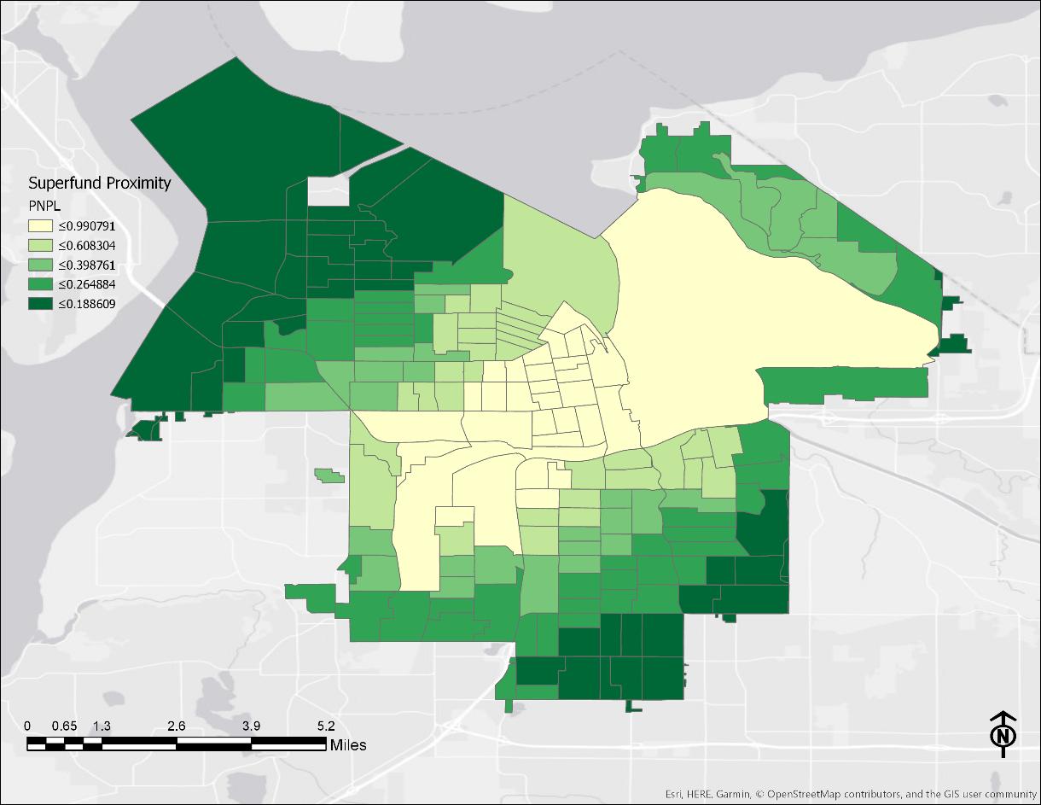
Layers
Proximity to Superfund sites
Median Home Value
Crime Index

Slide 7
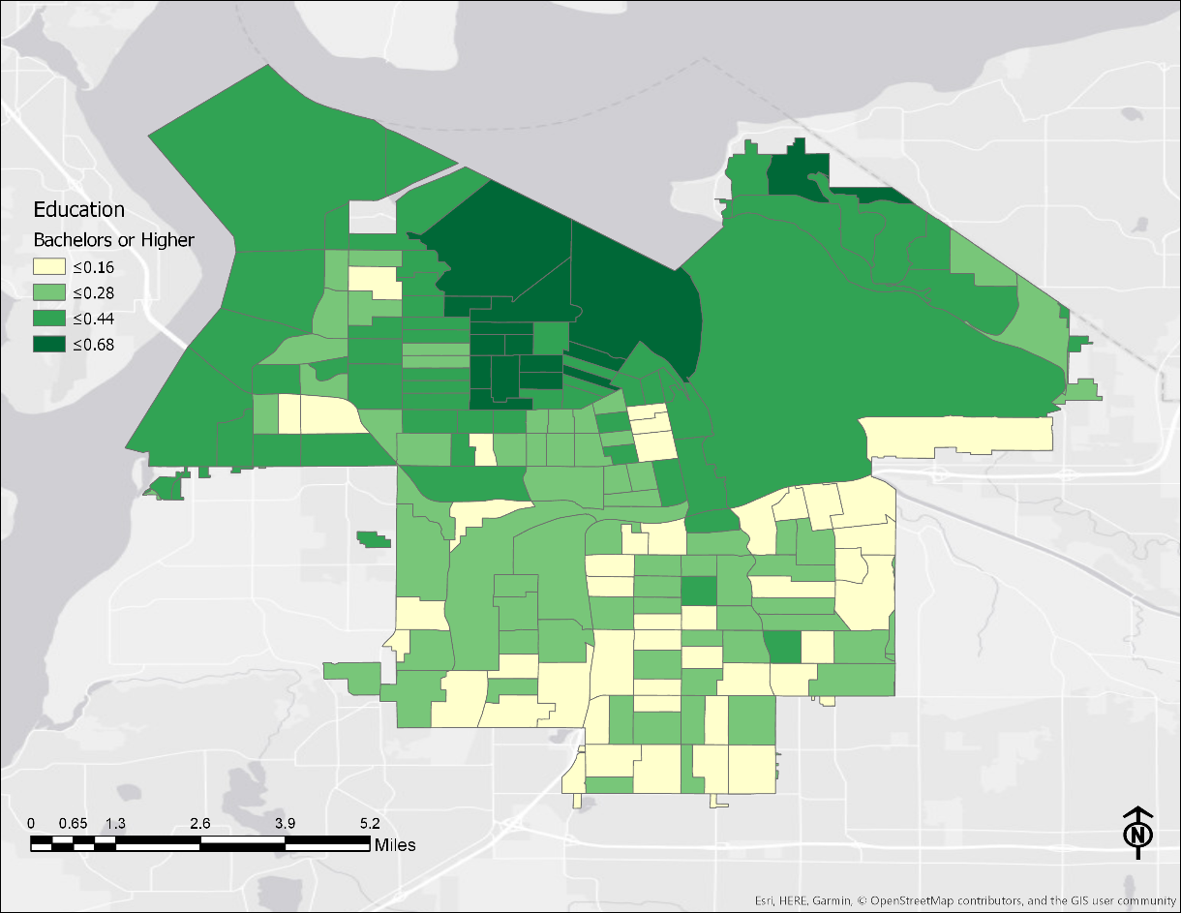
Layers
Educational Attainment
Percentage Renter Occupied

Slide 8
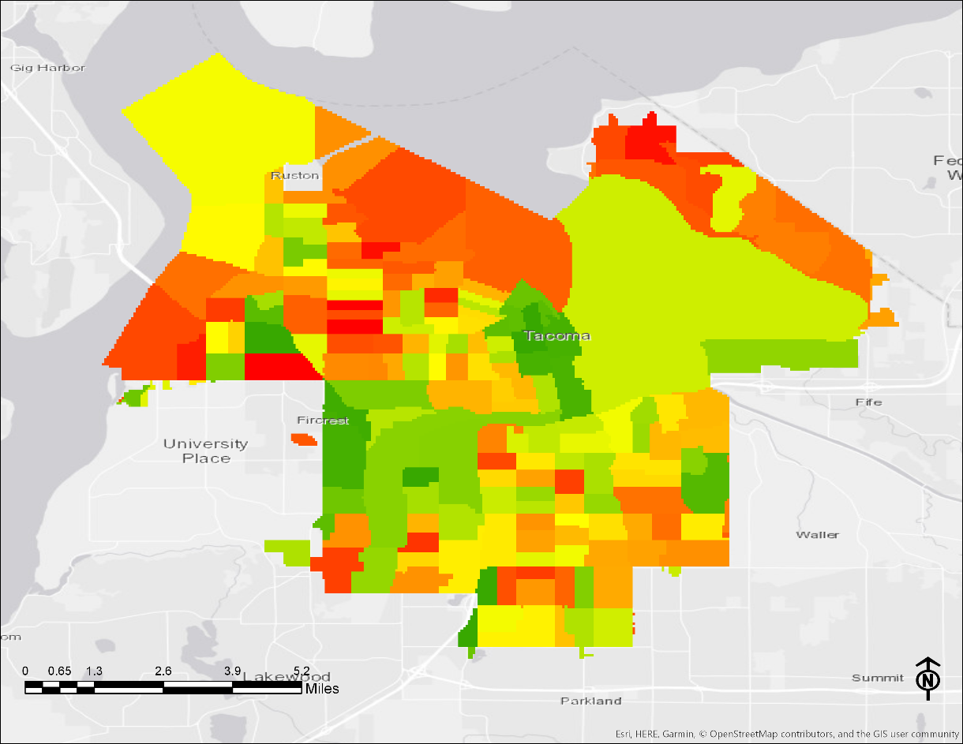
Methods
Data at Block Group
Layer for each dataset
Layers converted to raster images
Raster layers transformed to common scale (1 – 10)
Rasters combined with equal weight
  (Weighted Sum)

Slide 9
Methods
Data at Block Group
Layer for each dataset
Layers converted to raster images
Raster layers transformed to common scale (1 – 10)
Rasters combined with equal weight
  (Weighted Sum)

Slide 10
Proximity to Superfund Sites
Dark green furthest from superfund sites
Low scoring areas in Port of Tacoma and heavy industrial sectors

Slide 11
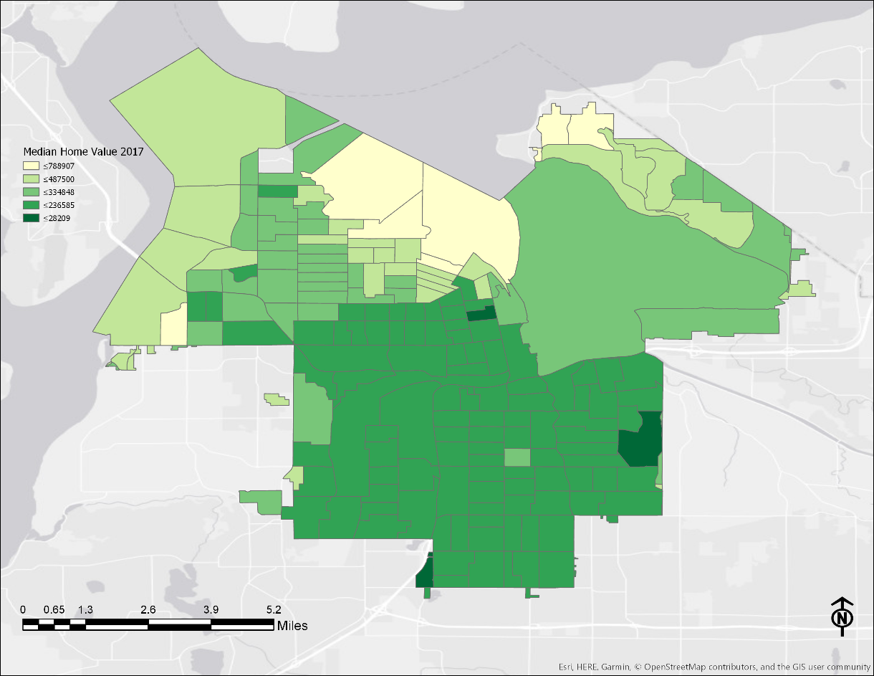
Median Home Value
High values near water
Limited variance in value in central areas

Slide 12
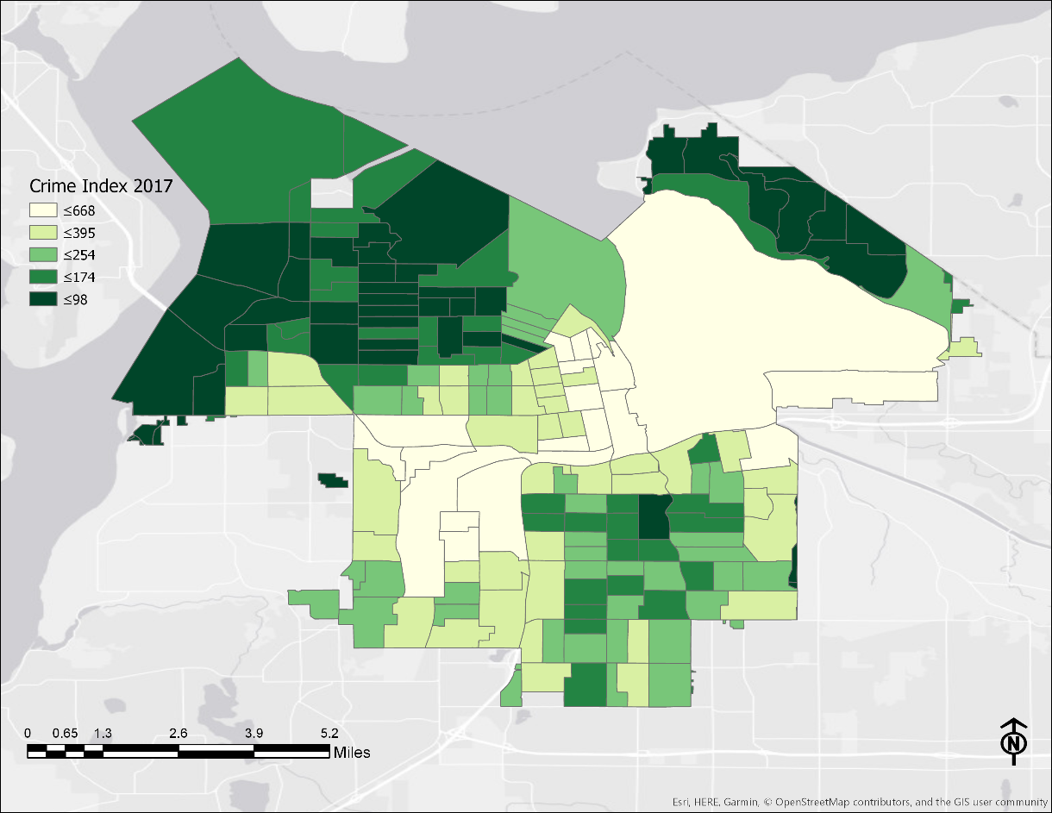
Crime Index
Lowest crime in dark green
National average crime index is 100
Some areas score 400+ or 3 times as much crime as the national average

Slide 13
Educational Attainment
Education operationalized as percentage of population with Bachelors degree or higher
Highest scores in wealthiest areas

Slide 14
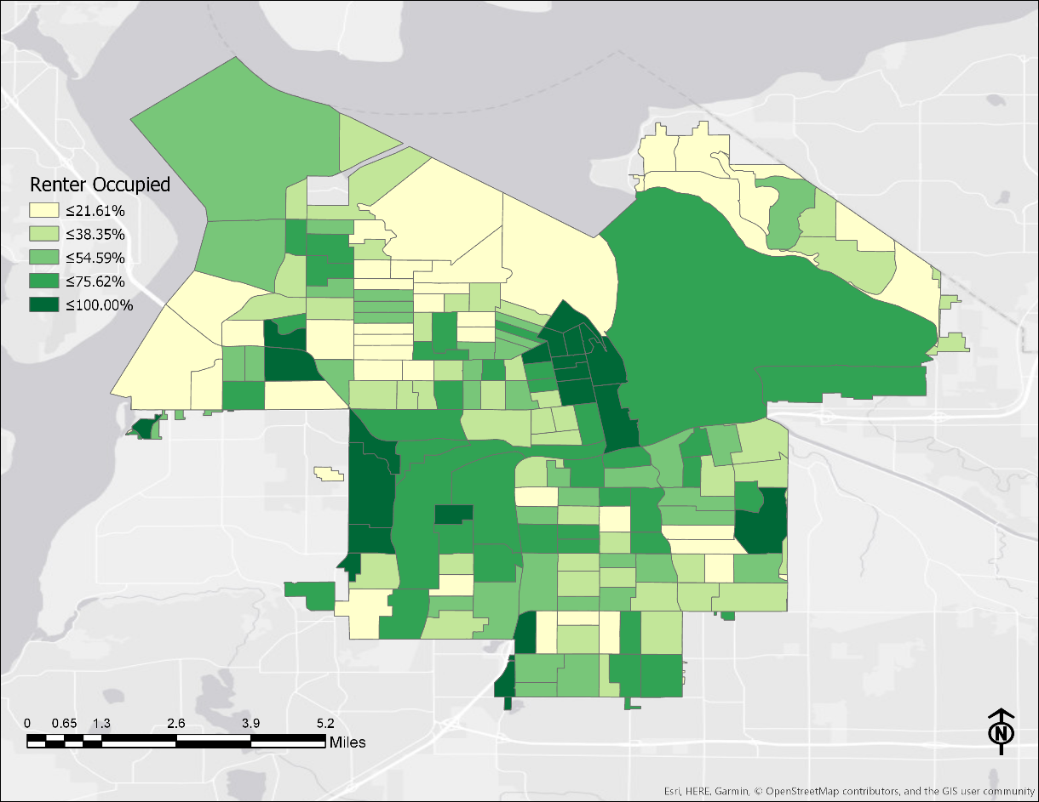
Percentage Renter Occupied
Lowest percentage of renters near water
Higher percentage of renters near TCC / UPS and Hilltop neighborhood

Slide 15
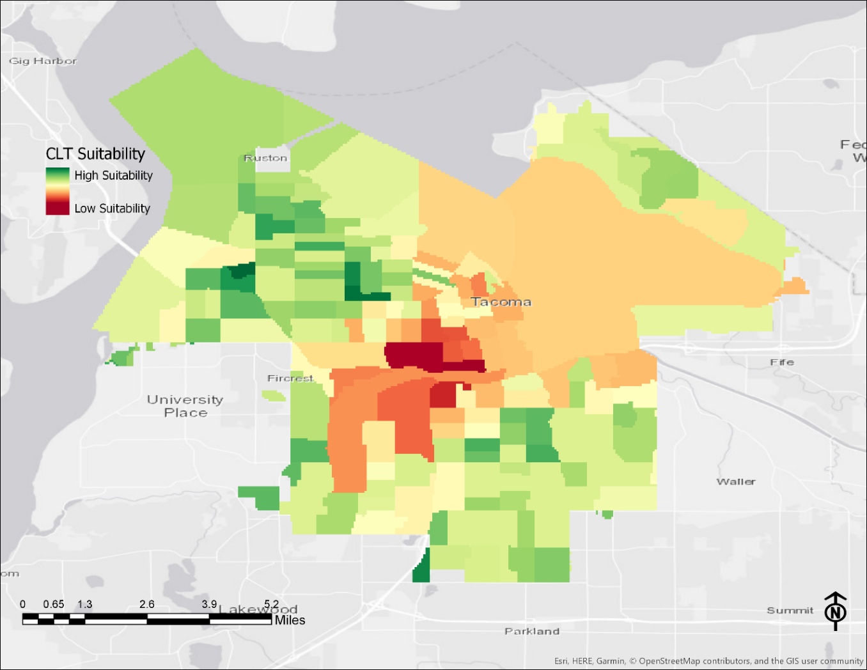
Suitability Model

Slide 16
Suitability Model

Slide 17
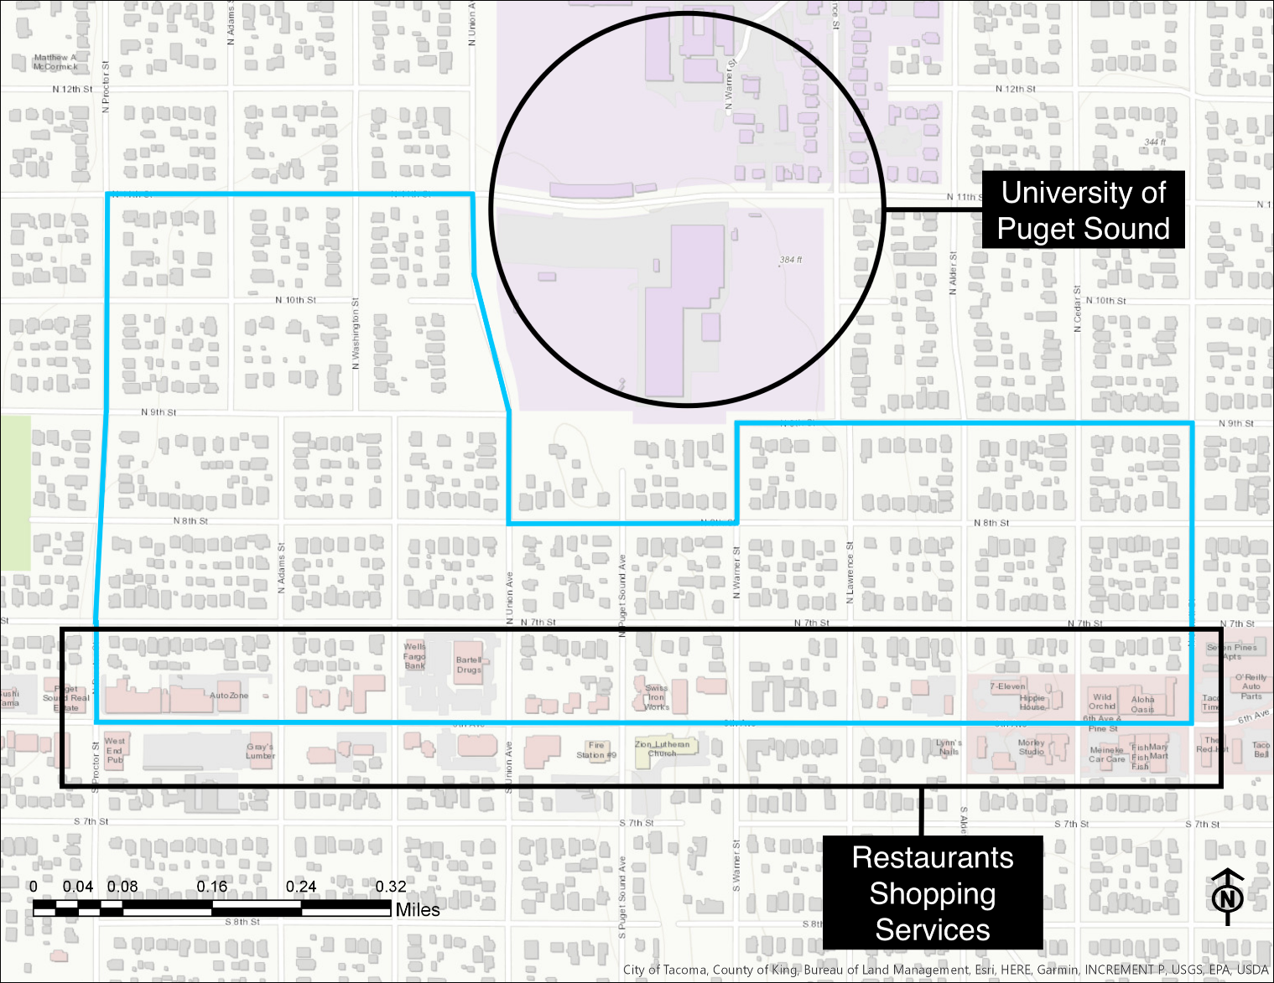
Site 1: North Central

Slide 18
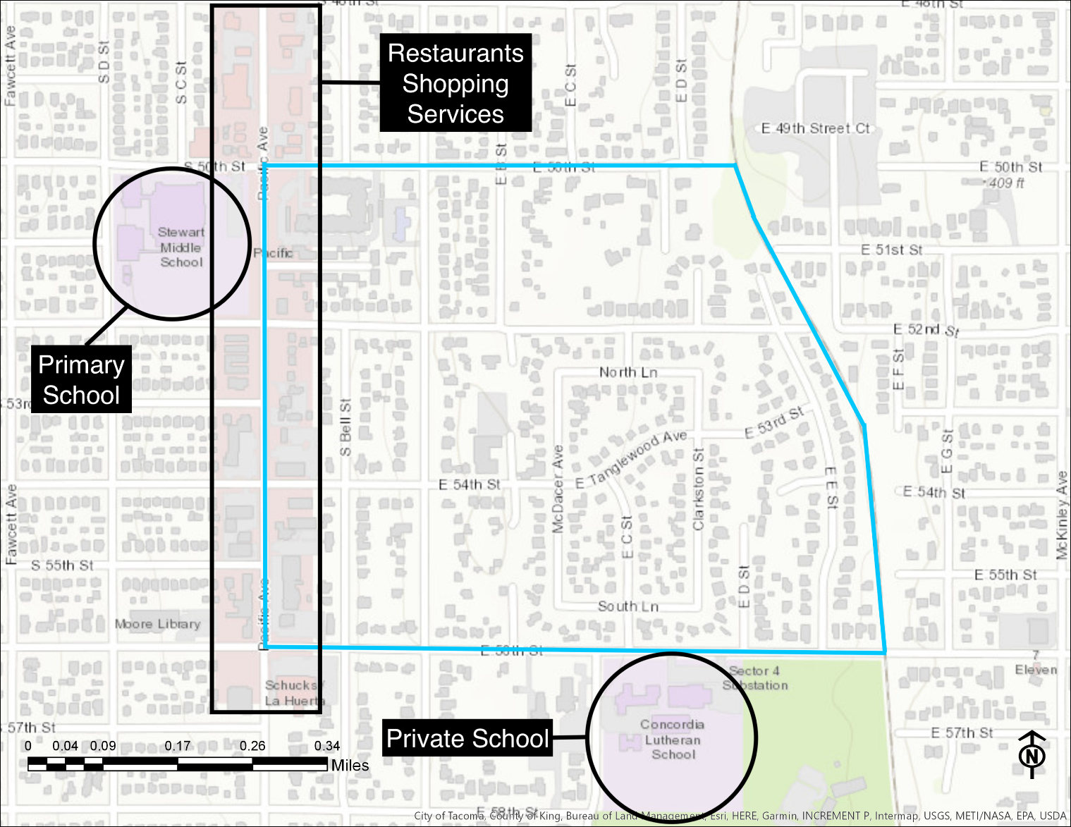
Site 2: Southeast

Slide 19
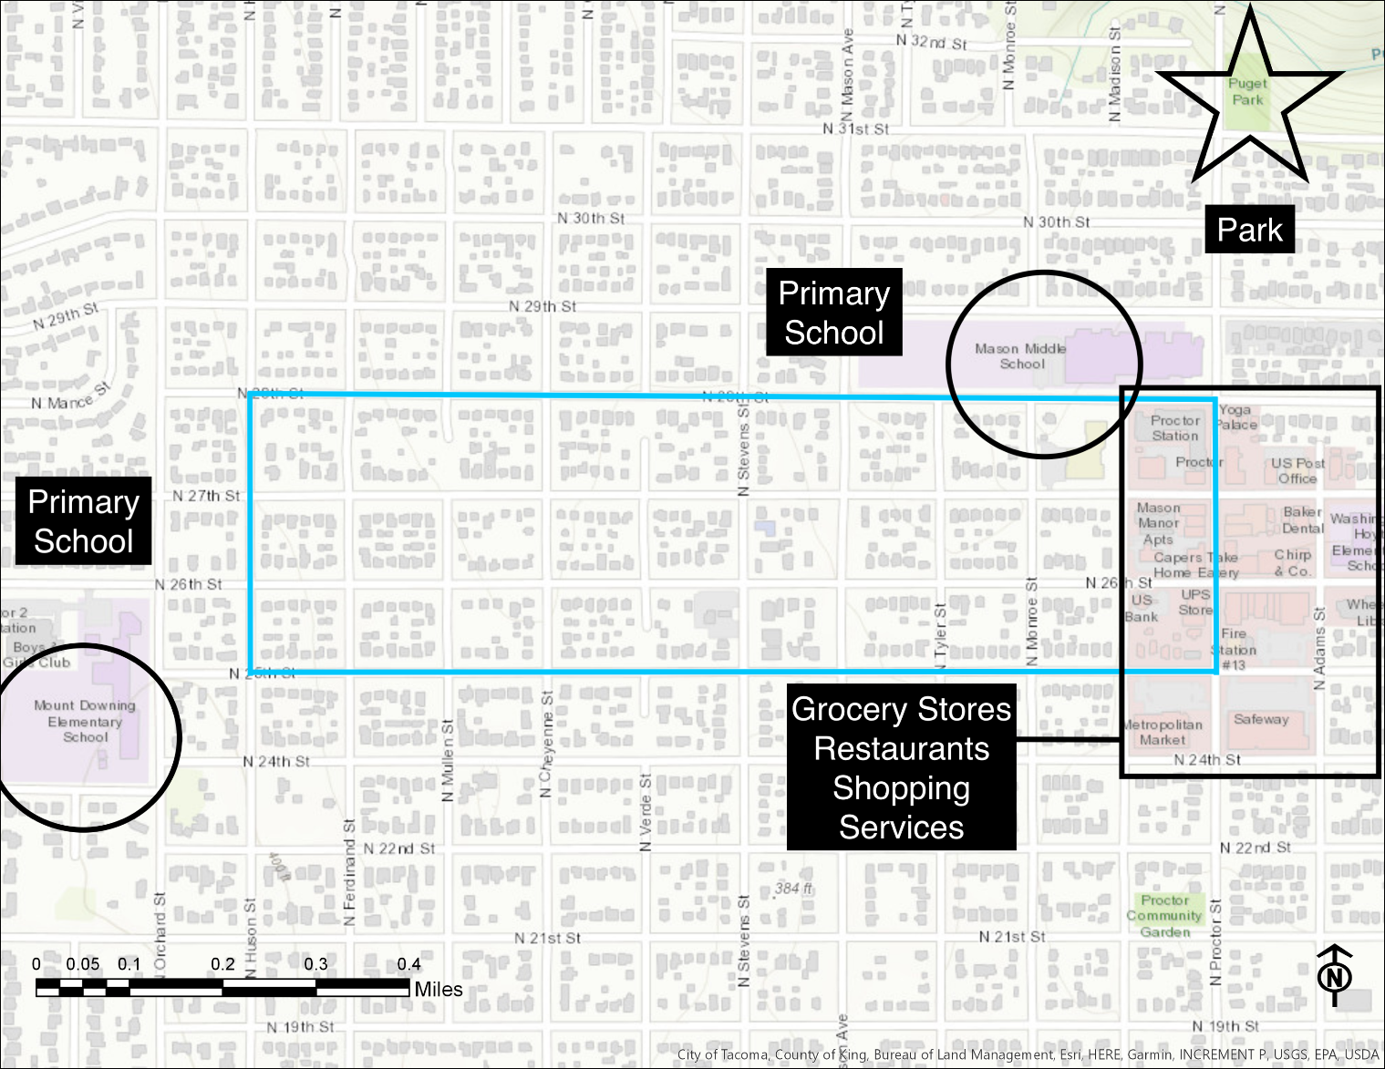
Site 3: North

Slide 20
Future Improvements
Access to Healthy Foods
Exclude Upper Threshold of Home Values
Interview more community stakeholders

Slide 21
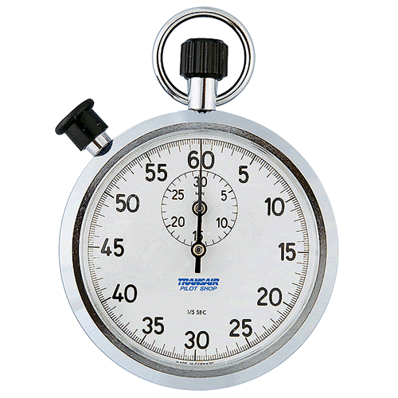
Time’s Up!
About your speaker:
  Name: Michael Monroe
  Company: Bromik Design & Build
  Tel: (206) 795-8686
  Email: mmonro@uw.edu
  Social Media: Call / Email
  Quick bio: Michael is a Junior in the Community Environment & Planning Major and is also the Director of Operations for Bromik Design & Build in Kirkland. After he graduates Michael aims to help create an affordable housing nonprofit in Tacoma.

