Slide 1
Norris Medical Library Wellness and Reflection Room
Presented by: Leslie Jones, Karin Saric, Annie Thompson, Renee Rau, and Luis Franco
BTAA Wellness Symposium – April 24, 2025

Slide 2
Presentation Overview
                Wellness Survey
                Planning Process
                Challenges
                Funding
                Impact of Space
                Practical Tips for Similar Wellness Initiatives
Notes:
This presentation will cover everything from the planning process to practical tips.

Slide 3
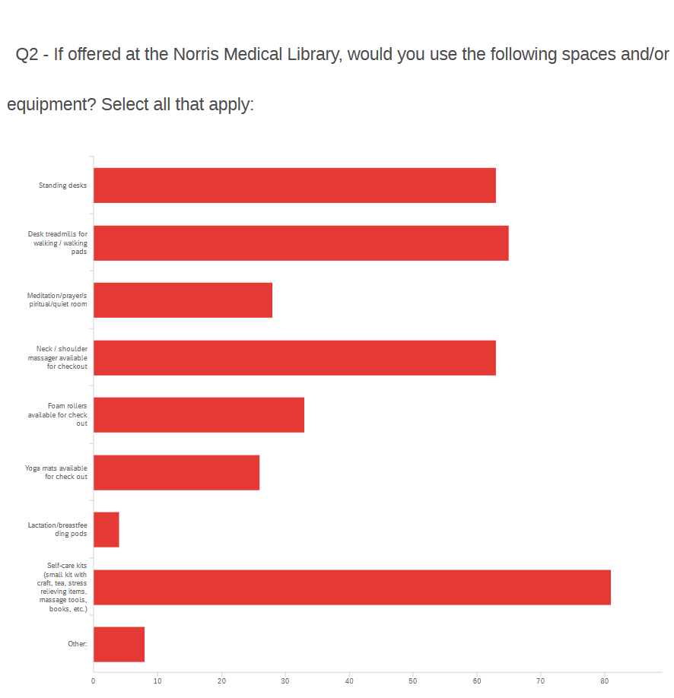
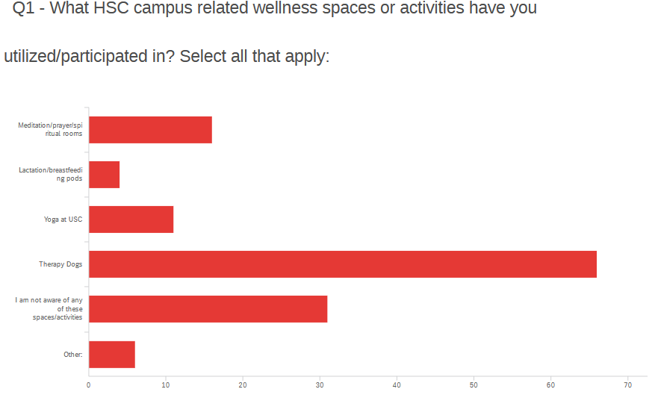
Feedback Results
Notes:
In 2023, the Norris Medical Library Outreach and Engagement Committee saw the value of contributing to campus wellness.
To collect feedback we held a wellness event in April and included a short survey about wellness activities and interests.
In total, we received 110 survey responses.
We asked participants which campus wellness spaces or activities they had used, and what wellness modalities they were interested in. Therapy dogs ranked highest, followed by meditation sessions and yoga.
We also asked if they would use certain wellness spaces or equipment if offered at Norris Medical Library. Self-care kits were the most popular choice, ahead of options like standing desks, neck massagers, and foam rollers.

Slide 4
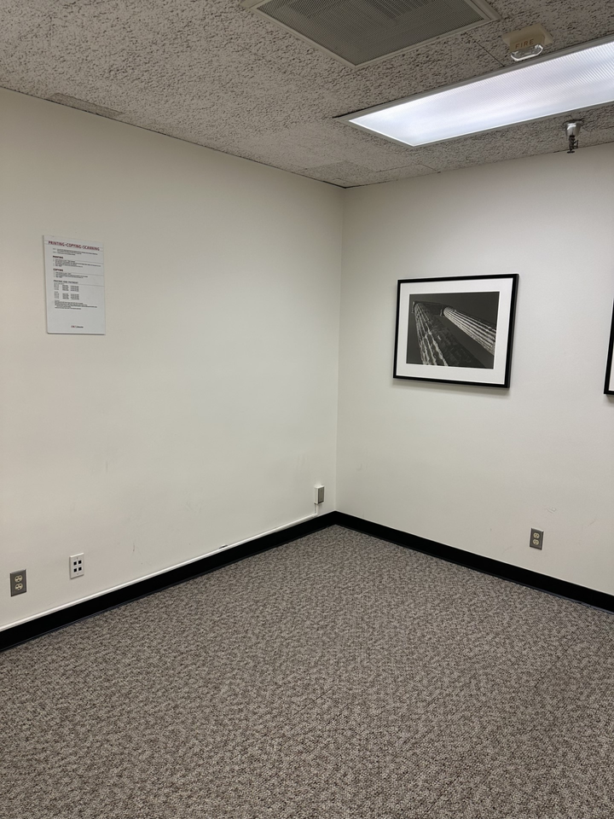
Notes:
Based on the survey feedback we decided to convert an old copy room into a calming environment where students could meditate, pray, reflect, stretch, relax, and unwind.

Slide 5
The Planning Process
Gather feedback from the students, faculty, and staff at HSC.
Committee met weekly to develop plans, policies, procedures, signage, etc. for the NML Wellness and Reflection Room.
Worked with the university’s Facilities Planning and Management team to paint and clean the space.
Collaborated with multiple departments across USC.
Notes:
Here’s a high level overview of how we spent the following year to coordinate and put together our wellness space.
This included gathering information, weekly meetings, and working with facilities and other campus groups.
We wanted to be very thoughtful about everything, so our group met once a week for a year to discuss all aspects of what we wanted to include in the room. This included detailed discussions around furniture, wellness equipment, artwork, lighting, décor, and overall arrangement of the room.
In order to ensure that we were creating an inclusive environment we researched and discussed aspects of religion, and considered all aspects of how patrons may want to use the room, including parameters to mitigate inappropriate use.

Slide 6
Challenges
Challenges
Scheduling challenges with Facilities Planning & Management
Consistent communication and timely follow-up via email
Make room for the unexpected
Notes:
Really, the main challenge we faced was coordinating with Facilities Planning & Management to clean and paint the room. This caused a six month delay to our launch. This challenge came as a surprise to us, because we had a long standing working relationship with them. Everyone is likely to encounter different challenges the main take away is to budget in time for unexpected occurrences.

Slide 7
Funding
Received a USC Libraries Dean’s Challenge Grant Award - $3,000
Received funding support for the USC Graduate Student Government - $500
Utilized funds from the Friends of the Library Endowment Account - $1,800
Notes:
Overall we spent ~$5,300. Funding came from multiple sources, including A USC Libraries Dean’s Challenge Grant Award, support from the USC Graduate Student Government, and additional funds from our Friends of the Library Endowment Account. Main expenses included painting and cleaning services, furniture, equipment, art work, and catering for our promotional launch.

Slide 8
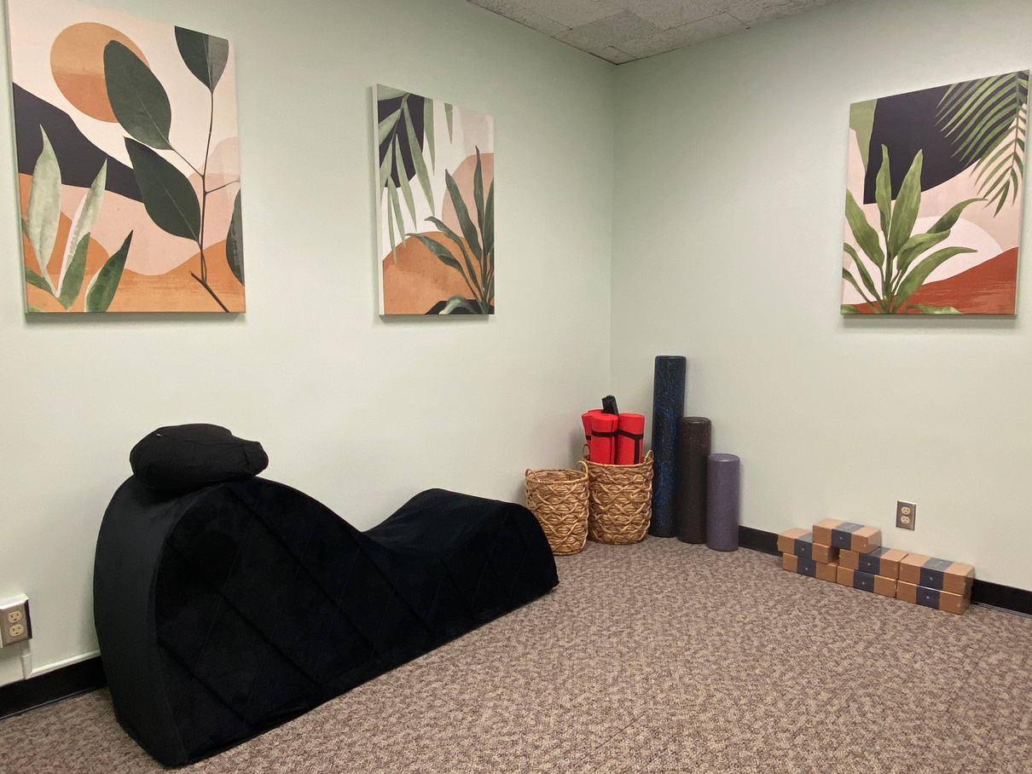

Launched April 16th, 2024
Notes:
Here’s the end result. One year after that wellness survey, we were able to launch The Norris Medical Library Wellness and Reflection Room. The room now includes foam rollers, yoga mats, a prayer mat, a small couch, and other wellness-related items.
On the right you see the logo we created to brand the room and all promotional material.

Slide 9
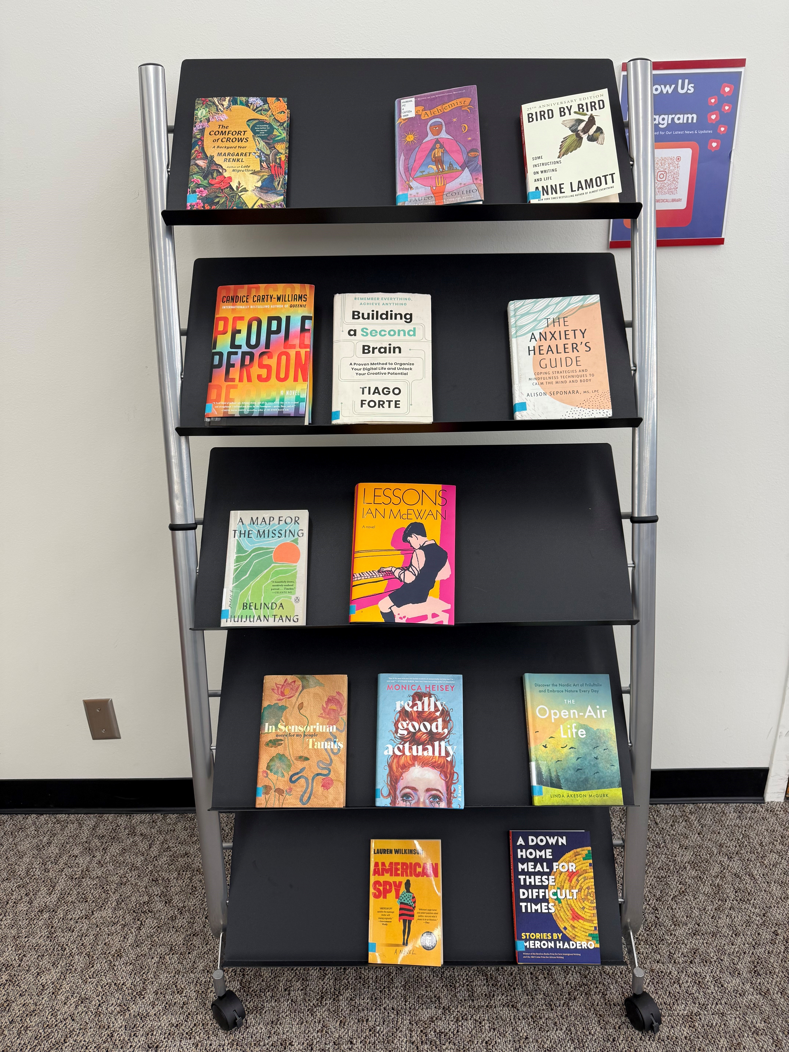
Wellness & Reflection Room Book Titles
Notes:
As a supplement to the room, we also curated a small collection of physical books on topics like mental health, mindfulness, and wellness. The books are located just outside the room, making it easy for users to grab one to read while relaxing or to check out for personal use.

Slide 10
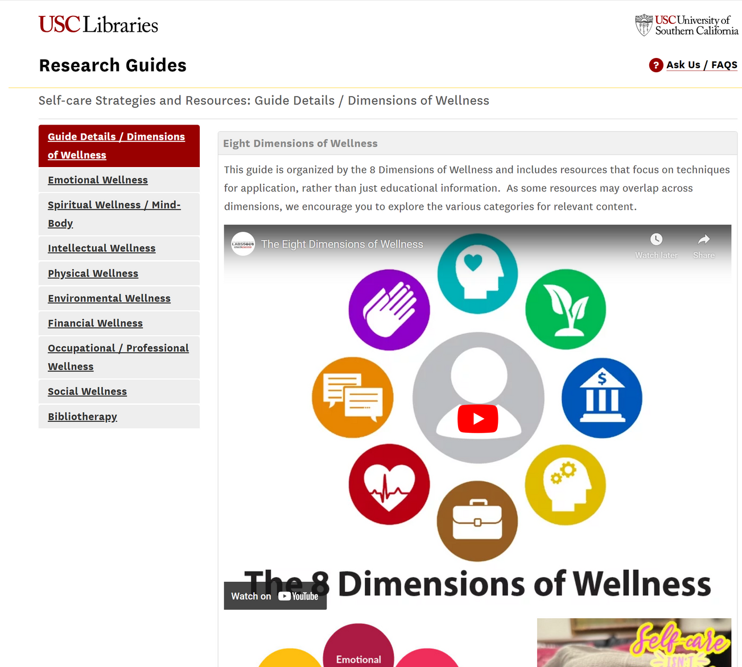
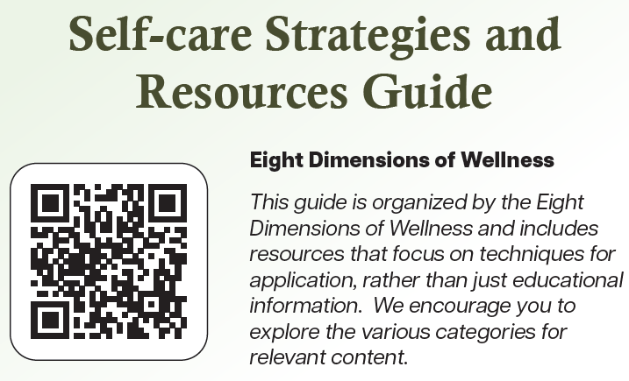
Online Self-care Guide
Notes:
We also created an online self-care guide that highlights many resources that support the 8 dimensions of wellness. You can access it via this QR code.

Slide 11
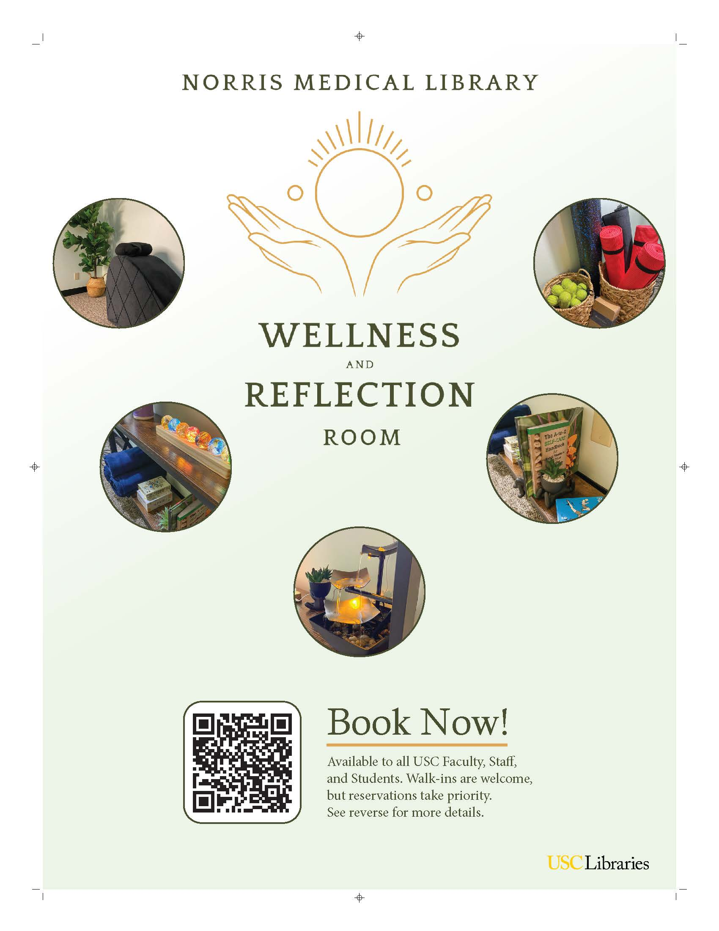
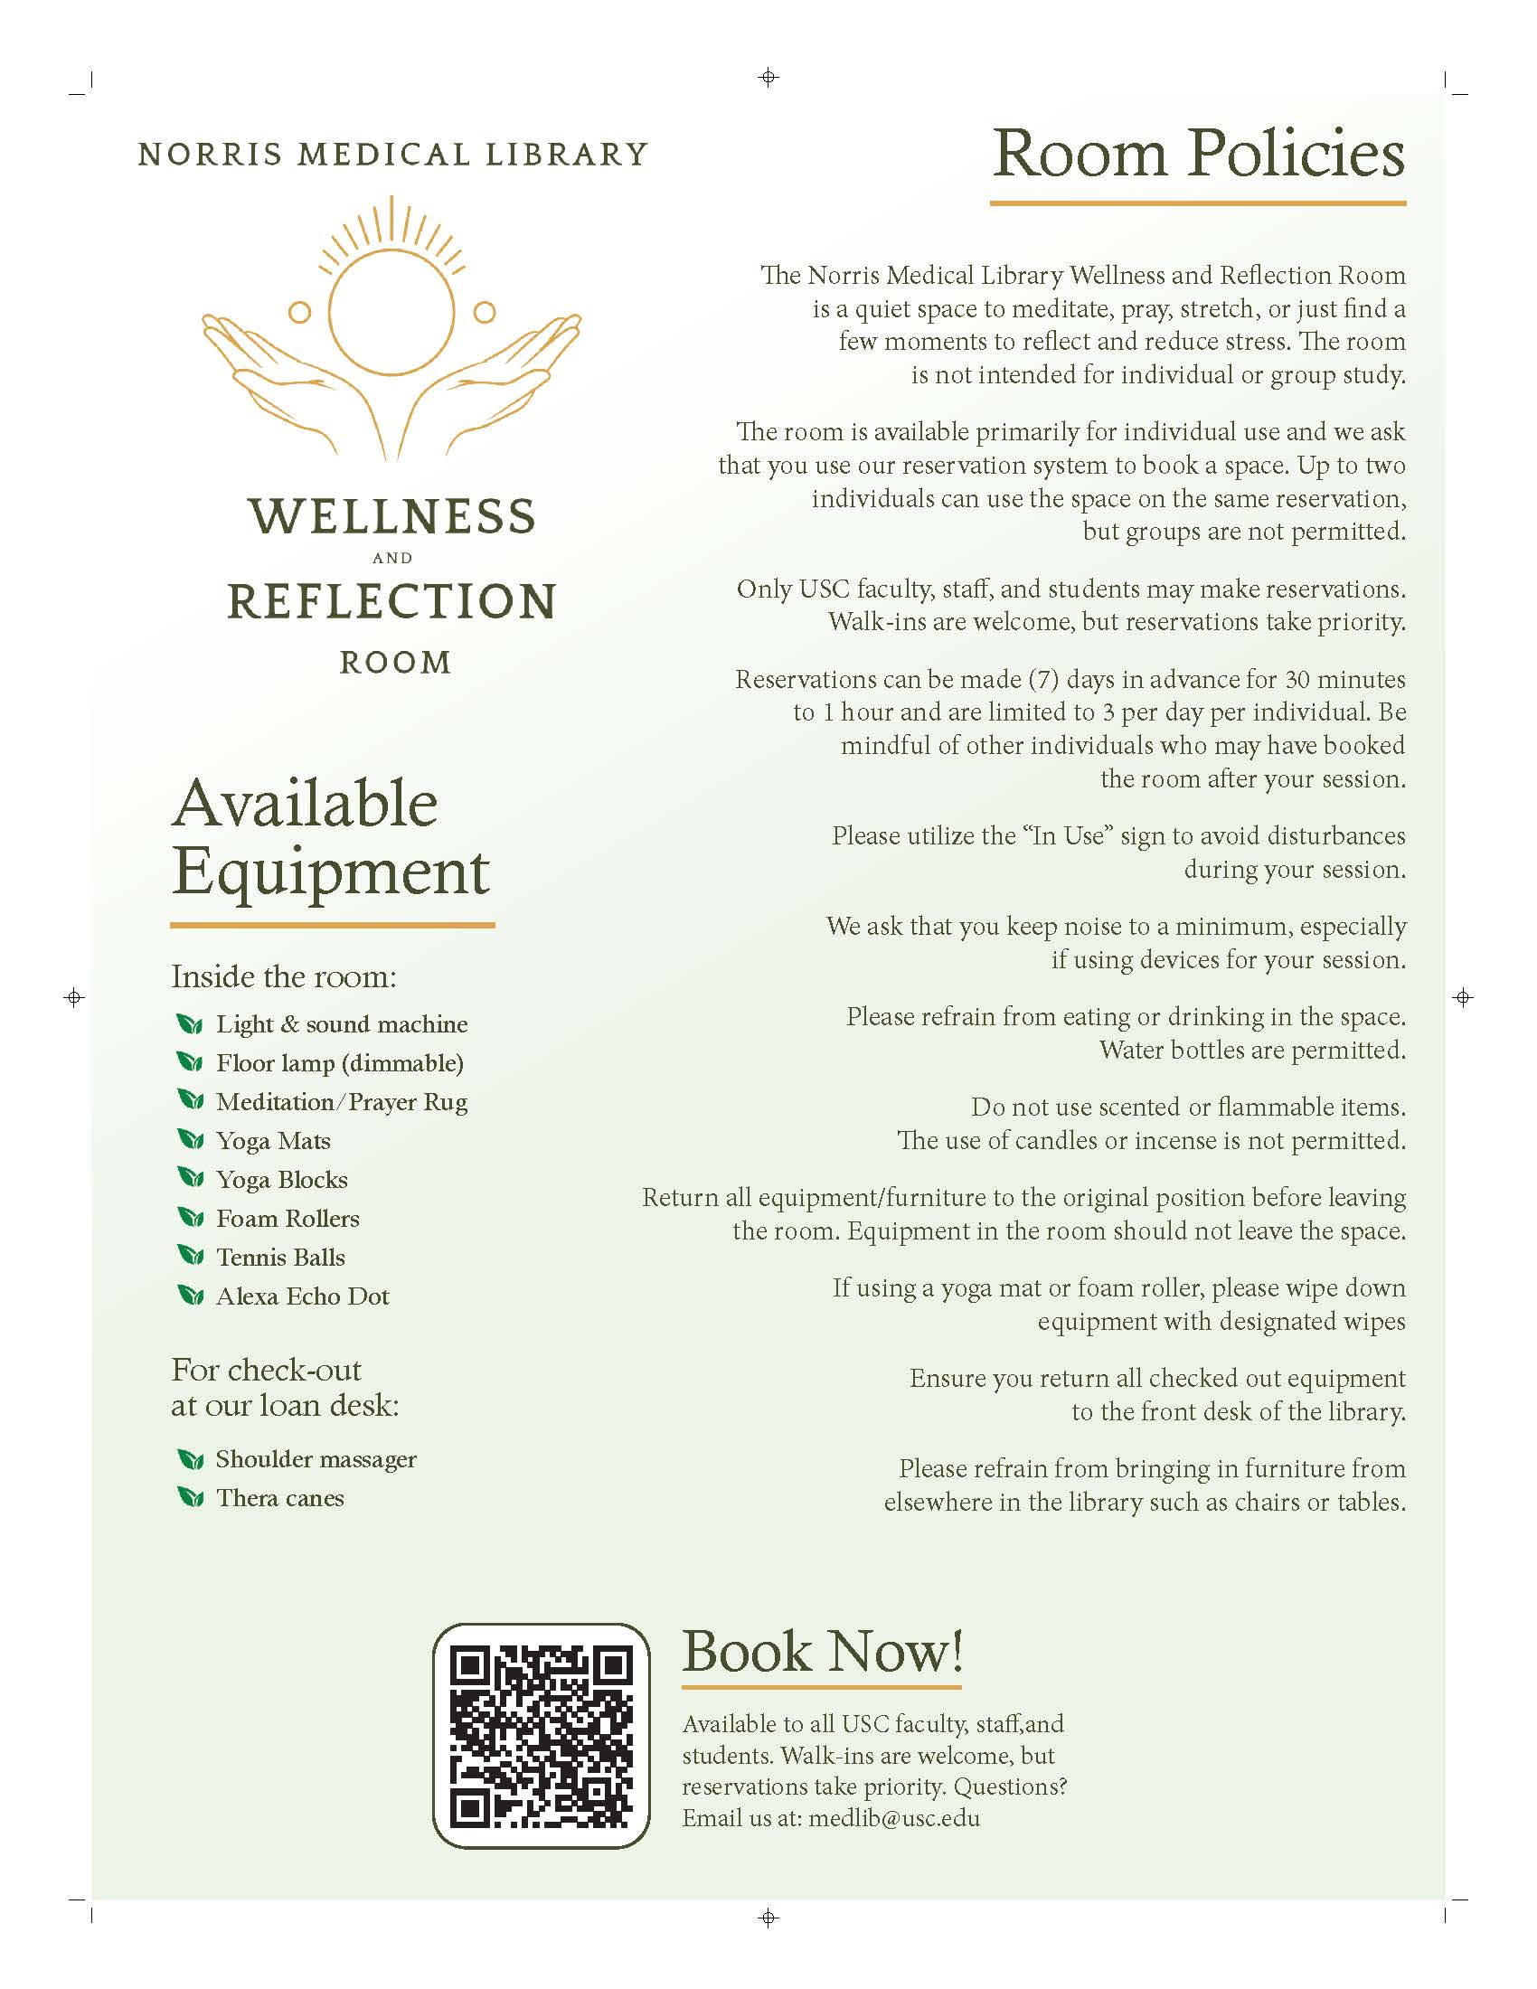
Notes:
We created both physical and digital materials to promote the room, including how to reserve the space, what equipment is available, and which items can be checked out at the circulation desk. We also shared the room’s policies and procedures. Signage was placed throughout the library and across campus, and we shared this information on social media and through collaborations with other departments. This helped raise awareness and gave users a clear, centralized source of information about the wellness and reflection room.

Slide 12
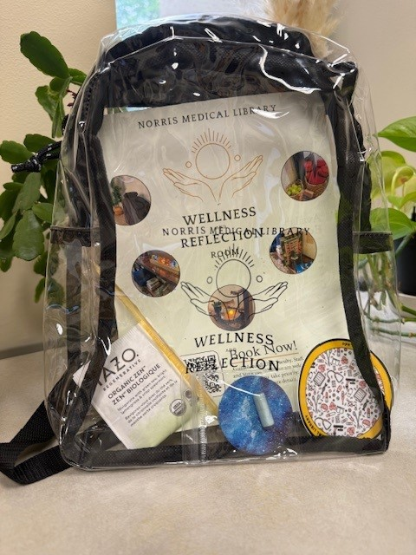
Self-Care Kits
What’s Included
Informational fact sheet
Tea
Honey
Calming Patch
Positive Affirmation Message
Norris Medical Library Sticker
Notes:
To attract more people we also created self-care kits. You can see we branded the clear mini-back pack with our logo. This was a huge draw for our community as they were able to get a branded bag that they could also use for stadium events.

Slide 13
Impact of Space
Impact of Space
336 reservations April 2024-2024
  room open to walk-ins as well
Patron messages:
  “Thank you so much, beyond excited for the new Wellness and Reflection room!”
  “I love the new wellness room and all the wellness-related library events.”
  “The positive affirmation is such a nice touch - I put it on my computer
Notes:
From April 2024 to April 2025 there has been a total of 336 reservations using LibCal. The space includes a personalized journal were users can leave positive messages. Here are a few that we’ve captured:
“Thank you so much, beyond excited for the new Wellness and Reflection room!”
“I love the new wellness room and all the wellness-related library events.”
“The positive affirmation is such a nice touch - I put it on my computer 😊

Slide 14

Practical Tips for Wellness Initiatives
  Identifying campus wide initiatives that are already support wellness
  Identify platforms/programming taking place
      Less labor for the library
      Provides another way to connect to funding
  Find ways to cross-promote on campus
  Delineate the role of the library
Notes:
We recommend identifying campus wide initiatives and campus groups that are already participating.
Partnering with other campus groups or programming can reduce labor for the library.
This also affords the opportunity to cross promote and reach a broader audience.
However, we do want to stress that if you opt to collaborate with other groups, it is important to consider your role.
What can you offer? What is realistic? For more detailed information regarding our process and some tips and tricks, you can link out to our flyer using this QR code

Slide 15
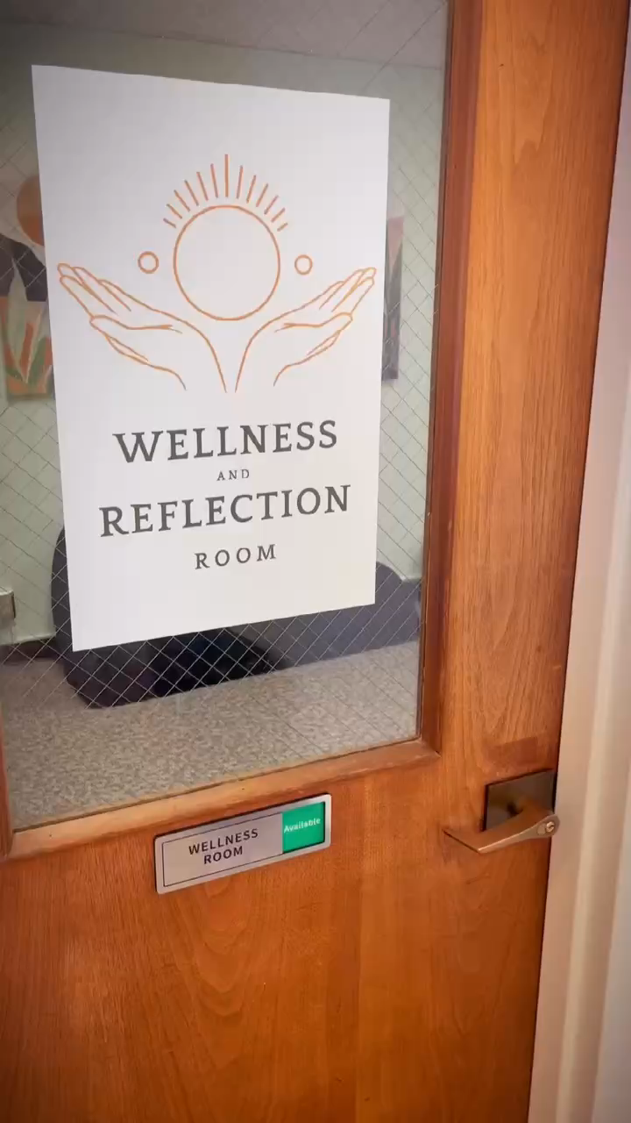
Wellness & Reflection Room: Final Outcome

Slide 16
Thank You

