Slide 1
Design Activity Build Your Vehicle
To reflect on the elements that make up [topic, ex: university library].
To build a better understanding of the relationships between the most important elements of [topic].

Slide 2
Build Your Vehicle
Description
We will each draw and label a picture of a vehicle (any vehicle: car, boat, bike, plane…) that represents the [topic] and its component parts.

Slide 3
Build Your Vehicle
Instructions
Draw a picture of a vehicle. Any vehicle (car, boat, bicycle ferry, submarine...whatever resonates with you!) It might be helpful to draw this image large.
As you draw, we will be providing prompts to incorporate into and label within your drawing. You may want to add something or just label something that already exists. Up to you!
Don’t worry too much if you miss a prompt. Draw and label what you can.

Slide 4
Build Your Vehicle
*Tech Tips*
Use https://www.autodraw.com/ to make your drawing.
You can use the autodraw feature or draw freehand.
You will then save this drawing and paste it into your Google Slide.
We will have a quick tech tutorial now.

Slide 5
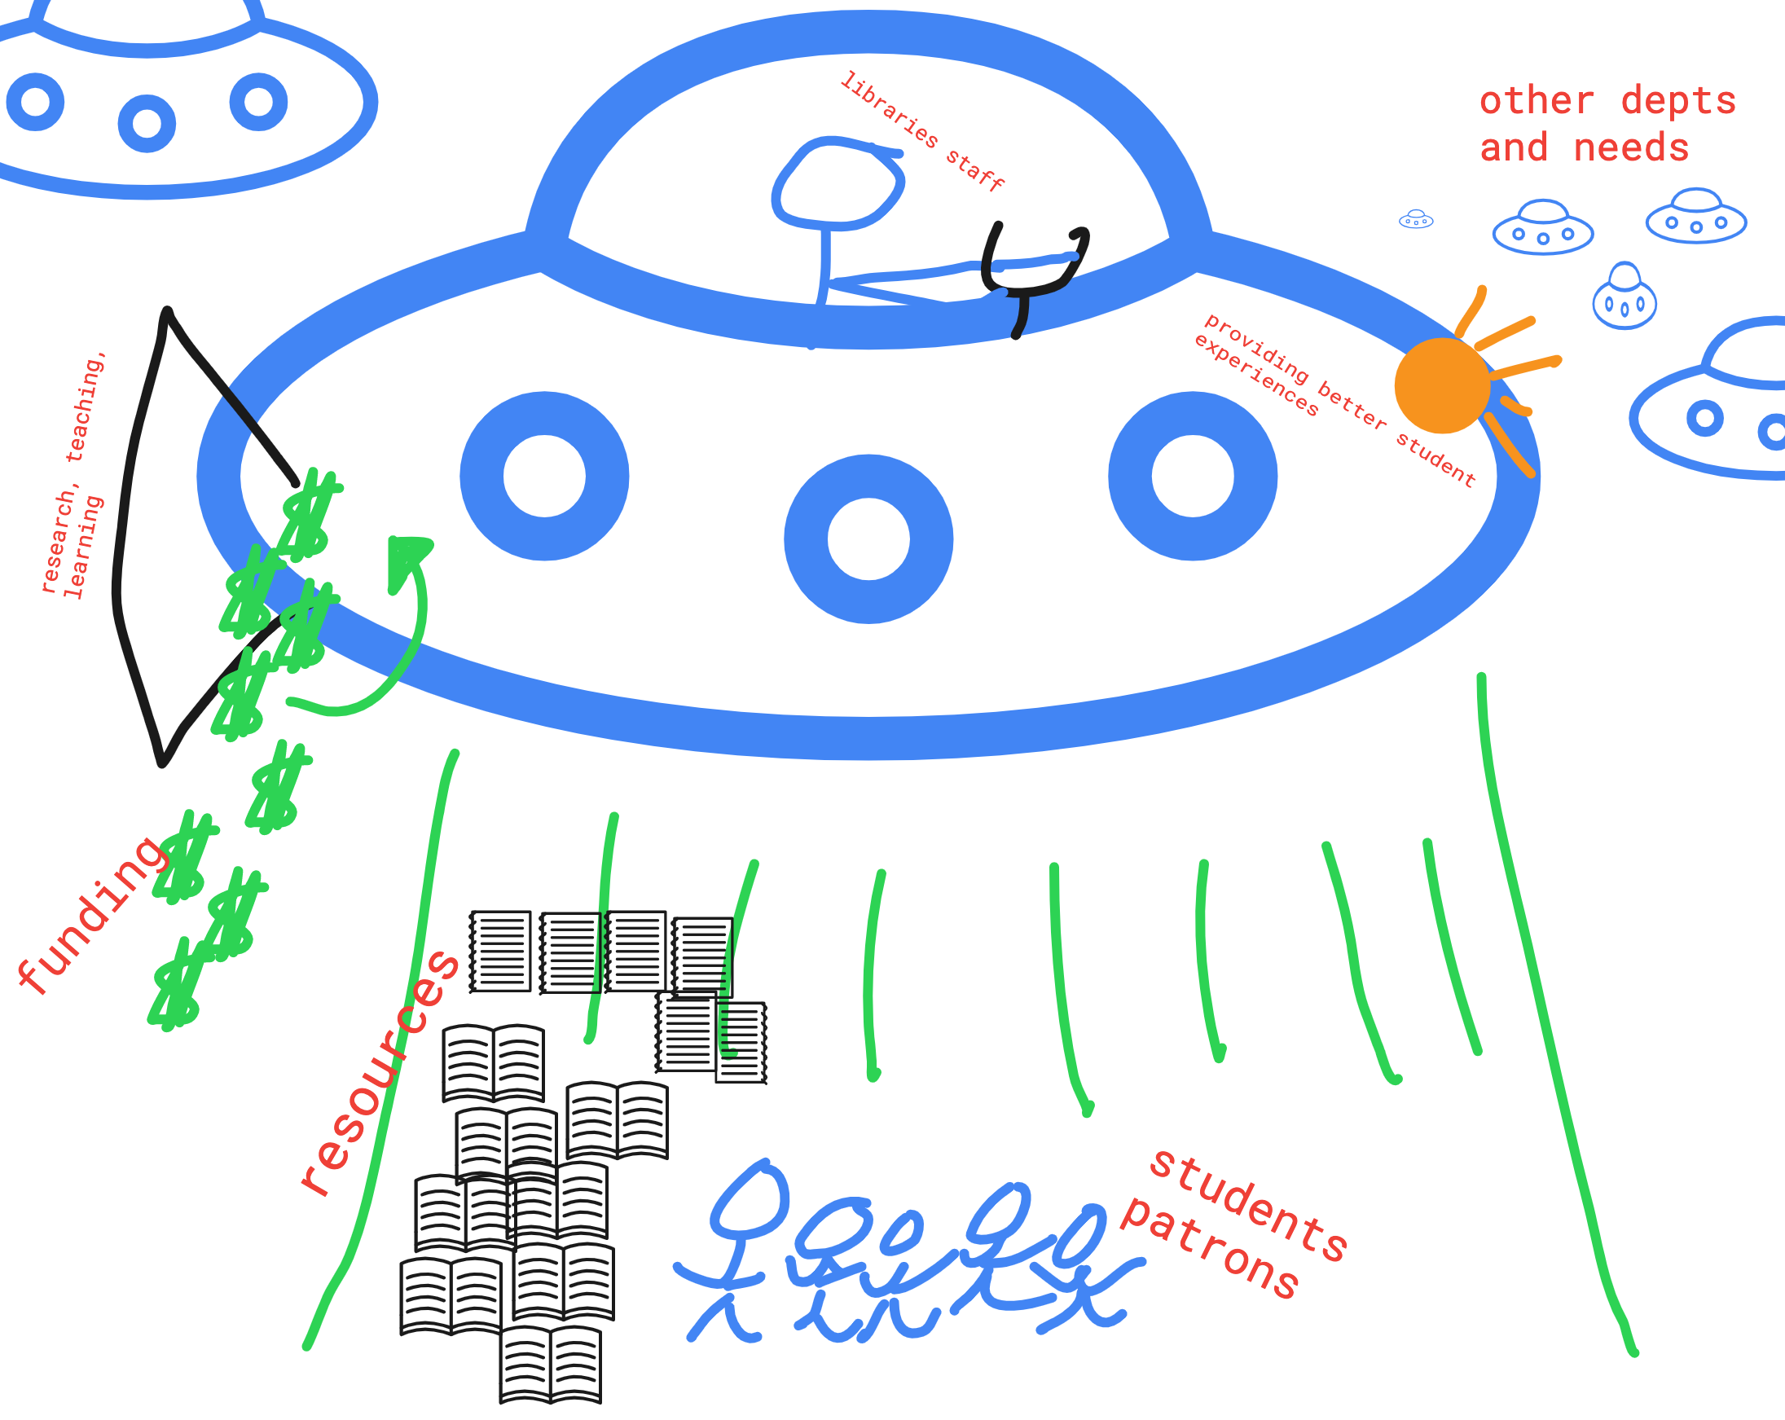
Build Your Vehicle EXAMPLE

Slide 6
ACTIVITY MODELING
Facilitators will share their screen to model how to use the tools for this activity.
Auto Draw: https://www.autodraw.com/
Example here

Slide 7
Participant

Slide 8
Participant

Slide 9
PART
PARTICIPANT

Slide 10
BUILD YOUR VEHICLE DEBRIEF
Reflection
Let’s take a moment to look back on this activity.
Was this activity fun? Challenging? Interesting? What made it so?
What did you find to be the most difficult part of this activity?
What are some common themes that you see throughout all of our drawings? What is something unique?
Can we draw any conclusions about our relationship with UW Libraries from this activity?

