Slide 1
Mapping Our Realities in the Pacific Northwest Natives Geodatabase
Victoria Buschman

Slide 2
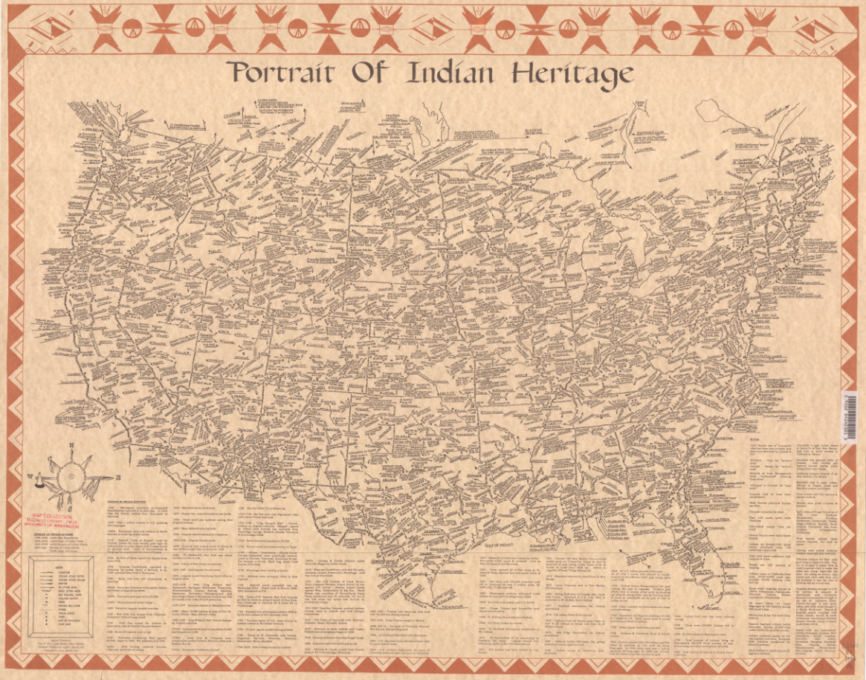

Notes:
People have tried mapping complex Indigenous realities for a long time. Physical maps draw by Indigenous scholars to address some of this complexity and robustness of information are available, but they are often criticized for their cartographic choices as being overwhelming or unconventional.
Introduction to the topic. What are our realities, what are our histories, how can we make this information relevant to our communities, both of Natives and to academics. How do we decolonize information and make it available to people who would benefit most from this information. Is an institution the place to host this information. How do we use geospatial information to tell the stories of our people.

Slide 3
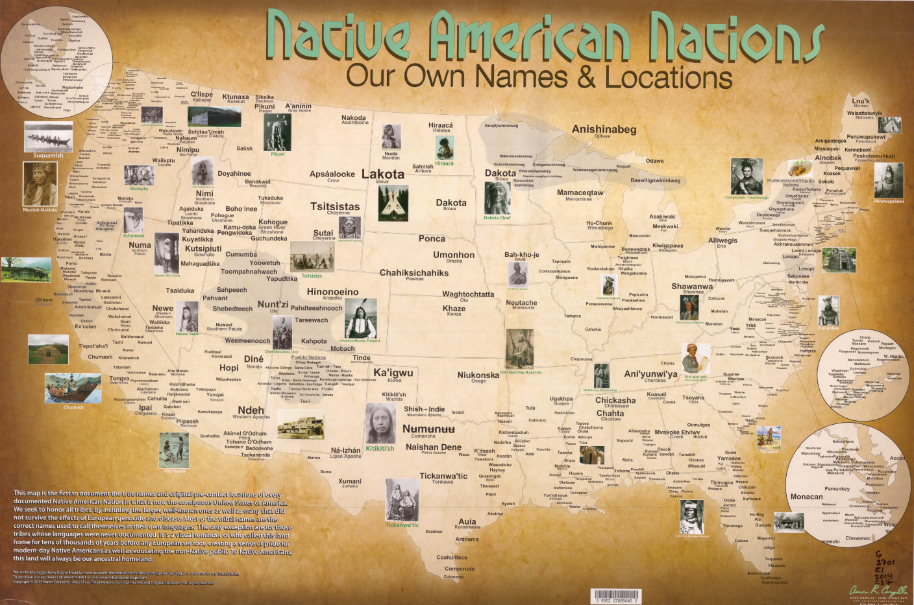
Notes:
Why we chose the scale – something more continuous
We have a lot of publically available data, but there isn’t any kind of centralized place for this data to live. That’s why I came up with the idea for the PNW Natives Geodatabase, a publically facing data portal for use by Native communities, Indigenous scholars, and academic researchers.

Slide 4
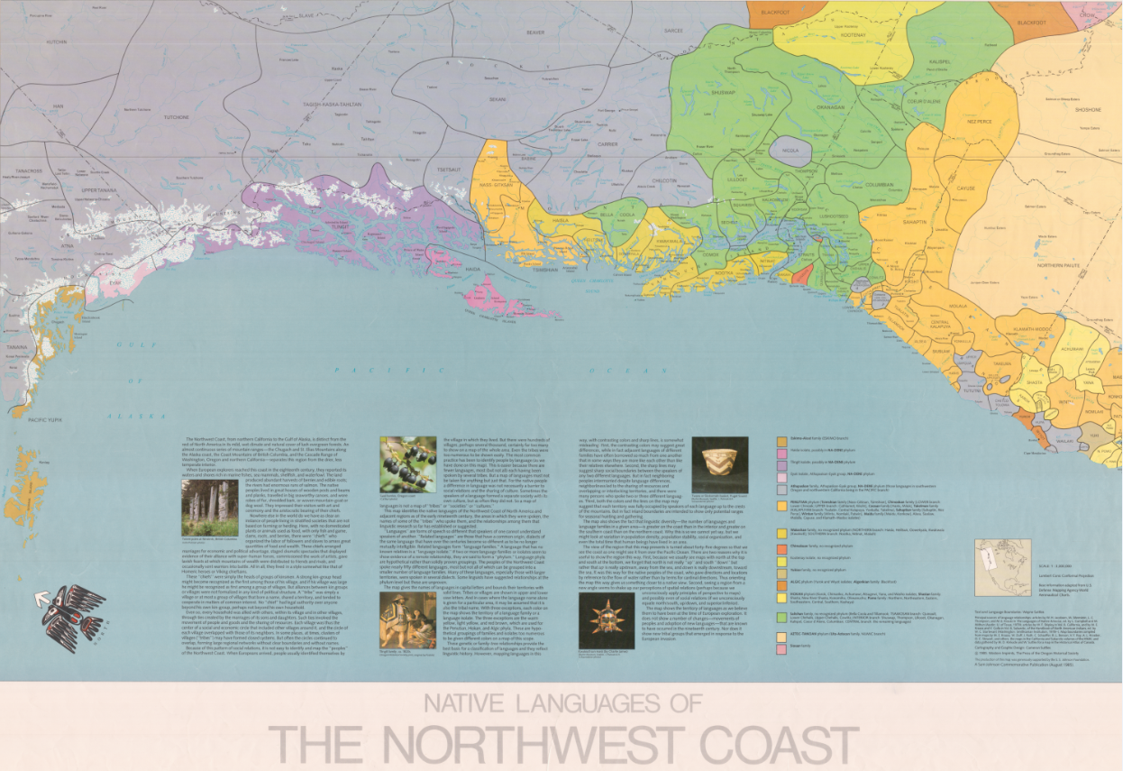
Notes:
Professional geospatial technologies are often out of reach for tribal organizations and governments, often relying on the BIA to provide relevant information.

Slide 5
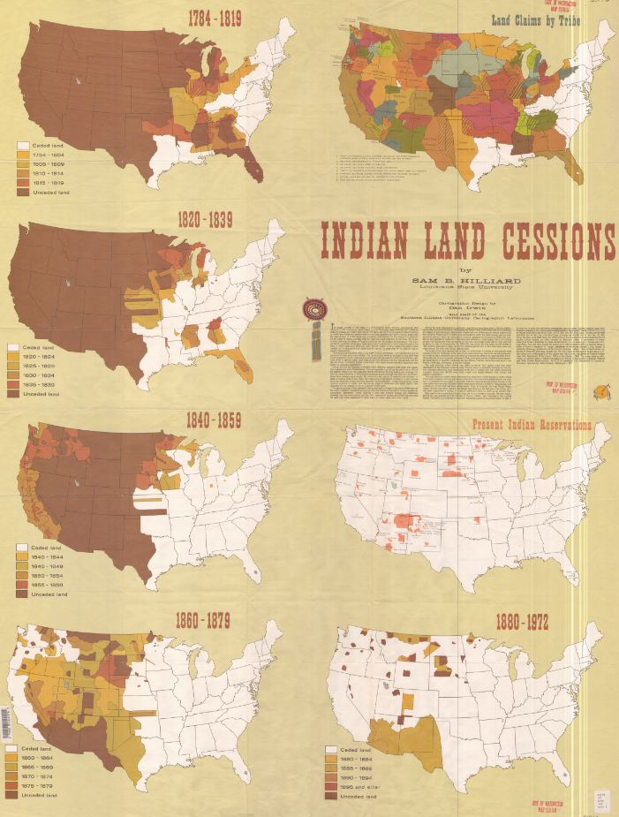
Transformative data from physical maps
US federal and state public data
Canadian federal and provincial data
From Where?
Notes:
Show emblems of the different data places.
Where does the data come from?
End: Forewarning, I am not a cartographer and the rest of the images are more for previewing the available data rather than making it easily consumable.

Slide 6
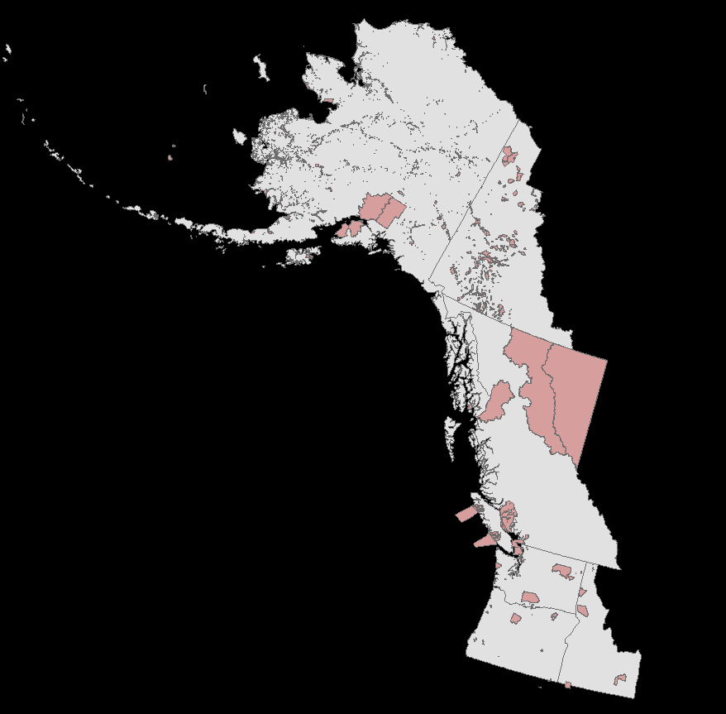
Native-Owned Lands
Notes:
So what is the data? Mixture of georeferenced paper maps and vector data.

Slide 7
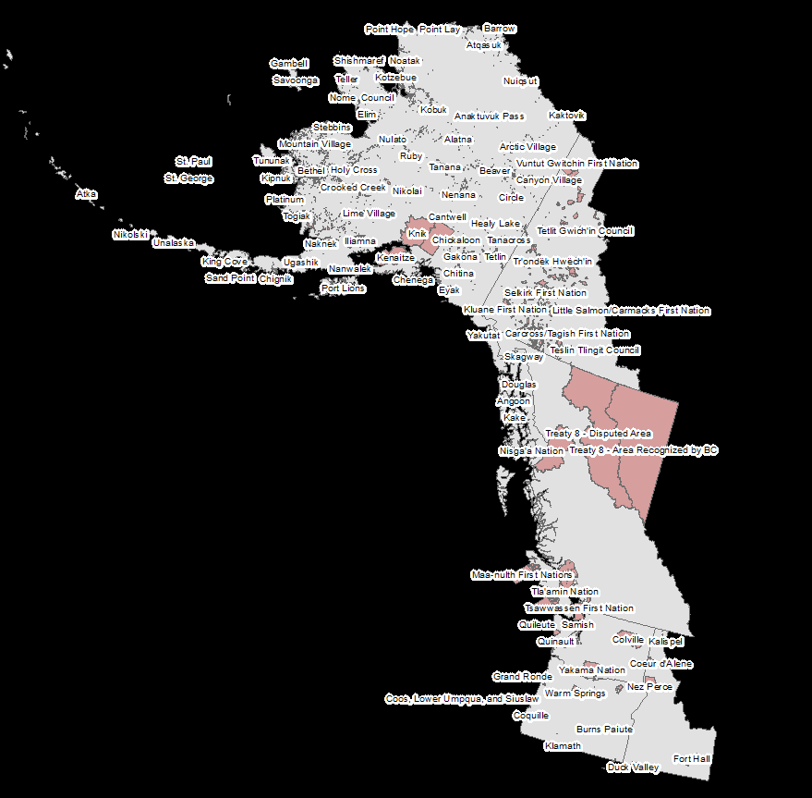
Native-Owned Lands

Slide 8
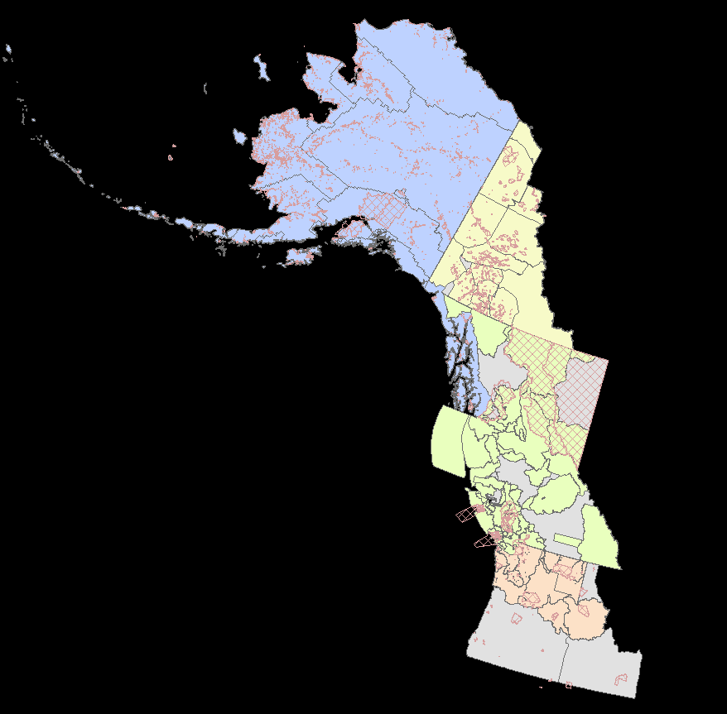
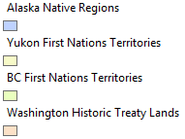
Current and Historic Territories
Notes:
We should maybe be asking questions like, why is the Colville Nation one quarter the size it was when the first treaty was signed. What is being done to all of those lands. Why was the new treaty signed just one year after the publication of a map surveying precious metals in the Colville area. I have a lot of theories and conspiracies.

Slide 9
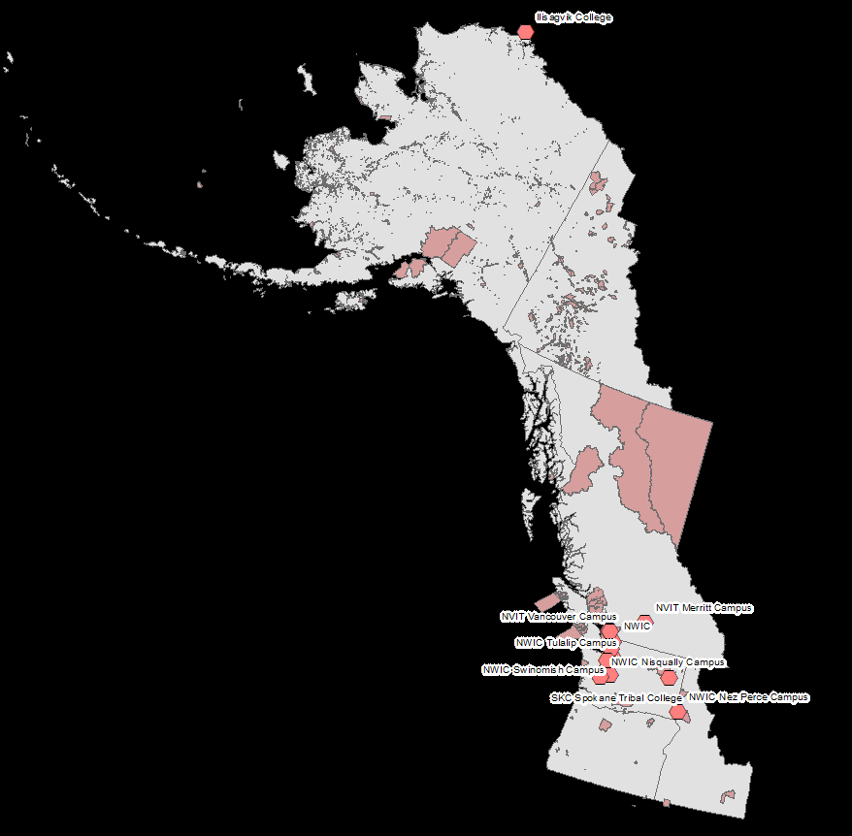
Native Community Resources

Slide 10
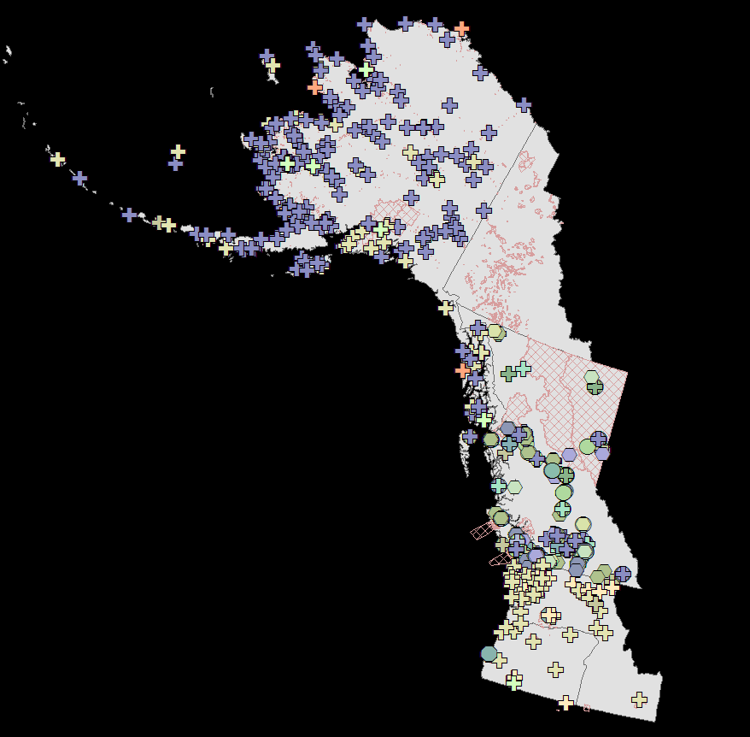
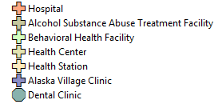
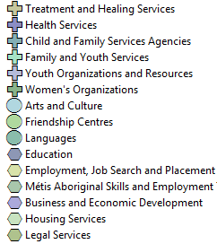
Native Community Resources

Slide 11
Native Community Resources

Slide 12
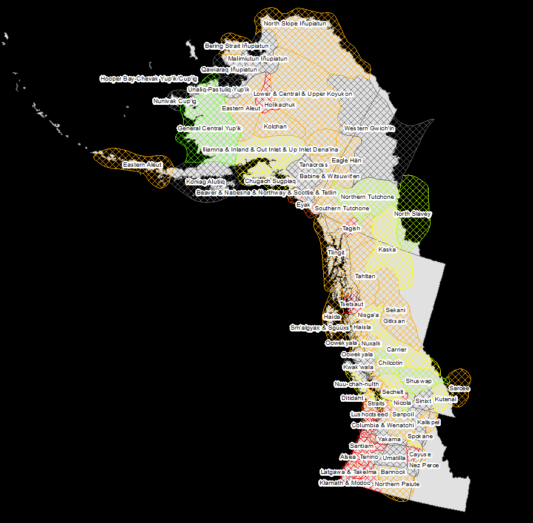
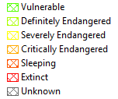
Native Languages

Slide 13
Native Languages

Slide 14
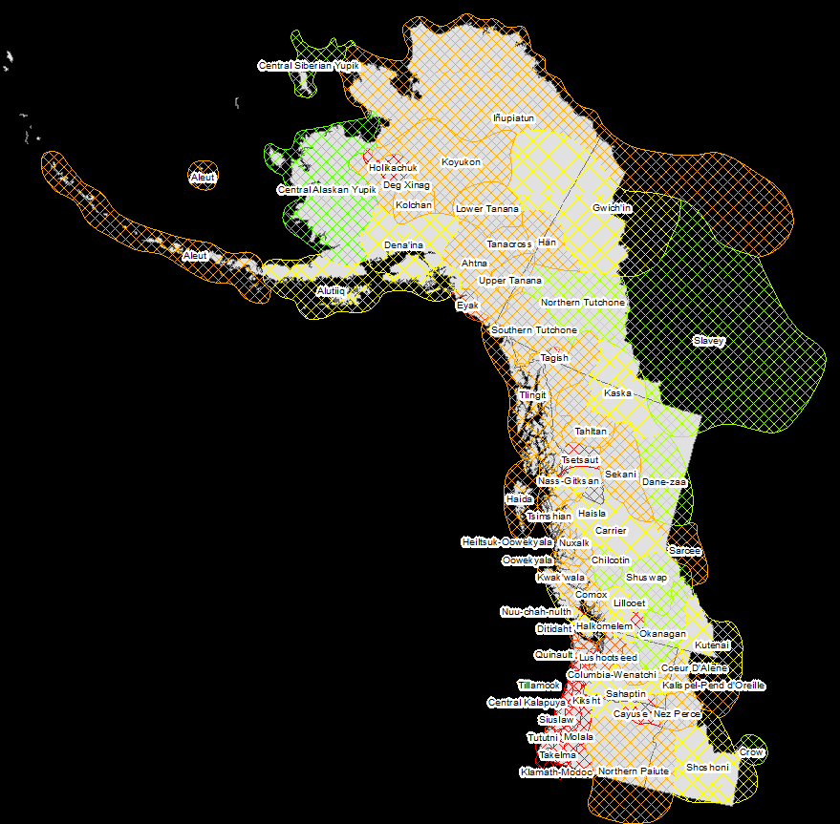
Native Languages

Slide 15
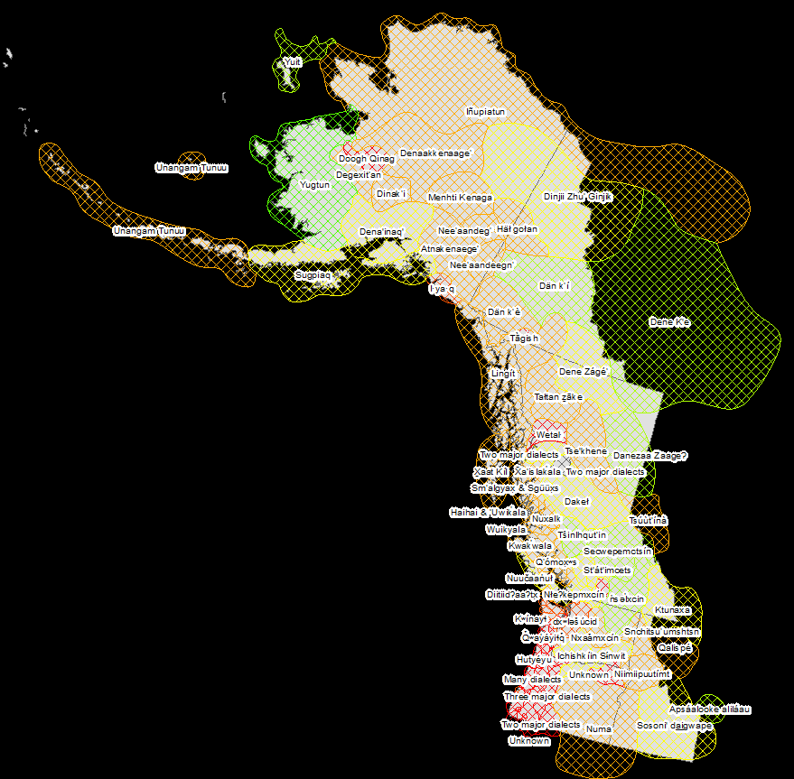
Native Languages

Slide 16
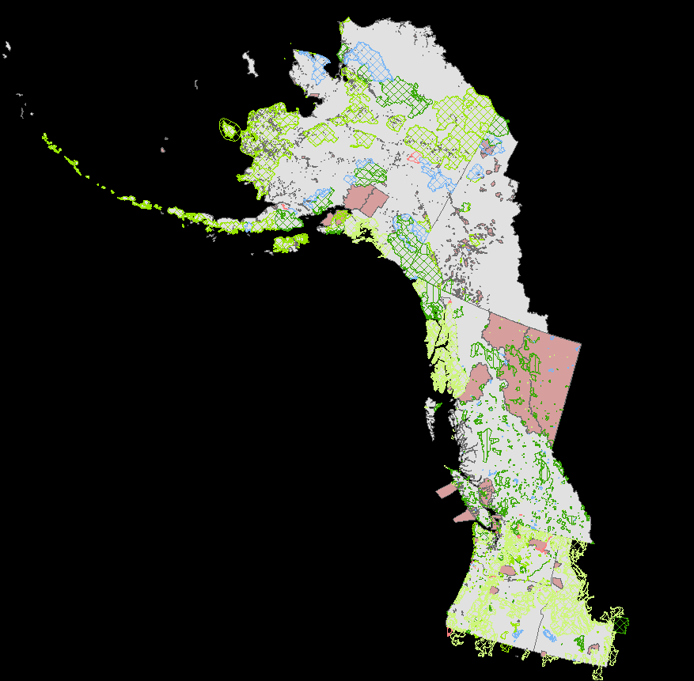


Public Lands
Notes:
I’ve also collected data related to environmental concerns.

Slide 17
Public Lands
Notes:
I’ve also collected data related to environmental concerns.

Slide 18
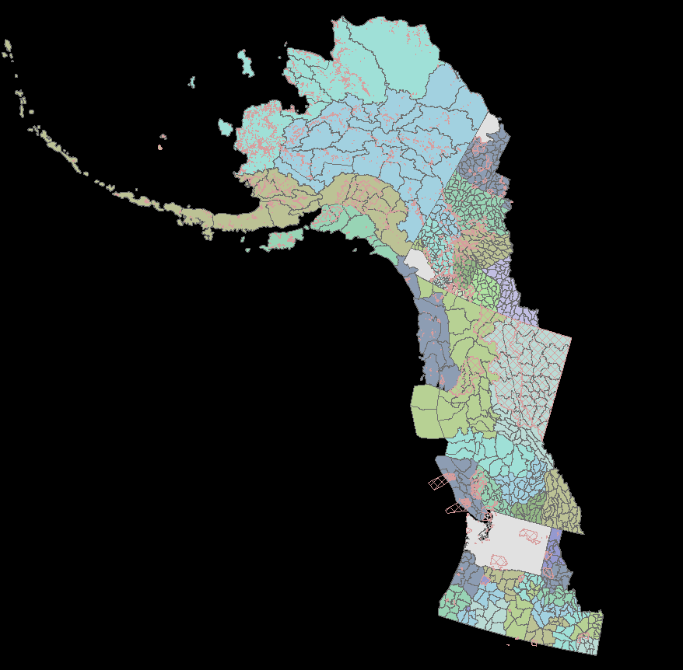
Natural Resource Management

Slide 19
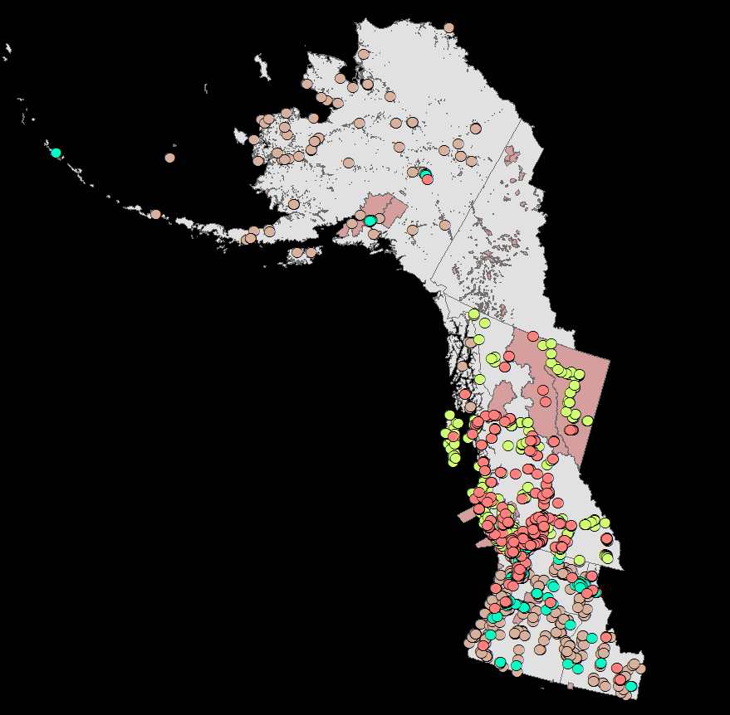
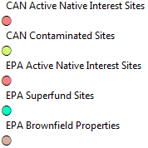
Environmental Concerns

Slide 20
Environmental Concerns

Slide 21
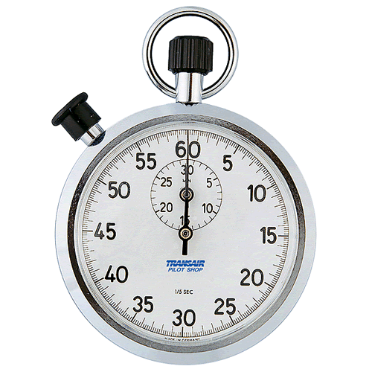
Time’s Up!
About your speaker:
Victoria Buschman
School of Environmental and Forest Sciences vbuschmn@uw.edu
Victoria is Alaska Native, a PhD Students at the University of Washington, and a Fulbright-NSF Scholar to Iceland. She studies food security and conservation planning in the Arctic.

